Slide 1
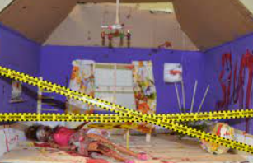
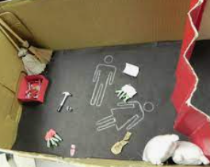
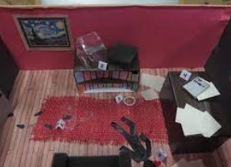
CSI Unit Final Project
Teacher Notes:
The digital slides for this project is available at https://docs.google.com/presentation/d/1z77Iqw_PlKf3vVGSbrP9EXgShkojoC8Aw8BTtCdqKI8/edit?usp=sharing.
IMPORTANT: Make a copy of the student notebook before you assign it on your LMS. It is view-only and I am not able to approve access for your students.
The FULL digital notebook (with all the slides for the digital lessons and activities) is available at https://docs.google.com/presentation/d/14eIEiGacRXMsDyuUxiEsSM2m4YOAtIlfmD4O4YsLdPI/edit?usp=sharing. It is set up for standard paper (8.5x11) in landscape mode for easier printing when needed. Paper versions are available for this unit on my Forensic Science page at https://sciencespot.net/Pages/classforsci.html
A DRAFT of the general outline of the digital lessons (with corresponding slide #s for the student notebook) is available at https://docs.google.com/document/d/15wxjmL-uHQPXDKOxmZXtU_gxy9dphEuyC1P4jzP-9mA/edit?usp=sharing . It is based on 44-minute class periods with 7th & 8th grade students.
Preview presentations before using with your classes as many slides have animations and links you will need to use.
I do Science Starters at the beginning of each class period. A collection of starters for Forensics is available on my lessons plans page at https://sciencespot.net/Pages/classforsci.html .
It’s your turn!
USE WHAT YOU HAVE LEARNED DURING THE CSI UNIT TO CREATE A MINI CRIME SCENE TO CHALLENGE YOUR CLASSMATES!
DUE DATE: Your team should be ready to present your crime scene by the START of class on _______________!
T. Tomm 2015 Updated 2023 https://sciencespot.net

Slide 2
How many people can be in our group?
Limit of 3 people in a group – two is best. You may also choose to work on your own.
How long do we have to finish the project?
Your team will have four class periods to create the project.
WARNING: Failure to use class time wisely will result in an alternate assignment for you and/or your partner!
Can we work on the project in study hall?
You may work on the project during study hall ONLY if you can do so independently. No passes for group work will be provided!
Can we work on the project at home?
Yes, if everyone on your team is contributing to the project!

Slide 3
WHAT DO WE HAVE TO DO?
1 - CASE BRIEFING – Introduction with descriptions of crime, suspects, victims, etc.
2 - CRIME SCENE – Virtual, physical, or combo of both
3 – EVIDENCE – Minimum of 10 pieces with at least 5 pieces that are physical evidence
4 – CASE SUMMARY – Final report (or “answer key”) that will be shared only with the teacher.

Slide 4
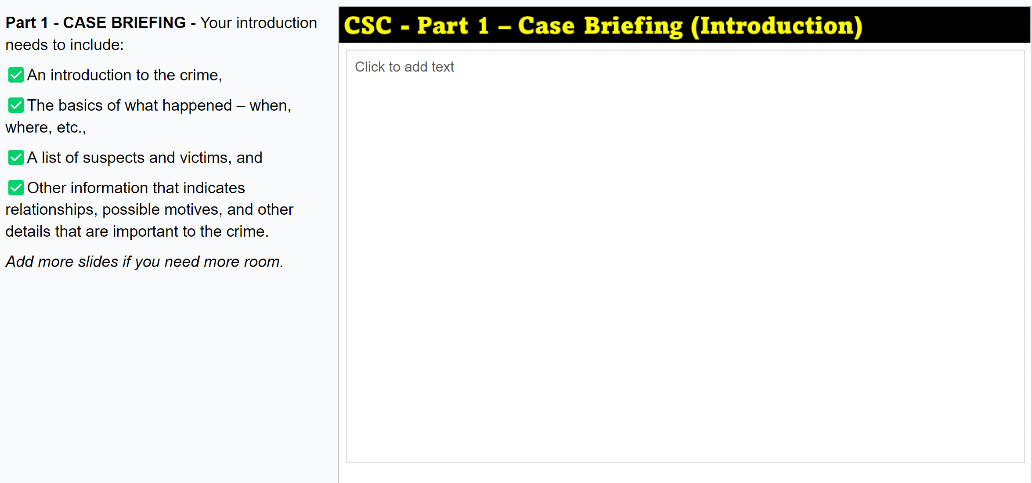
1 - CASE BRIEFING (INTRO) - Your project needs to include:
☑ The title of your crime scene along with all an introduction to the crime,
☑ The basics of what happened with a list of suspects, victims, location, time, etc., and
☑ Background information that indicates relationships, possible motives, and other details that are important to the crime.

Slide 5
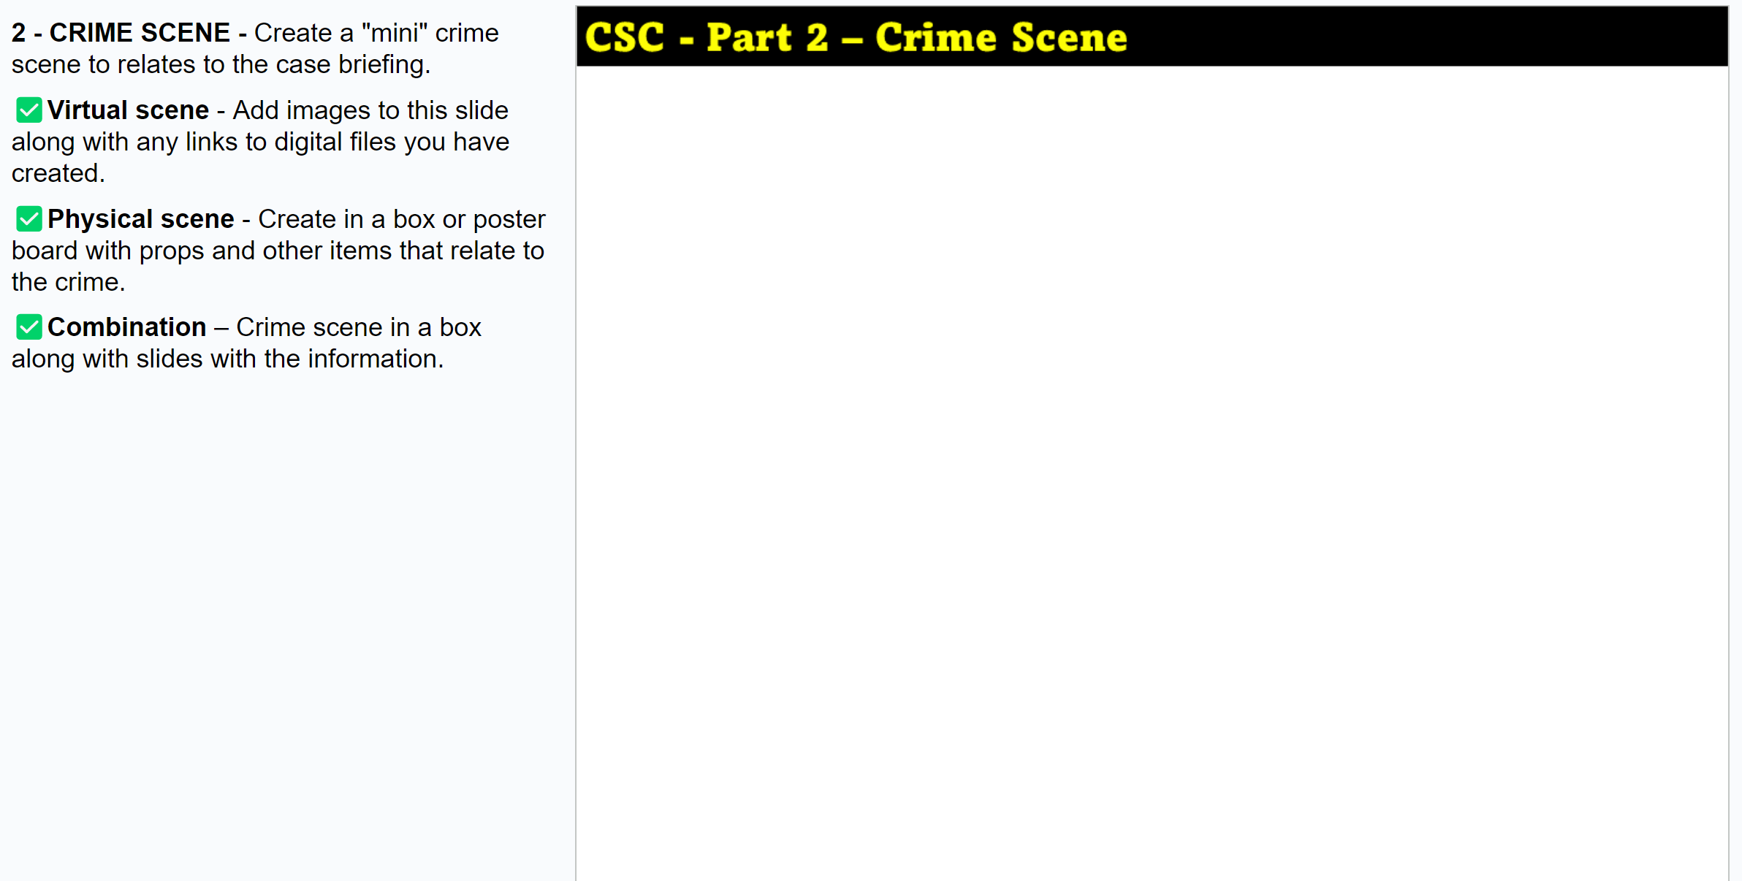
2 - CRIME SCENE - Create a "mini" crime scene.
☑ Virtual scene - Add images to this slide along with any links to digital files you have created.
☑ Physical scene - Create in a box or poster board with props and other items that relate to the crime.
☑ Combination – Crime scene in a box (or as a poster) along with slides with the information.

Slide 6
MATERIALS
If your team wants to create a physical scene, team members will need to bring in the materials from home except the following:
Ink pads for fingerprints
Fake blood evidence (limited amount)
Hot Wheels & ink pads for tire tracks
Small evidence bags
Paper (including index cards)
Tape, Scissors, & Glue (Regular
& hot sticks/glue guns)
Something else? Ask me – I might have it!
Each team may send the teacher up to 3 pages of images or text for their project. Try to get as much on one page as you can!
Each page must have a name
or it will not be printed.
IMPORTANT: DO NOT bring in any materials that could be considered threatening – even if they are “toys” or fakes. Do not use the names of real people as it could be considered threatening, too.

Slide 7
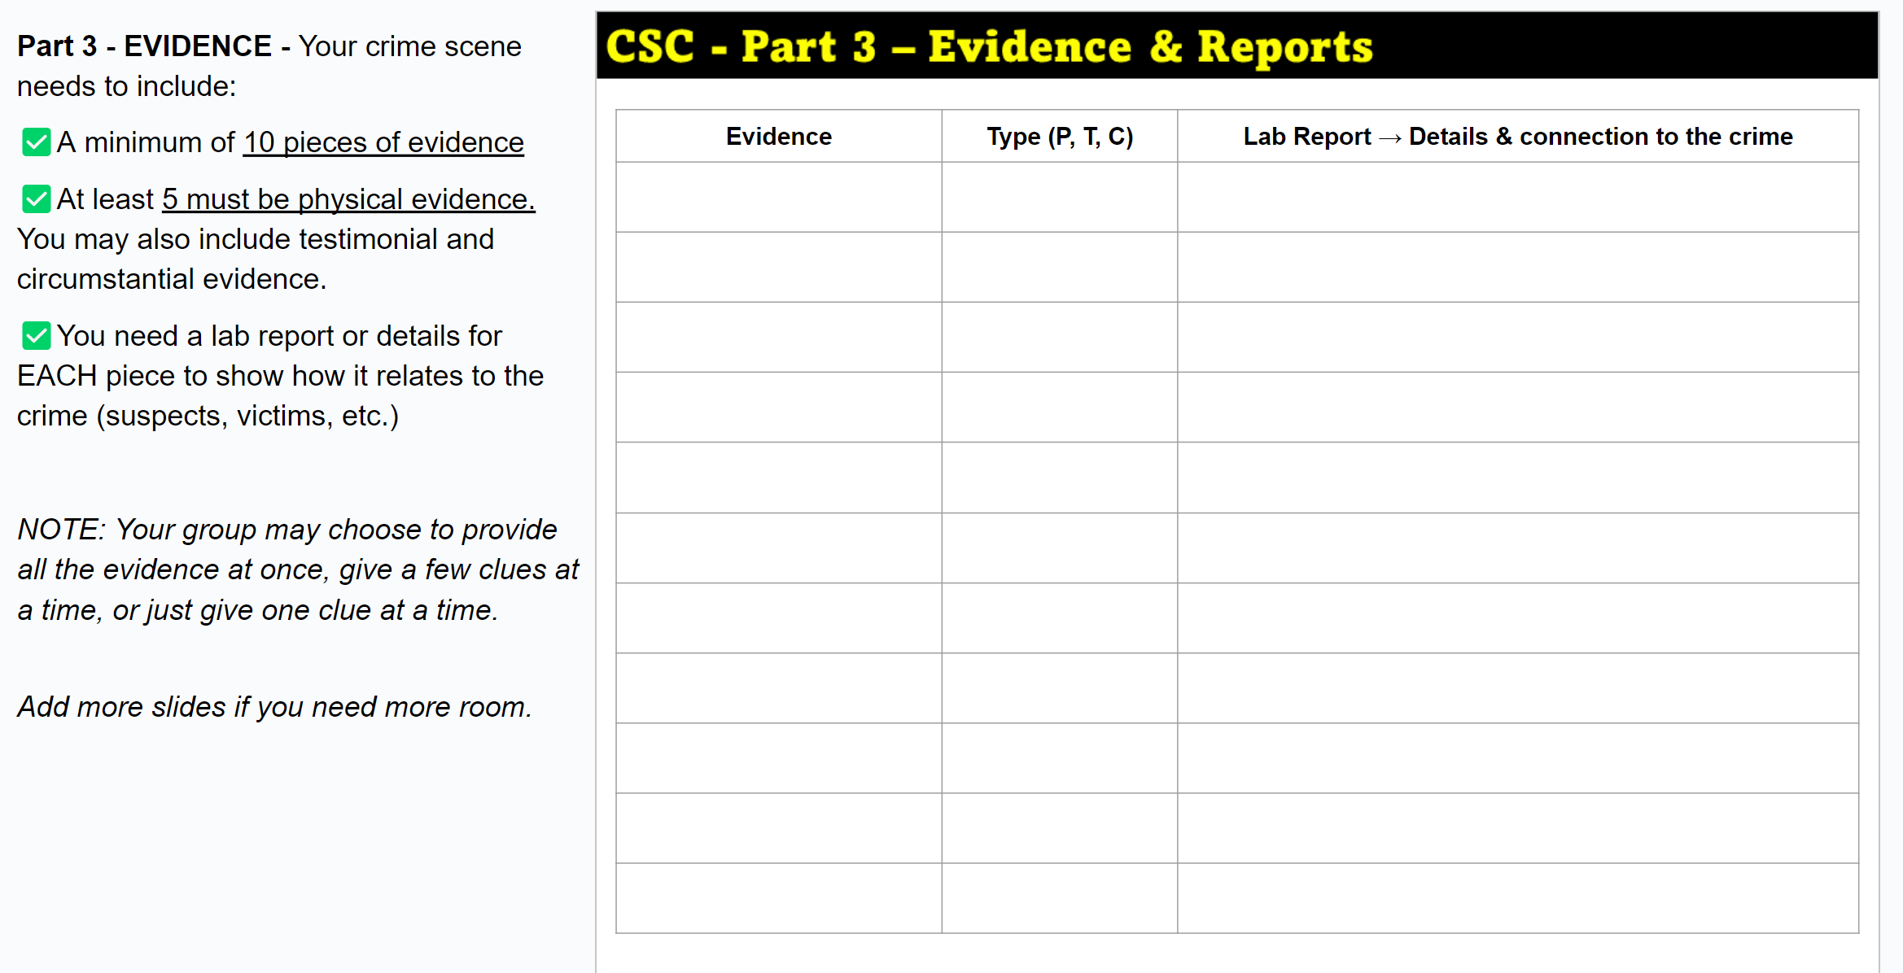
3 - EVIDENCE - Your crime scene needs to include:
☑ A minimum of 10 pieces of evidence
☑ At least 5 pieces must be physical evidence. You may also include testimonial and circumstantial evidence.
You need a lab report or details for EACH piece to show how it relates to the crime (suspects, victims, etc.)
Your group may choose to provide all the evidence at the start or provide it a few clues at a time like the teacher did in the “Fun Dip” murder.

Slide 8
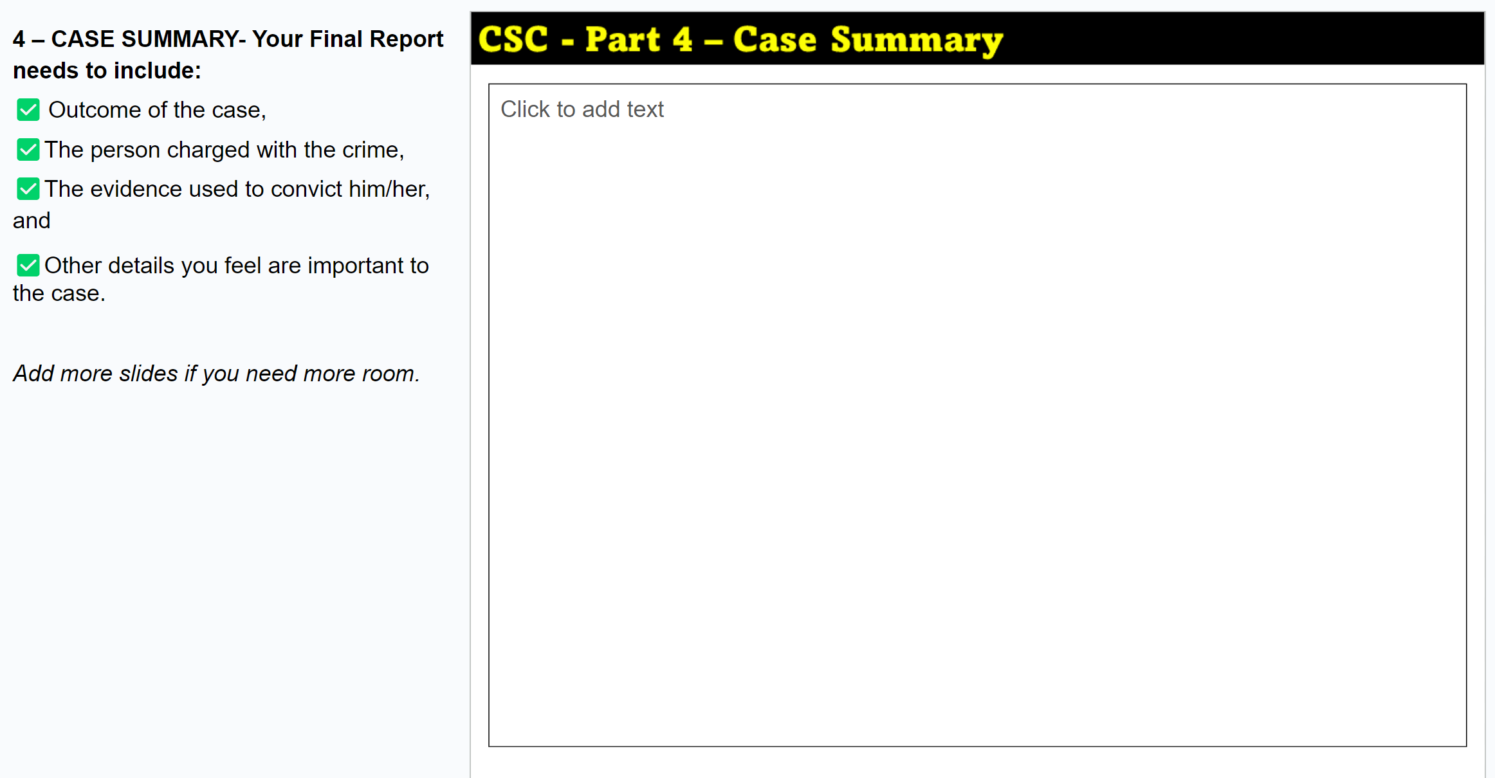
4 – CASE SUMMARY - Your group must also submit a Final Report that includes:
Outcome of the case,
Person charged with the crime,
The evidence used to convict him/her, and
Other details you feel are important to the case.
This slide should be the “answer key” that shows how the evidence proves your crime.

Slide 9
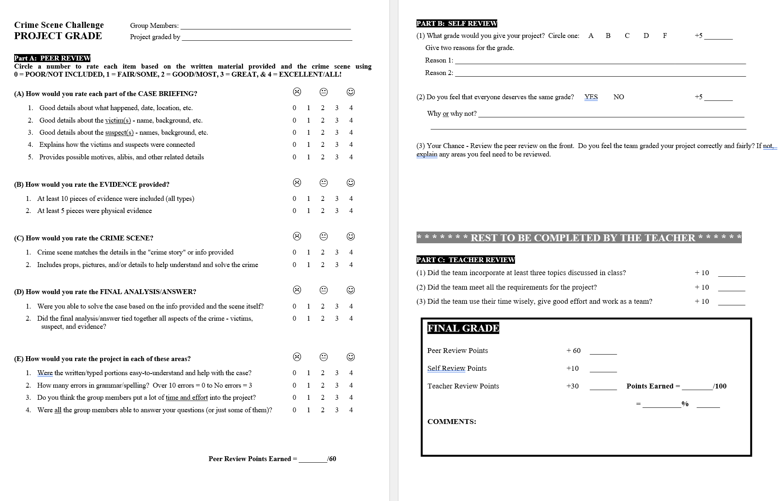
Grade determined by peers, you, & the teacher.
Self Review
Peer Review
Teacher Review

Slide 10
GRADING:
PEER & SELF REVIEW - Part of your grade will be based on an evaluation by another group and your own review.
CASE BRIEFING & FINAL REPORT – These will be graded based on the information and details you included in each along with the quality of the information.
CRIME SCENE - The scene (virtual or physical) will be graded based on its quality, realistic characteristics, and accuracy (based on your evidence).
OVERALL GRADE - Your overall grade will be based on individual and group efforts along with how well your group applied the concepts studied in class.

Slide 11

Time to get started … Go to Google Classroom and open the Crime Scene Project assignment. Click to open the CSI Challenge Project Template. Make a copy and share it with your team members. Use the notes on each slide to help you!
This assignment must be completed whether or not you use the actual slides or use printed/handwritten material.
DUE DATE: Your group should be ready to present your crime scene by the START of class on ___________
TOC

Slide 12
Add Unit Review materials

