Slide 1

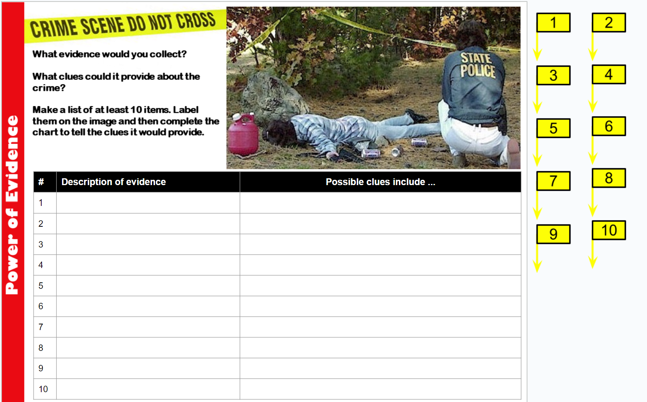
Teacher Notes:
The student digital slide for this activity is available at https://docs.google.com/presentation/d/1s49aNziqy4MRxLDSCZPjJTIDDEZXHWioUnuWI2tAOMA/edit?usp=sharing
IMPORTANT: Make a copy of the student notebook before you assign it on your LMS. It is view-only and I am not able to approve access for your students.
The FULL digital notebook (with all the slides for the digital lessons and activities) is available at https://docs.google.com/presentation/d/14eIEiGacRXMsDyuUxiEsSM2m4YOAtIlfmD4O4YsLdPI/edit?usp=sharing. It is set up for standard paper (8.5x11) in landscape mode for easier printing when needed. Paper versions are available for this unit on my Forensic Science page at https://sciencespot.net/Pages/classforsci.html
A DRAFT of the general outline of the digital lessons (with corresponding slide #s for the student notebook) is available at https://docs.google.com/document/d/15wxjmL-uHQPXDKOxmZXtU_gxy9dphEuyC1P4jzP-9mA/edit?usp=sharing . It is based on 44-minute class periods with 7th & 8th grade students.
Preview presentations before using with your classes as many slides have animations and links you will need to use.
I do Science Starters at the beginning of each class period. A collection of starters for Forensics is available on my lessons plans page at https://sciencespot.net/Pages/classforsci.html .
CSI Unit Training Materials
Background: The mock crime scene picture has been used since the first year I taught CSI. In later years, I expanded the lesson to extend over several days as an example students could use for the Crime Scene in a Box project at the end of the quarter.
Since I usually do the first part of the CSI unit around Valentine’s day, I can find Fun Dip packets as a class prize. Instead of calling the baggie in the purse drugs, we refer to it as “fun dip” as we are in a school setting. (Air quotes included during the class discussion.) The same idea for the beer cans – they are just “beverage canisters”.
The activity is set up to be shared over several days rather than all at once. The final report is shared at the end of the unit as an introduction to the CSI Unit Final Project. See the link to the unit outline on the left side of this slide for more details.
CSI Challenge
Case #2024-1:
Barbie Mystery
Crime Scene Analysis
Go to your case slide.
Add information to
your chart or in the
text box.
T. Tomm Updated 2023
https://sciencespot.net
This Photo by Unknown Author is licensed under CC BY

Slide 2

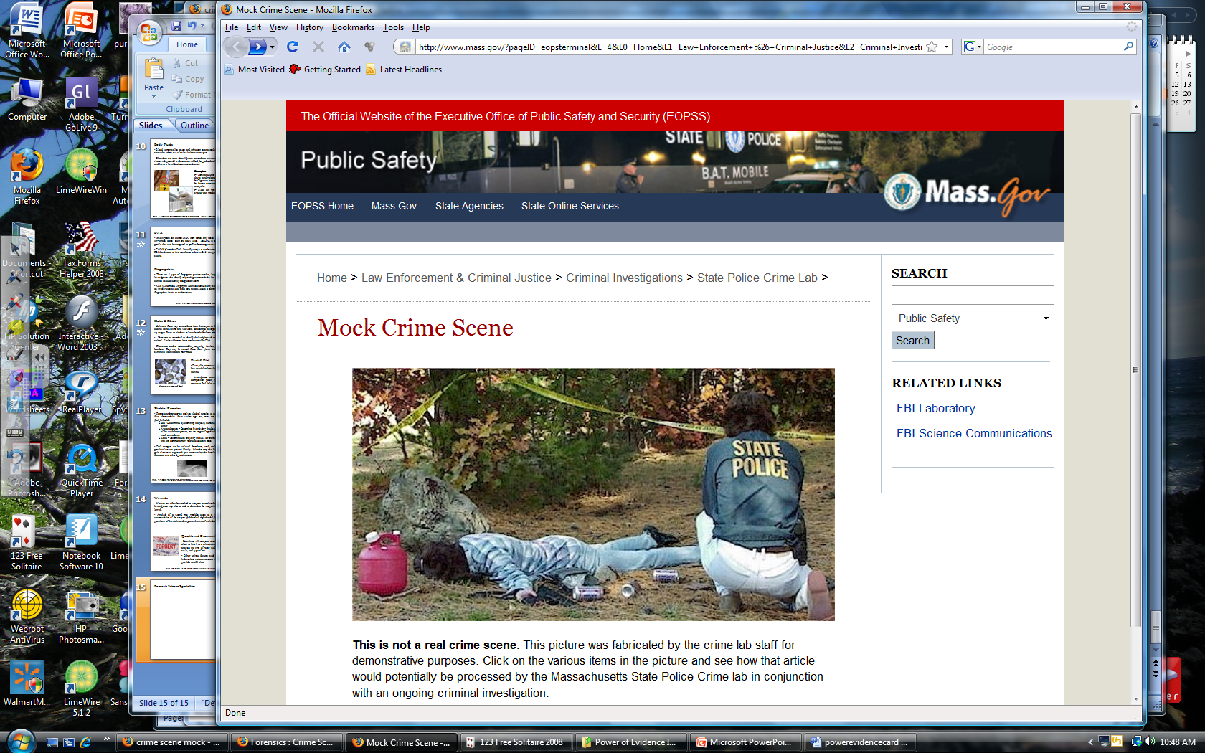
Mock Crime Scene: http://www.masss.gov
911 Report
Ms. Brooks called 911 at 6:45 am. She was out walking her dogs along Dead End Road when they started barking at something on the other side of the road. She said it looks like a body, but it had not moved for the whole time she was watching.
She also said it looked like some kids were mudding as there were areas where the ditch was all torn up and burnout marks were seen on the road.

Slide 3
What evidence would you collect? How would it be used?
Identify at least 10 pieces of evidence using the flags and complete the chart about each piece.
Mock Crime Scene: http://www.masss.gov

Slide 4










What evidence should you collect?
# | Description of evidence | What do we hope to learn from analyzing the evidence?
1
2
3
Gas can
Regular or diesel (fire), Fingerprints – ID suspect/victim
Rocks
Blood – Human? DNA? How fresh?
Wounds on body – Match the rocks?
Beverage canisters
Fingerprints – ID suspect, victim, or others; swab for saliva, special brand (local only?)
Mock Crime Scene: http://www.masss.gov

Slide 5
What evidence should you collect?
# | Description of evidence | What do we hope to learn from analyzing the evidence?
4
5
6
Purse/Handbag
ID - DL, phone, credit cards/checks
Baggie – Type of substance?
Finish the chart before class tomorrow– label using ALL the flags and explain what the evidence may tell you!
Mock Crime Scene: http://www.masss.gov

Slide 6
# | Description of evidence | What do we hope to learn from analyzing the evidence?
1 | Gas can | Type of gas – regular or diesel (fire), Fingerprints – ID suspect/victim
2 | Beverage canisters | Fingerprints, saliva, hairs, fibers, & receipts to connect suspects and the victim
3 | Gun | Test for GSR (gun shot residue), serial # = owner, fingerprints, caliber, spent shells
4 | Rock – Large | Type of blood (human or other animal), match to victim’s blood or wounds
5 | Purse | IDs, fingerprints, money (none → burglary) receipts, baggie of “fun dip”
6 | Baggie | Test for identification (drugs, other substances), fingerprints
7 | Body | Tox screen (alcohol, drugs), wounds, ID by teeth, fingerprints & nail scraping to see if there was a fight
8 | Victim’s Clothing | Hairs and fibers → connect people to the crime, biological evidence (saliva, blood) for DNA
9 | Tire Tracks | Type of tire, possible vehicles, make casts for comparison
10 | Footprints | Match to victim’s shoes, determine other people at the scene
 | Trash | Cigarette butts or gum → DNA, trash → fingerprints or source (where purchased)
 | Rock – Small | Type of blood (human or other animal), match to victim’s blood or wounds
 | OTHER?
Any order!
Mock Crime Scene: http://www.masss.gov

Slide 7
# | Description of evidence | What do we hope to learn from analyzing the evidence?
1 | Gas can | Type of gas – regular or diesel (fire), Fingerprints – ID suspect/victim
2 | Beverage canisters | Fingerprints, saliva, hairs, fibers, & receipts to connect suspects and the victim
3 | Gun | Test for GSR (gun shot residue), serial # = owner, fingerprints, caliber, spent shells
4 | Rock – Large | Type of blood (human or other animal), match to victim’s blood or wounds
5 | Purse | IDs, fingerprints, money (none → burglary) receipts, baggie of “fun dip”
6 | Baggie | Test for identification (drugs, other substances), fingerprints
7 | Body | Tox screen (alcohol, drugs), wounds, ID by teeth, fingerprints & nail scraping to see if there was a fight
8 | Victim’s Clothing | Hairs and fibers → connect people to the crime, biological evidence (saliva, blood) for DNA
9 | Tire Tracks | Type of tire, possible vehicles, make casts for comparison
10 | Footprints | Match to victim’s shoes, determine other people at the scene
 | Trash | Cigarette butts or gum → DNA, trash → fingerprints or source (where purchased)
 | Rock – Small | Type of blood (human or other animal), match to victim’s blood or wounds
 | OTHER?
NOTE: All evidence has been sent to the crime lab for testing. Your teacher will update you as important information is available.
Any order!
Mock Crime Scene: http://www.masss.gov

Slide 8
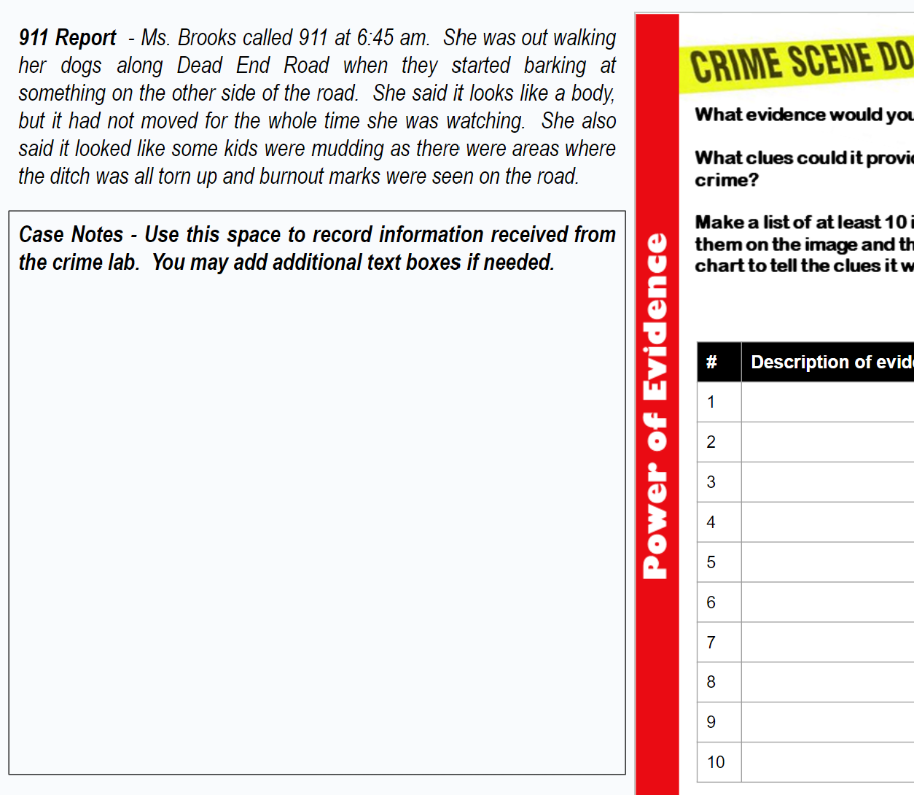
CSI Unit Training Materials
CSI Challenge
Case #2024-1:
Barbie Mystery
CASE BRIEFING #1
Go to your case slide.
Add information to
your chart or in the
text box.
T. Tomm Updated 2023
https://sciencespot.net
This Photo by Unknown Author is licensed under CC BY

Slide 9
Case Briefing #1
A female victim was found on March 1, 2017 at in a wooded area near Dead End Road located west of Havana, IL, near the Spoon River.
The victim was identified as Barbie “Doll” Jones, 35, from Lewistown based on the ID in her purse and DNA testing. She was a waitress at a local restaurant along with her friend, Kitty Brown.
Barbie was last seen on February 14, 2017, at a concert with Kitty and two other friends identified as Sam Smith and Tony Thomas.
Her car was found one week prior to the discovery of the body at approximately 1 mile away from the scene with ½ tank of gas.
Wounds on the victim's body indicate there was a struggle (bruises and cuts on her face and arms), but no gunshot wounds were found. Cause of death was determined as blunt force trauma to the back of the head.
Evidence collected included insects from the body, several sets of tire tracks, cigarette butts, shoeprints, a purse, beverage canisters, handgun, and blood samples from the rocks (large & small).

Slide 10
Evidence Report – Part 1
Add notes to slide 7.
Beverage Containers
– Found several separate prints with only one matching the victim.
– The other prints were checked by AFIS and some matched the three friends that were seen with the victim at the concert were found. Two prints were not identified.
Toxicology Screen on Victim – No alcohol or illegal drugs were found in her system
Purse Contents - Baggie contained Tylenol and cold medicine
Ballistics - Gun was recently fired, but the victim did not have any gunshot wounds. GSR tests were positive on the victim’s hands.
Blood Evidence
Large Rock – DNA testing shows a match to Sam
Small Rock – DNA testing shows a match to Barbie

Slide 11
Evidence Report – Part 1 (Cont’d)
Gas Can – Contained diesel gasoline; less than ½ gallon.
Insect Evidence – Insect evidence collected from the victim showed the PMI (postmortem interval - time since death) as 1 week based on weather data the week prior to discovery. Some decomposition was evident on the exposed areas of the body.
Cigarette Butts – No viable DNA to test, but the brand matched the brand Sam was known to smoke.

Slide 12
Discussion Time: What do you think?
What leads do we need to follow up on?
What other information would be helpful?
Note: Your teacher will share your insights & questions with the investigators and crime lab. Important information will be shared with the class as it is received.

Slide 13
CSI Unit Training Materials
CSI Challenge
Case #2024-1:
Barbie Mystery
CASE BRIEFING #2
Go to your case slide.
Add information to
your chart or in the
text box.
T. Tomm Updated 2023
https://sciencespot.net
This Photo by Unknown Author is licensed under CC BY

Slide 14
Evidence Report – Part 2
Add notes to slide 7.
Shoe prints
One set of the shoeprints matched the brand, style, and size the victim was wearing.
Another set of shoeprints was classified as a man’s work boot in size 8, which is similar to those found at Sam the Man’s house.
The third set of shoeprints have not been identified.
Tire Tracks – Several sets of tracks were identified.
- One set was identified as the type used on an Arctic Cat ATV produced between 2001 and 2007. Tony had a 2005 Arctic Cat ATV registered to him.
The other set of tire tracks was similar to the brand and style on Tony the Tiger’s Duramax Diesel 4x4 truck.
The detectives have not been able to locate the ATV or the truck to do an actual comparison.

Slide 15
Evidence Report – Part 2 (cont’d)
Ballistics - Gun was registered to Sam “the Man”. His fingerprints were found on the gun along with 2 other partial prints. Investigators are still trying to determine matches for those.
Interview with Barbie’s boss at the restaurant …
He told police that Barbie and Kitty have been friends for many years, but they had a big fight on February 14th , which was the last day Barbie was at work. He was not sure what the cause of the fight was, but said he figured it had to do with a guy.
He did not see Barbie the following week since she did not show up for work. He tried calling her, but she didn’t answer and did not call him back. He asked Kitty if she had seen her. Kitty replied that she didn’t care to see her ever again.

Slide 16
Discussion Time: What do you think?
What are the main clues you learned from the evidence?
Who is the lead suspect? Which evidence supports this?
What other information do you need to be positive?
Note: Your teacher will share your insights & questions with the investigators and crime lab. Important information will be shared with the class as it is received.

Slide 17
CSI Unit Training Materials
CSI Challenge
Case #2024-1:
Barbie Mystery
CASE BRIEFING #3
Go to your case slide.
Add information to
your chart or in the
text box.
T. Tomm Updated 2023
https://sciencespot.net
This Photo by Unknown Author is licensed under CC BY

Slide 18
Evidence Report – Part 3
Ballistics → The partial prints on the gun were matched to Barbie’s thumb on her right hand and Kitty’s pinky on her left hand.
Shoe prints→ The third set of shoeprints have been identified. They were matched to a set of women’s cowboy boots found in Kitty’s closet. Mud on the boots was similar to the mud at the crime scene. She claims she gave those boots to Barbie and has no idea why they were in the closet.
Tire Tracks → Tony the Tiger’s truck was found; the tracks at the scene DO NOT match the tires on his truck. Tony told the police that Kitty’s father also has a Duramax 4x4 truck. The tire tracks at the scene were matches to her father’s truck.
Sam Smith → No one had heard from him since February 21st. His family had reported him missing on March 3rd. However, his body was found along the Spoon River on March 5th.

Slide 19
CSI Unit Training Materials
CSI Challenge
Case #2024-1:
Barbie Mystery
YOUR TURN
Go to your case slide.
Review the case evidence
information in your chart
or in the text box.
T. Tomm Updated 2023
https://sciencespot.net
This Photo by Unknown Author is licensed under CC BY

Slide 20

Discussion Time: What do you think?
Teachers: A sample form is available at https://forms.gle/oV4nDwHQict6dFRcA
Create your own copy to share via your LMS or teacher website.
Review the evidence with your tablemates to answer these questions:
What happened to the victims?
Which person is responsible for their deaths?
What are the three most important pieces of evidence? Why?
Find the link to the form to submit. Only one person from your group needs to submit the form.
The final report …
will be shared tomorrow!

Slide 21
CSI Unit Training Materials
CSI Challenge
Case #2024-1:
Barbie Mystery
FINAL REPORT
Go to your case slide.
Add information to
your chart or in the
text box.
T. Tomm Updated 2023
https://sciencespot.net
This Photo by Unknown Author is licensed under CC BY

Slide 22
The final report …
Sam knew Kitty, his longtime girlfriend, was jealous that he and Barbie had become such close friends. He and Tony were hoping if they could get both of them together, they would be able to talk and resolve their differences.
Tony stopped by Barbie’s house and convinced her to join him for a bonfire, but did not mention that Kitty would be there.
Sam convinced Kitty to go, but didn’t tell her Barbie would be there.
As soon as Kitty saw Barbie, she started a big cat fight about Sam and Barbie’s relationship.
Kitty admitted to holding Sam’s gun, but said that Barbie was the one who pulled it out of Sam’s backpack and threatened her with it. Kitty tried to get the gun away from Barbie when it went off and shot Sam. He fell back on the rock.
Tony hit Barbie on the back of the head with a rock to knock her out so Kitty could help him get Sam in her father’s truck and head to the hospital. However, Sam died on the way there and they dumped his body in the river.

Slide 23
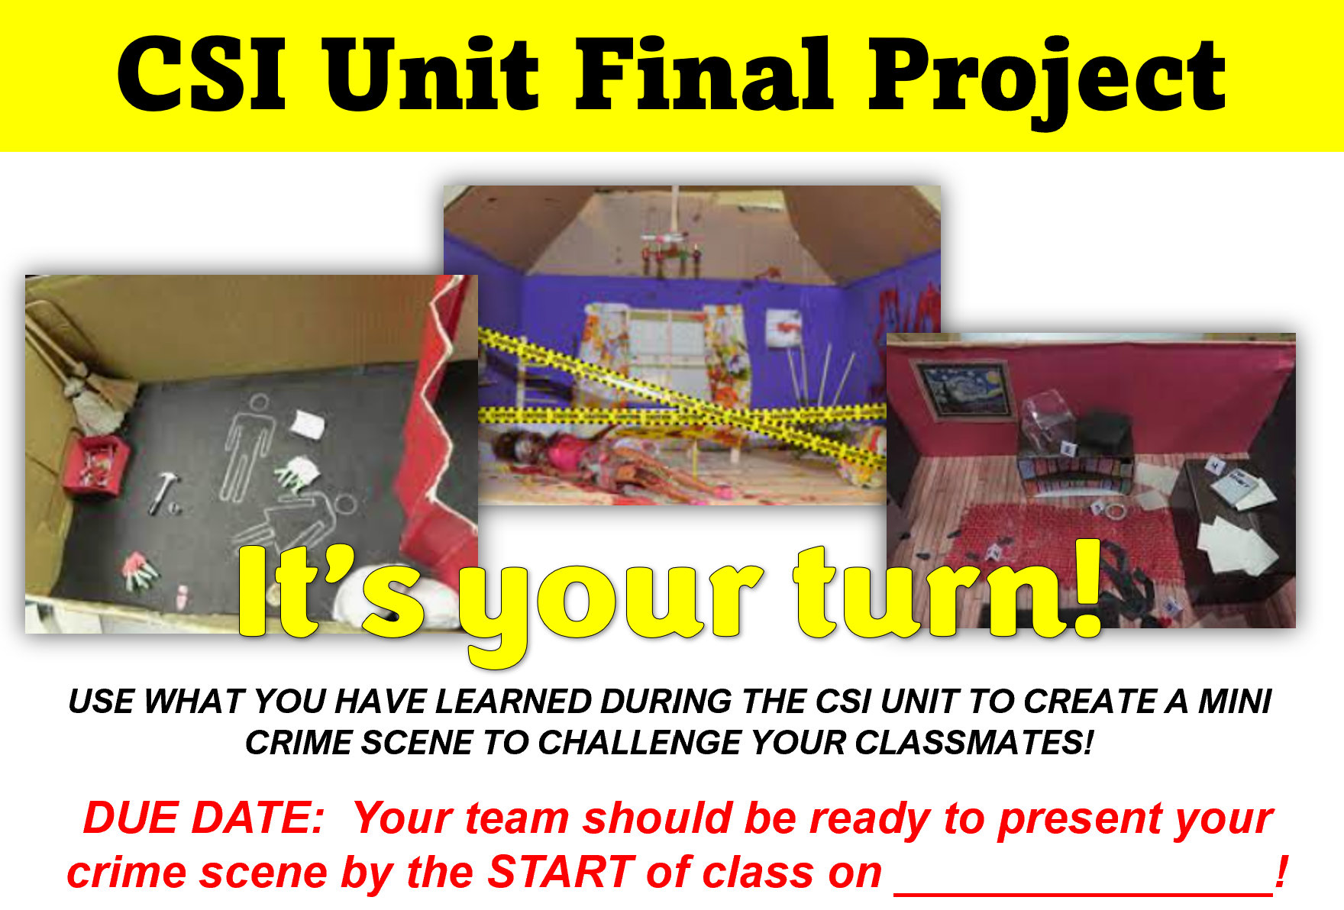
Discussion Time: What do you think?
What was the outcome of the case?
Were you correct? Explain why or why not.
Now it’s your turn …

