Slide 1

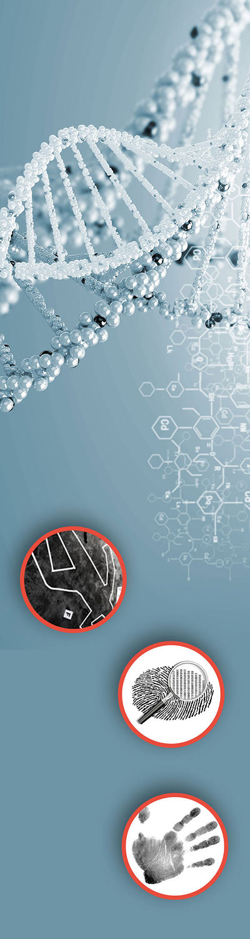
Teacher Notes:
The student digital slides for this unit are included with the file available at https://docs.google.com/presentation/d/1cK42rhAWr0iTKZ2TPXZvFgH3nvMom8tL-sgAa8PLXM0/edit?usp=sharing
IMPORTANT: Make a copy of the student notebook before you assign it on your LMS. It is view-only and I am not able to approve access for your students.
The digital notebook (with all the slides for the digital lessons and activities) is available at https://docs.google.com/presentation/d/14eIEiGacRXMsDyuUxiEsSM2m4YOAtIlfmD4O4YsLdPI/edit?usp=sharing. It is set up for standard paper (8.5x11) in landscape mode for easier printing when needed. Paper versions are available for this unit on my Forensic Science page at https://sciencespot.net/Pages/classforsci.html
A DRAFT of the general outline of the digital lessons (with corresponding slide #s for the student notebook) is available at https://docs.google.com/document/d/15wxjmL-uHQPXDKOxmZXtU_gxy9dphEuyC1P4jzP-9mA/edit?usp=sharing . It is based on 44-minute class periods with 7th & 8th grade students.
Preview presentations before using with your classes as many slides have animations and links you will need to use.
I do Science Starters at the beginning of each class period. A collection of starters for Forensics is available on my lessons plans page at https://sciencespot.net/Pages/classforsci.html .
CSI Unit Training Materials
T. Tomm Updated 2023
https://sciencespot.net
This Photo by Unknown Author is licensed under CC BY

Slide 2
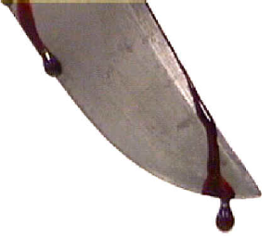
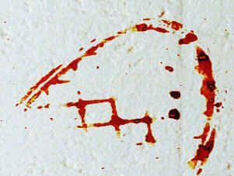
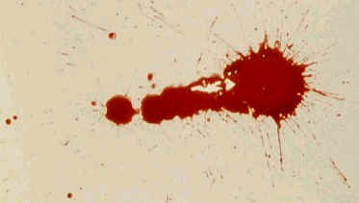
Part A: Watch the Blood Spatter 101 video to help you
complete this section.
1. What does BPA represent?
2. What are the three types of blood patterns?
Note: Due to age restrictions, video #1 is only available on YouTube.
Blood Spatter 101
Bloodstain Pattern Analysis
PASSIVE
_____________ (or drip) stains occurs when gravity pulls blood downward to the floor or surface. They tend to be round and fat without tails.
______________ stains occurs when a bloody object comes in contact with another object or surface; appears as smears or stripes
_______________ (or ___________) patterns occur when a force is applied to a blood object or pool and are classified as high, medium, or low velocity.
TRANSFER
SPATTER
IMPACT
Click to reveal answers
Notes:
Teacher Note: If you have test tube clamps available, have the students attach it to the meterstick in the desired location and hold the bottle of blood (upside-down) in the other end where the test tube would normally go. This helps keep the bottle in the right spot and the chances of hitting the same spot twice are much higher!

Slide 3
3. What can the shape and size of a droplet tell us?
The angle of impact and the speed the droplet was traveling.
Examine the blood spatter samples on your table. What do you observe?
I made several sample pages of blood spatter based on the four labs in this lesson. I laminated the pages & places several on each table.
Notes:
Teacher Note: If you have test tube clamps available, have the students attach it to the meterstick in the desired location and hold the bottle of blood (upside-down) in the other end where the test tube would normally go. This helps keep the bottle in the right spot and the chances of hitting the same spot twice are much higher!

Slide 4
Part B: Watch the BLOOD SPATTER BASICS video to
help you complete this section.
1. The trainers created _________ scenes using ___________ blood to help police officers learn how to investigate crime scenes with blood evidence.
2. The height of the drop as well as the speed at which it is traveling affect the ________ and _________ of the blood droplets.
3. True or False?
____ Blood evidence follows a definite pattern that can be applied to
every crime scene.
____ Popular television shows, such as CSI Miami, are an accurate
representation of how investigators analyze real crime scenes.
____ Blood evidence is easy to analyze and always tells investigators
who is responsible for the crime.
4. The trainer reminds the investigators that what they can't ________, they can't _____ in a case or court of law.
Video 2
Blood Spatter Basics
MOCK
ANIMAL
SIZE
SHAPE
F
F
F
PROVE
SAY
Notes:
Teacher Note: If you have test tube clamps available, have the students attach it to the meterstick in the desired location and hold the bottle of blood (upside-down) in the other end where the test tube would normally go. This helps keep the bottle in the right spot and the chances of hitting the same spot twice are much higher!

Slide 5
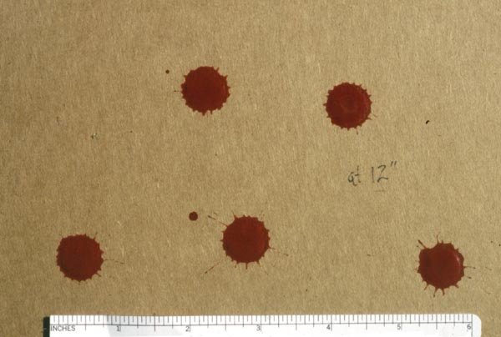
Part C: What else can an investigator learn from the analysis of a blood spatter?
  TYPE OF INJURY- Blunt force, sharp force, gunshot, etc.
  WEAPON - Type and velocity
  WOUNDS – Number of blows or the order in which they were inflicted
POSITIONS and MOVEMENTS of the victim and suspect during the attack
How does a blood droplet form? Click the image for more details.
https://www.youtube.com/watch?v=I0-nIsw1LXU
Source: http://science.howstuffworks.com/bloodstain-pattern-analysis1.htm

Slide 6
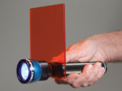
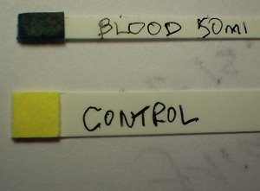
Part D: How is blood evidence detected at a crime scene?
Light Source
Investigators will first examine the crime scene to look for areas that may contain blood. They may use high-intensity light or UV lights to help them find traces of blood as well as other bodily fluids that are not visible under normal lighting conditions.
Blood Reagent Tests
These tests, referred to as presumptive tests, are used to detect blood at crime scenes based upon the properties of hemoglobin in the blood. Further tests at the crime lab can determine if it is human blood or not.
Examples:
Phenolphthalein is a chemical that is still utilized today and is usually referred to as the Kastle-Meyer test and produces a pink color when it reacts with hemoglobin.
HemaStix is a strip that has been coated with tetramethylbenzidine (TMB) and will produce a green or blue-green color with the presence of hemoglobin.
Kastle-Meyer Test
Video
HemaStix

Slide 7
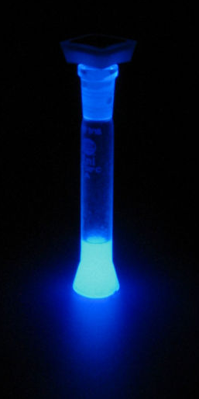
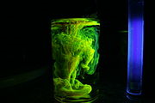
Luminol
This chemical is used by crime scene investigators to locate traces of blood, even if it has been cleaned or removed.
Investigators spray a luminol solution is throughout the area under investigation and look for reactions with the iron present in blood, which causes a blue luminescence.
One problem is that other substances also react, such as some metals, paints, cleaning products, and plant materials. Another problem is that the chemical reaction can destroy other evidence in the crime scene.
Luminol Reaction
Fluorescein
This chemical is also capable of detecting latent or old blood, similar to luminol. It is ideal for fine stains or smears found throughout a crime scene. After the solution has been sprayed onto the substance or area suspected to contain blood, a UV light and goggles are used to detect any illuminated areas, which appear greenish-white if blood is present. It may also react to many of the same things as luminol (copper and bleach).
Fluorescein Reaction in UV Light
LCV or Leuco Crystal Violet, is one type of chemical process that is used for blood enhancement. Using this test helps to make the blood evidence more visible so it can be photographed and analyzed.

Slide 8
Part E: Bloodstain Pattern Analysis Terms
SPATTER
Bloodstains created from the application of force to the area where the blood originated.
The place from where the blood spatter came from or originated.
ORIGIN/
SOURCE
Small drops of blood that break off from the parent spatter
SATELLITE
SPINES
The pointed edges of a stain that radiate out from the spatter
The droplet from which a satellite spatter originates.
PARENT DROP

Slide 9
Part F: Blood Spatter Labs
This can be messy! Be very careful to keep the blood on the paper and not on yourself, the table, or floor.
Hold you hand as steady as possible when making the drops. Brace your wrist against the meter stick to help you.
Get a pair of goggles and an apron. Sit quietly until we are ready to continue!
If you make a mess or goof up a drop,
grab a paper towel and wipe it up immediately!
Notes:
Teacher Note: If you have test tube clamps available, have the students attach it to the meterstick in the desired location and hold the bottle of blood (upside-down) in the other end where the test tube would normally go. This helps keep the bottle in the right spot and the chances of hitting the same spot twice are much higher!

Slide 10
Getting ready …
Divide the paper into THREE sections.
Label one side with “30 S” for
30 cm and SINGLE droplet.
Label the other side with “60 S”
for 60 cm and SINGLE droplet.
Label the middle with “90 S”
for 90 cm and SINGLE droplet.
30 S
90 S
60 S

Slide 11


Lab #1: SINGLE DROPS
FOR EACH HEIGHT:
Hold the dropper bottle upside down (& away from the ruler) so that the BOTTOM of it is the correct height from the table and blood won’t get on the meterstick.
GENTLY squeeze the bottle so that ONE drop of blood is released and lands on your paper.
Complete THREE good drops at each height.
X
✓
Hold the bottle away from the meterstick
If you make a mess or goof up a drop,
grab a paper towel and wipe it up immediately!

Slide 12
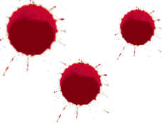
Lab 1: SINGLE DROPS – The answers are …
What did you notice about the droplets (size, shape, & spines) as you increased the height of the drop? Explain using the terms height, diameter, and spines in your answer.
WIDER
The higher the height of the drop, the _________ the diameter of the parent drop and the ___________ the spines become.
LONGER
Quick Question: Which of the three blood droplets shown would have been created by a wound in the lower part of the leg? Why?
The smallest diameter would be the from a lower height.

Slide 13
Lab #2: MULTIPLE DROPS
Directions:
You are going to repeat the process from Lab 1 - same labels, same process.
You need to have TWO droplets in the SAME SPOT. If you miss, wipe it off with a towel and try again.
Try THREE TIMES from THREE HEIGHTS – 30 cm, 60 cm, and 90 cm – with the simulated blood.
30M | 90M | 60M
X
✓
Hold the bottle away from the meterstick, but brace your hand so it doesn’t move.
If you make a mess or mess up a drop,
grab a paper towel and clean it up immediately!

Slide 14
DONE with Lab #2?
Fold up your blood spatter paper and throw away.
Put metersticks and blood on front counter
Wash your hands.
Answer the questions for Lab #2 before class tomorrow.

Slide 15
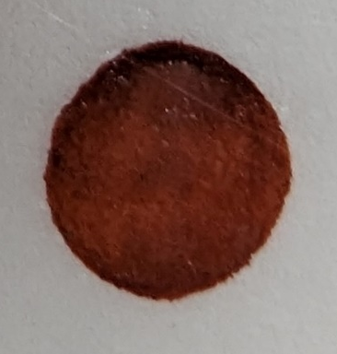
Lab 2: MULTIPLE DROPS – The answers are …
What did you notice about the droplets (size, shape, & spines) as you increased the height of the drop? Explain using the terms height, diameter, spines, and satellites in your answer.
How do your results from Lab 2 compare to Lab 1?
The more droplets that land in the same place, the ___________ the diameter of the spatter pattern and _________ satellites appear that are _______-shaped with some with _________.
WIDER
MORE
OVAL
SPINES
SATELLITE
The single drops from Lab 1 did not have _____________ spatter and the spines tended to be ___________.
SHORTER

Slide 16
Lab #3: MOTION DROPS
We are going to walk at different rates (slow, medium, and fast) along a strip of paper and observe the changes in the spatter.
Some of you will have a marker so you can help label the spatter.
Use S for slow, M for medium, and F for fast.
Answer the questions for Lab #3 before class tomorrow.

Slide 17
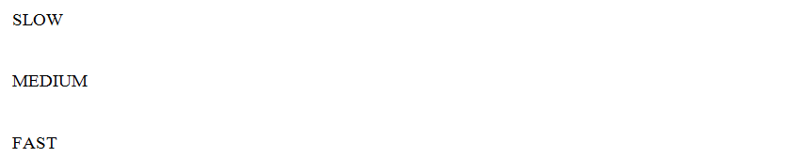
Lab 3: MOTION DROPS – The answers are …
What did you notice about the droplets (size, shape, & spines) as you increased the walking speed? Explain using the terms speed, shape (round/oval), distance, and spines.
SLOWER
The __________ a person is moving the more-rounded the droplets with spines on all sides. The droplets will also be ________ _____________.
As a person’s speed _____________, the droplets will be further apart with an _______ shape and spines mostly on _____ side.
CLOSER TOGETHER
INCREASES
OVAL
ONE

Slide 18
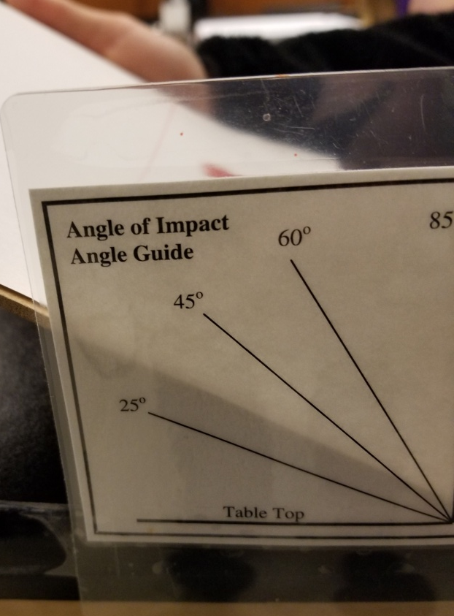
Lab #4: ANGLE OF IMPACT
Directions:
Divide a piece of copy paper into three columns and label with the angle for each droplet - 25º, 45º, 60º.
Place the paper on the clip board and align the clipboard with the 25º line. Hold the bottle of blood at a height of 50 centimeters from the top of the paper.
GENTLY squeeze the bottle so that a SINGLE drop of blood is released and lands on the paper. Repeat two more times at this angle.
Try the test again, but use 45º and 60º

Slide 19
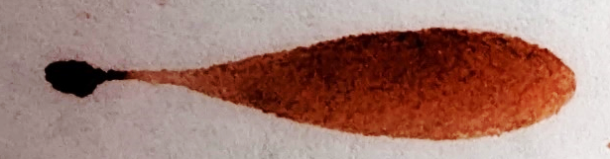
Lab 4: ANGLE OF IMPACT– The answers are …
How does the ANGLE OF IMPACT affect the blood spatter? Explain using the terms angle, shape, length, & tails.
The greater the angle with the table (25º → 60º), the ___________ the droplet and more ________-shaped it will be with _________ tails.
The droplets that form from angles close to 90º with the table tend to be __________-shaped without __________.
LONGER
OVAL
LONGER
ROUND
TAILS
Has spines on all sides – length depends on the height of the drop
What does the tail tell us?
Indicates the direction of movement after the droplet hits the surface

Slide 20
Remember the blood spatter samples on your table at the start of this lesson. Examine them again.
Are you able to explain how each of the patterns was likely created?
How did your observations change after completing the labs?
I put the same sample pages from the start of the lesson on the table for students to observe again. They are usually able to explain the most likely cause/process that formed each one.
Notes:
Teacher Note: If you have test tube clamps available, have the students attach it to the meterstick in the desired location and hold the bottle of blood (upside-down) in the other end where the test tube would normally go. This helps keep the bottle in the right spot and the chances of hitting the same spot twice are much higher!

Slide 21
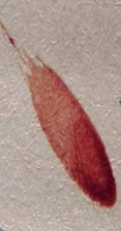
These questions are listed to the right of the student slide from the spatter labs.
1. What forces are acting on a blood droplet as it falls?
2. If you have a blood droplet like this one, what does it tell you? Explain.
Quick QUESTIONS
3. If you find a trail of blood with droplets that are round and close together with small spines, what could this mean?
4. How do Newton’s Laws of Motion apply to blood spatter?

