Slide 1
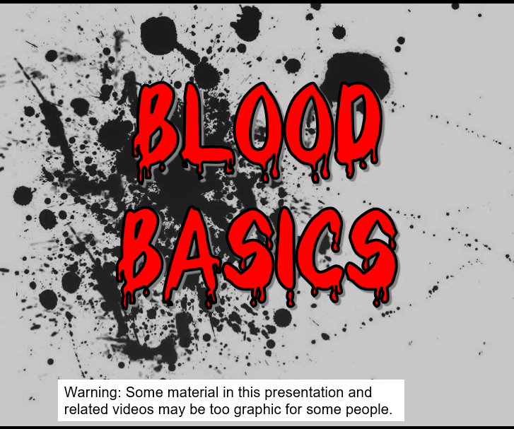
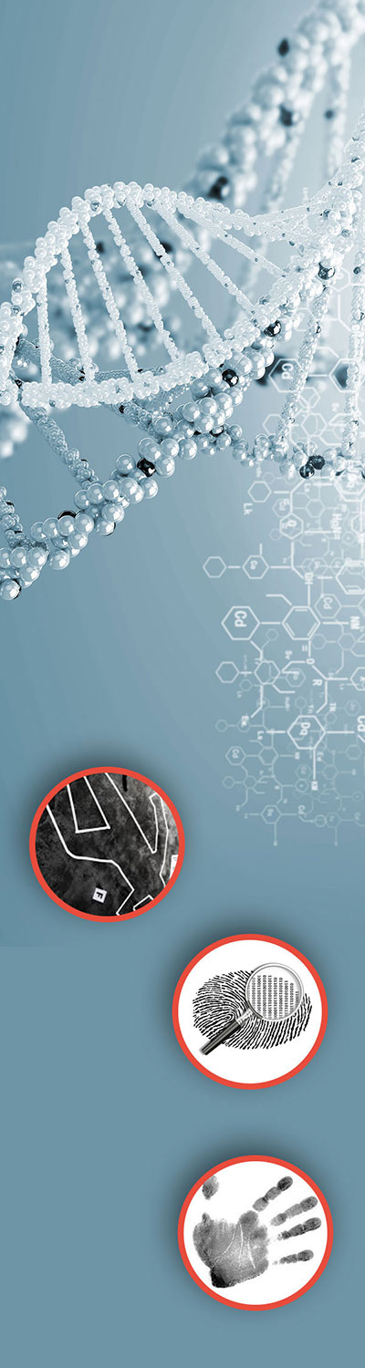
Teacher Notes:
The student digital slides for this unit are available at https://docs.google.com/presentation/d/1cK42rhAWr0iTKZ2TPXZvFgH3nvMom8tL-sgAa8PLXM0/edit?usp=sharing
IMPORTANT: Make a copy of the student notebook before you assign it on your LMS. It is view-only and I am not able to approve access for your students.
The digital notebook (with all the slides for the digital lessons and activities) is available at https://docs.google.com/presentation/d/14eIEiGacRXMsDyuUxiEsSM2m4YOAtIlfmD4O4YsLdPI/edit?usp=sharing. It is set up for standard paper (8.5x11) in landscape mode for easier printing when needed. Paper versions are available for this unit on my Forensic Science page at https://sciencespot.net/Pages/classforsci.html
A DRAFT of the general outline of the digital lessons (with corresponding slide #s for the student notebook) is available at https://docs.google.com/document/d/15wxjmL-uHQPXDKOxmZXtU_gxy9dphEuyC1P4jzP-9mA/edit?usp=sharing . It is based on 44-minute class periods with 7th & 8th grade students.
Preview presentations before using with your classes as many slides have animations and links you will need to use.
I do Science Starters at the beginning of each class period. A collection of starters for Forensics is available on my lessons plans page at https://sciencespot.net/Pages/classforsci.html .
CSI Unit Training Materials
T. Tomm Updated 2023
https://sciencespot.net
This Photo by Unknown Author is licensed under CC BY

Slide 2
#1 - Blood Facts
The average adult has about FIVE liters of blood inside of their body, which makes up 7-8% of their body weight.
Blood is living tissue that carries oxygen and nutrients to all parts of the body, and carries carbon dioxide and other waste products back to the lungs, kidneys and liver for disposal. It also fights against infection and helps heal wounds, so we can stay healthy.
There are about one billion red blood cells in two to three drops of blood. For every 600 red blood cells, there are about 40 platelets and one white cell.
______
______
_________
_________
_______
___
__
___
http://www.bloodbankofalaska.org/about_blood/index.html

Slide 3
#2 – Components of Blood
RED BLOOD CELLS (Erythrocytes) – The most abundant cells in our blood; they are produced in the bone marrow and contain a protein called hemoglobin that carries oxygen to our cells.
WHITE BLOOD CELLS (Leukocytes) – They are part of the immune system and destroy infectious agents called pathogens.
PLASMA – This is the yellowish liquid portion of blood that contains electrolytes, nutrients and vitamins, hormones, clotting factors, and proteins such as antibodies to fight infection.
PLATELETS (Thrombocytes) – The clotting factors that are carried in the plasma; they clot together in a process called coagulation to seal a wound and prevent a loss of blood.
_____________________
__________________________
_________
______________

Slide 4

#3 - Genetics of Blood Types
Your blood type is established before you are BORN, by specific GENES inherited from your parents.
These two genes - one gene from your MOTHER and one from your FATHER -determine your blood type by causing proteins called AGGLUTINOGENS to exist on the surface of all of your red blood cells.
_______
_______
___________
___________
______________________

Slide 5
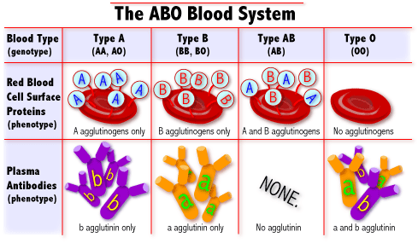
#4A - What are blood types?
There are 3 alleles or genes for blood type: A, B, & O. Since we have 2 genes, there are 6 possible combinations.
Blood Types
Type A=AA or AO
Type B = BB or BO
Type O = OO
Type AB = AB
_
_
_
Distributions on next slide
http://learn.genetics.utah.edu/units/basics/blood/types.cfm

Slide 6
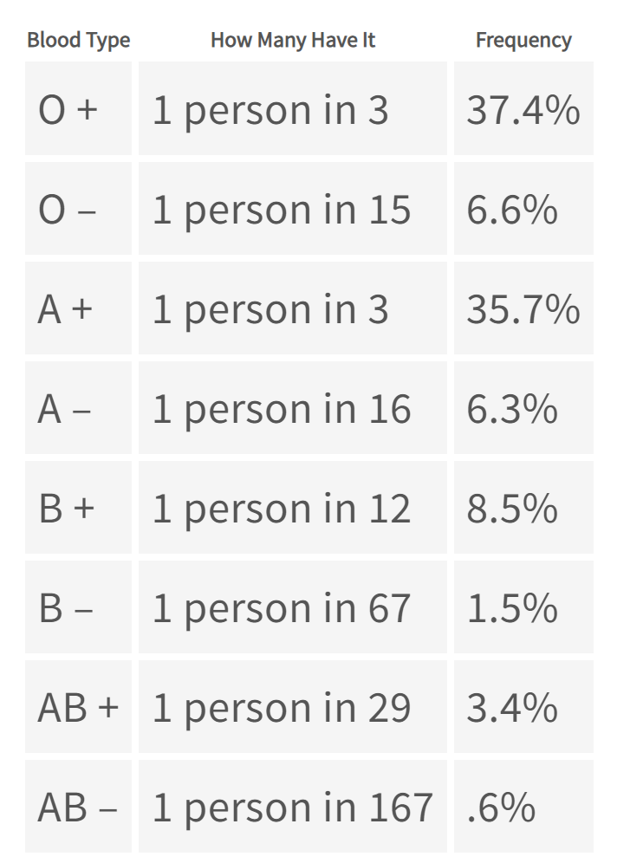
#4B – Blood Type Distribution
Type O ≈ 44%
___
Type A ≈ 42%
___
Type B ≈ 10%
___
Type AB ≈ 4%
___
Source: https://stanfordbloodcenter.org/donate-blood/blood-donation-facts/blood-types/

Slide 7
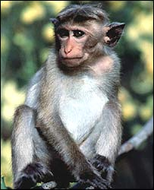
#5 - Rh Factors
Scientists sometimes study Rhesus monkeys to learn more about the human anatomy because there are certain similarities between the two species. While studying Rhesus monkeys, a certain blood protein was discovered. This protein is also present in the blood of some people. Other people, however, do not have the protein.
The presence of the protein, or lack of it, is referred to as the Rh (for Rhesus) factor.
If your blood does contain the protein, your blood is said to be Rh positive (Rh+). If your blood does not contain the protein, your blood is said to be Rh negative (Rh-).
_________________
A+ A-
B+ B-
AB+ AB-
O+ O-
_______
_______
http://www.fi.edu/biosci/blood/rh.html

Slide 8
#6 - Blood Transfusions
A blood transfusion is a procedure in which blood is given to a patient through an intravenous (IV) line in one of the blood vessels. Blood transfusions are done to replace blood lost during surgery or a serious injury. A transfusion also may be done if a person’s body can't make blood properly because of an illness.
Universal Donor
Universal Donors vs. Recipients
People with TYPE O blood are called Universal Donors, because they can give blood to any blood type.
People with TYPE AB blood are called Universal Recipients, because they can receive any blood type.
Rh + → Can receive + or -
Rh - → Can only receive -
O
_________
A
B
_________
AB
_____
Universal Recipient
_____

Slide 9
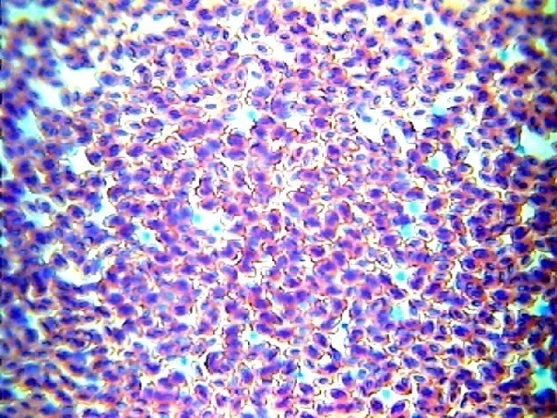
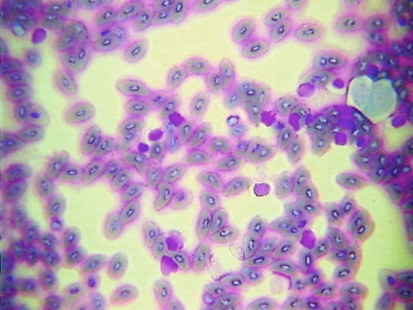
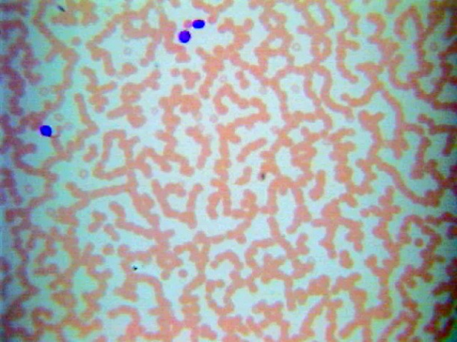
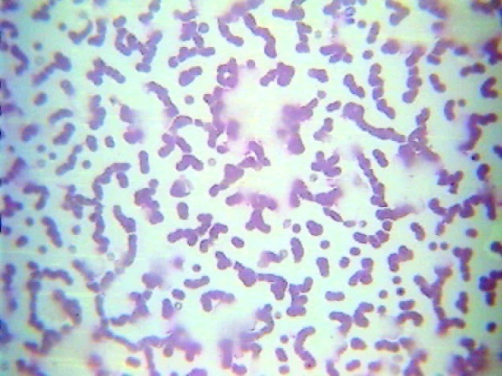
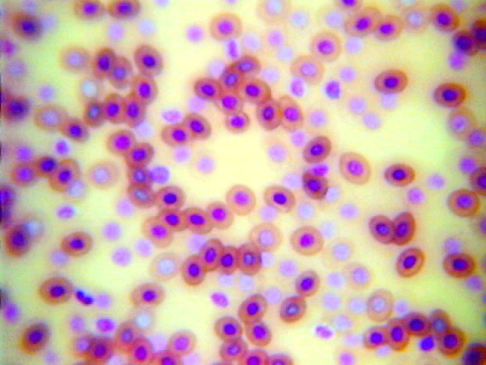
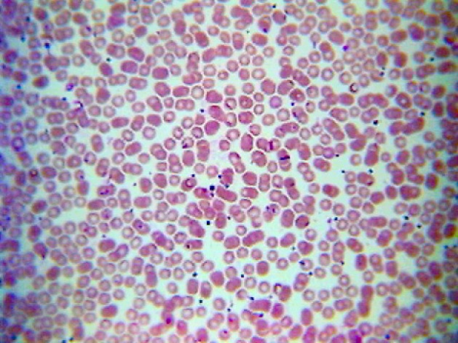
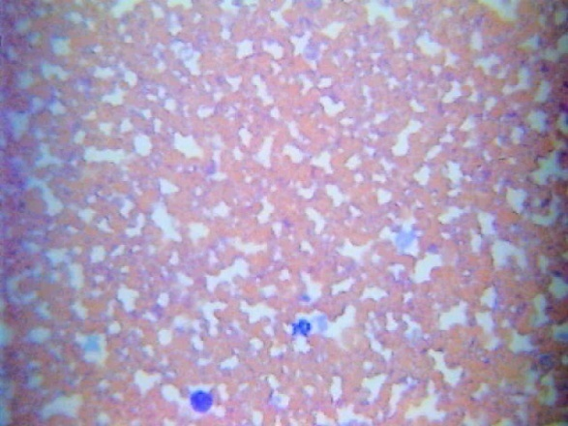
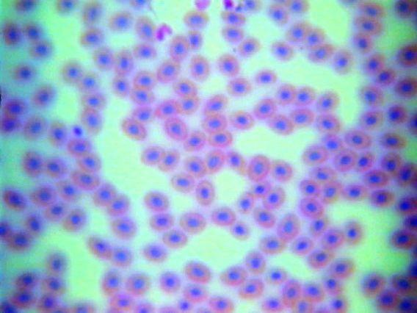
Microscopic
Views
Bird Blood
Fish Blood
Horse Blood
Cat Blood
Frog Blood
Human Blood
Dog Blood
Snake Blood

Slide 10
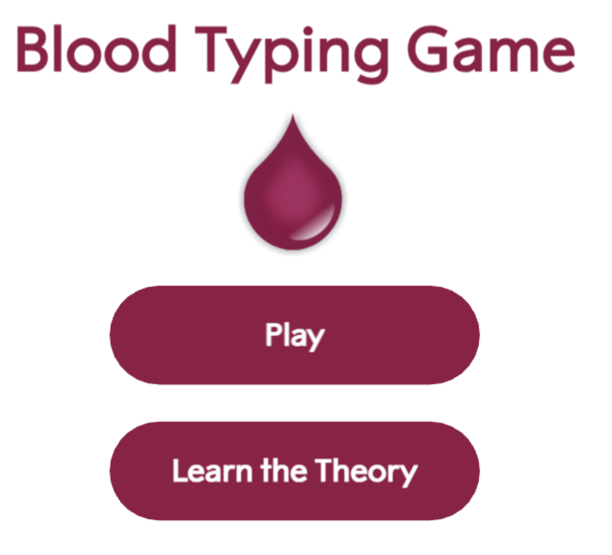
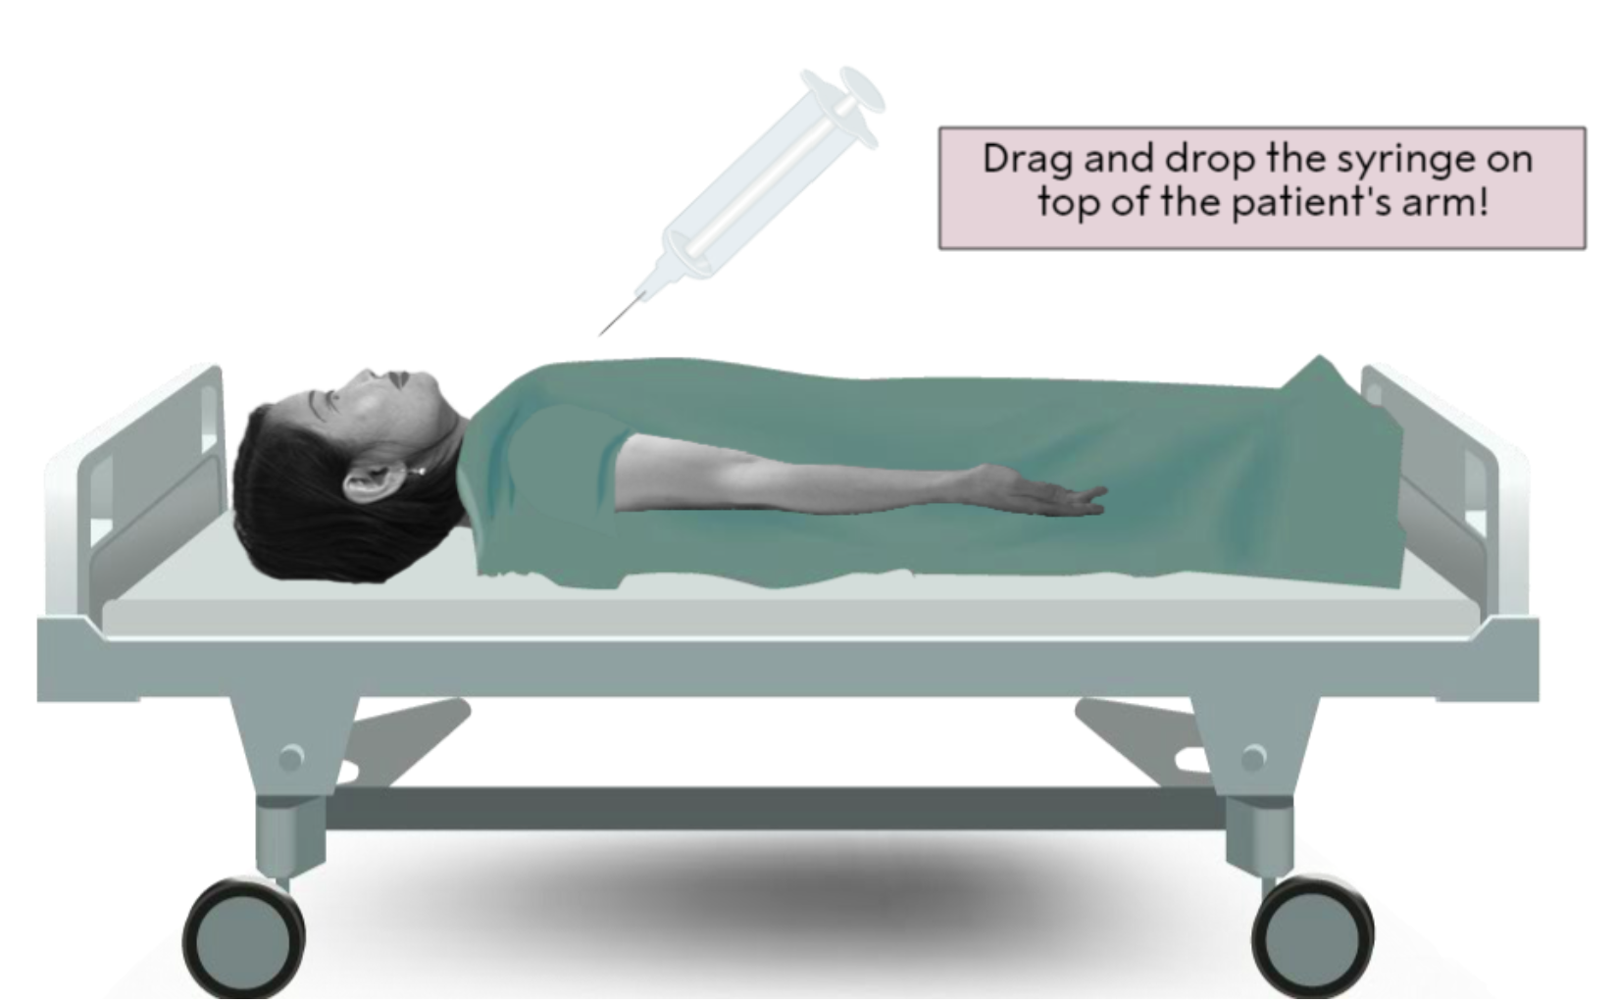
#7 – Online Challenge Directions
Click the image on your slide to find the link and then click PLAY.
Read the introduction and then click to get your first patient.
Enter a description of the patient using hair color and gender in your chart.
Drag the syringe so the needle is located over the elbow area. It will obtain a sample.

Slide 11
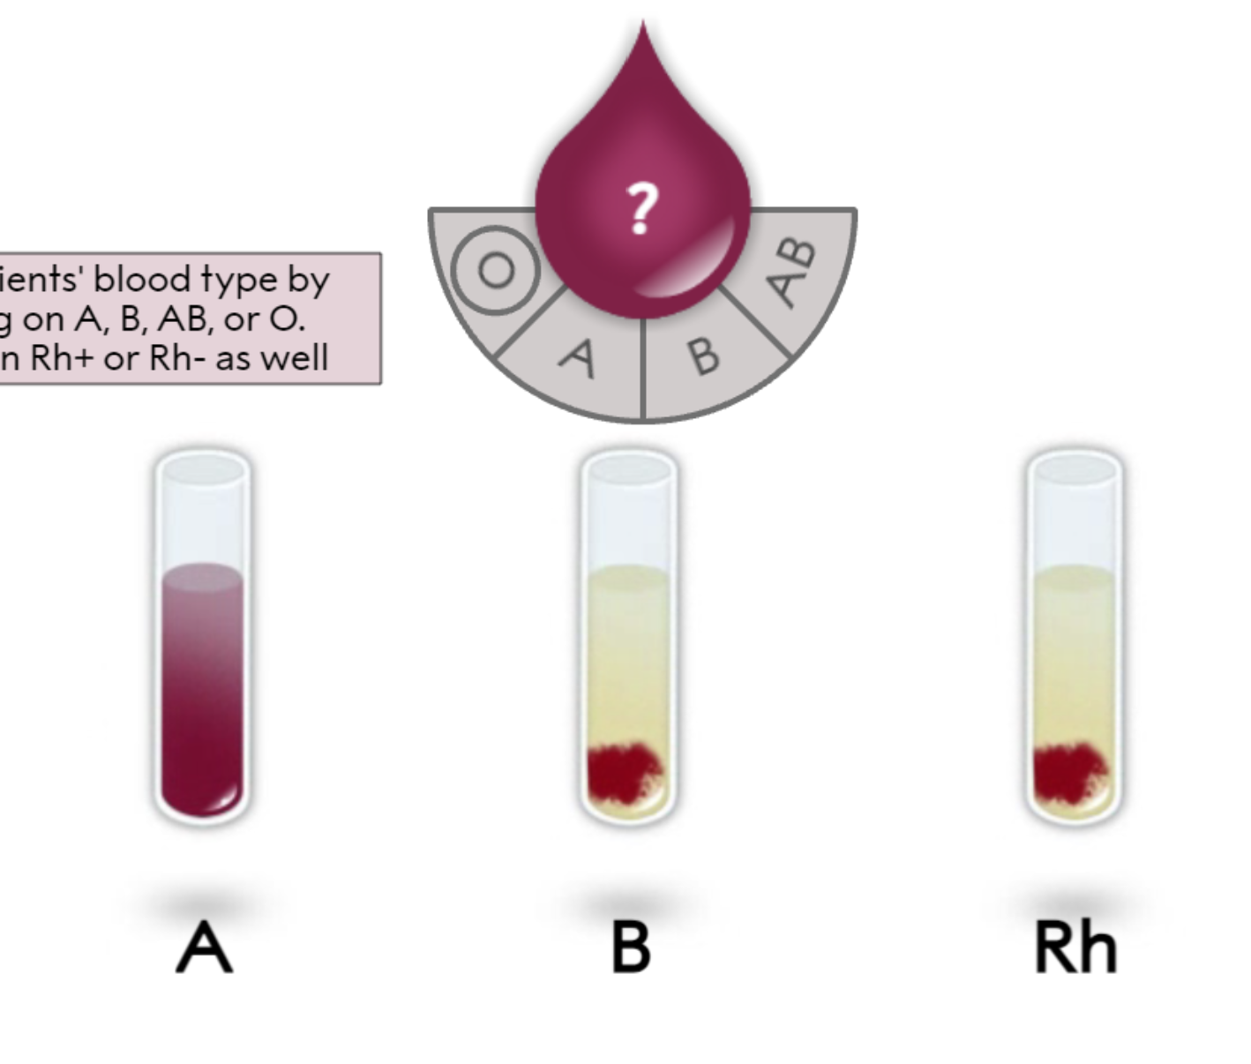
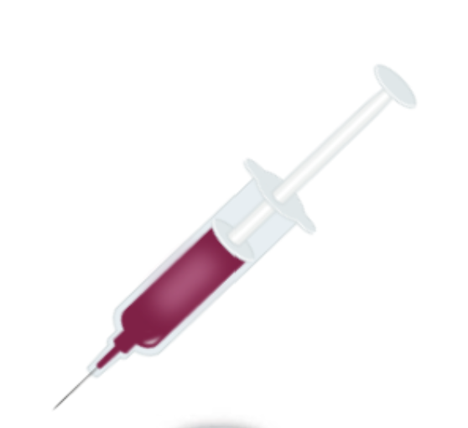
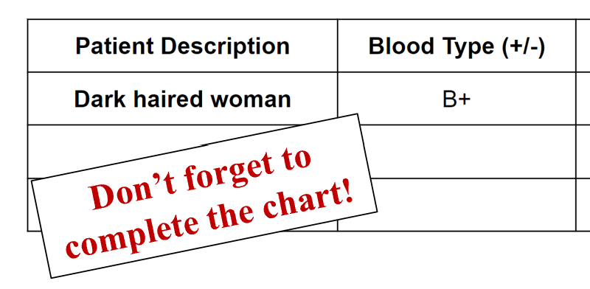
Task 1: Blood Typing
Drag the syringe over the top of each vial to add blood. Wait to see if there is a reaction.
Clump = Positive result
No clump = Negative result
What type of blood does this patient have?
There was a reaction for B and Rh, which would be B+ blood.
Finish by clicking the correct letters for the BLOOD TYPE the patient has by the blood drop and then click Rh+ or Rh–.

Slide 12
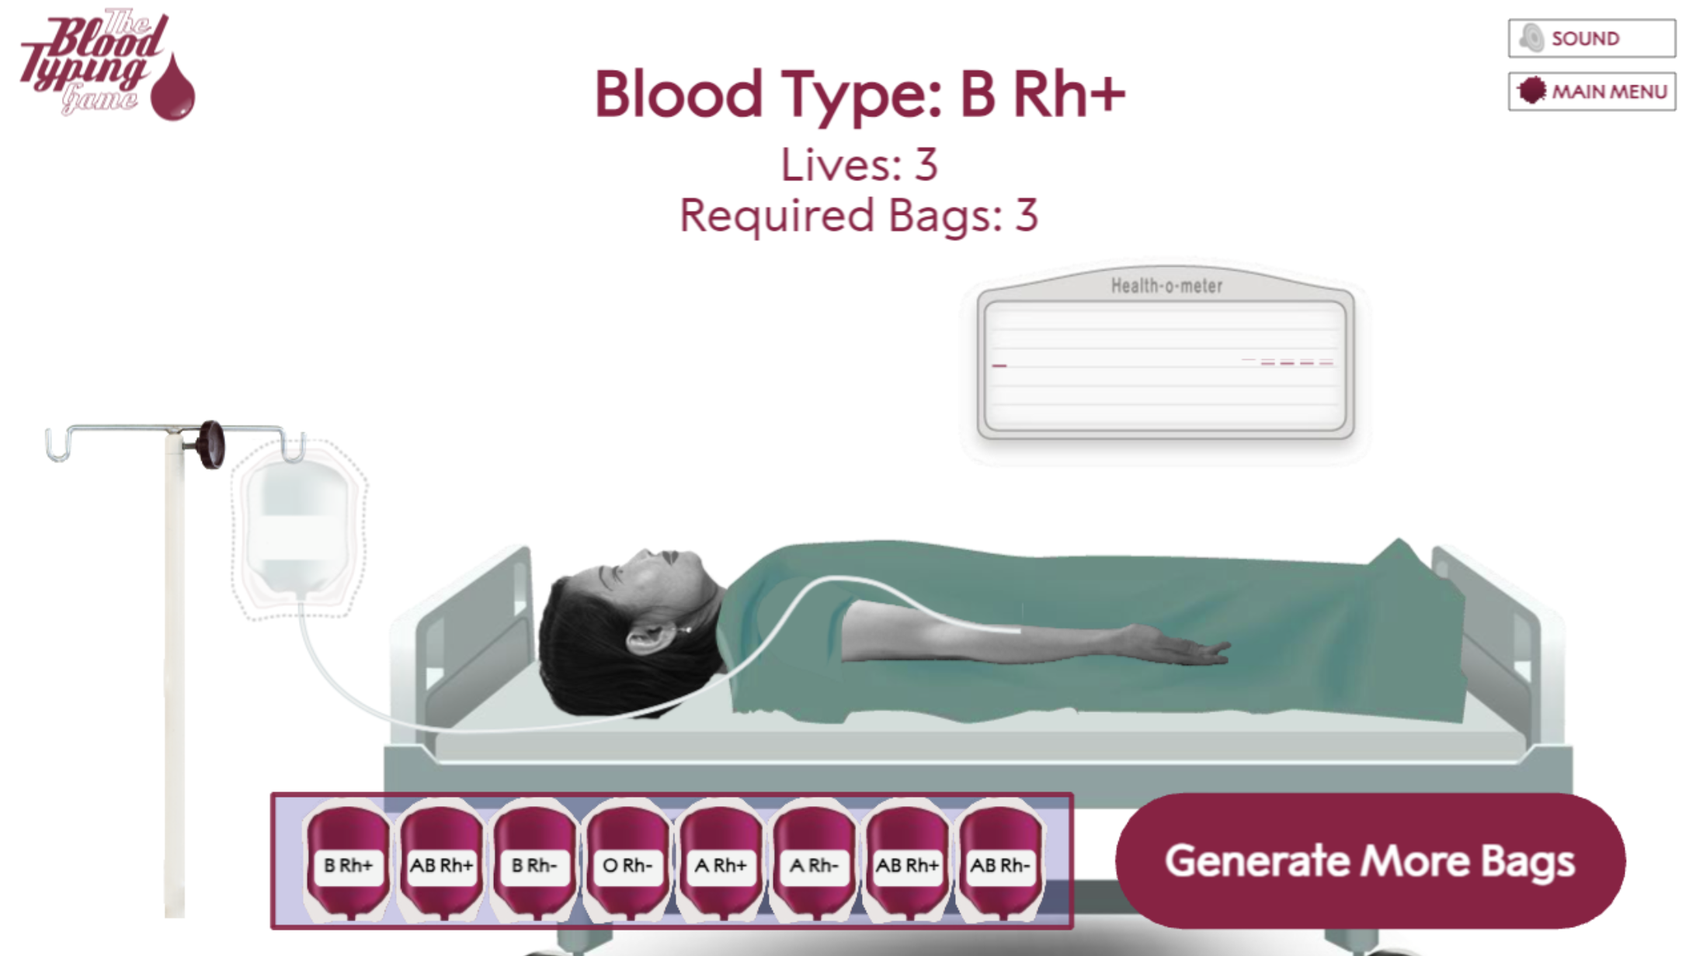
Task 2 – Blood Transfusion
Determine the blood types the patient can receive. Refer to the diagram for #6 on your slide for help.
Click and drag the correct bags to the IV pole & record the information in your chart. The patient in this example needs 3 bags. You have only 3 chances (lives) to get the correct ones.
Click to get more bags if you do not have the blood types you need.
Don’t forget to complete the chart as you play!

Slide 13

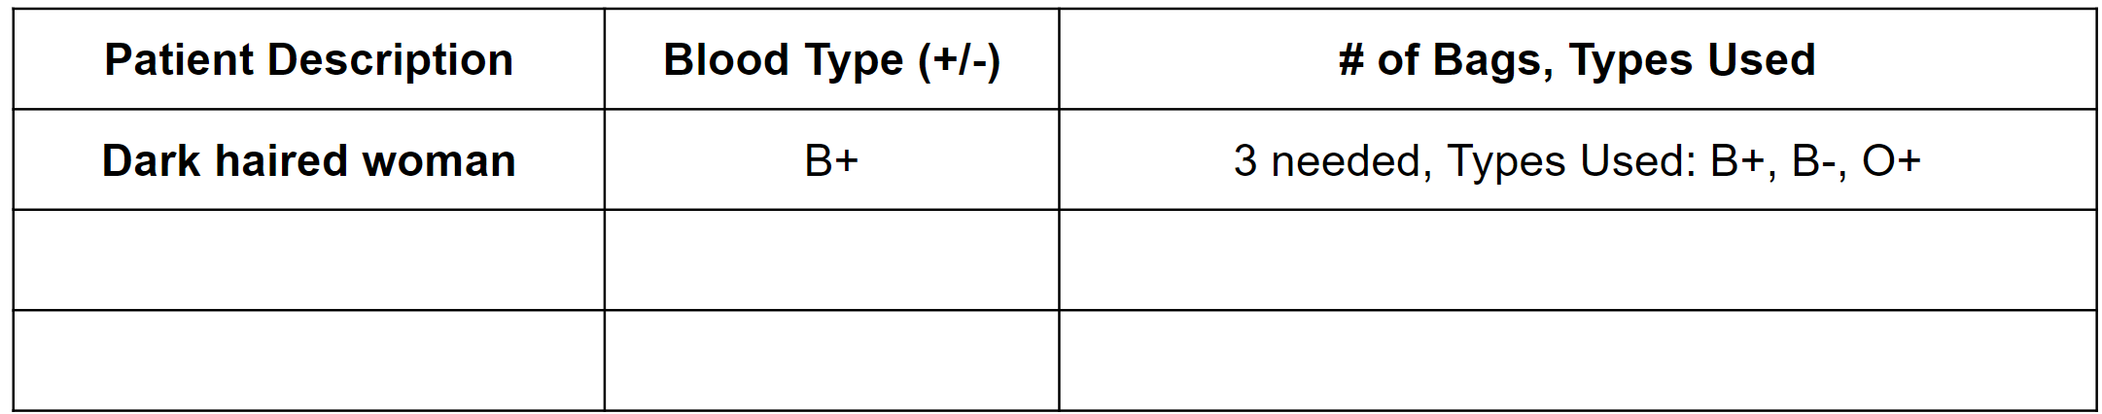
Click MAIN MENU and then click PLAY again. Follow the same directions to determine the patient’s blood type and then complete the transfusion. Complete the chart as you play.
Repeat for more patients. You need to have a total of three different blood types to finish!
EXAMPLE
Don’t forget to complete the chart!
You need to have patients with three different blood types to finish the activity.

Slide 14

Ernie's Exit
Forensic Science
Blood Typing Lab Activity
Go to https://sciencespot.net/Pages/classforsci.html#blood for teacher information for this activity.
T. Tomm 2006 Updated 2023 https://sciencespot.net/
TOC

Slide 15
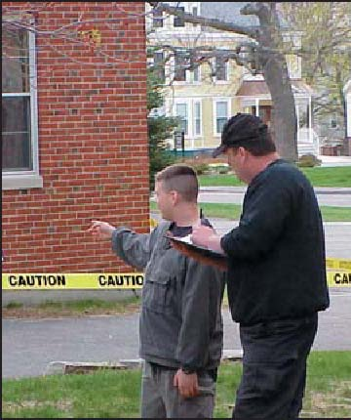
The Crime Report
A small pool of blood and a weapon was found near a garbage dumpster. After examining the area, the CSI on the scene discovered a body in the garbage dumpster and identified him as Earnest “One-Eyed” Earl. Earl had a wound to his chest that will be analyzed by the medical examiner.
The CSI tested blood samples from the blood pool and the weapon at the crime scene. It was determined that it was human blood, but he needs to know the blood type to help identify if it was from the victim or the person who murdered him. He has come up with three suspects that either knew the victim or were seen in the area before the body was discovered. He would like to question them further while he waits for DNA test results.
Follow your teacher’s directions to complete the lab.
Remember to be careful to prevent cross-contamination of the blood samples!
Image: http://www.fbi.gov/publications/leb/2005/apr2005/apr2005leb_img_3.jpg

Slide 16
What’s the type?
We will be determining blood types using Anti-A serums, Anti-B serums, and Anti-RH serums. Complete the chart to help you determine the blood type of each sample and its Rh factor (+ or -) during the lab.
Clumping = + (Positive) No Clumping = - (Negative)
Type | Reaction w/ Anti-A Serum | Reaction w/ Anti-B Serum
A
B
AB
O
Fill in the chart on your slide.
+
-
-
+
+
+
-
-
Rh Serum - Clumping = Rh+ blood

Slide 17
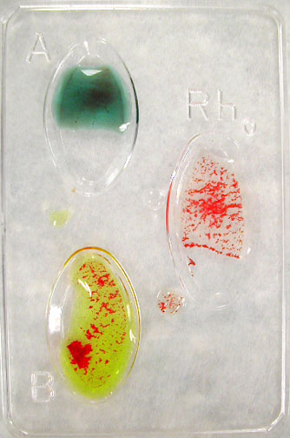
Lab Directions
Step 1: Place 1 drop of the anti-A serum in the A well.
Step 2: Place 1 drop of the anti-B serum in the B well.
Step 3: Place 1 drop of the anti-Rh serum in the Rh well
Step 4: Place 1 drop of the blood sample in each of the A, B, and Rh wells.
Step 5: Use a clean toothpick to stir the serum in
well A. Repeat with clean toothpicks for the B & Rh
wells. Don’t cross-contaminate!
Step 6: Record your results for each test by using the
+ or – signs on the right side of your slide.
Video Tutorial
https://www.youtube.com/watch?v=5ysaMKoqmr8
No clumping
Clumping

Slide 18
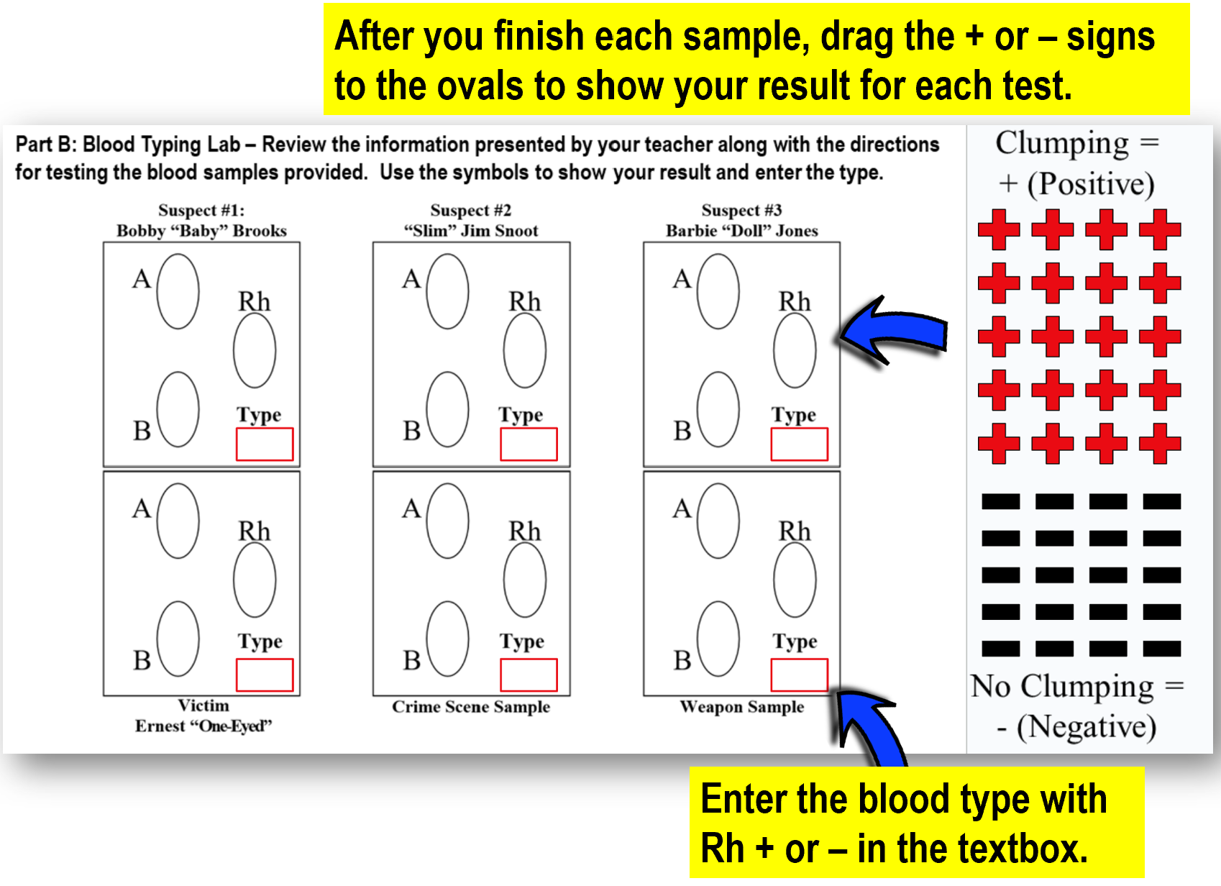
It’s time for the lab …
Get your materials …
1 blood typing tray
3 toothpicks
Blood & serum samples
Paper towel
Safety goggles
Complete your lab
report on the slide
as you do the lab.

Slide 19
Lab Directions
Step 1: Place 1 drop of the anti-A serum in the A well.
Step 2: Place 1 drop of the anti-B serum in the B well.
Step 3: Place 1 drop of the anti-Rh serum in the Rh well
Step 4: Place 1 drop of the blood sample in each of the A, B, and Rh wells.
Step 5: Use a clean toothpick to stir the serum in
well A. Repeat with clean toothpicks for the B & Rh
wells. Don’t cross-contaminate!
Step 6: Record your results for each test by using the
+ or – signs on the right side of your slide.
Fill in your slide
as directed.
No clumping
Clumping

Slide 20
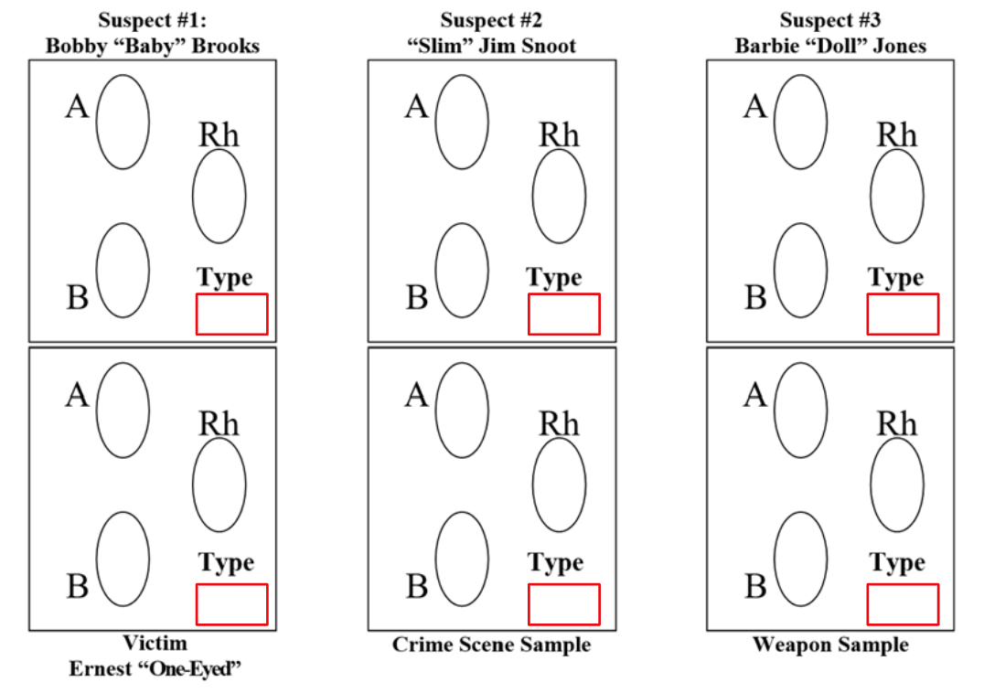
Lab Results
TEACHER KEY: Complete the experiment before you try it with the class so you have an answer key that matches your kit. This slide could be used on a SmartBoard. If that is not available, drag the + & - signs to show the actual results for your blood typing kit. You will need to add textboxes for the blood types.
Analysis: What do your results show? What should investigators do next?

