Slide 1
Doodle Notes
Using Doodles as a
Learning & Thinking Tool
Note Taking Strategy
Tracy Tomm 2014 http://sciencespot.net/
Notes:
This PowerPoint was created to introduce my students to the Doodle Notes strategy.

Slide 2
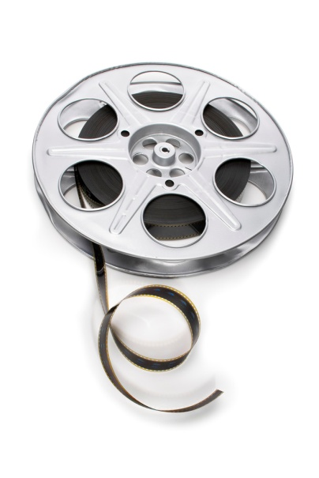
What are “doodle notes”?
Doodle notes are a version of graphic notes that can be used to help us remember important information and concepts from articles we read, things we discuss, or videos we watch.
Watch the video to learn more!
Notes:
The video is available on Educreations – a great iPad app that can be used to create instructional videos for any topic!

Slide 3
Ready to get started?
Remember …
Focus on getting the main ideas and concepts written down in your notebook.
Add drawings, shapes, colors, and details to help you remember the information.
Build connections between the ideas/concepts as well as to real world examples.

Slide 4
Ready to get started?
1st - Read section 3.2 in your textbook about sponges .
2nd - Try creating your own “doodle notes” on page ___ of your Handy Dandy Science Notebook. Feel free to use the whole page!
What should you include? Here are some words that should be included in your notes …
Notes:
For the first attempt at Doodle Notes, I give the students a basic list of words/phrases that should be included in their notes. I also tell them that they should be able to find a few more things to add that are not on the basic list.

Slide 5
Time to Share …
Spend a few minutes comparing your Doodle Notes to those created by your tablemates.
What did you have in common?
What other information was included?
What else would you like to add to your notes? Take a few moments to add more information, doodles, or details!
Notes:
I allow time at the start of each class period for students to compare their doodle notes to those of their classmates. They usually do a good job of discussing what they included as well as taking time to add information they may have missed. After the small group discussions, I lead the students in a whole class discussion and create a class set of notes on the SmartBoard for reference.

