Slide 1
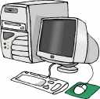
TECH SKILLS Click-N-Learn
ANSWER
KEYS

Slide 2
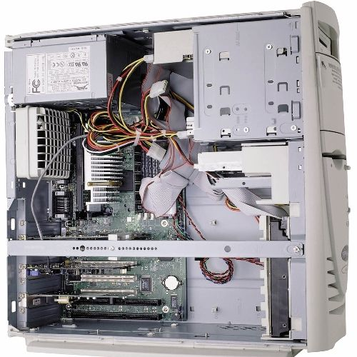
2. POWER CABLES provide power for the DRIVES.
1. POWER SUPPLY supplies the fuel (POWER) for the computer and often has a FAN to help keep the computer cool.
3. CASE FAN is used to cool the computer.
4. CENTRAL PROCESSING UNIT is a microprocessor that acts as the BRAIN of the computer.
5. MOTHERBOARD uses tiny electrical paths to connect each component of the computer and tie everything together.
6. MEMORY or RAM is used to store information.

Slide 3
7. 5.25” drive bay can hold several types of hardware, such as drives for CDs. A CD-R drive can read and write information, but cannot erase it. CD-RW drives, can also read and write, but it will also erase the data you have already saved.
8. 3.5” drive bay may be inside the computer (called INTERNAL) or outside the computer (called EXTERNAL.)
9. CASE FAN is used to cool the computer.
10. MOTHERBOARD BATTERY is used to preserve the computer’s CLOCK and settings.
11. BIOS or BASIC INPUT/OUTPUT SYSTEM is used to set up your computer’s hardware.

Slide 4
13. The CASE protects all the ELECTRONIC components inside and provides adequate ventilation to prevent OVERHEATING.
12. MODEM converts DIGITAL data into ANALOG waves, so that the data can travel through the phone lines to another computer. The modem on someone else’s computer converts the analog waves back into digital data.
14. EXPANSION SLOTS (OR PORTS) allow you to plug CARDS into these slots to add more devices for your computer.

