Slide 1


Techie
Terminology

Slide 2

Speak the Technology!
We use computers, cell phones, iPods, and other gadgets every day along with technology-related words.
What “techie terms” do you know?
Challenge: Work with your group to list as many technology-related words as you can in 3 minutes.

Slide 3
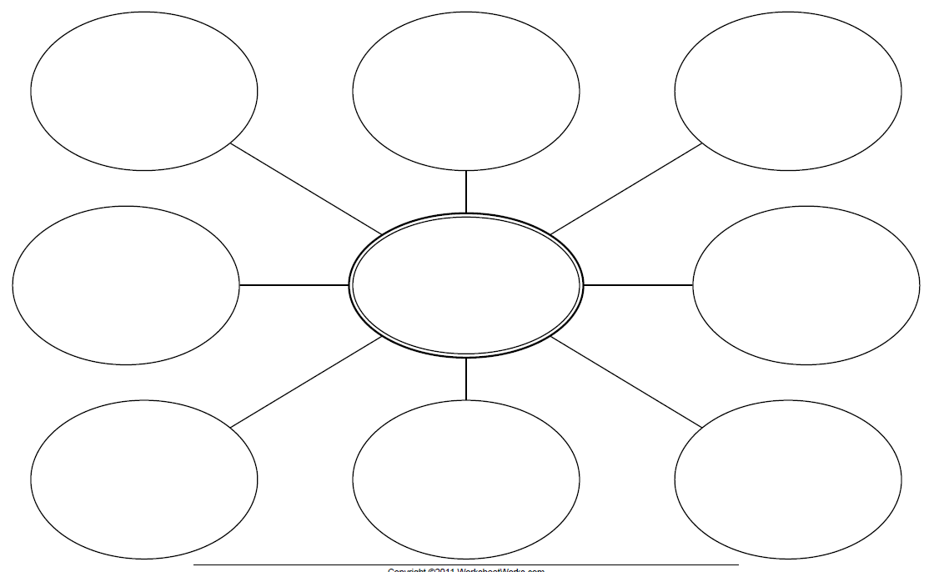
How can we classify the words we listed?
TECH TERMS

Slide 4
Challenge Cards
Draw a picture that illustrates your technology term along with a clue.
Write your technology term on the back along with your name.
MOUSE
Mrs. Trimpe
We might need this “rodent” to help us navigate the web!

