Slide 1
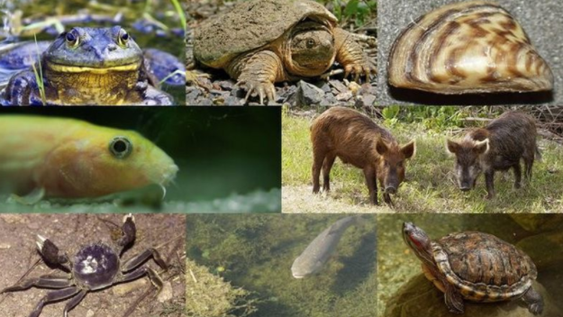

Digital Assignment available at https://docs.google.com/presentation/d/1uWSw5z1ZE2mthHtsU0l-rCJbAv21H23I6oSgs6U05SM/edit?usp=sharing
WANTED POSTER PROJECT
Last week we discussed invasive species and the problems they cause for native organisms. Species, such as the zebra mussel, cause both ecological and economic harm. They compete with native animals for food harming them. They make problems for power plants as they attach themselves to pipes, which costs money to remove.
For this project, you will choose one invasive species to research by drawing a slip.
You will use what you discover to create a “Wanted” poster.
Video Directions: https://watch.screencastify.com/v/qCDlCBjEA6dSeroomY3N

Slide 2
Getting started …
Draw a slip to determine which invasive species you will research.
Write your name on the line for your organism.
NOTE: You will be turning these into the teacher once you have added the common and scientific names to your poster.
Natasha Brooks

Slide 3
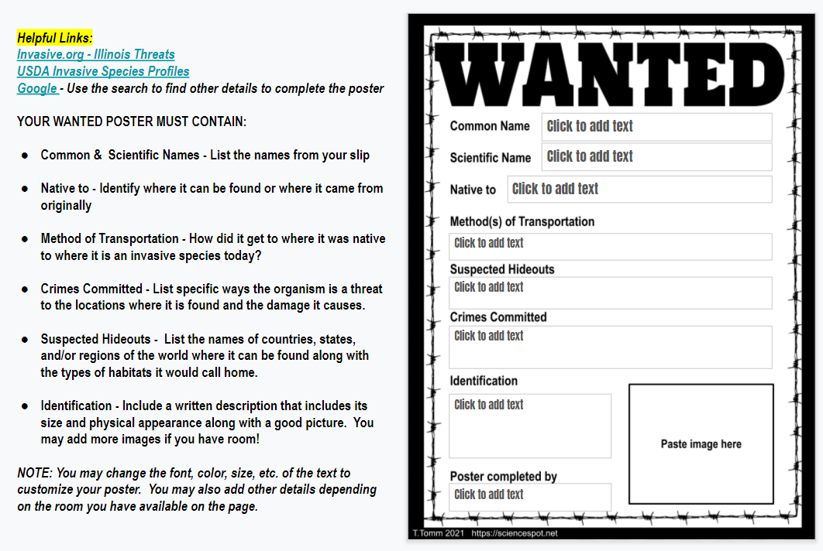
Use the information in the margins to help you with the project. A link to the video is included on your slide.

Slide 4
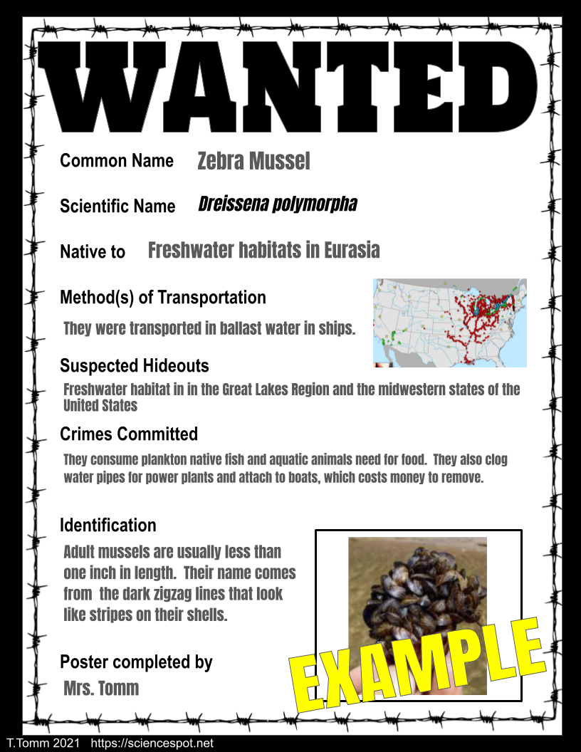
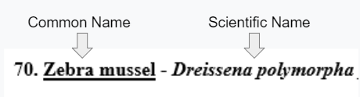
Native to - Identify where it can be found or where it came from
Method of Transportation - Explain how it was transported to where it is today as an invasive species.
Suspected Hideouts - List the names of countries, states, and/or regions of the world where it can be found along with the types of habitats it would call home.

Slide 5
Crimes Committed - List specific ways the organism is a threat to the locations where it is found and the damage it causes. Damages can be harm due to the ecosystems and the organisms that live there as well as economic harm costing money to address.
Identification - Include a written description (size, colors, etc.) and a good picture. You may add more images if you have room, such as the range map showing where they are located.
Add your name to the last text box

Slide 6
Before you turn it in …
Proofread for grammatical and spelling errors.
Customize the poster by changing the font (style, color, etc.) and adding other details that relate to your invasive species.

