Slide 1
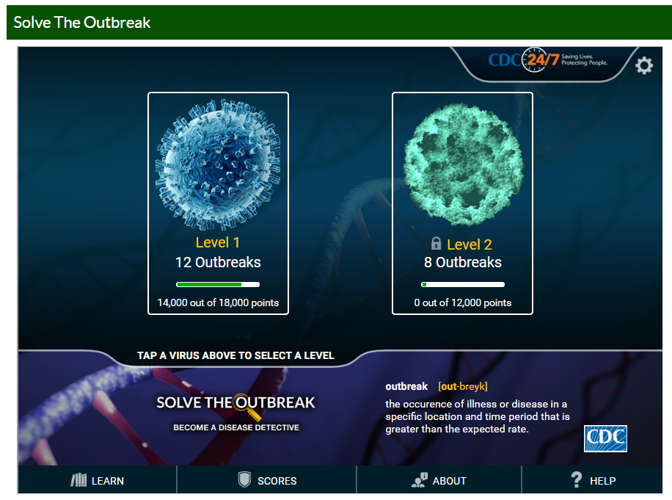
CDC Solve the Outbreak
Your class will investigate 12 outbreaks by analyzing the case notes, data, and other details about the disease.
Glue the worksheet on page ____ FAF Left
Presentation developed by T. Tomm 2020 http://sciencespot.net/ for use with the Solve the Outbreak activity

Slide 2
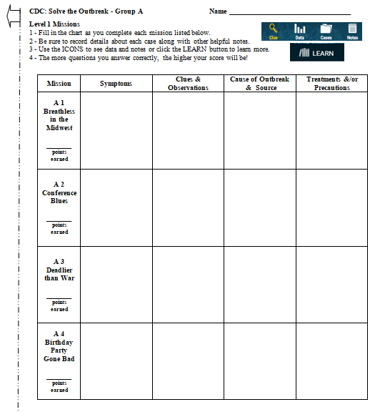

What is your group letter?
Directions:
Glue the worksheet on
page ______ FAF Left.
Go to mrstomm.com
→ Assignments
→ Solve The Outbreak
→ Level 1
Assignment: Complete the 4 missions listed on the front of your worksheet. Due tomorrow at the start of class!

Slide 3

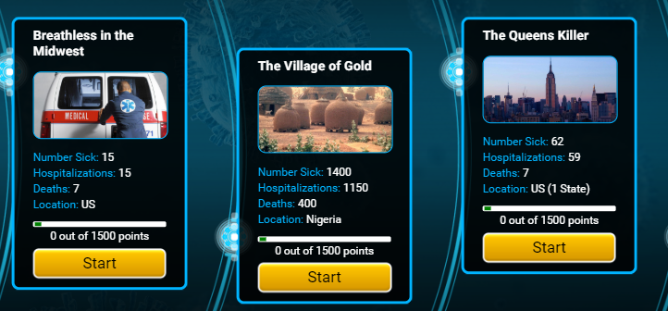
Click for the first case listed on your worksheet.
A1
B1
C1
Note: You will have to scroll to the left to find the other missions.

Slide 4
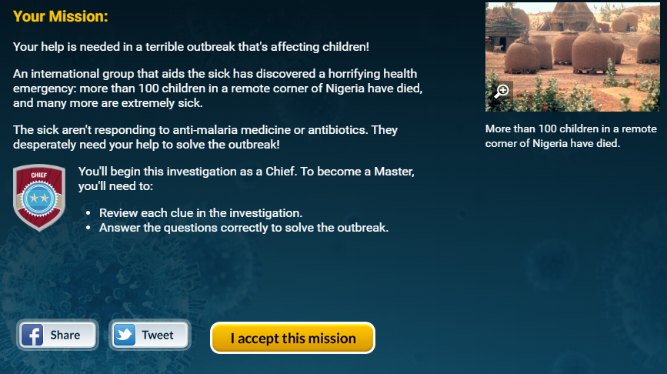
CASE OVERVIEW – Provides the basic information you need to get started.
Read the information & add to your chart (if needed)
Click “I accept this mission.”

Slide 5

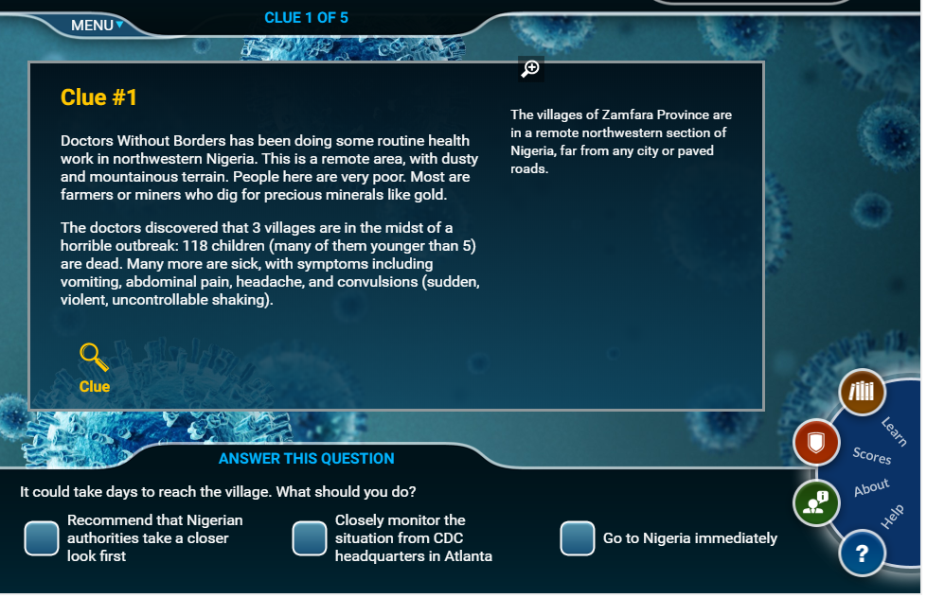


Read the first clue & write down any info you find in the chart.
Click MENU to review past clues & info.
Click hyperlinked words for clues or try the LEARN icon.
Click the + to see more.
Click the tool icons for each clue.
Do not answer the question until you have reviewed all the information/clues!
Try to earn as many points as you can, but focus on getting your chart completed.
We will complete the BACK of the worksheet in class tomorrow.

Slide 6
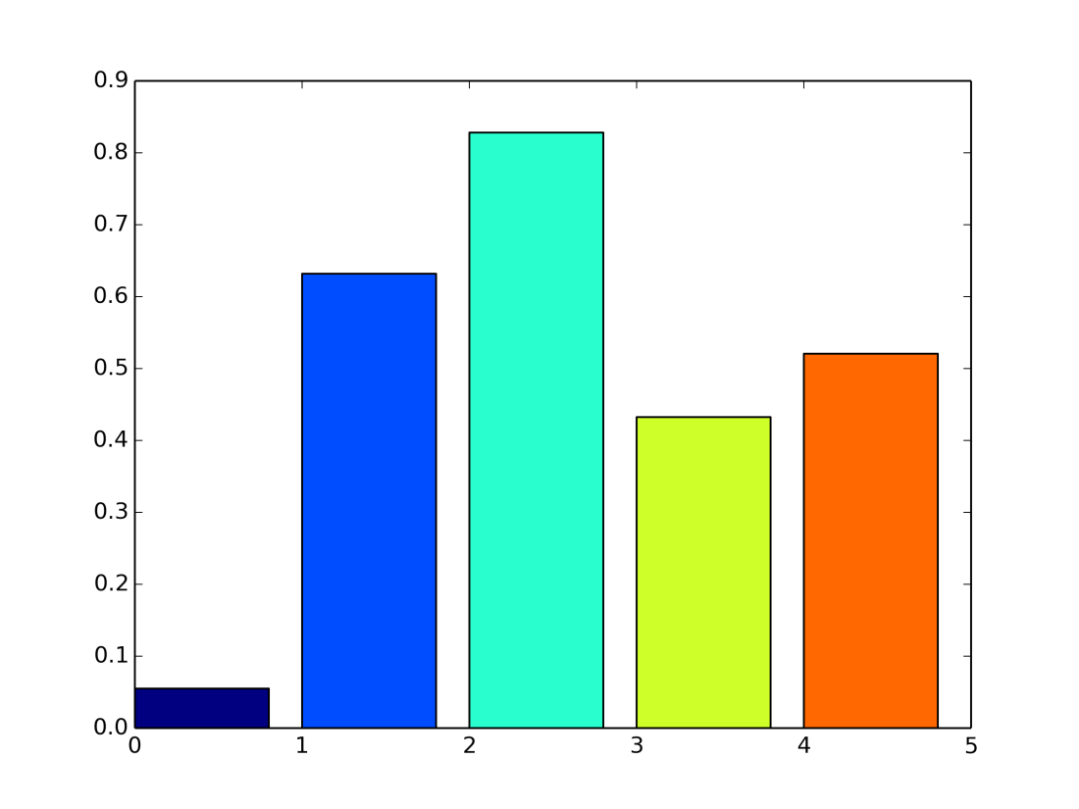
Part B: Data & Discussion

Slide 7
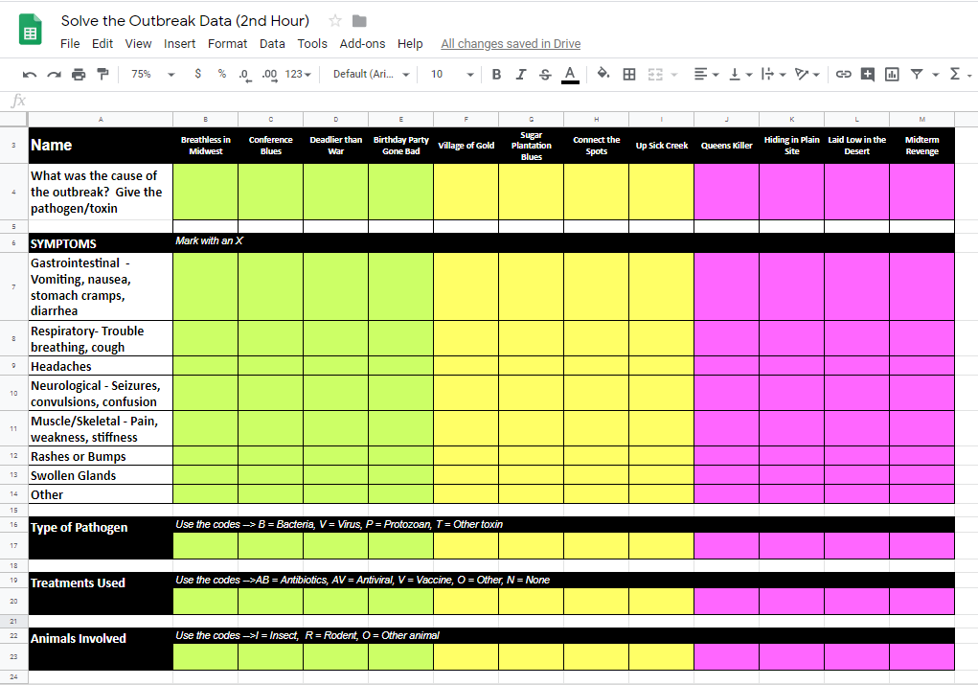
Sharing your data …
ONE PERSON in your group needs to log into Google using their school account.
Go to DRIVE → Shared with Me → Find the Solve the Outbreak Chart for your class period.
Enter Xs or CODES to
share your data with your
classmates.
Done? Use the data to answer the questions in Part B on your worksheet.
Teachers: Click the link below to download a copy for your classes. https://docs.google.com/spreadsheets/d/11qzPj5CM9ualGpeAKcpuSOgcRgrruSLCoSMCVACLOuM/edit?usp=sharing

Slide 8
Solve the Outbreak Data Use an X to mark any symptoms for your cases.
Cause of the Outbreak | Anthrax | Lead Poisoning | West Nile Virus | E. Coli | Rabies | Ameoba (AK) | Legionella pneumophila | Monkeypox | RM Spotted Fever | Cryptosporidium | Rift Valley Fever | Norovirus
Case # → | A1 | B1 | C1 | A2 | B2 | C2 | A3 | B3 | C3 | A4 | B4 | C4
Fever/Chills
Gastrointestinal Vomiting, nausea, stomach cramps, diarrhea
Respiratory Trouble breathing, cough
Headaches
Neurological Seizures, convulsions, confusion
Muscle/Skeletal Pain, weakness, stiffness
Rashes or Bumps
Swollen Glands
Other
For use on a SmartBoard as an alternative to Google Slides
May also be printed out and displayed in the classroom.

Slide 9
Solve the Outbreak Data 2 Use a CODE to share the data for your cases.
Pathogen/ Toxin Case # | Anthrax | Lead Poisoning | West Nile Virus | E. Coli | Rabies | Ameoba (AK) | Legionella pneumophila | Monkeypox | RM Spotted Fever | Cryptosporidium | Rift Valley Fever | Norovirus
 | A1 | B1 | C1 | A2 | B2 | C2 | A3 | B3 | `C3 | A4 | B4 | C4
Type of Pathogen B = Bacteria V = Virus P = Protozoan T = Toxin
Which diseases involved animals? What type? M = Mammal I = Insect R = Rodent
Treatments AB = Antibiotics AV = Antiviral V = Vaccines O = Other N = None available
For use on a SmartBoard as an alternative to Google Slides
May also be printed out and displayed in the classroom.

Slide 10
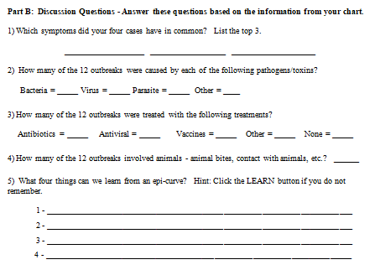
Part B: Discussion Questions
Work with your teammates to complete the questions on your worksheet using the online spreadsheet.

Slide 11
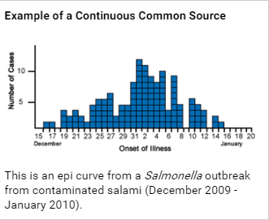
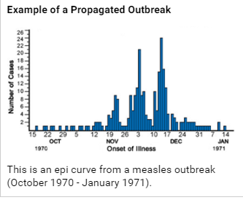
What four things can we learn from an epicurve? Hint: Click the LEARN button if you do not remember.
1 - Size of the outbreak (Magnitude)
2 – Trend – # of cases ⬆ or ⬇?
3 – Spread – Patterns in the cases to tell how its spread
4 – Period of exposure (Incubation time)
Images: https://www.cdc.gov/mobile/applications/sto/web-app.html

Slide 12
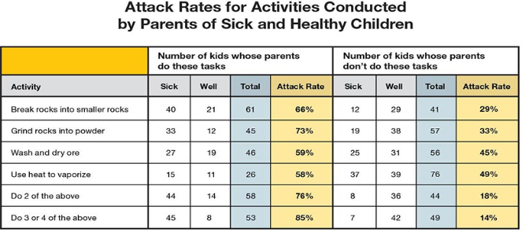
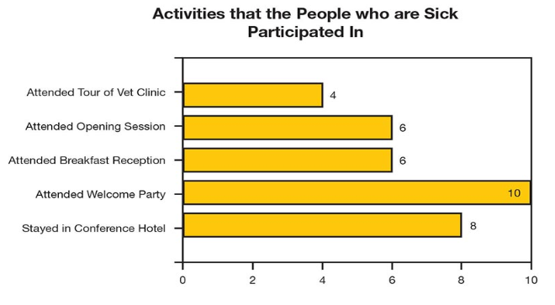
What other types of data did you analyze for the cases?
Which activities had the highest attack rates?
How does this help the investigation?
Which activities did victims have in common?
What would this tell investigators?
Images: https://www.cdc.gov/mobile/applications/sto/web-app.html

Slide 13

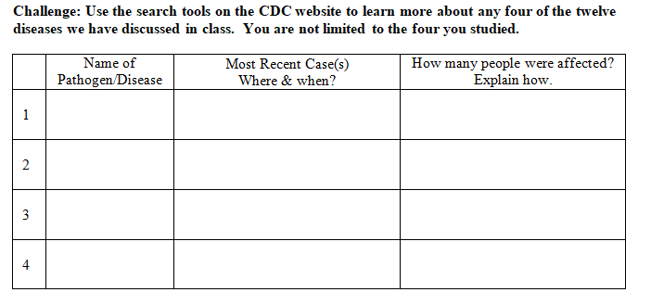
Note: You may also use a Google search if you limit your information to reliable and accurate sources.

