Slide 1
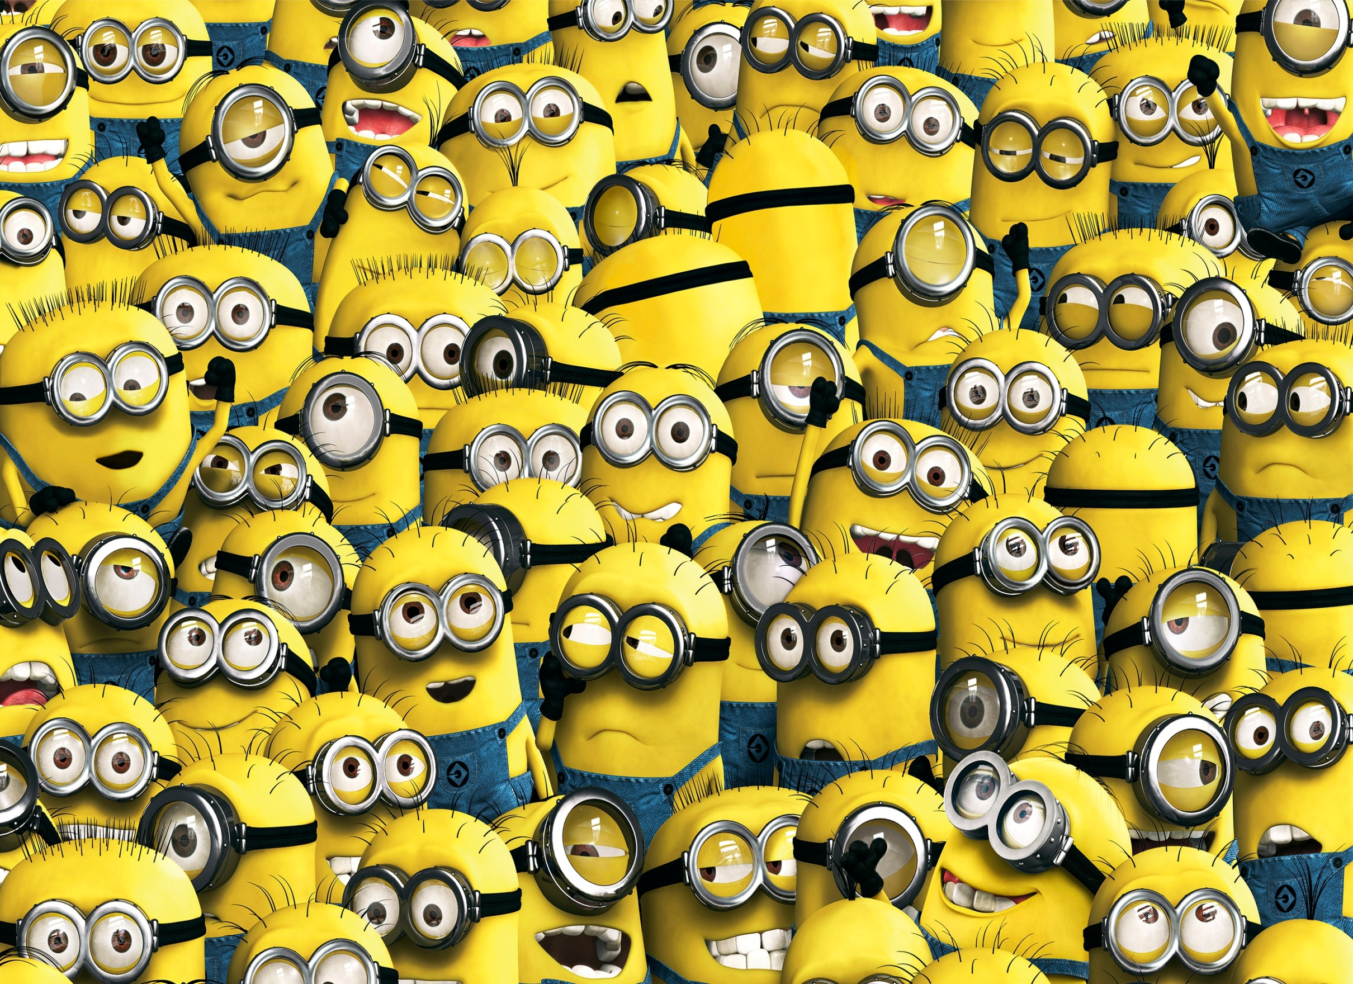
Welcome to
Mrs. Tomm's Class!
Pick a spot to sit …
We will be changing seats in a bit!
Keep your laptop closed.
Day 1 Day 2 Day 3
Teachers: If you would like the PPT version, send an email to ttomm@sciencespot.net to request it.

Slide 2


My Most Important Rule
We will discuss more expectations and class procedures this week.

Slide 3

Class?
If I say “Class”, you say “Yes!” and then wait QUIETLY for me to continue.
Remember …
You have to say it the same way I do!
Notes:
NOTE: I use many of the classroom management techniques from http://www.wholebrainteaching.com/. Visit their website for great resources to spiff up your classroom atmosphere and make it a place where everyone loves to learn!

Slide 4
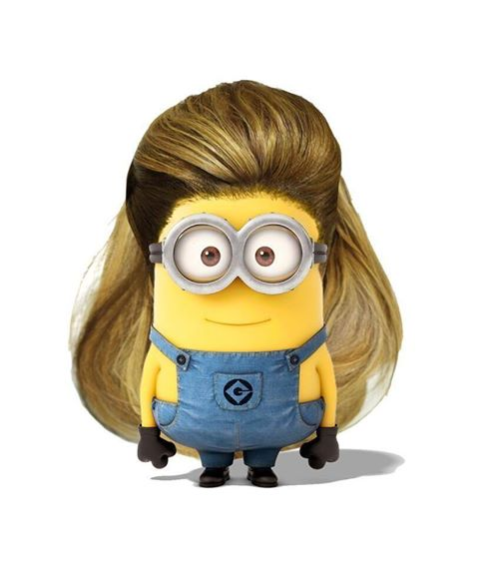
Get out your laptop and sign in.
Go to CHROME and wait for everyone to get ready.
Bookbags/backpacks need to be stashed under the table – not in an area where people walk.
No old lady tripping hazards, please!

Slide 5



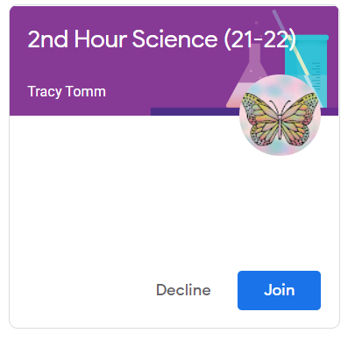

Google Classroom
Click the + to open a new browser tab
and enter google.com in the address bar.
Click the “waffle” button
Choose CLASSROOM.
Look for your SCIENCE CLASS PERIOD
and click the + or JOIN.
If you do not see a science class listed, raise your hand to let the teacher know you need to be added.
WAIT for everyone to join the class!
Help someone at your table if needed.

Slide 6
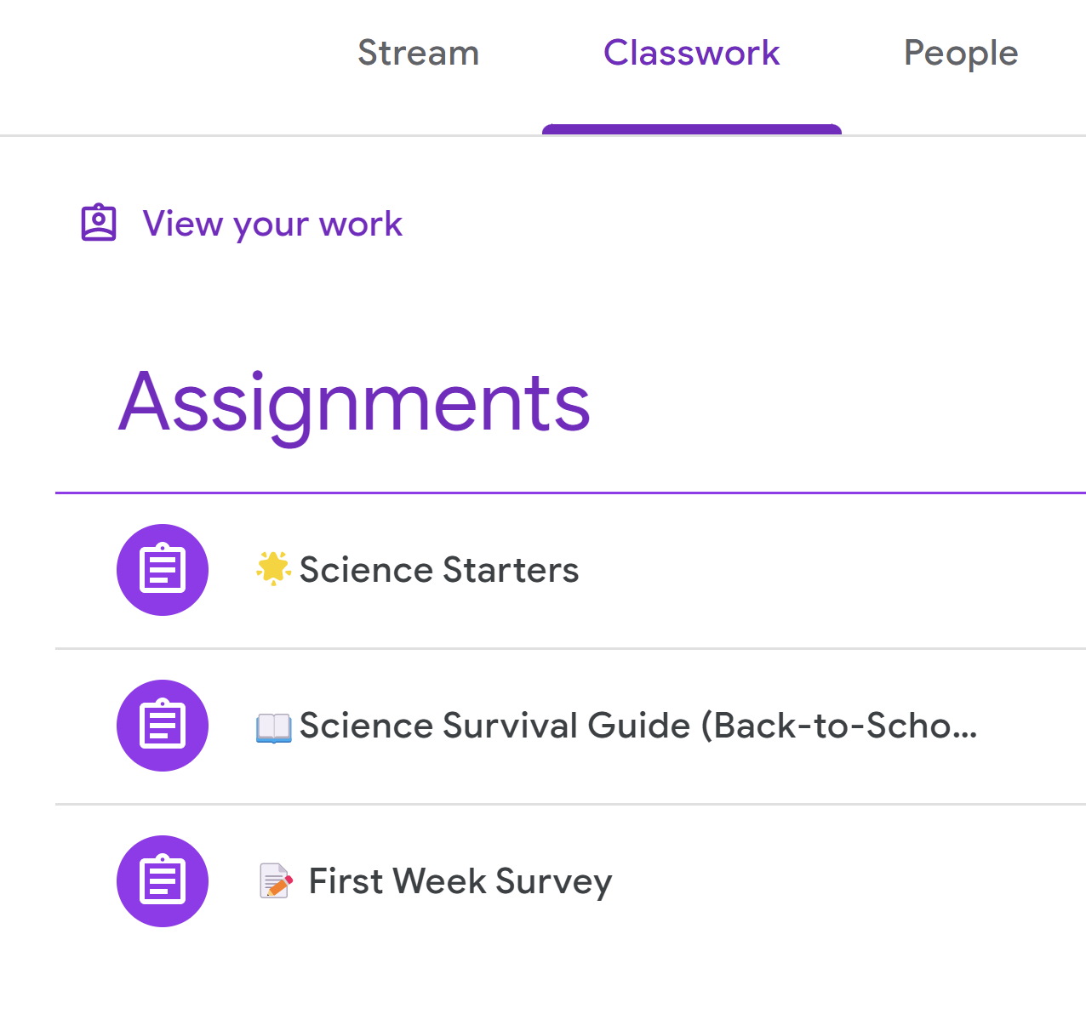
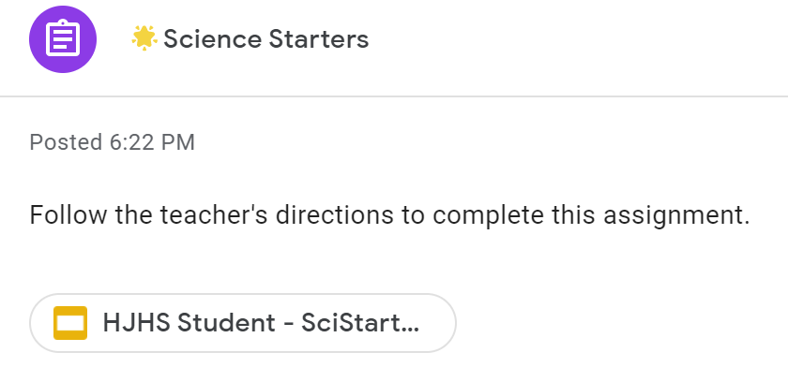
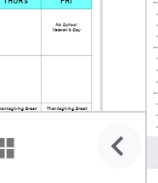
Your first assignment …
Click CLASSWORK
Click SCIENCE STARTERS
(always the first assignment)
Click the assignment link & wait for your file to load
← New Option - Click the arrow to minimize the left side of the slide.

Slide 7
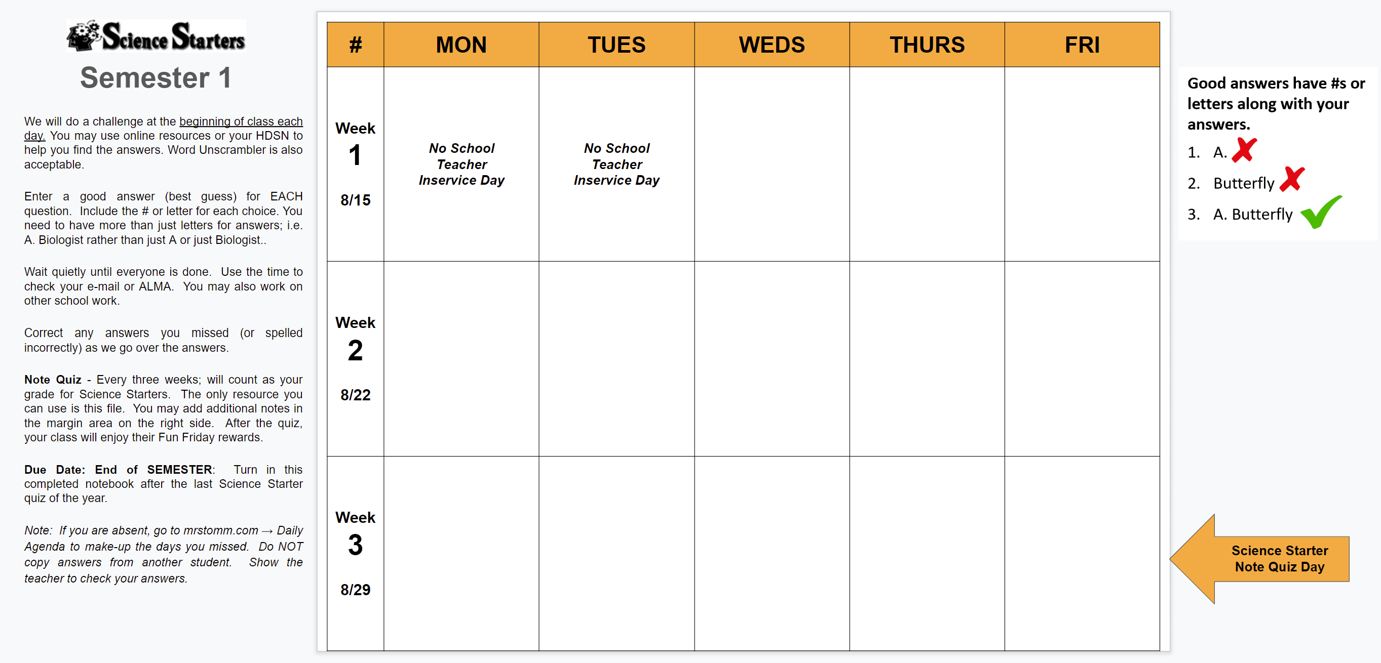
Read the information in the margins to answer the questions for today.
Enter your answers in this box.
Questions?
← New Option - Click the arrow to minimize the left side of the slide.

Slide 8

Got It?
If I ask “Got It?”, show me how well you understand
what we are discussing!
Thumbs up?
Thumbs down?
In the middle?

Slide 9

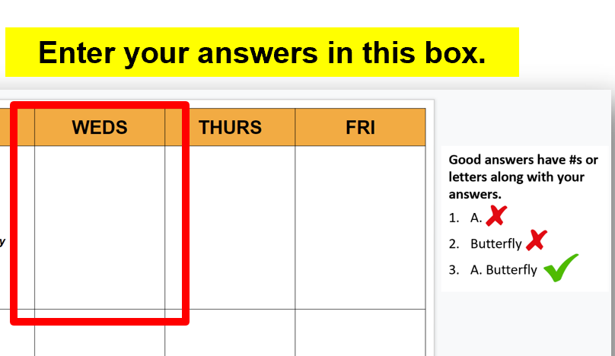

WEDNESDAY
Science Starters – The Basics
Read the information on the first slide of your Science Starter assignment to answer these questions.
How often will we do a Science Starter?
How many do you have to answer?
What do you do if you miss any of them?
How often will we have a note quiz over the challenges?
When should you turn in your Science Starter assignment?
What do you do if you are absent?

Slide 10


WEDNESDAY
Science Starters – The Basics
The answers are …
How often will we do a Science Starter?
How many do you have to answer?
What do you do if you miss any of them?
How often will we have a note quiz over the challenges?
When should you turn in your Science Starter assignment?
What do you do if you are absent?
Good answers have #s or letters along with your answers.
A.
Butterfly
A. Butterfly
Every Day
All of them
Correct wrong answers
Every 3 weeks
End of semester
Go to mrstomm.com → Daily Agenda

Slide 11
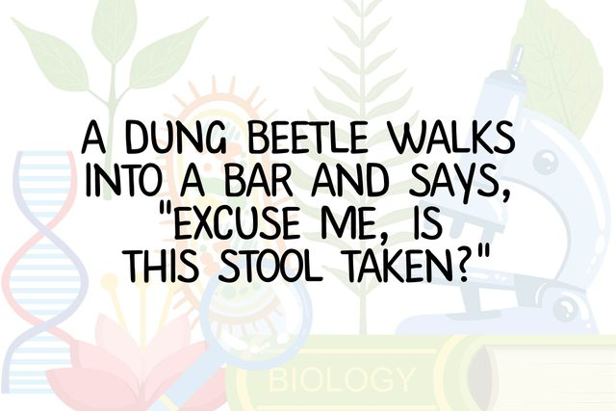
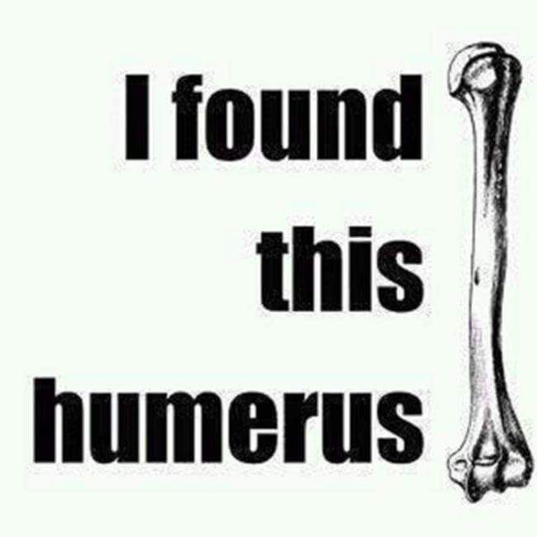
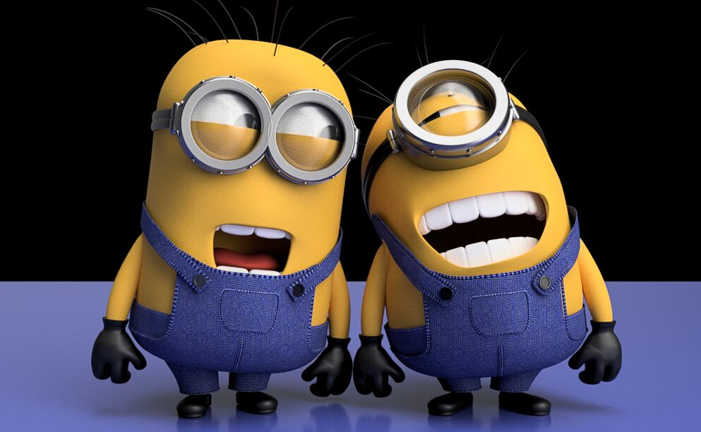
Notes:
NOTE: I use many of the classroom management techniques from http://www.wholebrainteaching.com/. Visit their website for great resources to spiff up your classroom atmosphere and make it a place where everyone loves to learn!

Slide 12

Hands & Eyes
If I say “Hands & Eyes”, you need to take your hands off your laptop, look at the teacher, and
get ready to listen!
No talking!

Slide 13
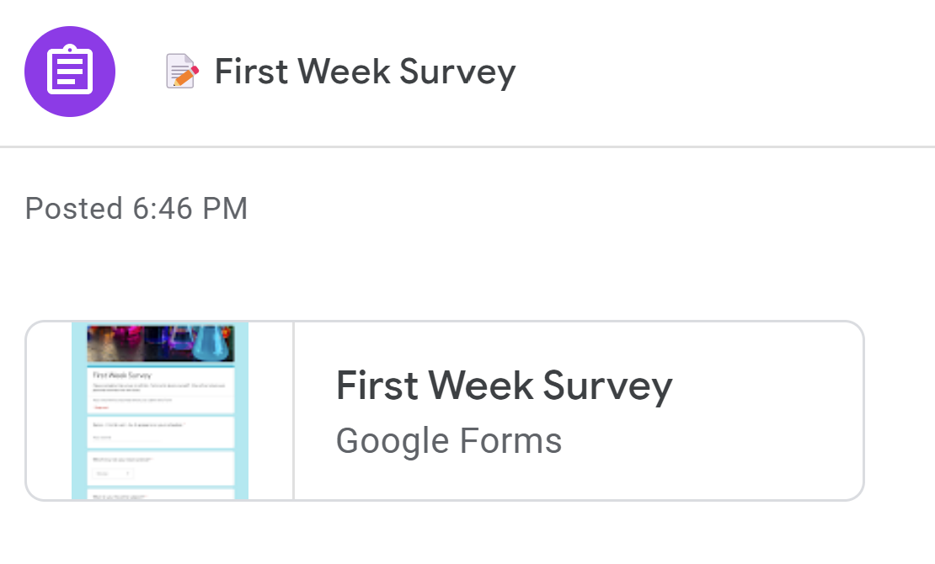
Your second assignment …
Return to Google Classroom
Click CLASSWORK
Click the link to go to the survey
Click FIRST WEEK SURVEY

Slide 14
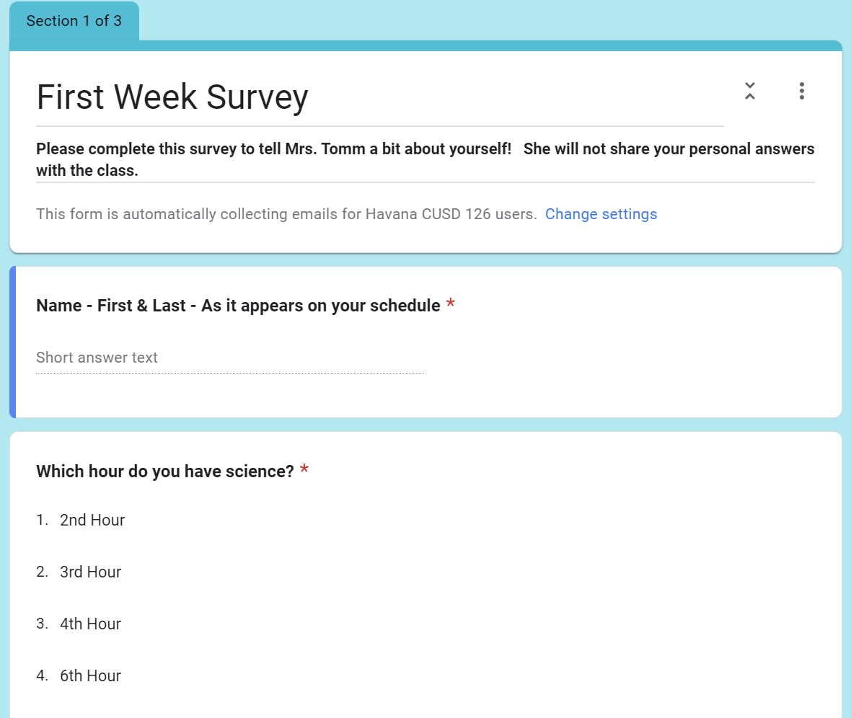
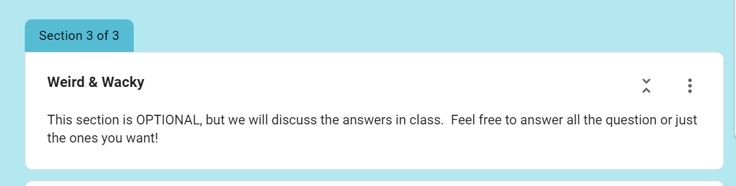
Your second assignment …
Answer the questions on the survey.
I will NOT share your answers with the class.
We will discuss the results on Monday.
Section 3 is OPTIONAL – you do not have to answer any of these if you do not want to.

Slide 15
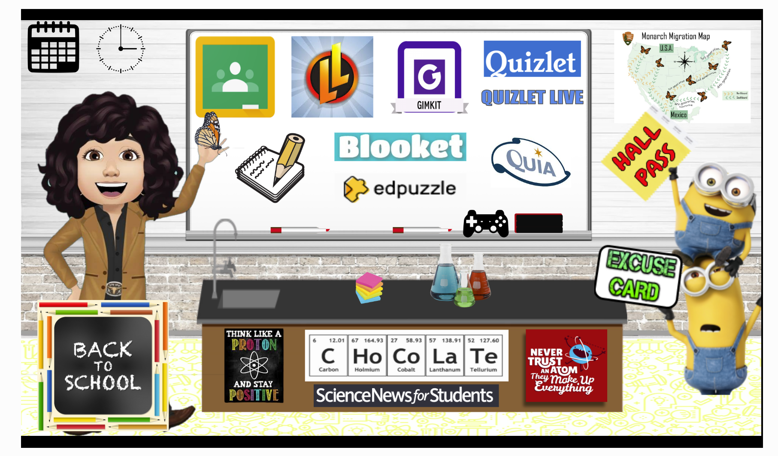
Done with the survey?
Go to mrstomm.com and find the game controller.
Use the remaining class time to explore some of my favorite science websites – games, cams, & apps!
NOTE: This is NOT free game, music, or video time – you need to explore ONLY the sites I have listed on the Free Time Sites webpage!
Need the new schedule? Click the clock above my avatar!

Slide 16
At the end of each class, you will…
Work on the class activity or assignment (or other homework) UNTIL I tell the class to pack up.
Stay in your chair until the bell rings.
Push in your chair.
Leave the room in an orderly manner.
NOTE: If you have a question about an assignment, you should come up to my desk before you leave class.
Waiting to enter? Stand with a shoulder along the wall so you don’t crowd the hallway.

Slide 17

Welcome to Day 2!
Find your seat.
Get out your laptop.
Stash your bookbag UNDER the table.
Go to Google Classroom → Classwork.
Open your Science Starter assignment.
Wait quietly for class to begin!

Slide 18
Enter your answers in this box.
Questions?
← New Option - Click the arrow to minimize the left side of the slide.

Slide 19

Science Scramble – Year of Science
THURSDAY
Can you unscramble all the words below?
Hint: The first letter of each word is underlined.
CMHERIYST
1. Study of elements & compounds
AMNIASL
2. Living things such as humans
PYHCSIS
3. Study of motion and forces
FECNSIORS
4. Crime scene investigation
GESTINEC
5. Study of DNA & traits
mrstomm.com → Daily Agenda → Word Unscrambler

Slide 20
Science Scramble – Year of Science
THURSDAY
The answers are …
CMHERIYST
1. Study of elements & compounds
CHEMISTRY
AMNIASL
2. Living things such as humans
ANIMALS
PHYSICS
PYHCSIS
3. Study of motion and forces
FORENSICS
FECNSIORS
4. Crime scene investigation
GENETICS
GESTINEC
5. Study of DNA & traits
If you had the wrong answer or did not write down all the parts, make corrections as we go over the answers.

Slide 21
QNS #
Did you register your laptop? If not, you need to do so right now.
Go to havana126.net
Click MENU & find HJHS Student Zone.
Click Laptop Registration Form
Enter the information and submit.

Slide 22
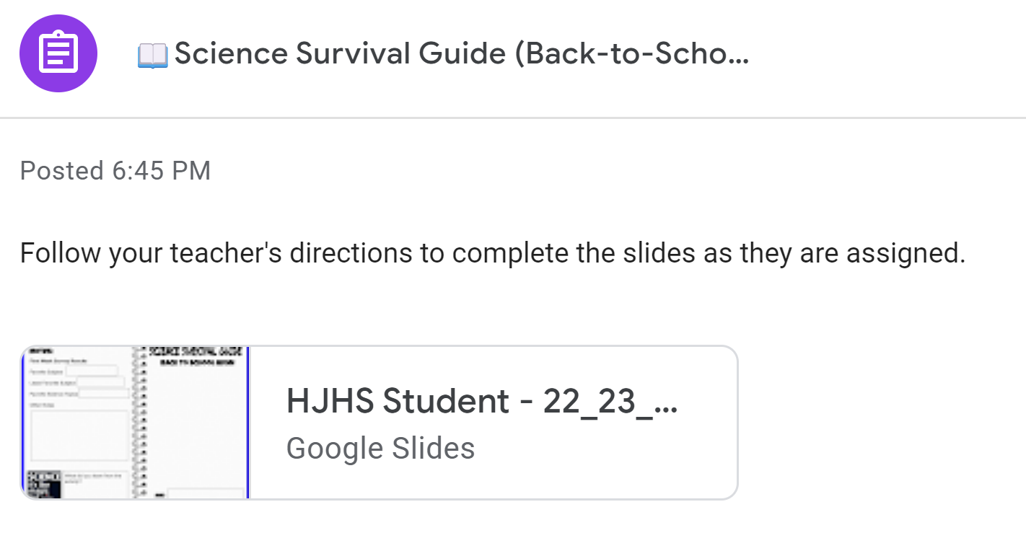
Your first HDSN …
Click CLASSWORK
Click Science Survival Guide
Click the assignment link & wait for your file to load
← New Option - Click the arrow to minimize the left side of the slide.

Slide 23
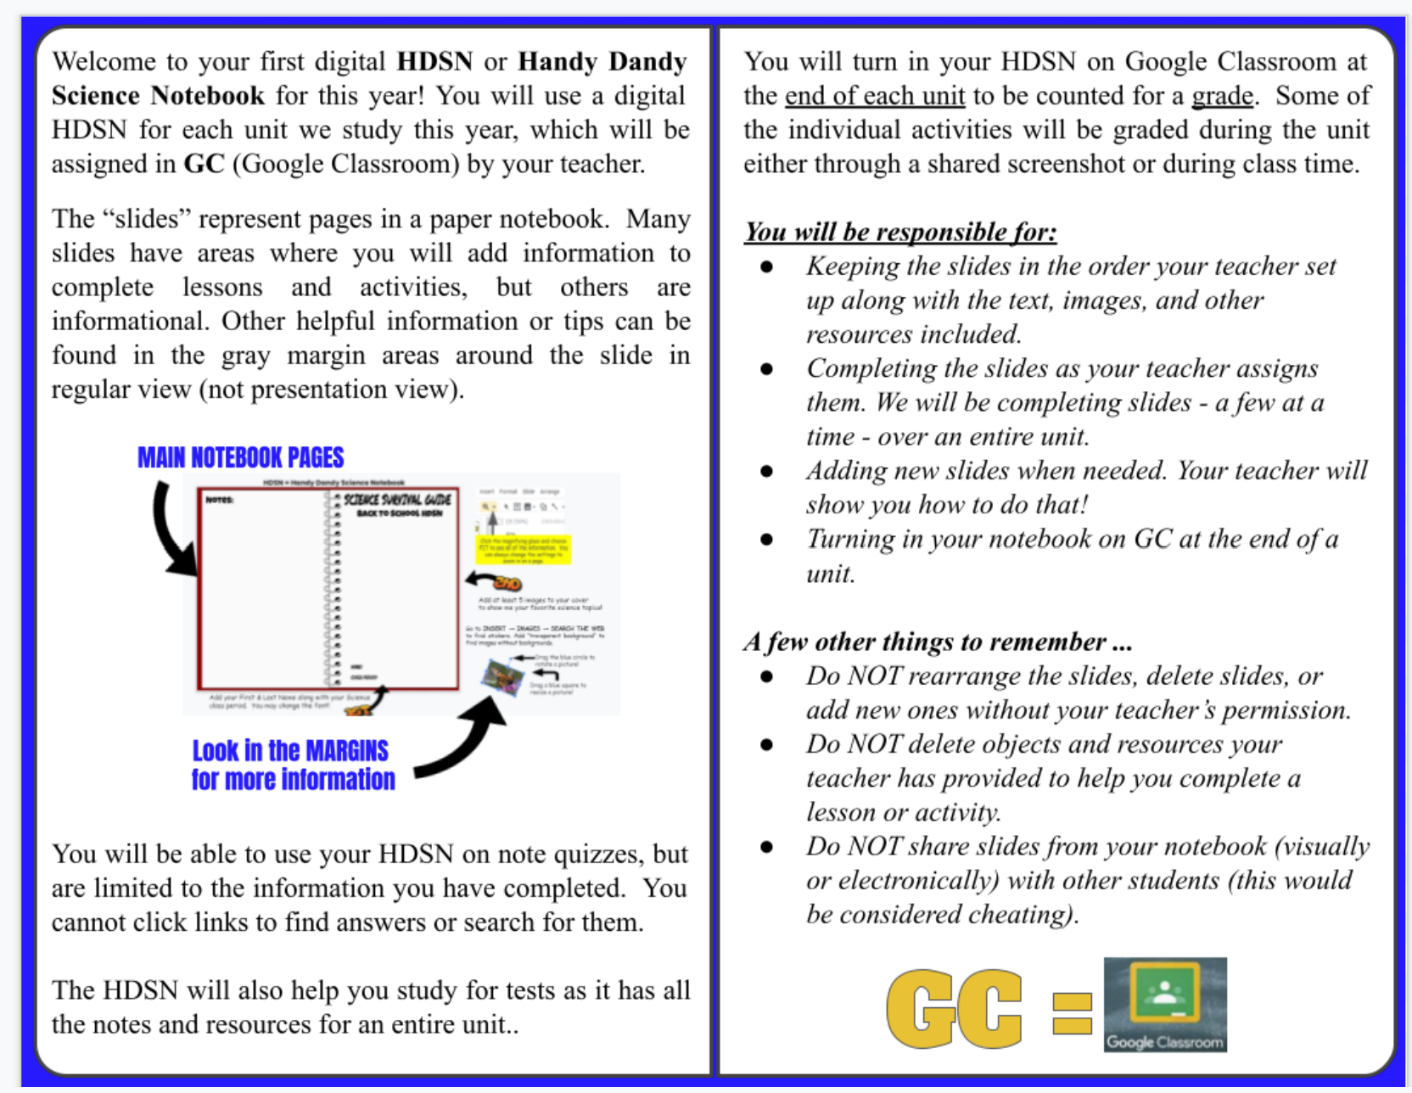
Go to slide 2 and follow along with the teacher.

Slide 24
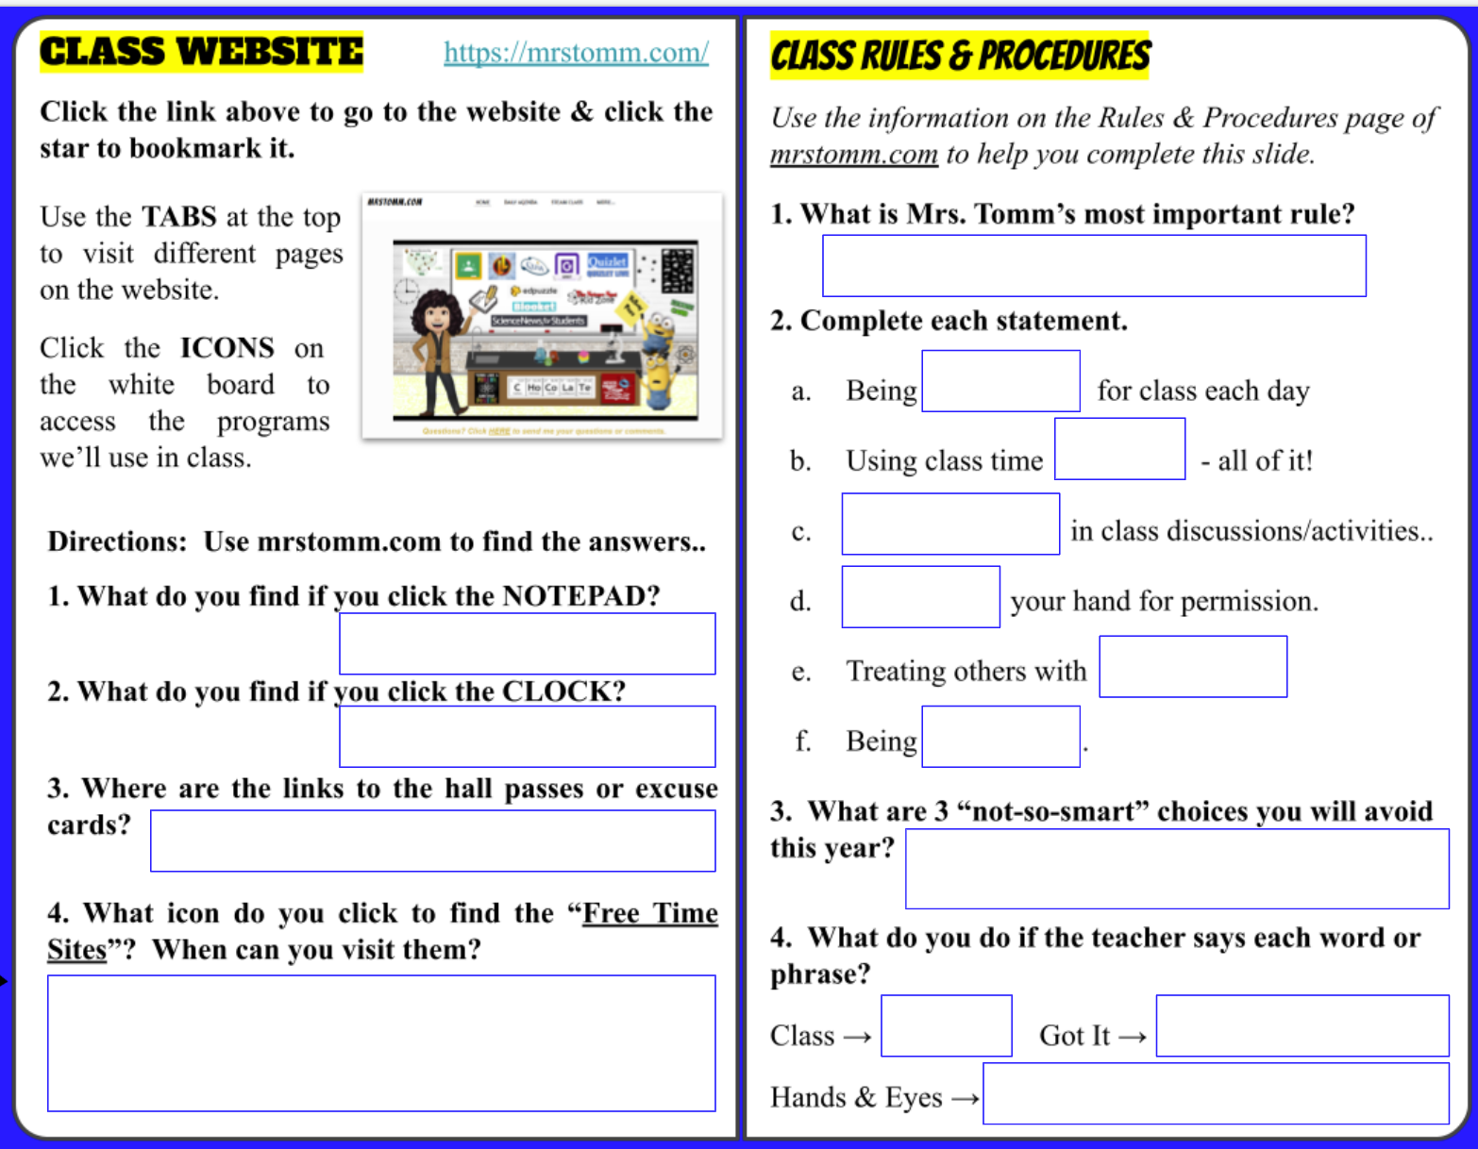
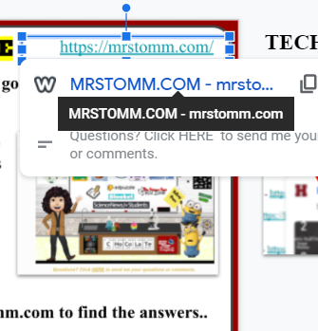

Go to slide 3 and follow along to answer the questions on the LEFT side.
Let’s use TAB RESIZER to see two windows at the same time.

Slide 25
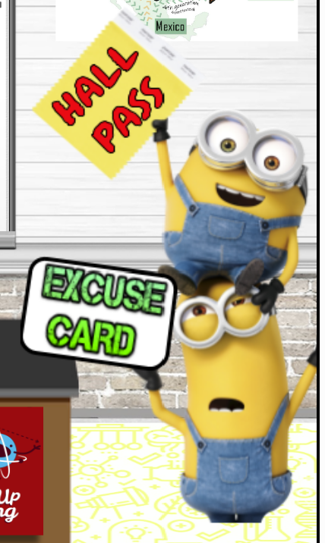
Daily Agenda
(Weekly assignments)
Bell Schedules
By the minions
Game Controller
You may visit the sites after all classwork is done and you have the teacher’s permission

Slide 26
Click “Rules & Procedures” at the top of mrstomm.com
​Being PREPARED for class each day includes being on time for class, having your laptop (charged), completing class work before it is due, and bringing any other materials you need. You should also turn off your phone (& other personal electronic devices) and keep it in your bookbag)
Using class time WISELY - all of it - from the first minute to the last! Use your time to focus on your class work or work/interventions from another class when you have extra time.

Slide 27
​
PARTICIPATING in class discussions and activities by paying attention, checking your notes, and answering questions.
RAISING your hand for permission to ask/ or answer questions, to leave your seat, or to help another student.
Treating others with RESPECT by showing positive attitudes & actions towards everyone, keeping your hands off other people's property/belongings, and keeping your hands/feet to yourself. You should not gossip about other students and teachers. Most importantly, do not disrupt class and make it difficult for others to learn or hard for me to teach. ​

Slide 28
Being HONEST by doing your own work to the best of your abilities. You should not copy answers from an online source, copy someone else's work, or allow others to copy your work.
Cheating = Zero scores for all involved!
It’s OK to give help or hints.
It is NOT OK to give answers!

Slide 29
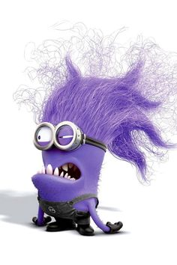
WHICH 3 WILL YOU TRY YOUR BEST TO AVOID THIS YEAR!
Listening to music, watching videos, or playing games when you should be working on class work.
Putting up your materials and waiting for the bell to ring.
Not having your laptop charged for the day.
Borrowing materials without asking (or hiding them).
Messing with another student's stuff, such as pushing buttons on their laptop.
Calling other students names or talking about them when they are not in the class.
Keeping your cell phone on the table or in a pocket - pants or hoody.
Walking around the room to chat with a friend.
Cheating by copying answers from another student or using other
online resources during quizzes/tests.
Distracting other students making it hard for them to stay focused and able to
learn, such as making noises or talking to people at your table.
Making it hard for your teacher to enjoy teaching!

Slide 30
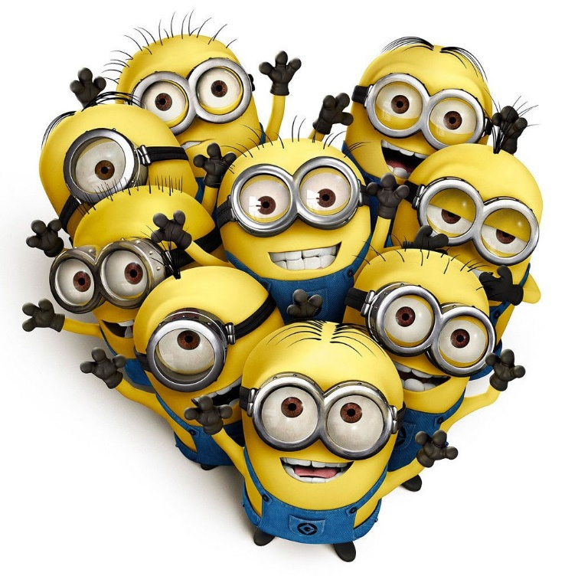
Consequences
​If you are not making smart choices, I will give you a warning to let you know you need to correct your behavior/actions.
If I have to warn you again, you will fill out an excuse card.
If I have to continue to warn you, you may have to fill out more excuse cards, which will result in after-school detentions. You will also be referred to the office and phone calls or emails to parents will be made.
Let’s all be SMART MINIONS!

Slide 31
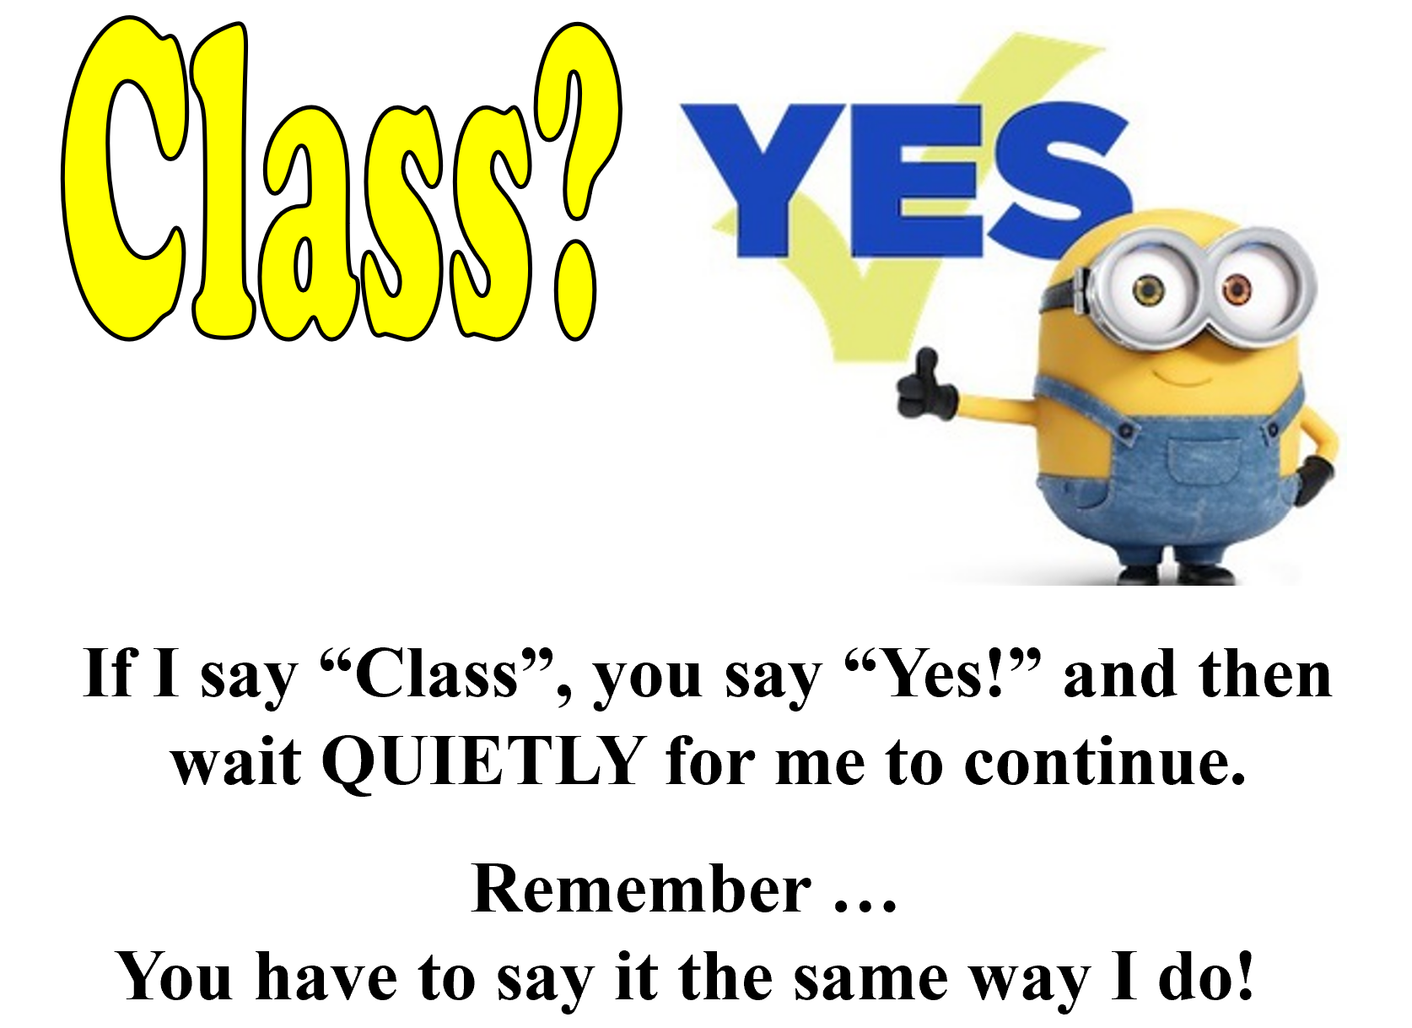
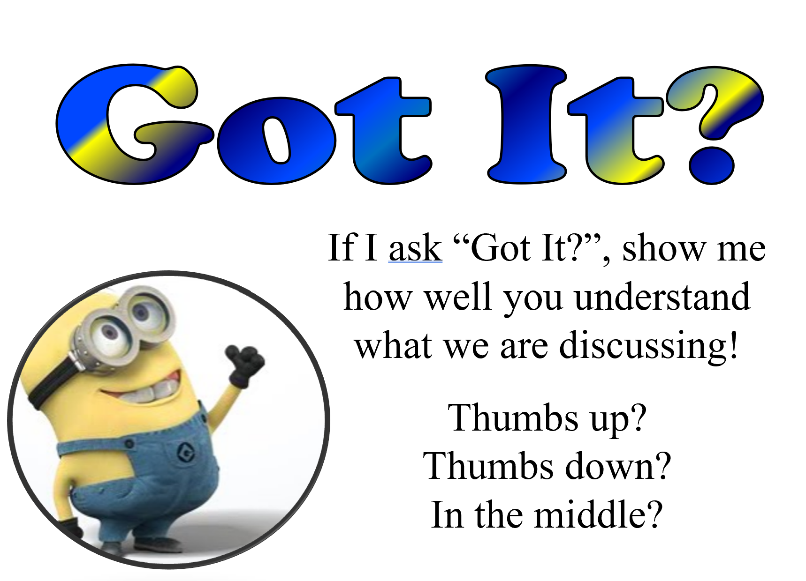

?

Slide 32
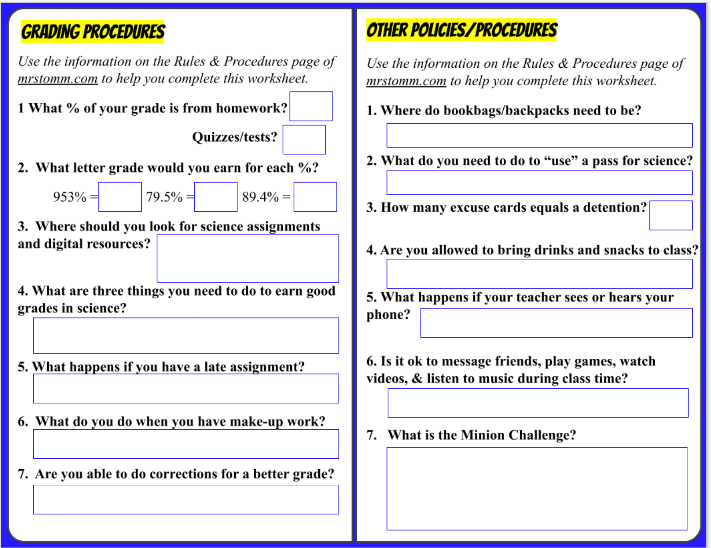
YOUR ASSIGNMENT: Use the Rules & Procedures page to help you answer ALL the questions on Slide 4.

Slide 33
At the end of each class, you will…
Work on the class activity or assignment (or other homework) UNTIL I tell the class to pack up.
Stay in your chair until the bell rings.
Push in your chair.
Leave the room in an orderly manner.
NOTE: If you have a question about an assignment, you should come up to my desk before you leave class.
Waiting to enter? Stand with a shoulder along the wall so you don’t crowd the hallway.

Slide 34
TGIF
Find your seat. Day #3
Get out your laptop & open your Science Starter assignment.
Stash your bookbag UNDER the table.
Get quiet!

Slide 35

Please, please, please …
If you are waiting to enter the classroom, stand in a line along the hallway (touching the wall) so you don’t crowd the hallway.

Slide 36
FRIDAY
Super Scientists
Can you unscramble all the words below?
Hint: The first letter of each word is underlined.
GOLOZOIST
1. Studies animals
LEGOGOIST
2. Studies rocks & minerals
MCHSEIT
3. Studies atoms & molecules
ISOLTOBGI
4. Studies living things
GSEISOSLOMIT
5. Studies earthquakes
mrstomm.com → Daily Agenda → Word Unscrambler

Slide 37
FRIDAY
Super Scientists
The answers are …
ZOOLOGIST
1. Studies animals
GOLOZOIST
GEOLOGIST
2. Studies rocks & minerals
LEGOGOIST
CHEMIST
3. Studies atoms & molecules
MCHSEIT
BIOLOGIST
4. Studies living things
ISOLTOBGI
GSEISOSLOMIT
5. Studies earthquakes
SEISMOLOGIST
If you had the wrong answer or did not write down all the parts, make the correction
as we go over the answers. Red underlining means it is misspelled.

Slide 38
Quick Review
Where do you look for the daily assignments?
GC or mrstomm.com → Daily Agenda (or notepad)
Where are the links to the passes and excuse cards?
mrstomm.com → By the minions or under MORE tab
What do you do with your backpack?
Stash it under your chair or table – all the way under!
How often will we have a quiz for Science Starters?
Every three weeks

Slide 39
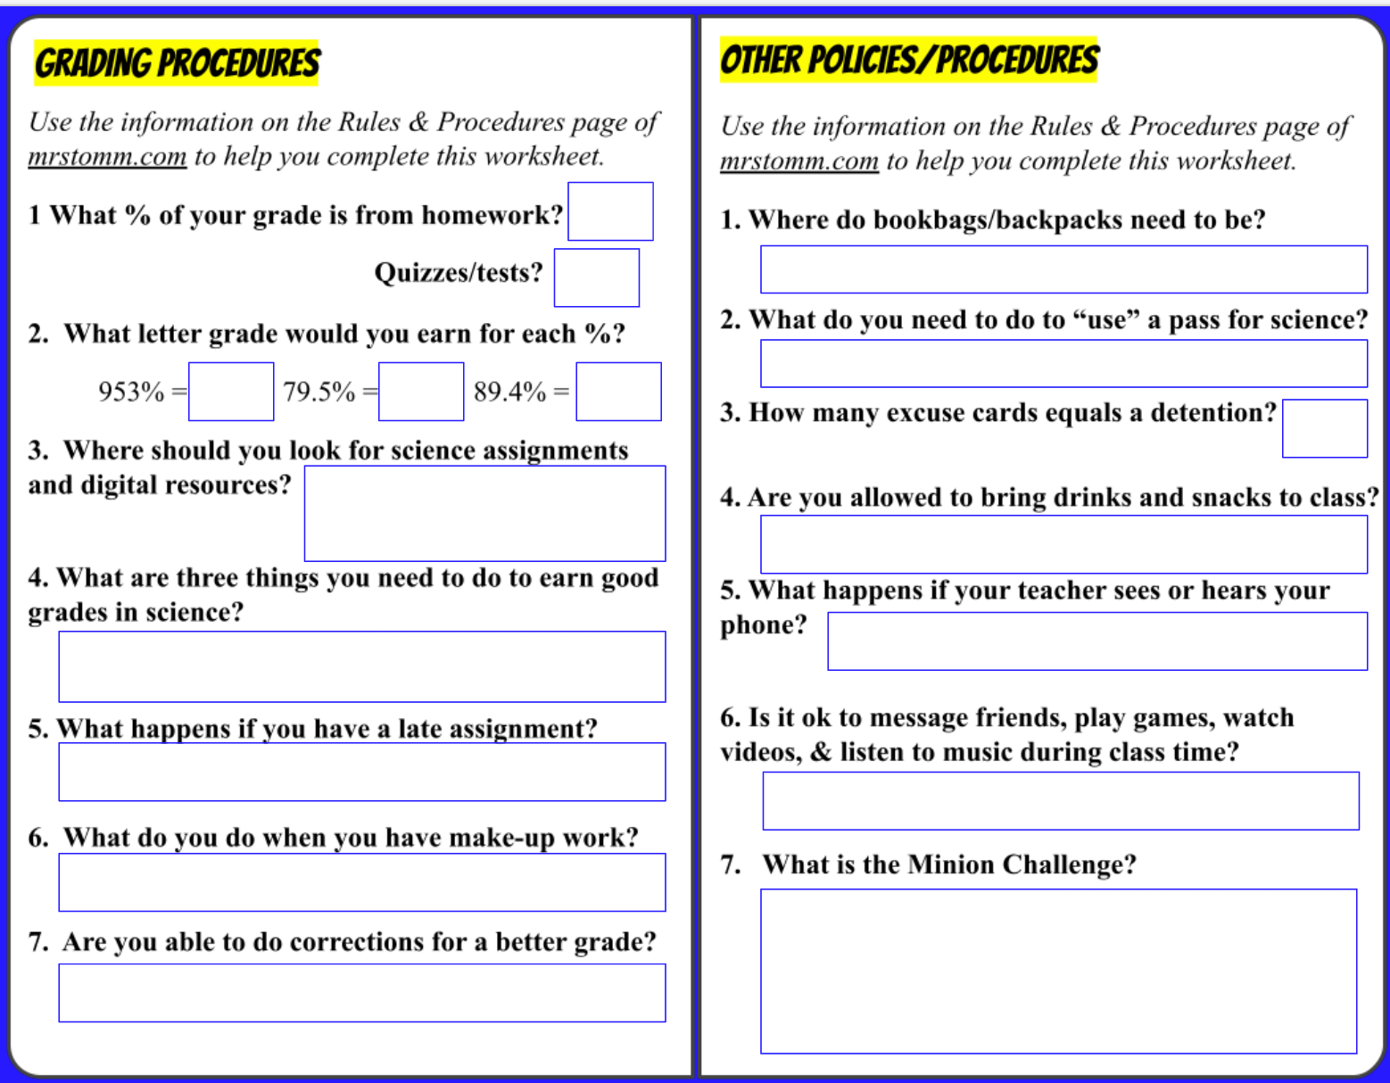
Open your HDSN & go to Slide 4

Slide 40
We will have a lot more homework grades than quizzes & tests.
One bad quiz/test grade will hurt your grade more than one bad homework grade.
50%
50%
A
C⁺
B+
Daily Agenda (mrstomm.com)
&
Google Classroom → Classwork

Slide 41

ZERO GRADES are grade killers! One zero can cancel out several good grades!
50%
50%
A
C⁺
B+
How do you earn good grades in science?
Good attendance - Attend class every day so you don't miss what we do in class. If you do miss class, be sure to get your make-up work done on time!
Good participation - Participate in class discussions and activities by sharing ideas and asking questions.
​Good effort - Do your best on everything! Don’t rush through to just to get it done!
Daily Agenda (mrstomm.com) &
Google Classroom → Classwork
Check ALMA daily – let the teacher know if you have questions.

Slide 42
50%
You can earn full credit on a late assignment if you:
Fill out an excuse card,
Complete the assignment,
Submit on Google Classroom, and
E-mail the teacher within 5 days of the assignment's due date.
50%
A
C⁺
B+
Daily Agenda (mrstomm.com) &
Google Classroom → Classwork
Good attendance, good participation, & good effort
Earn a ZERO (unless you fill out an excuse card and complete it!)

Slide 43
What does “not cumulative” mean?
M T W Th F
50%
50%
Absent
Day 1
Day 2
Absent
Day 1
Day 2
A
C⁺
B+
Absent
Day 1
Day 2
Daily Agenda (mrstomm.com) &
Google Classroom → Classwork
NOT # of days absent x 2
Makeup Time =
# of days absent + 1
Good attendance, good participation, & good effort
Earn a zero → Excuse care for credit
Check the Daily Agenda to see what you need to make up.
Complete the work, turn it in, & email the teacher.

Slide 44
Corrections (Half Credit):
​
Regular quizzes & tests:
Corrections may be made using the form provided by the teacher. All corrections must be turned in within five school days of the quiz/test date.
Note Quizzes/Tests:
No options for corrections will be available as you should have been prepared for the quiz/test.
Homework:
​Corrections may be allowed if sufficient effort has been shown on the first attempt, class notes and activities are completed, and I feel you deserve another chance to show me what you have learned.
50%
50%
A
C⁺
B+
Daily Agenda (mrstomm.com) &
Google Classroom → Classwork
Good attendance, good participation, & good effort
Earn a zero → Excuse care for credit
Check the Daily Agenda to see what you need to make up. Complete the work, turn it in, & email the teacher.
Yes, you can correct ALL regular quizzes and tests.

Slide 45
Under your table (or chair)
No old lady trip hazards!
You need to ask permission & fill out the form and submit it.
NOTES:
You should not ask to use a pass during a class activity UNLESS it is an emergency.
One person at a time.
Do not waste time or roam around to places you should not be during the day.
I will not limit you to a specific number of passes as long as you do not make it a daily habit. If you abuse the privilege, you will lose it!
If you do not submit a pass, you will be assigned a excuse card.
​

Slide 46
Reasons for an excuse card:
Late to class without a pass.
Need to charge your laptop.
Forget to submit a pass slip.
Not making smart choices.
Did not complete an assignment on time.
What are the consequences for excuse cards? Four or less excuse cards will not result in consequences. The fifth excuse card will earn you an after-school detention (30 min) with the teacher.
Examples:
#1 - 4 = No Consequence
#5 = After-school Detention
#6-9 = No Consequence
#10 = After-school Detention
#11 - 14 = No Consequence
#15 = After-school Detention
#16 - 19 = No Consequence
#20 = After-school Detention
Under your table (or chair)
Ask permission, fill out form
5
​
NOTE: Excuse cards do not disappear at the end of the quarter!​ ​ They will disappear at the end of the school year!

Slide 47

Yes → Water & Gum
No → Soda, snacks & candy
(Only on reward days or as a prize from another teacher.)
Under your table (or chair)
Ask permission, fill out form
5
Goes to the office!
Phones should be turned off and put away in your bookbag during class time and in the hallways.

Slide 48
Under your table (or chair)
Ask permission, fill out form
5
Water & gum only
Only with your teacher’s permission EACH TIME!
Goes to the office
Class time is for classwork!
(This also applies to study hall!)

Slide 49
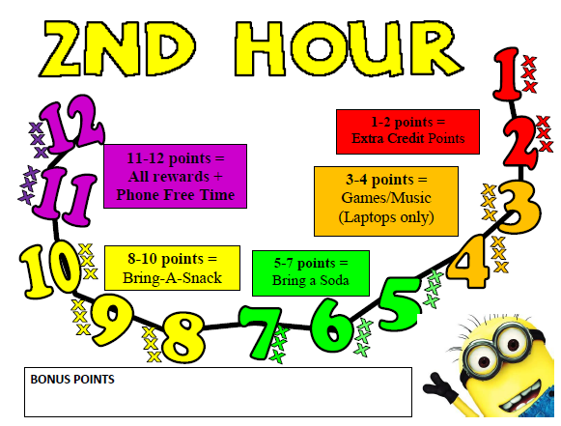
Each class has a chance to earn 12 points every 3 weeks. The points you earn will determine the rewards you get to enjoy on Fun Fridays.
Your class will LOSE points for not making smart choices, such as:
Not completing homework,
Being late to class,
Wasting class time,
Being too loud or off task with non-class chatter,
Being disrespectful, and
Overall behavior problems that makes learning difficult.

Slide 50
NOTE: The THREE STRIKES will apply to homework
completion, science starters, tardies, etc.
Examples include:
Three people not completing/turning in an assignment on time will result in the loss of a point.
Three people not being to class on time will result in the loss of a point.
The third time I have to remind the class to
make smart choices will result in the loss of
a point.

Slide 51
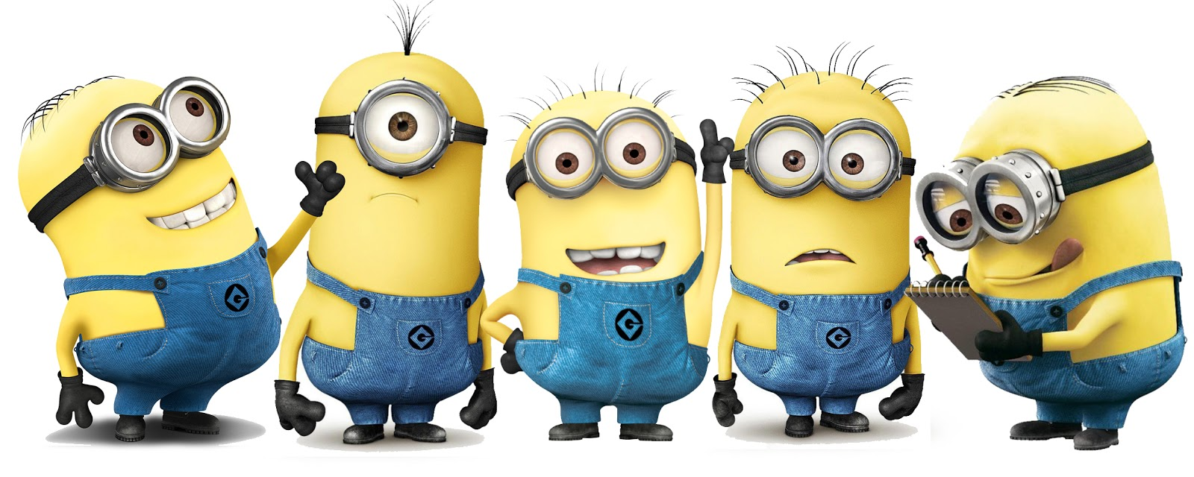
MINION CHALLENGE BONUS:
At the end of the semester, the class with the
MOST POINTS OVERALL will earn all rewards, brownies & a
110% on the Science Starter quiz
(without having to take the quiz!)

Slide 52
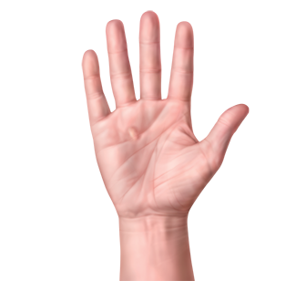
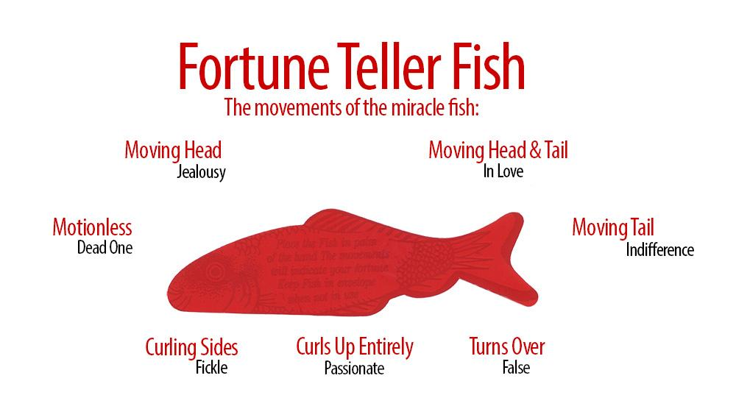
What’s your fortune?
Get a “miracle fish” from your teacher.
Find the open end of the package and take out the fish CAREFULLY.
Place the fish (longways) in the palm of your RIGHT hand & make observations.
Use the chart on the package to interpret the movements.
What does your
fish say?

Slide 53

How does your fish “read” your mind?
Can you get your fish to say something different? Do some experimentation!
Try placing it on the palm of your left hand.
Try placing it on your arm.
Try placing it on your pants or clothing.
Try placing it on the table.
Try laying it flat and placing it under your laptop.
What would be different about your hand compared to other surfaces?

Slide 54

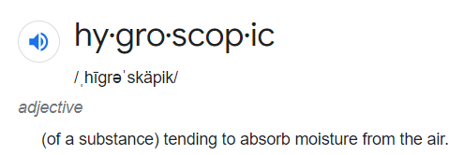
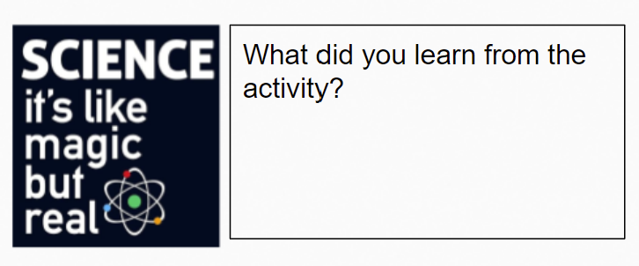
What’s the science?
What happens to a sponge when it is near water?
What if only part of the sponge is in water?
Only the parts of the fish that touch water absorb it, causing those parts to expand. This causes the fish to “move”.
Add answers to the box on Slide 1.
CHALLENGE: Find other items that are hygroscopic. How do they compare to the Fortune Fish?

Slide 55
What should the fish really be telling you?
I think these would be better options …
Needs candy
Needs candy
Needs to wake up
Needs candy
Needs candy
Needs candy
Needs candy

Slide 56
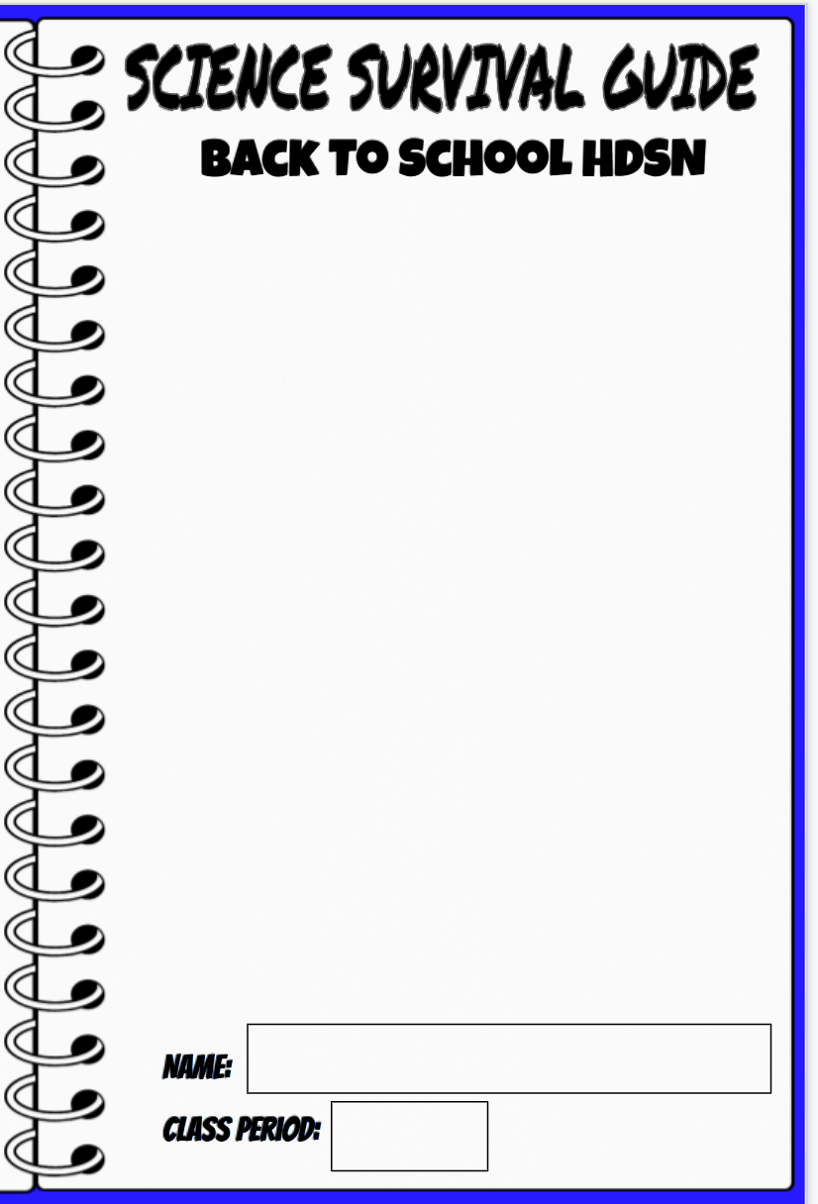
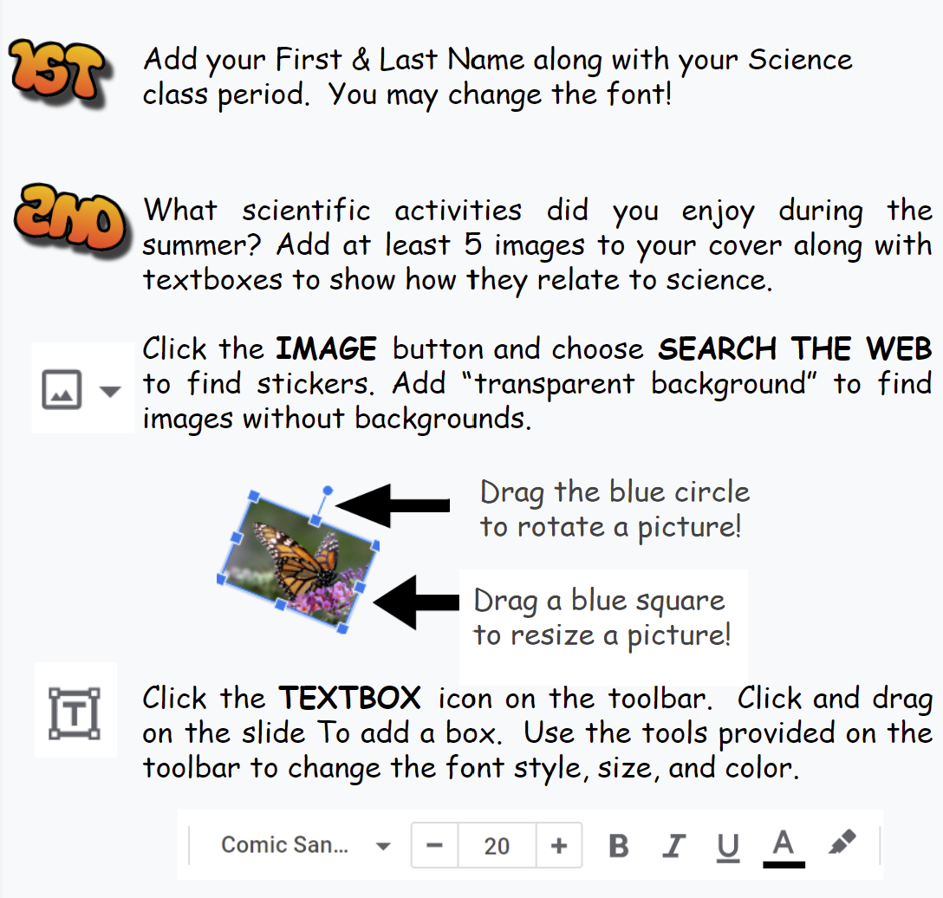
Assignment: Decorate your cover by adding at least 5 images related of things you did this summer. Add textboxes to explain how each of them relates to science.
https://docs.google.com/presentation/d/1HMqtxR1F0efo1vjc4zPT-POzODzeyD6eLlZdEb_MVYk/edit?usp=sharing

Slide 57
At the end of each class, you will…
Work on the class activity or assignment (or other homework) UNTIL I tell the class to pack up.
Stay in your chair until the bell rings.
Push in your chair.
Leave the room in an orderly manner.
NOTE: If you have a question about an assignment, you should come up to my desk before you leave class.
Waiting to enter? Stand with a shoulder along the wall so you don’t crowd the hallway.

