Slide 1

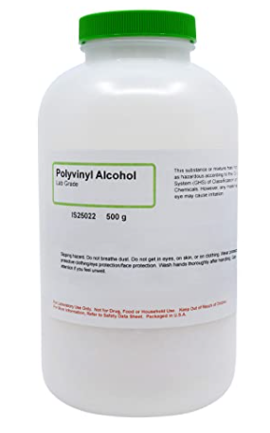
Video Lesson (used with my remote students)
https://drive.google.com/file/d/1wFs--RyJ-J5Yk9HfyMITBHlLh3k4YUBJ/view?usp=sharing
Digital Student Assignment (Slides)
https://docs.google.com/presentation/d/1xPCURnm6JcWtBh9T7f176gW6rMqBqbBOFjzEQeIwxp8/copy
Background/Resource:
https://www.exploratorium.edu/snacks/spinning-cylinder
This presentation was developed by T. Tomm 2020, https://sciencespot.net/
Science of Spin
What does PVC mean?
What is it made from?
How is it used? Why?
Polyvinyl Chloride
Derived from oil and mixed with salts and/or other additives depending on its uses
Plumbing - Strong, can be made in different diameters, doesn’t rust like metal pipes, lower cost/foot than metal pipe
COVID Procedures…
Markers → One bag of markers; pick ONE person to be the labeler.
Sharing → Avoid touching other students’ spinners or sharing markers.

Slide 2

PART A: INTRO
How would you describe your piece of pipe? List at least 5
characteristics on your worksheet.
Complete BOX A as you watch the video.
Color?
Length?
Shape?
Hardness?
Writing?
Thickness of walls?
Diameter?
Mass?
Volume?
Length vs Diameter?
Practice the “spin” …
Spin your pipe by pushing down on one end while pulling back towards your body. Practice until you can get it to spin and stay on the table. Try to notice the direction it spins (CW or CCW), number of times it spins, how long it spins, and other details about the spin.
PUSH DOWN HERE
Before you go on … Label the pipe with colored circles.
O
X

Slide 3
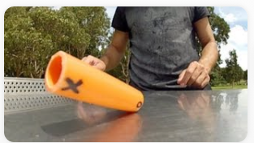
Part B: Going Further
Discuss It: What will happen when we spin the pipe by applying the force to an end of the pipe?
Complete BOX B as we discuss this section.
Try several spins by pushing on the X end of the pipe. What do you observe?
Try several spins by pushing on the O end of the pipe. What do you observe?
Write your observations in BOX B.
You should have noticed the pipe spins CCW (counterclockwise) if you apply the force to the X end of the pipe and you mostly (or entirely) see the X.
If you applied the force to the O end, it spins CW (clockwise) and you mostly (or entirely) see the O.
Part A

Slide 4
O
TOP VIEW
X
Before we go on …
Draw a SQUARE under the CIRCLE.
Draw a TRIANGLE under the X.
○
BOTTOM VIEW
❐
Discuss It: What will you see when you spin the pipe this time?
Try several spins by pushing on the different ends of the. What did you observe? Which shapes/symbols did you see? How many times?
Write your observations in BOX B.
When you apply the force to the X end of the pipe, you see the X and the triangle, which is on the underside at the same end of the pipe.
When you applied the force to the O end, you see the O and the square, which is on the underside at the same end of the pipe.
Why is this happening?

Slide 5
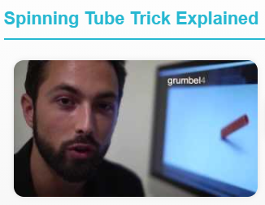

Part C: EXPLAIN IT - Explain the science of the spin using your observations.
FORCE
The pipe is rotating in one direction around the x-axis at the same time it is spinning around the y-axis.

Slide 6
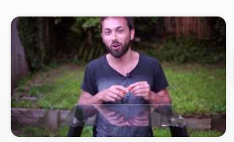
Challenge Questions
Challenge 1: How would using a shorter piece of pipe affect your observations of Xs & Os?
Long vs. Short
What did you predict? Were you correct? Explain.
Glass Table A
Challenge 2: What would happen if were to spin it on a piece of glass? What would you see from “underneath”?
Watch the A video and make a prediction.
Watch the B video. Were you correct? Explain.
Glass Table B

Slide 7
Rules:
You are allowed to take your spinner home today.
Keep it put away in your backpack until you get home. If you have it out, it will be confiscated and returned to the teacher.
Teach your parents about the science behind the spinning tube!
What else could we investigate about the spinner?
Decorated with different patterns
Different ways of spinning
Applying pressure at different spots

