Slide 1
Playing with
QUICK LINKS
Polymer Notes
Safety Rules
Gloop
Boogers
Goobers
Super Slime
Slime Tests
POLYMERS
Science of Slime
T. Tomm Updated 2023 https://sciencespot.net/
Teacher information & the original (paper version) is available at https://sciencespot.net/Pages/classchem.html#Anchor-poly
Student Digital Notebook – Click HERE to access!

Slide 2
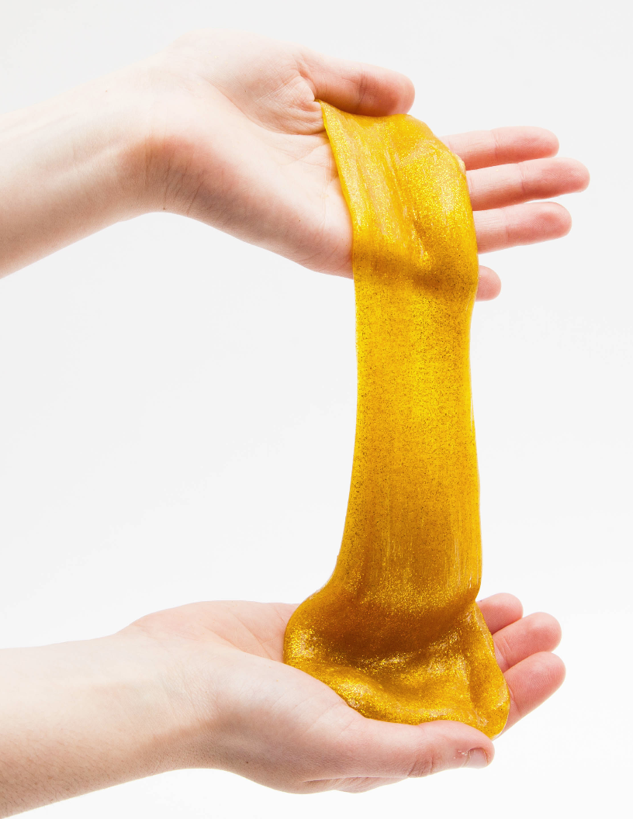
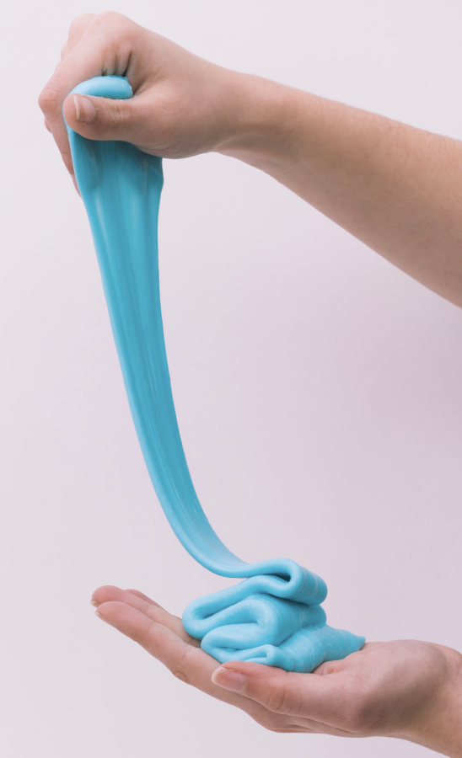
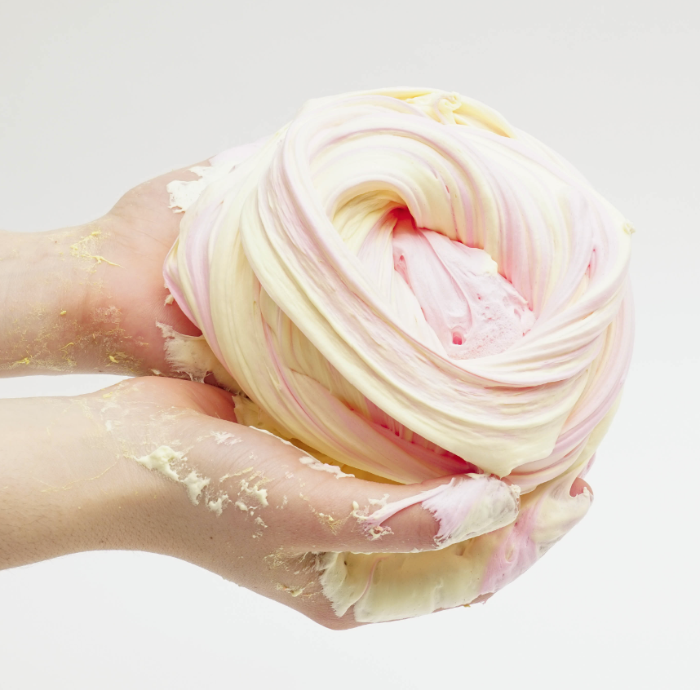
What words would you use to describe slime?
Slimy
Gross
Cool
Slick
Sticky
Messy
Fun
Colorful
Directions: Fill out slide 1 as you watch the video. We will review the answers in class for any you miss.

Slide 3
Slide #1 - Polymer Basics: Watch the “Polymers from DNA to Silly Putty” video complete this section.
1. ______________are large molecules made of smaller repeating units called ______________.
2. What does each mean? Poly = Mono = Mers =
POLYMERS
MONOMERS
MANY
ONE
PARTS
MONOMER + MONOMER + MONOMER
POLYMER

Slide 4
NATURAL
3. A ____________ polymer is made from living things, such as plants and animals. Examples include:
Complex _____________________are made of simple sugars.
______________is found in trees and plants.
_____is made of nucleic acids that contains the ____________ information our bodies need to make proteins, which are polymers made of chains of _________acids.
___________ makes up feathers, hair, and fingernails.
__________ makes up the exoskeletons of many arthropods.
CARBOHYDRATES
CELLULOSE
DNA
GENETIC
AMINO
KERATIN
CHITIN (“kite-in”)

Slide 5
Natural Polymers
https://www.barnwell.co.uk/what-is-a-polymer/

Slide 6
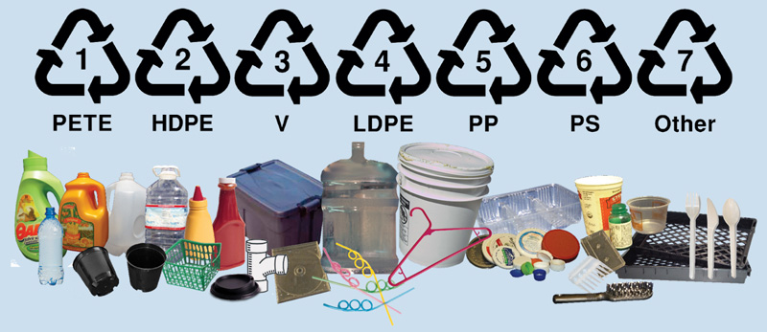
SYNTHETIC
4. Man-made or ______________polymers are made from _____________________, which are chemicals formed from petroleum products. Examples are:
____________ was the first synthetic polymer.
_______________ is made of styrene and break down slowly leaving behind toxins.
____________ come in many varieties and do not completely break down and can cause problems for marine life.
PETROCHEMICALS
BAKELITE
STYROFOAM
PLASTICS
https://exchangeorcas.org/the-realities-of-plastic-recycling/

Slide 7
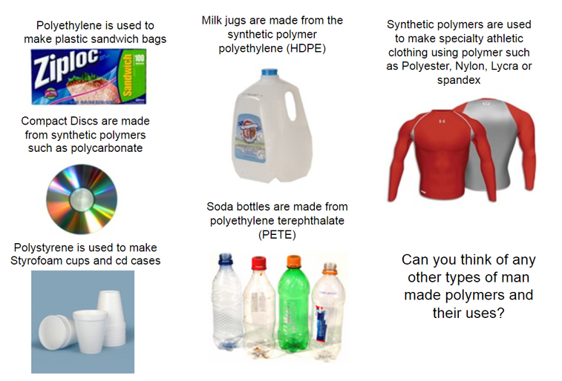
Synthetic Polymers
https://www.barnwell.co.uk/content/uploads/2017/10/Man-Made-Synthetic-Polymers.jpg

Slide 8
5. Polymers form by two types of chemical reactions – _______________ and __________________.
6. The ______________ of polymers depend on the types of _______________ they contain and how they are _______________.
ADDITION
CONDENSATION
PROPERTIES
MOLECULES
CONNECTED
What words would you use to describe slime?
Slimy
Gross
Cool
Slick
Sticky
Messy
Fun
Colorful

Slide 9
Slide #2 - Safety Rules
Read directions carefully! Ask for help if needed and do not make up your own recipes!
(2) Goggles and aprons should always be worn when experimenting with chemicals.
(3) WAFT! Do not sniff directly from the container!
WAFT – Hold it several inches away from your face and use your hand to wave fumes towards your nose.
(4) No eating or drinking during the lab. This also means that you should NOT eat the slime or taste any substances used to make slime!

Slide 10
Do not put the slime where it doesn’t belong, such as on CLOTHING, carpeting, or other people! Keep your slime out of reach of small CHILDREN and PETS.
(6) DISPOSE of slime materials properly. All slime must be THROWN away in the trash can. Use a DRY TOWEL to clean your hands BEFORE you wash them with soap. DO NOT put any amount of slime in the SINK!
(7) Clean up MESSES immediately as well as at the END of class!
8) WASH your hands before you leave class.
(9) BEHAVE! No hitting, shoving, or other HORSEPLAY is allowed! Do not take or mess with anyone else’s slime.

Slide 11
Slime must remain in the classroom until the end of the day on Thursday, December 21st! No slime or slime stuff should be taken out of my classroom before that time.
NOTE: Most of the slime will keep for 3-4 days. If your slime goes bad, throw it away! Do not dump in a sink!
WARNING: You will receive a grade for this activity along with your grade on the note quiz. Any behavior issues or failure to follow the safety rules will result in a zero grade for the activity AND you will not get any slime you make.
Also … anyone who has science work to do OR are missing work from any other class will need to work on those assignments BEFORE making slime!

Slide 12
Gloop
?
Ingredients: White glue & Borax solution
White glue contains PVA (polyvinyl alcohol), which is made from oil.
Borax (sodium tetraborate) - Used as a laundry agent and cleaning product.
When you add water to glue, the PVA starts to dissolve in the water. When you add the borax solution, it reacts with the PVA to crosslink. This crosslinking causes the gunk to undergo an irreversible gel-like reaction and forms the slime.
Each person will make their own batch, but share the equipment.
Alternate Assignment: Get a page and copy the information. Turn in to the bin when you are done for your daily lab grade.

Slide 13
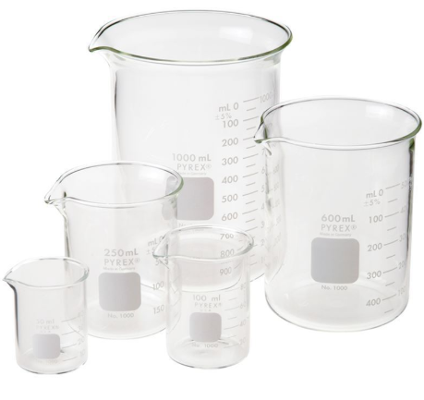
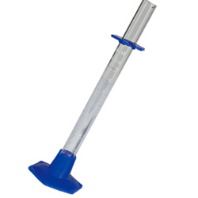
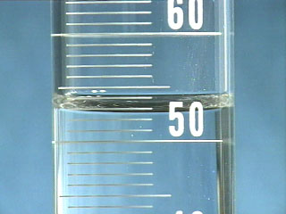
Measuring Volume
Cylinders vs. Beakers
Both used to measure volume
Both are usually graduated with a scale in milliliters
Graduated cylinders provide a more accurate measurement than beakers.
How is this used?
Measure from the bottom of the cylinder up to the bottom of the meniscus, which is the “bubble” at the top of the liquid.

Slide 14
Measuring Volume
What’s the scale? Determine the scale for the graduated cylinder – they are not all the same.
20
40
8
15
30
6
What is the value of each line?
?
?
?
10
20
4
5
10
2
13 ml
26 ml
5 ml

Slide 15
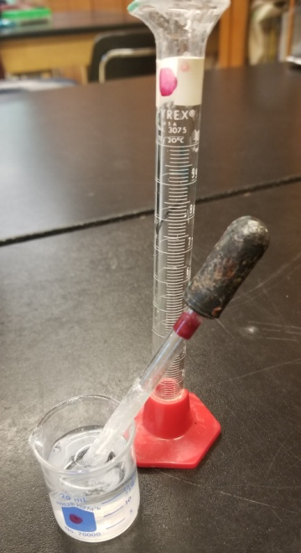
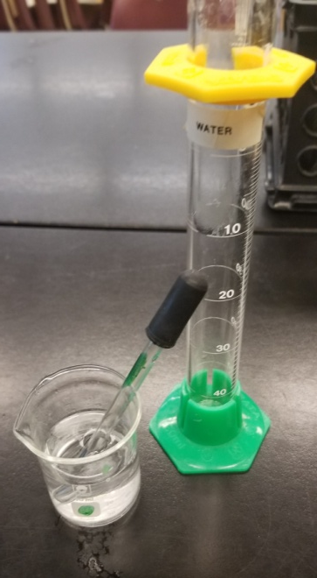
Use the correct equipment – color coded.
BORAX = RED (BOTTOM or DOT
WATER = GREEN
(BOTTOM or DOT)
Be sure to get the correct materials and KEEP them separated on your table.

Slide 16
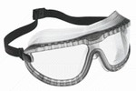
GLOOP - Each person will make their own batch, but SHARE the equipment/supplies.
SIDE COUNTER Each PAIR of students needs:
1 RED graduated cylinder 1 RED dot beaker of BORAX solution 1 eyedropper with RED band 1 GREEN graduated cylinder 1 GREEN dot beaker with water
1 eyedropper (GREEN dot – not red)
1 bottle of GLUE
TABLE BASKET Each PERSON needs: 1 cup
1 stick
1 small bag
1 black marker
1 ruler
Don’t forget your goggles & an apron!
Got everything? Sit quietly so we can begin!

Slide 17
1 – Label your plastic bag – your name and the type of slime.
2 – Make a mark 1cm from the bottom of your plastic cup.
The zero may not be at the bottom of the ruler.
3 – Remove the lid (not just twist it open) from the glue bottle & pour white glue into your cup until you reach the mark.
NOTE: Wipe any glue off the top before you put the lid back on.
T. Tomm
Gloop

Slide 18
4 – Add 2 drops of food coloring to the glue & use the stick to stir.
5 – Use a GREEN BASE graduated cylinder to measure 7 ml of water and add it to the glue. Mix well with the stick.
6 – Use a RED BASE cylinder to measure out 8 ml of borax solution. Add it to the glue mixture and stir.
7 – Stir until it forms a good blob on the stick and soaks up most of the liquid.
8 – Remove the blob from the cup and stick. Work it gently in your hands to get a good consistency. Too sticky? Add borax (one drop at a time) Too stringy? Add glue (one small bit at a time)

Slide 19
Time’s Up …
We will do the slime tests for Gloop on Monday!
Leave the gloop sitting on the table while you clean up.
Remember … no slime stuff in the sink!
Dump extra stuff in the trash!

Slide 20
Clean Up Time
Throw away your cup & stick.
Return materials to the side counter – rinse the Borax cylinder, but leave the solution & water in the small beakers.
Straighten up your table basket. Wipe down your table with a wet towel if needed.
Wipe your hands off with a dry paper towel BEFORE you wash them with soap.
Put away your apron & goggles.
Put your slime in the small baggie and then stash it in the tub on the front counter for your class period.
Done? Work on GIMKIT or other homework. Santa Tracker if everything is done!

Slide 21
Day 2 - Let’s Review …
Gloop
What type of slime did we make the first day?
What was the monomer?
What was used to link them together?
PVA (in white glue)
Sodium Tetraborate (Borax solution)
Time to make some boogers …
unless you have science work to do or grades below 70% in any class!

Slide 22
Boogers
?
Ingredients: White glue & Laundry starch
Laundry starch, used to help fabric resist wrinkling, is a polymer in water, but becomes rigid when it dries. We will use it as the “linking” agent instead of borax.
This one can be very messy!
1 - Don’t dump it out until the teacher gives the OK!
2 - Don’t allow it to get too stringy when doing the slime tests!
Work in pairs to make ONE batch and then split it with your partner!
Alternate Assignment: Get a page and copy the information. Turn in to the bin when you are done for your daily lab grade. (Turn in yesterday’s assignment if you didn’t already do so!)

Slide 23
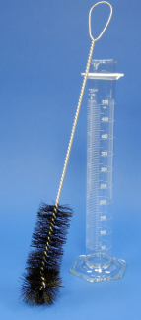
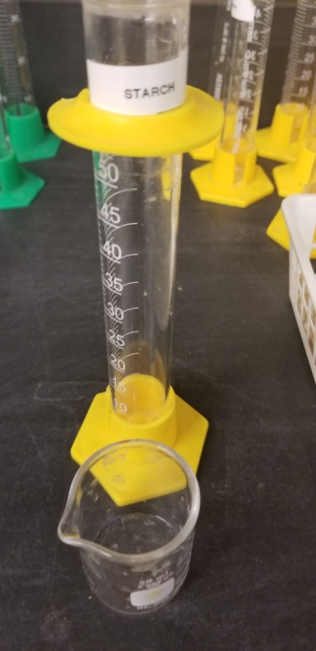
BOOGERS – Each group (2 students) will need:
SIDE COUNTER: 1 YELLOW graduated cylinder 1 YELLOW dot beaker - STARCH
1 bottle of GLUE
TABLE BASKET:
1 small cup
1 wooden stir stick 2 plastic bags
1 ruler (mini)
2 black markers
Share one bag of food coloring with everyone at your table
YELLOW = STARCH
NO EYEDROPPERS!
Don’t forget your goggles & an apron!
Got everything? Sit quietly so we can begin!

Slide 24
1 – Label your plastic bags.
Small bag - Your name & the type of Big bag – Your name
You will use the bigger bag to keep all your slimes together!
2 – Use the marker to make a mark 1 cm from the bottom of the cup.
The silver line marks 0.
3 – Remove the lid from the glue bottle and pour glue to reach the 1 cm of mark.
4 – Add 1 drop of food coloring and stir.
T. Tomm
Boogers

Slide 25
5 – Use a YELLOW cylinder to measure out 14 ml of the laundry starch. Have your partner stir as you pour the starch into the glue.
6 - Once the slime forms ONE BIG BLOB and pulls away from the sides, take it out of the cup LET IT SIT ON YOUR TABLE to rest while you clean up.
Too sticky or runny?
Add starch - one fingertip at a time!
Wait for the OK from the teacher to dump it out on the table!
Keep stirring!

Slide 26
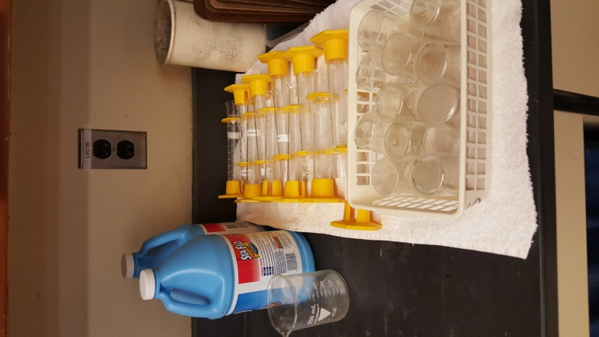
Clean Up Time
Remember … no slime stuff in the sink!
Throw away your cup & stick.
Return materials to the side counter – dump extra starch in the big beaker.
Use a brush to clean the cylinder & beaker.
Straighten up your table basket. Wipe down your table with a wet towel if needed.
Wipe your hands off with a dry paper towel BEFORE you wash them with soap.
Keep your apron and googles until AFTER you are done with the slime tests.
Use a brush to clean the graduated cylinder.

Slide 27
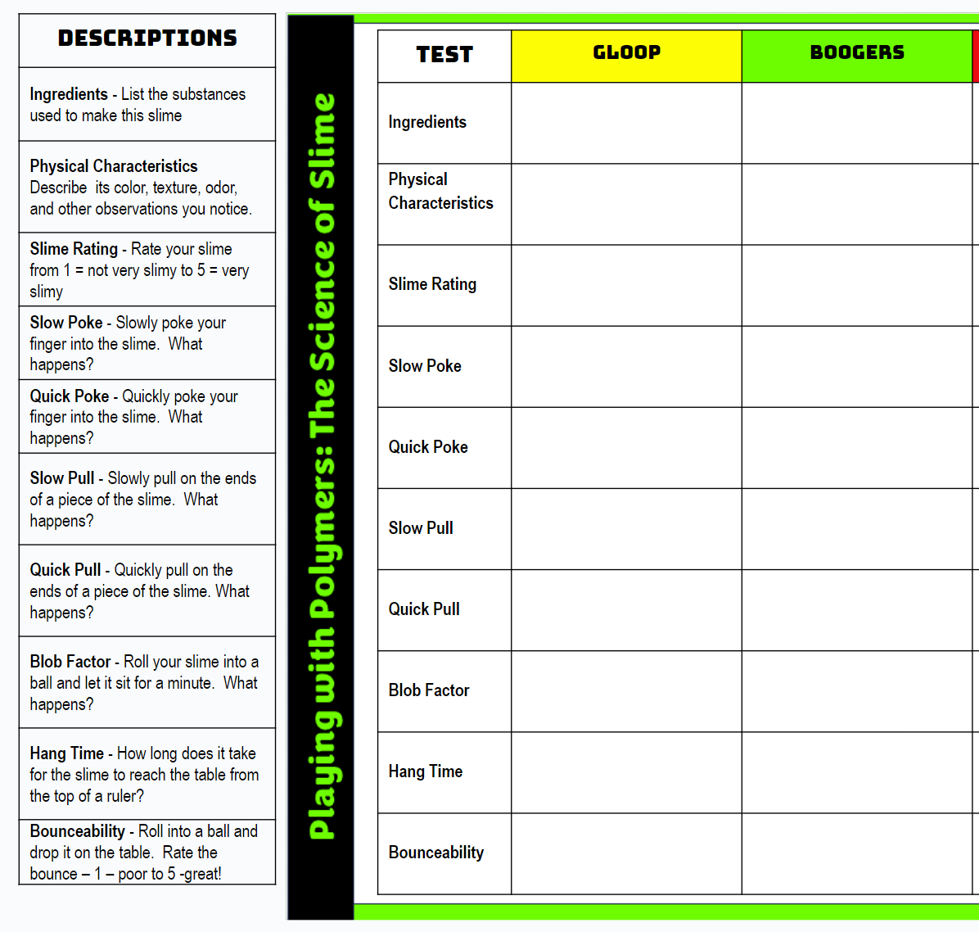
Leave your apron on until you are done with all the slime tests!
Follow the directions to do your slime tests with the BOOGERS.
Big rulers on the front counter!
You may test your GLOOP if you have time!
Sticky GLOOP? Add a drop of BORAX SOLUTION (red station.)
If a test DOESN’T WORK, write what happened in the box in the chart – it broke into pieces, it didn’t move or stretch, etc. Don’t leave it blank!

Slide 28
Physical Characteristics - Describe its color, texture, odor, and other observations you notice.
Slime Rating - Rate your slime from 1 = not very slimy to 5 = very slimy
Slow Poke - Slowly poke your finger into the slime. What happens?
Quick Poke - Quickly poke your finger into the slime. What happens?
Slow Pull - Slowly pull on the ends of a piece of the slime. What happens?
Quick Pull - Quickly pull on the ends of a piece of the slime. What happens?
Blob Factor - Roll your slime into a ball and let it sit for a minute. What happens? How fast does it flatten out?
Hang Time - How long does it take for the slime to reach the table from the top of a 30 cm ruler?
Bounceability - Roll into a ball and drop it on the table from the top of a 30 cm ruler. Rate the bounce – 1 – poor to 5 -great!
SLIME TESTS
NOTE: If a test doesn’t work, write what happened in the box in the chart. Don’t leave it blank!
Table of Contents

Slide 29
END OF CLASS
Put BOTH small bags of slime in the BIG BAG to keep them together – they are on the front counter.
Stash your slime in the tub for your class period on the front table.
Done? Work on GIMKIT or other homework. Santa Tracker if everything is done!

Slide 30
Day 3 - Let’s Review …
What type of slime did we make yesterday?
What was the monomer?
What was used to link them together?
Boogers
PVA in white glue
Laundry starch
Time to make some GOOBERS…
(if you are done with all class work & have grades above 70%!)
Work in pairs to make ONE batch and then split it with your partner!

Slide 31
Goobers
?
?
Ingredients: Guar gum & Borax solution
Guar gum is a natural polymer used as a thickening agent in many foods and other substances, such as toothpaste, yogurt, and gravies or sauces.
We have used the Borax solution (sodium tetraborate) for other slimes.
WARNING: This one takes the longest to make and can be quite a mess! Make sure to keep it on a plate or in your hands! We will let it “gel” overnight before doing your tests.
Alternate Assignment: Complete assignment #3 and turn in to the bin when you are done for your daily lab grade. (Turn in past assignments if you didn’t already do so!)

Slide 32
GOOBERS
GOOBERS – Each group (2 students) will need:
SIDE counter:
1 RED base graduated cylinder 1 RED dot beaker of BORAX solution 1 eyedropper with RED band
1 GREEN base graduated cylinder 1 GREEN dot beaker of water 1 eyedropper with a GREEN dot
1 DIGITAL SCALE – Do not play with the scale while you wait for us to start!
Guar Gum set (Purple dots)
Table Basket:
1 plastic cup
1 stir stick
2 small plastic bags
2 black markers
1 Styrofoam plate or bowl
Share with your table: 1 bag of food coloring
Need Cup, Mini Scoop, & Canister
Don’t forget your goggles & an apron!
Got everything? Sit quietly so we can begin!

Slide 33
1 – Label the small plastic bag with your name and the type of slime.
2 – Use a GREEN BASE cylinder to measure out 40 ml of water and pour into a CLEAN plastic cup – not the one with Guar Gum.
T. Tomm
Goobers
3 - Add food coloring and stir well.
You may make up your own color combo – up to 4 drops!
Funky Slime
1 drop of green
2 drops of yellow
Throat Junk
1 drop of green
2 drops of yellow
1 drop of red
Blood Clot
4 drops of red
1 drop of green
1 drop of yellow
Diarrhea
2 drops red
2 drops yellow
1 drop blue

Slide 34
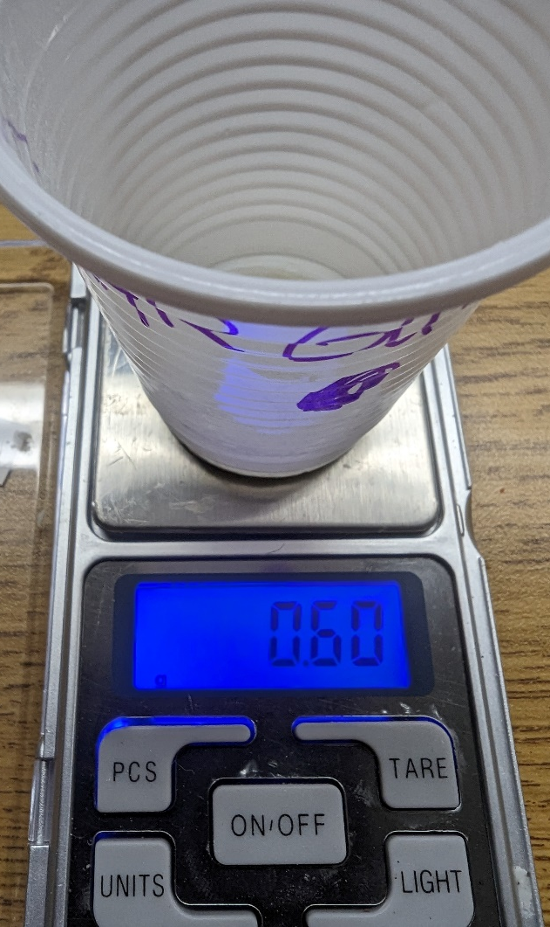
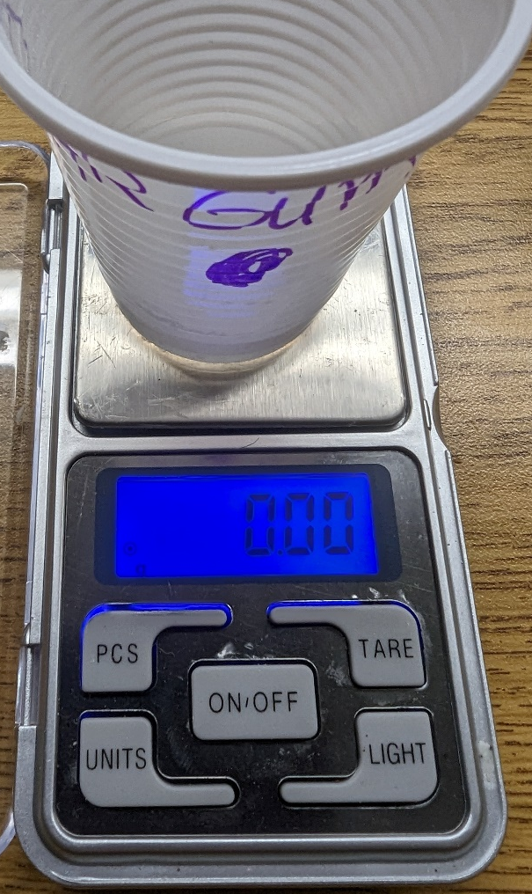
4 – Use a digital scale to measure 0.60 grams of guar gum. Follow these directions:
1st – Turn on the scale by pressing the ON-OFF button.
2nd – Place the EMPTY “Guar Gum” cup on the pan.
3rd – Click the TARE button to set the scale to ZERO - we don’t want to add the mass of the cup.
4th – Use the small scoop add 0.60 grams of GUAR GUM powder to the cup.
Get it as close as you can → Between 0.58 to 0.62 will work!

Slide 35
5 – Have one person stir the colored water as the other person SPRINKLES or TAPS the guar gum into it - a little at a time to keep it from clumping. Keep stirring until the mixture thickens – you cannot do the next step until it thickens.
Break up the clumps with the stick and stir until dissolved.
6 - Use a RED BASE cylinder to measure 12 ml of borax solution. Pour it into the cup & stir for 60 seconds.
Measure twice – 6 milliliters at a time DO NOT STIR until all the borax is in the cup!
7 – Dump the slime onto a plate to “gel” while you CLEAN UP.
We will do the slime tests with GOOBERS tomorrow.

Slide 36
Clean Up Time
Remember … no slime stuff in the sink!
Throw away your cup and stir stick.
Return all other materials to the correct spot on the side counter.
Split your Goobers in half – one for each person. Put your bag of Goobers with your other slimes.
Clean up your table & wash your hands after you use a dry paper towel to clean your hands.
Done?
Do slime tests for Gloop or Boogers → Follow the directions on slide 3!
Finish GIMKIT & turn in a screenshot on Google Classroom.
If done with everything, you may visit Santa Tracker!
Having problems? Gloop sticky? Add borax
Boogers sticky? Add starch

Slide 37
Physical Characteristics - Describe its color, texture, odor, and other observations you notice.
Slime Rating - Rate your slime from 1 = not very slimy to 5 = very slimy
Slow Poke - Slowly poke your finger into the slime. What happens?
Quick Poke - Quickly poke your finger into the slime. What happens?
Slow Pull - Slowly pull on the ends of a piece of the slime. What happens?
Quick Pull - Quickly pull on the ends of a piece of the slime. What happens?
Blob Factor - Roll your slime into a ball and let it sit for a minute. What happens? How fast does it flatten out?
Hang Time - How long does it take for the slime to reach the table from the top of a 30 cm ruler?
Bounceability - Roll into a ball and drop it on the table from the top of a 30 cm ruler. Rate the bounce – 1 – poor to 5 -great!
SLIME TESTS
NOTE: If a test doesn’t work, write what happened in the box in the chart. Don’t leave it blank!
Table of Contents

Slide 38
Day 4 - Let’s Review …
Goobers
What type of slime did we make yesterday?
What was the monomer?
What was used to link them together?
Guar gum (powder)
Borax solution
It’s time to do make some Super Slime …
(if your science work is done & all grades are above 70%)

Slide 39
Super Slime
?
Ingredients: PVA (polyvinyl alcohol) and Borax solution
PVA is used to make lubricating drops for contact lenses, artificial sponges, hoses, printing inks, and. It is also found in glue!
We have used the Borax solution (sodium tetraborate) for other slimes.
Each person can make ONE batch, but share equipment/supplies!
Alternate Assignment: Complete assignment #3 and turn in to the bin when you are done for your daily lab grade. (Turn in yesterday’s assignment if you didn’t already do so!)

Slide 40
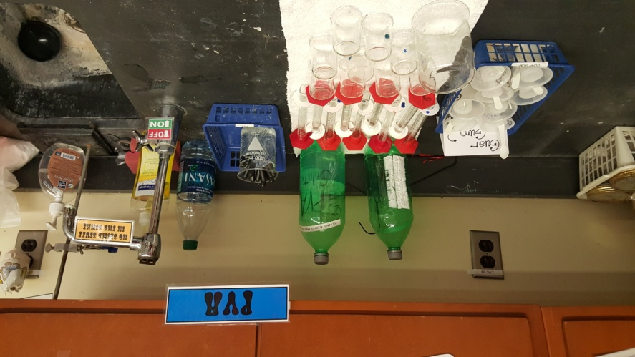
SUPER SLIME – Each person makes a batch, but you’ll share equipment!
SIDE counter: 1 RED graduated cylinder 1 RED dot beaker of BORAX solution 1 eyedropper with RED band 1 BLUE dot cylinder (PVA label) 1 BLUE dot beaker (PVA label)
(No eyedropper for PVA)
TABLE basket:
2 small plastic cups
2 wooden stir sticks 2 small bags
2 black markers
Share with your table: 1 bag of food coloring
PVA = BLUE
Don’t forget your goggles
& an apron!

Slide 41
1 – Label your small plastic bag like we’ve done before.
2 – Use a BLUE DOT cylinder to measure out 15 ml of the PVA and pour into a clean plastic cup.
3 - Add 1 drop of food coloring (or leave it clear) and stir well.
T. Tomm
Super Slime
4 - Use a RED DOT cylinder to measure out 4 ml of Borax solution and pour it into the cup. Stir with a stick. Take it out of the cup after it is set up and let it sit on the table to “gel”.
Too sticky or runny? Add borax (one drop at a time) Too crumbly? Add PVA (one drop at a time)
DO NOT PLAY WITH THE SLIME TOO MUCH … Give it time to set up!

Slide 42
Clean Up Time
Remember … no slime stuff in the sink!
Throw away your cup and stir stick.
Return all other materials to the correct spot.
NOTE: You’ll need to use a brush to clean the PVA cylinder and beaker. Rinse well!
Clean up your table & wash your hands after you use a dry paper towel to clean your hands.
Do the slime tests with your Super Slime and Goobers → plus any other slimes you have not tested.
NOTE: If a test doesn’t work, write what happened in the box in the chart. Don’t leave it blank!

Slide 43
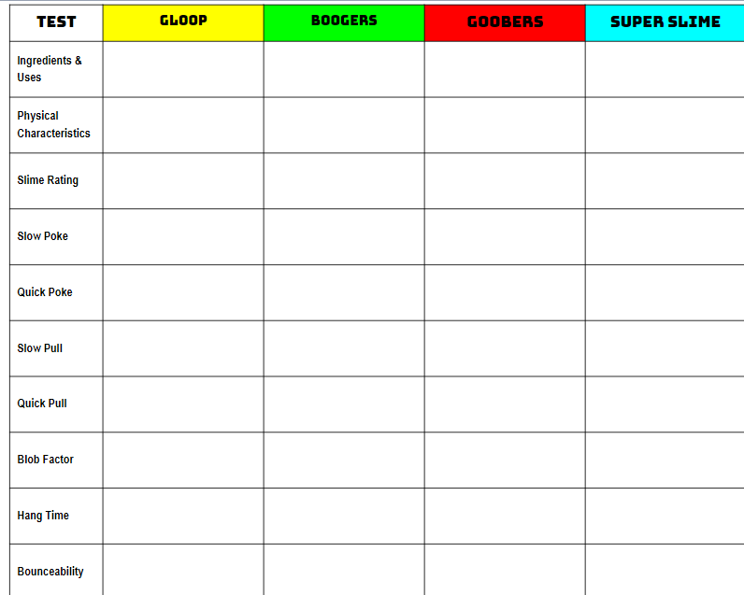
1st - Do your SLIME TESTS with the SUPER SLIME following the directions on Slide 3.
2nd - Put your Super Slime into the small plastic bag.
3rd - Finish any tests for other slimes that you need to do.
NOTE: If a test doesn’t work, write what happened in the box in the chart. Don’t leave it blank!

Slide 44
Physical Characteristics - Describe its color, texture, odor, and other observations you notice.
Slime Rating - Rate your slime from 1 = not very slimy to 5 = very slimy
Slow Poke - Slowly poke your finger into the slime. What happens?
Quick Poke - Quickly poke your finger into the slime. What happens?
Slow Pull - Slowly pull on the ends of a piece of the slime. What happens?
Quick Pull - Quickly pull on the ends of a piece of the slime. What happens?
Blob Factor - Roll your slime into a ball and let it sit for a minute. What happens? How fast does it flatten out?
Hang Time - How long does it take for the slime to reach the table from the top of a 30 cm ruler?
Bounceability - Roll into a ball and drop it on the table from the top of a 30 cm ruler. Rate the bounce – 1 – poor to 5 -great!
SLIME TESTS
NOTE: If a test doesn’t work, write what happened in the box in the chart. Don’t leave it blank!
Table of Contents

Slide 45
Last Day → End of Class →Put your slime bag in the correct tub for your class.
Listen for the announcement at the end of the day to know when you should come to my room to pick it up & take it home.
All slime needs to stay in your bag until you get home – do not take it out in other classrooms or on the bus!

