Slide 1
Teacher Notes:
I use this activity for our Parent/Teacher conferences. The students fill them out in class and take them home to review with a parent/guardian. They return them to me with a signature. I use the pages as I meet with their parent/guardian for a conference.
It is great way to involve the student in the process and “see” their grades and performance from their point of view. For the most part they are very honest and sometimes tougher on themselves than I would be. For a few I may comment that a rating should be higher or lower based on my notes/observations.
I provide a worksheet for each student – with the report on one side and the evaluation on the other. A digital version of the worksheet I use is available for you to edit for use with your students. You will have to go to File → Make a copy to make edits to the document. You will also have edit these slides to better fit with your grade program and student reports.
1st Quarter Evaluation – How did you do?
Use your 1st QUARTER grade report (on the back) to help you complete PART A by filling in your %, grade count, and category averages.
91%
98%
95% A
Note: You can also use ALMA to check your grades!
Find an error? Send me an email to check it!

Slide 2
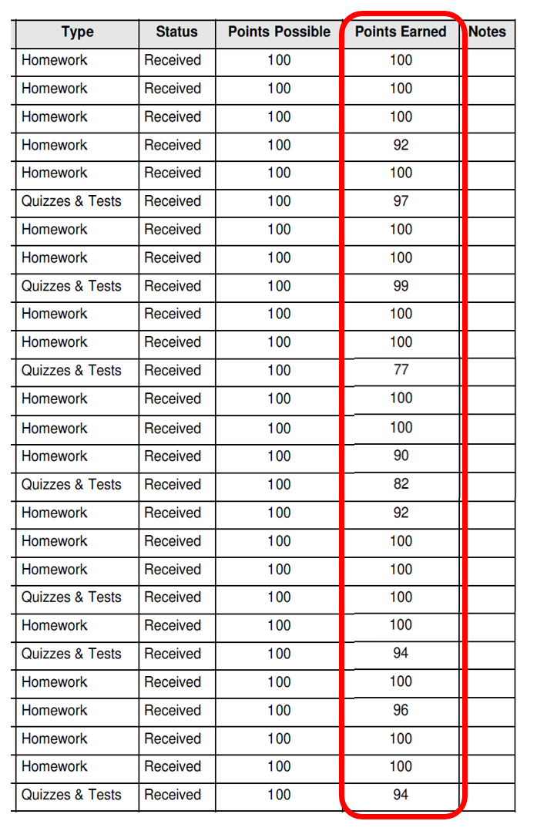
Count the number of each letter grade you earned.
?
?
?
?
?
Any F’s? How many were zeros?
90-100 = A
80-89 = B
70-79 = C
60-69 = D
Below 59 = F
Finished? Start Part B.

Slide 3
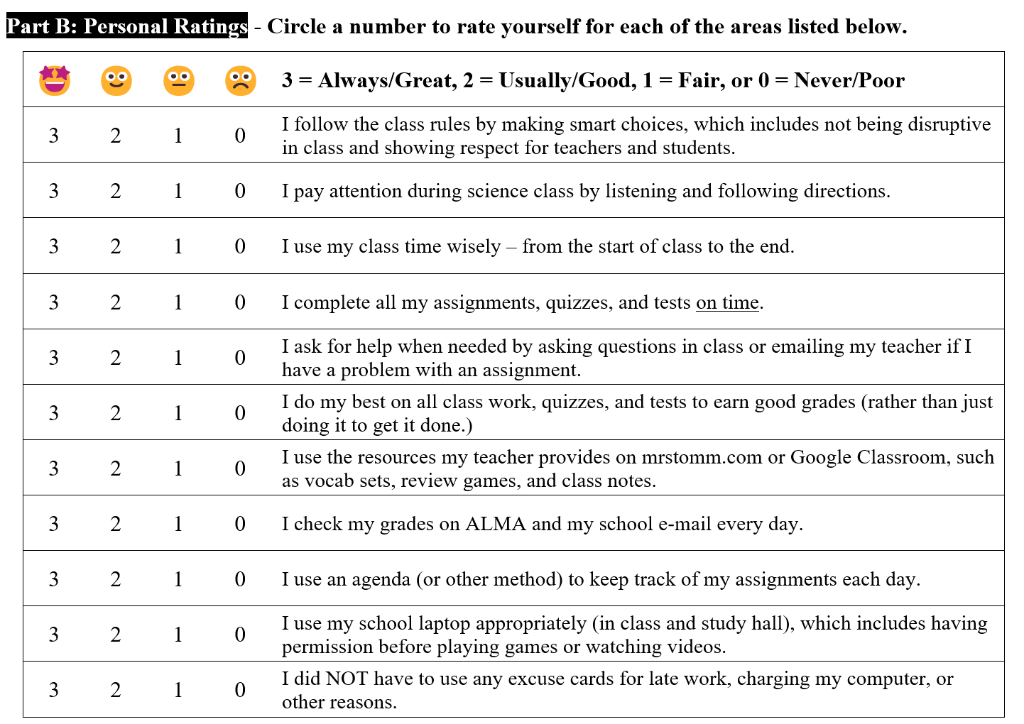
Part B: Circle a number for each area listed. We will review each one and you can make changes.
Base your ratings on SCIENCE class only!

Slide 4
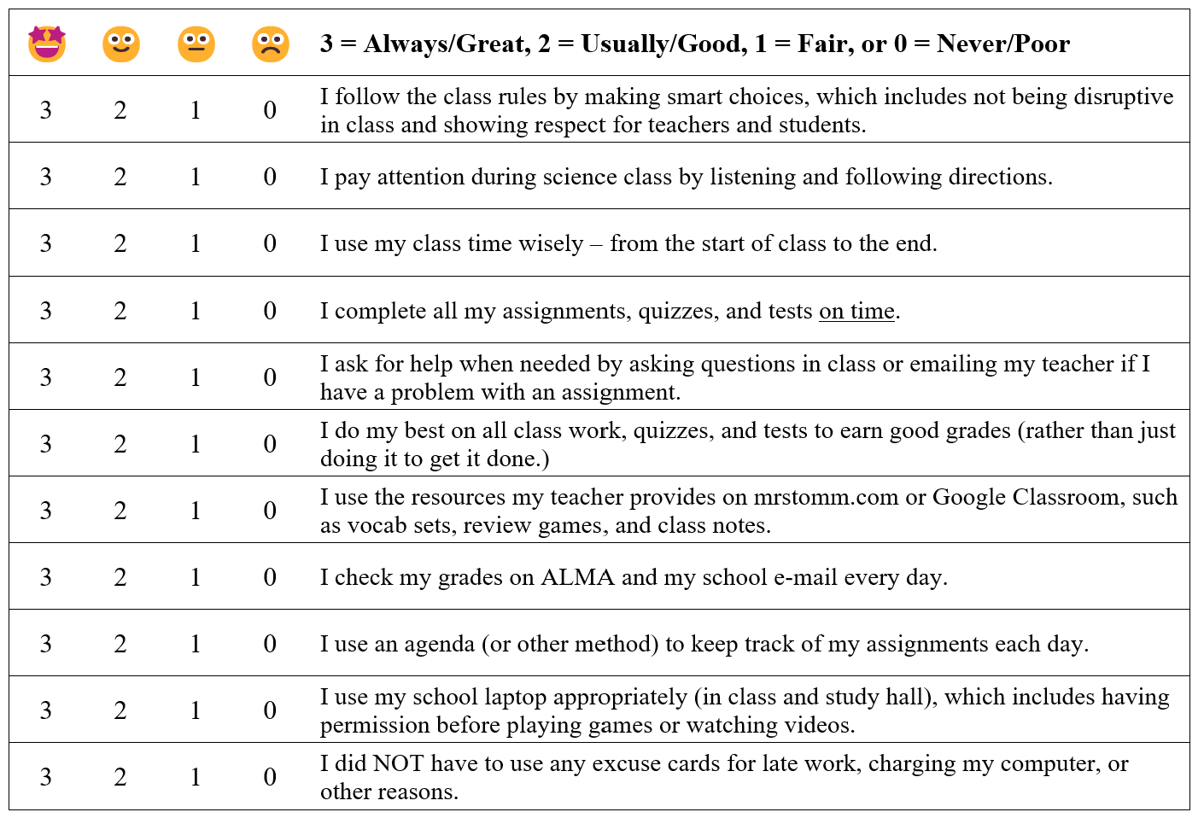

Slide 5
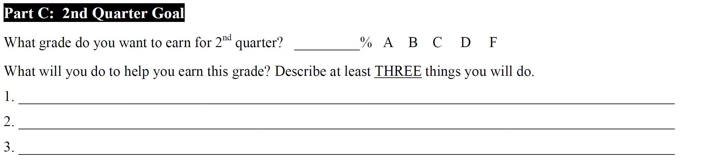
Finish Part C on your own.
If you need help thinking of things, look at your grades for Part A or the lowest ratings on Part B!
If you earned a good grade 1st quarter, list the three things you will continue to do to get good grades!

Slide 6
Your Assignment:
Review your form and grades with parent/guardian.
Have one of them sign the paper.
Turn it in to the bin by Wednesday @ 2:00 PM
Completed forms will be due by Wednesday, 10/18 by 2:00 PM to earn a STICKER & a BONUS POINT for the Minion Challenge!

Slide 7
Parent/Teacher Conferences
Thursday – 4:00 - 7:00 PM OR Friday – 8:00 AM - Noon
REPORT CARDS will be available in the OFFICE for parents or guardians to pick up.
The 7th & 8th grade TEACHERS will be in their classrooms and available for conferences.
Your parent/guardian may send me an email or give me a call instead of coming in for a conference.
My contact info is listed at the bottom of the evaluation form as well as on the district website.
Completed forms are due back by Weds by 2:00 PM to earn a sticker & a bonus point for your class rewards!

