Slide 1
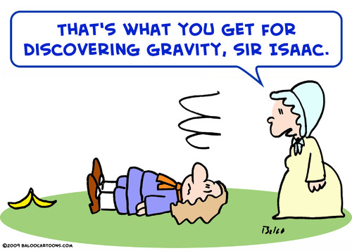
Newton’s Laws
Image: http://literaturequeen.com/wp-content/uploads/2011/09/isaac_newton_gravity_panana_627535.jpg
Presentation created by T. Tomm 2016 http://sciencespot.net

Slide 2
Introduction: Science 360º
How do they apply to hockey?
Write each law of motion in your own words.
1st Law –
2nd Law –
3rd Law –
Video Link: https://science360.gov/obj/video/642db496-d506-432e-85b4-4e38f75d9142/newtons-three-laws-motion

Slide 3

Part A: Wacky Washers
To prepare for this experiment, stack 4 washers one on top of the other so that you form a tower of washers. Place the stack of washers on top of the table so that you have a smooth, slick surface.
1. Aim ONE washer at the bottom of the stack of FOUR washers and apply a force with your finger or hand to slide it towards the taller stack. What happens?
2. Flick a stack of TWO washers into a stack of four washers. What happens?
3. Flick a stack of FOUR washers into a stack of FOUR washers. What happens?
4. What happens if you slide a stack of FOUR into a stack of TWO? Why?
5. Explain your observations in terms of Newton’s 1st Law using the terms force, inertia, rest, motion in your answer.

Slide 4
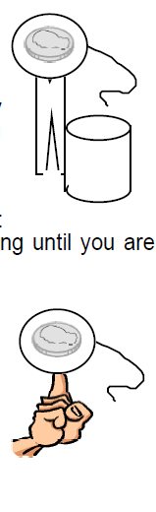
Part B: Tricky Tricks
Set up the situation shown in the diagram.
1. The goal is to remove the circle by pulling on the string, but the penny must remain in place on top of the clothespin. Can you do it?
2. Try the experiment again using the plain circle (no string). Can you flick the circle out from under the penny and keep the penny on the end of the clothespin?
3. Balance the penny on a circle (string or no string) on the tip of you finger as shown in the second diagram. Try to remove the paper circle to leave the penny balanced on your finger. Can you do it?
4. How does this activity relate to the “pull the tablecloth” trick used by magicians and inertia?

Slide 5
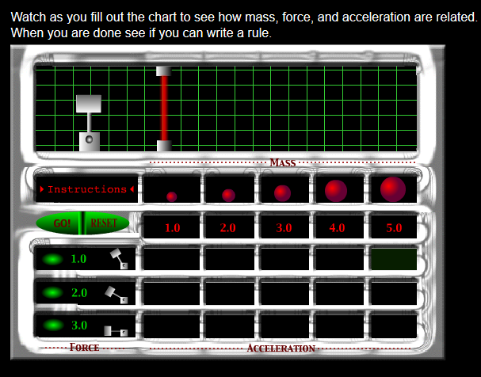
Part C: Master the Force
Go to the website listed on your worksheet to help you
complete this section.
1. Experiment with the different masses and forces to fill in the chart.
2. Write a summary of your observations that explains how force, mass, and acceleration are related.
Force Mass | 1.0 kg | 2.0 kg | 3.0 kg | 4.0 kg | 5.0 kg
1.0 N
2.0 N
3.0 N

Slide 6
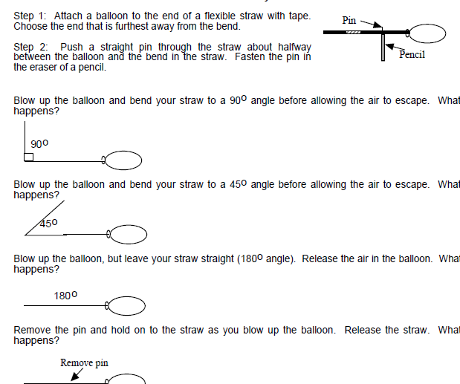
Part D: Balloon Rally
Step 1: Attach a balloon to the end of a flexible straw with tape.
Choose the end that is furthest away from the bend.
Step 2: Push a straight pin through the straw about halfway
between the balloon and the bend in the straw. Fasten the pin in
the eraser of a pencil.
1. Blow up the balloon and bend your straw to a 90 º angle before allowing the air to escape. What happens?
2. Blow up the balloon and bend your straw to a 45 º angle before allowing the air to escape. What happens?

Slide 7

3. Blow up the balloon, but leave your straw straight (180º angle). Release the air in the balloon. What happens?
4. Remove the pin and hold on to the straw as you blow up the balloon. Release the straw. What happens?
5. Explain your observations in terms of Newton’s 3rd Law using the terms action, reaction, balloon, and force in your answer.

