Slide 1
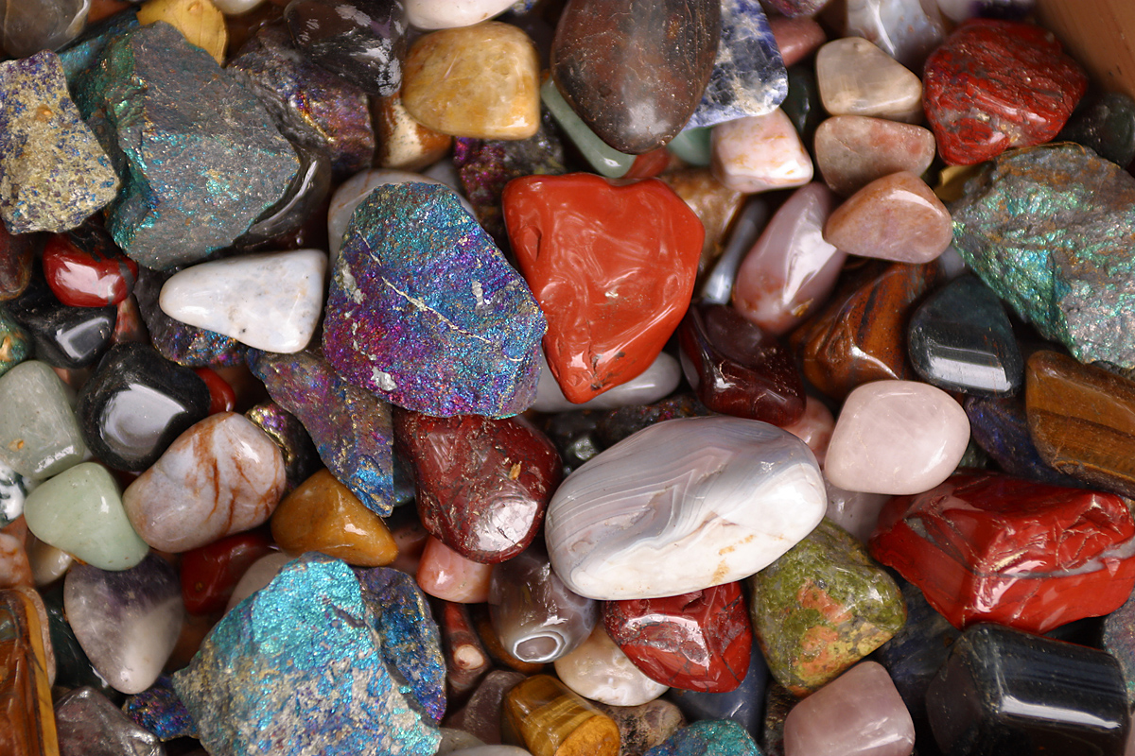
Mineral ID Challenge
7th Grade Science
http://www.beachminerals.org/wp-content/uploads/2015/05/gem2.jpg T. Tomm 2015 http://sciencespot.net/

Slide 2
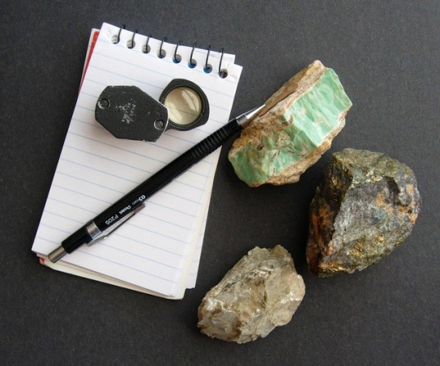
Mineral Identification Challenge
Directions:
Your team will need to identify various minerals by visiting each of the stations and following the directions on the station cards.
Work with your teammates to complete each task/test and write the answers on your worksheet.
You will only have a set amount of time at each station and then will rotate to the next highest number (or back to #1 if you are at #6).
Remember … If you do not know the identity of a mineral (♦), you will have time at the end for another look at them or you might get clues to help you at other stations. However, you should complete all the tests/tasks!
Let’s review the mineral identification characteristics …
Put a star next to any test that has this icon – an online video is available!

Slide 3
COLOR - The color a mineral appears to be; may vary from sample to sample
STREAK – The color of a mineral in a powder form; tested using a white plate
LUSTER – How a mineral reflects light, such as metallic, glassy, dull, pearly
TRANSPARENCY/OPACITY – Whether or not a mineral allows light to pass through it, may be transparent, semi-transparent, or opaque
TEXTURE – Description of what a mineral feels like, such as smooth, rough, grainy
CHEMICAL COMPOSITION – Classified based on the elements in they contain
Mineral Identification Tests
DENSITY – Mass ÷ volume; use a scale and overflow can/graduated cylinder to measure mass & volume (Video available)
CRYSTAL SHAPE – Minerals have specific crystal shapes that can be used for identification.
CLEAVAGE/FRACTURE – Determined by how the mineral breaks apart; cleavage = smooth and evenly , fracture = rough and jagged (Video available)
HARDNESS – Use Mohs scale and common objects to figure out a mineral’s hardness by the process of deduction. (Video available)
SPECIAL PROPERTIES – Does it create a double image from refraction? Glow in UV light? Fizz with acid? Is it magnetic?

Slide 4
Mineral Identification Challenge
Glue the activity worksheet on page 59 (FAF Right side).
Use your time at each station wisely so you can complete all the tasks/test.
Do not damage the samples – try to be as “nice” as you can so everyone will be able to use them.
Clean/straighten up your area before you rotate.
Use the resource books available at each station to help you. If you have extra time, you may check out the links in the Geology section of the Science Spot’s Kid Zone.
Remember … If you do not know the identity of a mineral (♦), you will have time at the end for another look at them or you might get clues to help you at other stations. However, you should complete all the tests/tasks!
If you see this icon, a video is available at sciencespot.net ➔ Kid Zone ➔ Rocks & Minerals

Slide 5
Station 1 – Color vs. Streak
Sample | Color | Streak | What do you think it is?
A | Tan, white | White | Barite
B | Whitish-clear | White | Gypsum
C | Yellow, brown | Yellow, gold | Sulfur
D | Reddish brown | Red brown | Hematite
E | White, light tan | No color | Quartz
F | Gray, white | White | Calcite
G | Gray | White | Talc
H | Greenish-gold gray | Black/green | Pyrite

Slide 6
Station 2 – Hardness
Sample | Observations | Hardness | What do you think it is?
A | Not scratched by fingernail, scratched by penny | 3 | Calcite
B | Scratched by glass, but not the nail | 5.5-6 | Sodalite
C | Scratches nail | 7+ | Hematite
D | Scratched by fingernail | 1 or 2 | Sulfur
E | Scratched by fingernail | 1 or 2 | Graphite
F | Scratches nail | 7+ | Chert
G | Scratched by fingernail | 1 or 2 | Talc
H | Scratched by fingernail | 1 or 2 | Gypsum
?

Slide 7
Station 3 – Density
Sample | Mass | Volume | Density
A | 22 | 5 | 3.14
B | 25 | 6 | 4.17
C | 17 | 9 | 1.89
D | 38 | 17 | 2.24
1. Galena has a high density. Which sample is most likely galena? 2B
2. Graphite has a low density. Which sample is most likely graphite? 2C

Slide 8
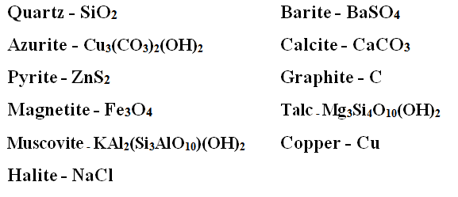
Station 4 – Chemical Composition
Family/Group | Chemical Description | Examples
Silicates | Must contain silicon and oxygen | Quartz, Talc, Muscovite (also called mica)
Carbonates | Must contain carbon and oxygen | Azurite, Calcite
Halides | Must contain fluorine, chlorine, iodine, or bromine | Halite
Sulfates | Must contain sulfur and oxygen | Barite
Oxides | Contain a metal and oxygen | Magnetite
Native Elements | Made up of a single element | Graphite, Copper
?

Slide 9
Station 5 – Crystals, Cleavage, & Fracture
Sample | Cleavage/Fracture? | Crystal Shape | What do you think it is?
A | X Cleavage  Fracture | Cubic or Rhombohedric | Calcite
B | X Cleavage  Fracture | Cubic | Galana
C |  Cleavage X Fracture | Cubes & other forms (too small to see) | Pyrite
D | X Cleavage  Fracture | Cubic or Rhombohedric | Gypsum
E | X Cleavage  Fracture | Hexagonal Prism | Quartz
F | X Cleavage  Fracture | Cubic | Halite (Salt)
G | X Cleavage  Fracture | Monoclinic (sheets) | Mica (Muscovite)

Slide 10
Station 6 – Special Properties
Magnetite is magnetic, but may have a rough texture. Which sample is magnetite? 6A
Calcite will cause a double image due to refraction. Did you find any calcite in the group? No
Some minerals glow in UV light. Which samples had this property? 6F, 6K, 6E
Pyrite (Fool's Gold) has a metallic luster. Which sample is pyrite? 6H
Quartz has a glassy luster. Which sample is quartz? 6I
Mica has a pearly luster and a glassy texture. Which sample is mica? 6J

Slide 11
7. Opaque means light cannot pass through it, while others are transparent allowing light to travel through.
Which samples were transparent? 6D, 6I, 6J
8. Did any minerals react with vinegar? If so, how would they be classified? Answers will vary

