Slide 1
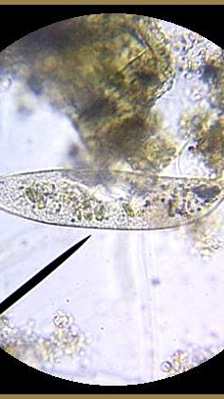
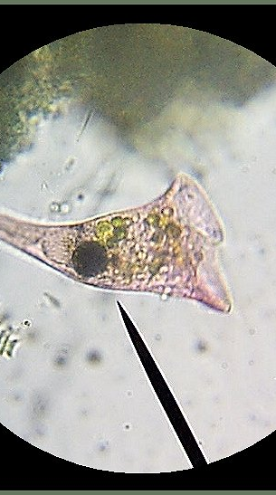
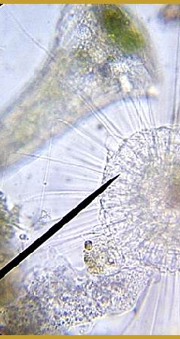
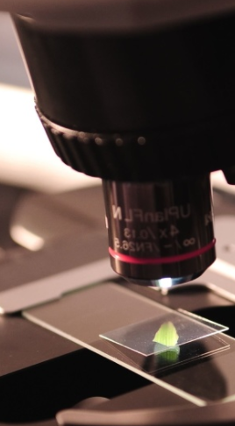
Teacher Note: This PPT was developed for use during class to review the activities and answers included in the student digital notebook.
Student Digital Notebook:
https://docs.google.com/presentation/d/1ocZs1E8QWf4DG2Pk542TzB6PPnOfVZF7g7rnmTZ_BTE/edit?usp=sharing
NOTE: You will have to make a copy to use with your students.
Check the margin areas of each slide for additional notes and links to the activities.
Also check out the CSI Challenge: Hair Evidence activity available on tbe Biology page of the Science Classroom at https://sciencespot.net/Pages/classbio.html#micro
Microscope Basics
T. Tomm Updated 2021 https://sciencespot.net/ Images from http://www.tnmanning.com/id150.htm

Slide 2
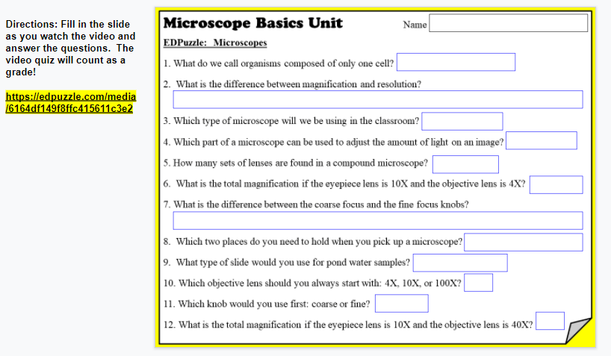
EDPuzzle Video Link: https://edpuzzle.com/media/6164df149f8ffc415611c3e2
Note: I usually create an assignment on Google Classroom with a link to the video. Students click “resubmit” to turn it in on GC when they are done.
Assignment #1: EDPuzzle: Microscopes
Your Assignment: Watch the video on EDPuzzle to help you fill in the text boxes on Slide #1.

Slide 3
EDPuzzle Microscope Video
Answer Key
Slide 1

Slide 4
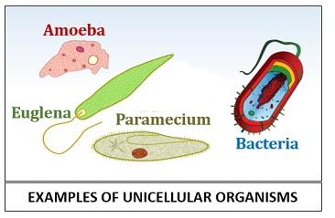
EDPuzzle: Microscopes
1. What do we call organisms composed of only one cell?
UNICELLULAR
How are humans & other animals classified?
MULTICELLULAR =
MANY CELLS
Image: https://biologyreader.com/difference-between-unicellular-and-multicellular-organisms.html

Slide 5
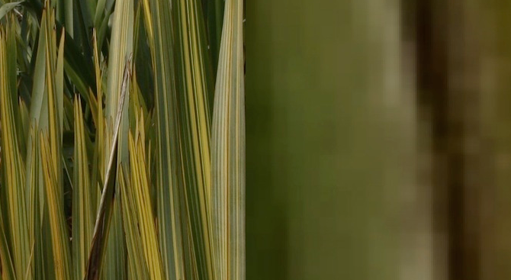
2. What is the difference between magnification and resolution?
Magnification = Making it larger
Resolution = Seeing it clearer; being able to distinguish between two objects
Ever hear the term “pixelated”?
Need to use high-resolution images to avoid this when enlarging images.
https://www.sciencelearn.org.nz/resources/495-magnification-and-resolution

Slide 6

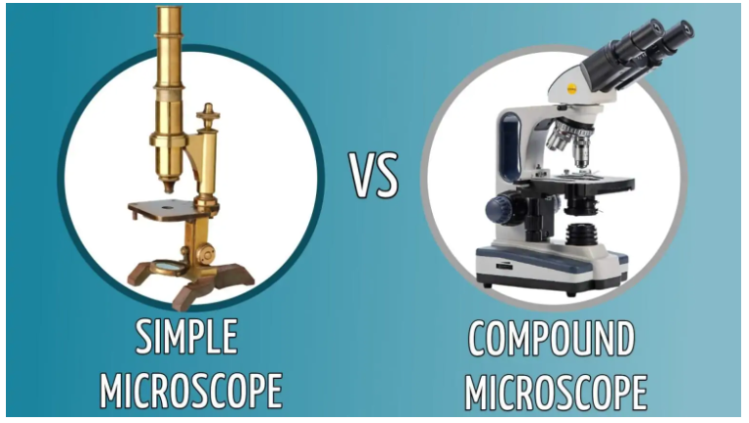
3. Which type of microscope will we be using in the classroom?
4. Which part of a microscope can be used to
adjust the amount of light on an image?
5. How many sets of lenses are
found in a compound microscope?
LIGHT
DIAPHRAGM
Adjusting the diaphragm to allow more light or less may help you view images better.
TWO SETS

Slide 7
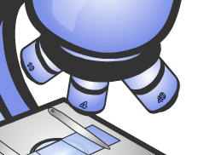

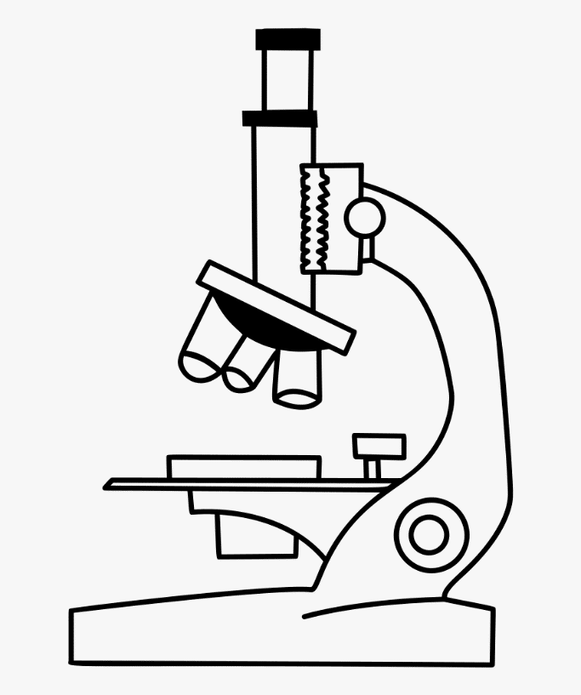
6. What is the total magnification if the eyepiece lens is 10X and the objective lens is 4X?
7. What is the difference between the coarse focus and the fine focus knobs?
8. Which two places do you need to hold
when you pick up a microscope?
10 x 4 = 40X
10
X
Coarse = Moves the stage up/down a lot
Fine = Moves the stage up/down a little bit
ARM & BASE

Slide 8
9. What type of slide would you use for pond water samples?
10. Which objective lens should you always start with: 4X, 10X, or 100X?
11. Which knob would you use first: coarse or fine?
12. What is the total magnification if the eyepiece lens is 10X and the objective lens is 40X?
WET MOUNT SLIDE
4X (smallest or shortest one)
COARSE
(Large knob)
10 x 40 = 400X
10
X

Slide 9
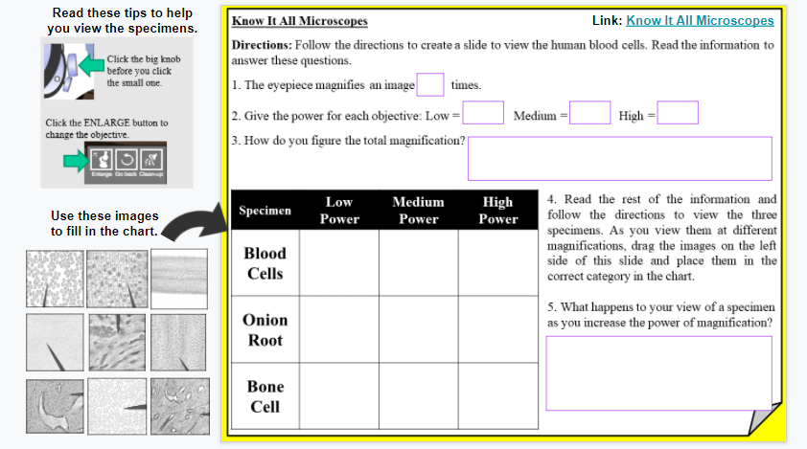
https://knowitall.org/interactives/hobbyshop/Microscope/index.html
Note: This link is available on the digital notebook.
Assignment #2: Know It All Microscopes
Your Assignment: Click the link in the top right of Slide #2 to access the site you need to complete this slide.
https://knowitall.org/interactives/hobbyshop/Microscope/index.html

Slide 10
Know It All Microscope
Answer Key
Slide 2

Slide 11
Know It All Microscopes
1. The eyepiece magnifies an image times.
2. Give the power for each objective:
Low = Medium = High =
3. How do you figure the total magnification?
10
4X
10X
40X
Multiply the power of the eyepiece and the power of the objective
Eyepiece | Objective | Total Power
10X | 25X
10X |  | 500X
 | 100X | 500X
Can you fill in the missing information?
250X
50X
5X

Slide 12

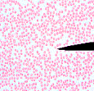
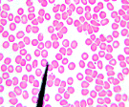
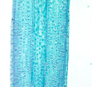

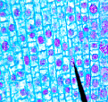
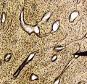
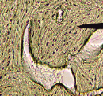
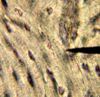
Specimen | Low Power | Medium Power | High Power
Blood Cells
Onion Root
Bone Cell
4. Read the rest of the information and follow the directions to view the three specimens. As you view them at different magnifications, drag the images on the left side of this slide and place them in the correct category in the chart.
How did you do? Correct any you had in the wrong spots!

Slide 13
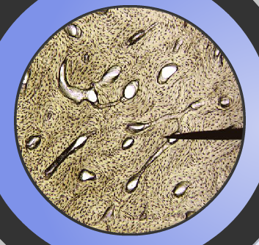
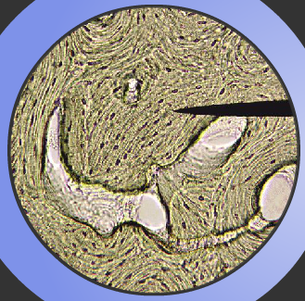
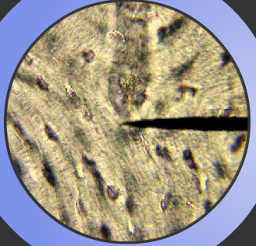

5. What happens to your field of view of a specimen and details you can see as you increase the power of magnification?
A
B
C
Larger field of view, but less detail
Smaller field of view, but more detail
What is this?
Pointer – To help you line up specimens
We can see small details much better with higher powers of magnification, but our field of view (or how much we see) of the image is smaller.

Slide 14
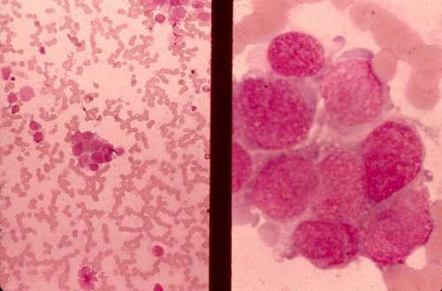
Which of these images would be viewed at
a higher power of magnification?
A
B
C

Slide 15
Compound Microscope Diagram
Slide 3

Slide 16
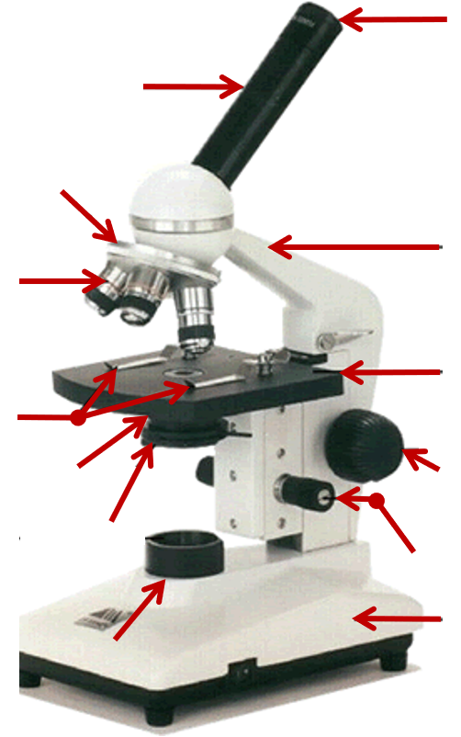

Compound Microscope
EYEPIECE
OCULAR LENS
BODY TUBE
Also called the
https://quizlet.com/328618658/compound-microscope-diagram/
MAGNIFICATION
Rotates to change
NOSEPIECE (TURRET)
ARM
OBJECTIVES
4X to 40X
Lenses range from
STAGE
STAGE CLIPS
CONDENSER LENS
COARSE FOCUS
IMPROVE IMAGE
DIAPHRAGM
Used to
FINE FOCUS
Regulates the
LIGHT
LIGHT
BASE
Put a star next to the two places where you should hold a microscope when you carry it.

Slide 17
Prepared Slides Activity
Day 1
Slide 4 (Top)

Slide 18

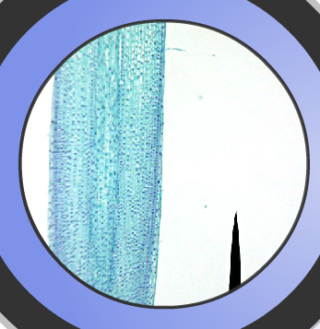
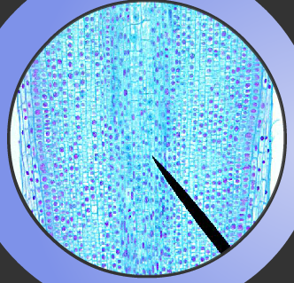


PREPARED SLIDES
In Class Activity – Students use classroom microscopes to view a selection of prepared slides.
Other ideas:
Student Phones – Students can download apps to use as “microscopes”. I have a few classes responsible enough to use this option.
Laminated Slides – Try using a thermal laminator to make slides of everyday objects. I do this for the CSI Micro Challenge to make slides of student hair samples.
After you have selected a slide, place it on the STAGE and CENTER what you want to see over the opening.
➢ Always start with the LOW power objective (shortest).
Make sure it is clicked into place (pointing straight down).
➢ Use the COARSE adjustment knob (big) to get your specimen into view.
➢ Use the FINE adjustment knob (little) to focus so you can see details.
If you don’t see anything, you may need to move the slide so the center of the specimen lines up with the end of the black pointer.
➢ Rotate the nosepiece to click the MEDIUM and HIGH power
objectives into place.
➢ Be careful with the HIGH powered objective (longest one) as it may not fit.
Don’t force it into place! Make a note on your worksheet that you could not use high power!

Slide 19
Time to clean up …
1 – Take off the slide and put away.
2- Turn off the microscope
3 - Go back to LOW POWER.
4 –Unplugged or returned to a charger.
5 – Put away all slides you viewed & straighten up your table.

Slide 20
Prepared Slides Activity
Day 2

Slide 21
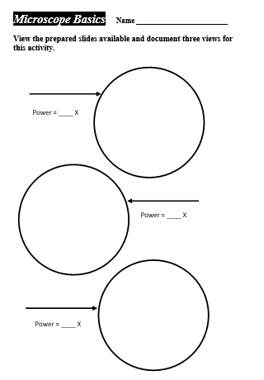
Directions: View the prepared slides at your table and choose THREE to document for this activity.
Spider Leg
You can do one slide at three different powers, three different slides at the same power, or a mixture of slides and powers.
40
Spider Leg
DRAW what you see and label with the NAME and POWER used.
100
Spider Leg
TURN IT IN TO THE BIN BY END OF CLASS TOMORROW!
You may view other slides at your table when you are done!
400

Slide 22
Wet-Mount Slides Activity
Day 1
Slide 4 (Bottom)

Slide 23


HOW TO MAKE A WET-MOUNT SLIDE …
Get a clean SLIDE and COVERSLIP from your teacher.
Place ONE drop of water in the middle of the slide.
Don’t use too much or the water will run off the edge and make a mess!
Place the EDGE of the cover slip on one SIDE of the water drop.
Slowly LOWER the cover slip on TOP of the drop.
Place the slide on the STAGE and use LOW power to view it first.
Once you see the image, you can ROTATE the nosepiece to view the slide with medium power objective.
Do not use HIGH power with wet-mount slides.
You do not need to use the stage clips when viewing wet-mount slides! You will want to be able to move the slide around.

Slide 24
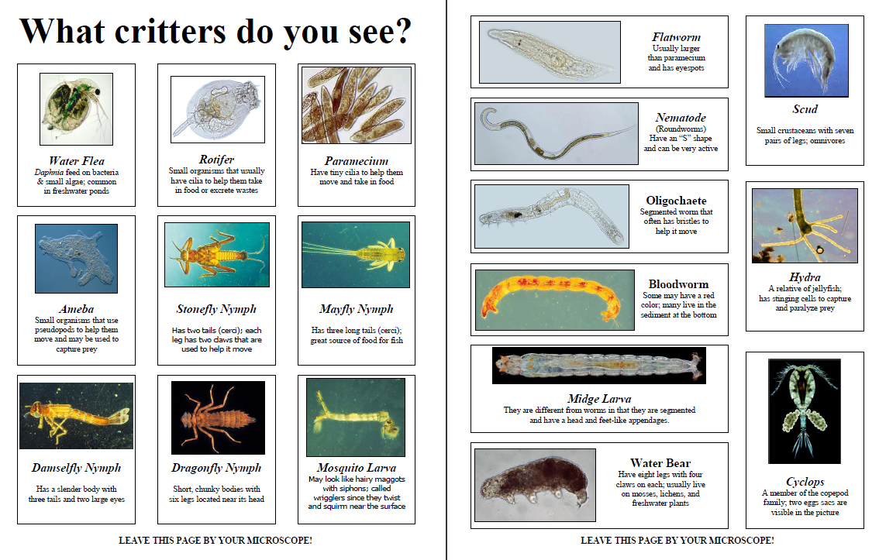

Use the guides or a Pond Water book to help you identify the critters you see!
Draw a textbox to the right of your slide to keep a list of all the things you see!

Slide 25
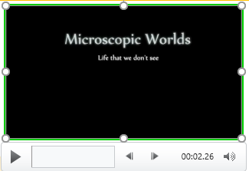
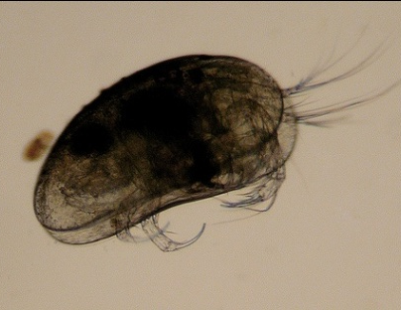
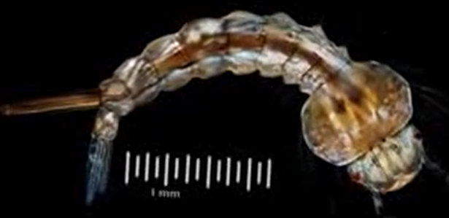
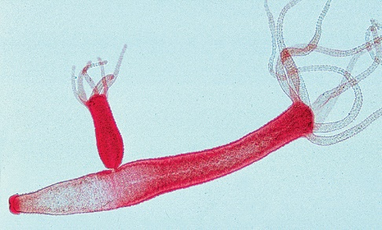
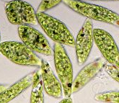

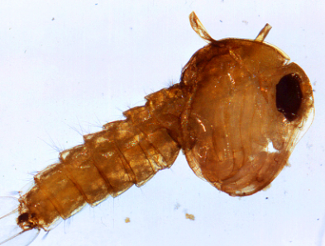
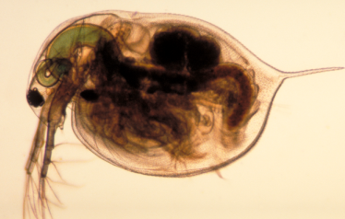
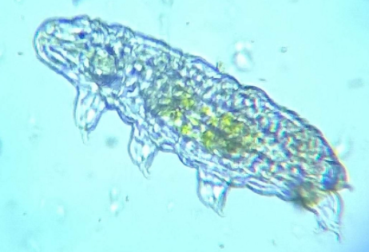
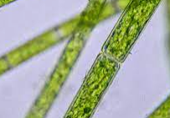
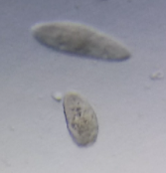
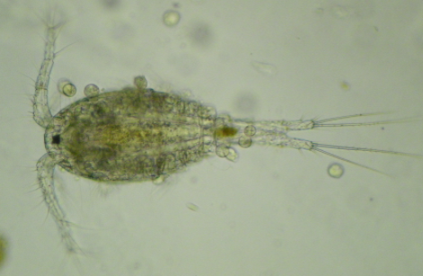
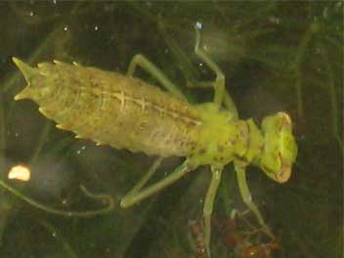
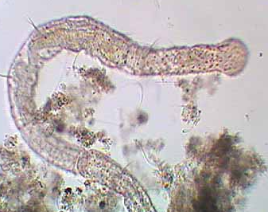
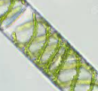
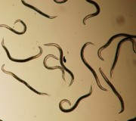
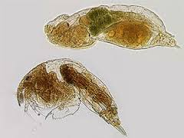
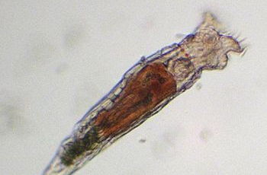
Pond Water Organisms
← Bud
Mosquito Larvae
Hydra
Seed Shrimp
Euglena
Water Flea
Water Bear
(Tardigrades)
Mosquito Pupa
Paramecium
Copepod
Dragonfly Nymph
Algae
Oligochaete (Segmented worm)
Nematodes
Use the picture guides or a Pond Water book to help you identify the critters you see!
Rotifers (Watch for “currents”)

Slide 26
Time to clean up …
1 –Use a towel to clean the slide & coverslip. Return to the tray at your table.
2- Turn off the microscope & reset it to LOW POWER.
3 –Unplug your microscope or return it to a charger.
4 – Straighten up the supplies at your table.
5 – Wait quietly to be dismissed by the teacher.

Slide 27
Wet-Mount Slides Activity
Day 2

Slide 28
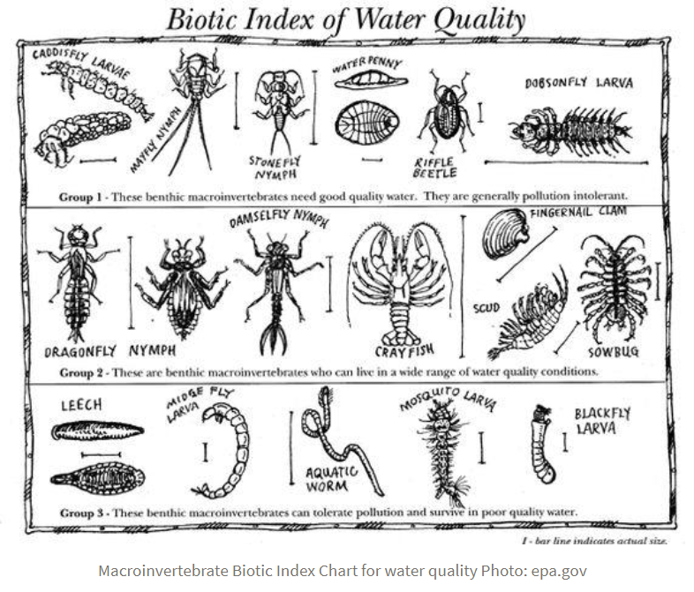
How could we use invertebrates as clues to water quality?
Pollution Sensitive
Pollution Tolerant
https://vt.audubon.org/news/macroinvertebrates

Slide 29
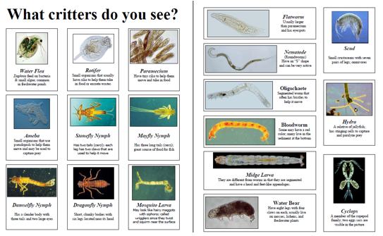
A few things to remember …
1 – Only use the LOW & MEDIUM-powered objectives with pond water.
2 –MOVE THE STAGE CLIPS OUT OF THE WAY. Use the BIG KNOB to get it into view and then the SMALL KNOB to make it clearer.
3 - It is better to look at 10 little drops rather than 1 big drop.
4 – DOCUMENT what organisms you see on Slide 5 #1. Use the pond water guides and online resources to help you.
CARRY WITH 2 HANDS – ONE ON THE ARM AND ONE ON THE BASE!
NEVER CARRY ONE WITH THE SLIDE STILL ON THE STAGE!

Slide 30
Time to clean up …
1 –Use a towel to wipe off the slide & coverslip. Return both to the teacher’s table.
2- Turn off the microscope & reset it to LOW POWER.
3 –Unplug your microscope or return it to a charger.
4 – Straighten up the supplies at your table.
5 – Sit down and wait quietly to be dismissed by the teacher.

Slide 31
Wet-Mount Slides Activity
Day 3
Slide 5

Slide 32
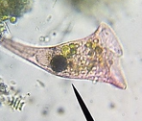
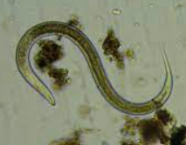

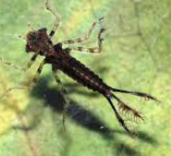
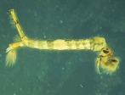


Wet-Mount Slides
1 – What did you see? Keep a list of all the organisms you observed in pond water. Use the identification guides and online resources to help you with identification.
2 – How does water quality affect the types of organisms you can see?
3 - Can you identify these pond water organisms?
http://www.ncbionetwork.org/iet/microscope/
Did you enter all the names of all the organisms you observed?
Bloodworms, oligochaetes, & scuds can tolerate poor water conditions,
Hydra, water fleas, and others need water with high oxygen levels and a balanced chemistry (no pollution).

Slide 33
Wet-Mount Slides
1 – What did you see? Keep a list of all the organisms you observed in pond water. Use the identification guides and online resources to help you with identification.
2 – How does water quality affect the types of organisms you can see?
3 - Can you identify these pond water organisms?
http://www.ncbionetwork.org/iet/microscope/
Did you enter all the names of all the organisms you observed?
Bloodworms, mosquito larva, & scuds can tolerate poor water conditions,
Hydra, water fleas, and others need water with high oxygen levels and a balanced chemistry (no pollution).
Algae
Dragonfly nymph
Euglena
Hydra
Mosquito larva
Mosquito pupa
Nematode
Paramecium
Rotifer
Water bear
Water flea
Dragonfly Nymph
Mosquito Larva
Rotifer
Nematode
Hydra
Algae
Water flea
Water bear
Paramecium
Euglena
Mosquito Pupa

Slide 34
Microscope Basics
Unit Review

Slide 35
Microscope Basics Unit Review
Complete the review assignment on GimKit.
Go to Google Classroom for the link!
Add notes to Slide 6 as you answer the questions to help you on the note quiz.
Upload a screenshot of your “balloon” screen to Google Classroom for credit.
Link: https://www.gimkit.com/view/61682ae59dad3d0023e5dca6
Note Quiz on ______________

