Slide 1
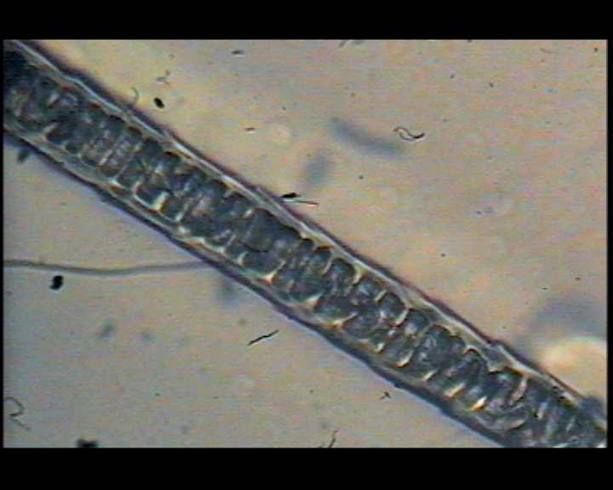
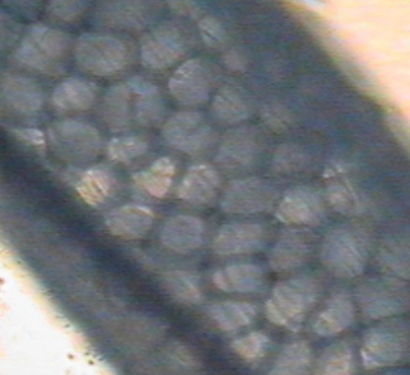
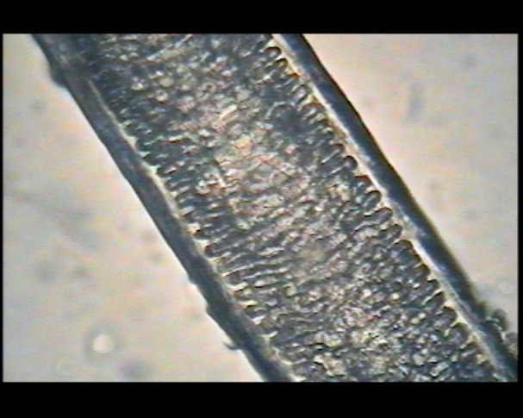
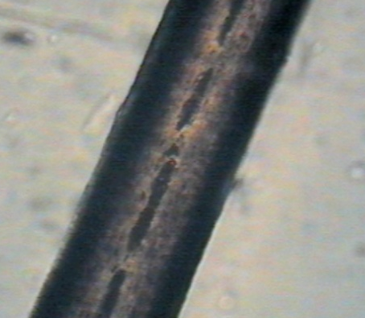
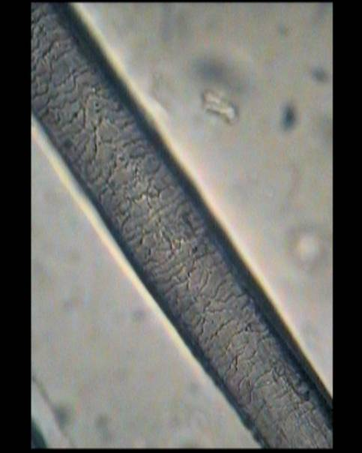
MICROSCOPIC EVIDENCE
Hair Evidence
Forensic Science
Mini Unit
Presentation developed by T. Tomm 2006 Updated 2021 https://sciencespot.net/

Slide 2
Time to pull some hair ...
1- Use a permanent marker to write your name on the plastic sheet from your teacher.
2 – Pull out a strand (or 2) of hair and place it inside the plastic sheet. Make sure it fits all the way inside the plastic.
3 – Listen for your table group to have it laminated.
We will be going over notes while I laminate the hair samples. We’ll look over them after notes!

Slide 3
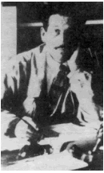

Part A: Microscopic Evidence
"Every Contact Leaves a Trace"
of evidence
The Locard’s Exchange Principle states that "with contact between two items, there will be an exchange."
The value of trace (or contact) forensic evidence was first recognized by Edmund Locard in 1910. He was the director of the very first crime laboratory in existence, located in Lyon, France.
#1
Example:
Burglars will may leave hairs from their body or fibers from their clothing behind and they may take carpet fibers away with them.
Watch the video to finish Part A
You will have to come back to these notes to finish Part B!
Source: http://www.virtualsciencefair.org/2004/fren4j0/public_html/trace_evidence.htm

Slide 4
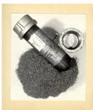
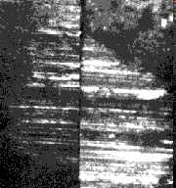
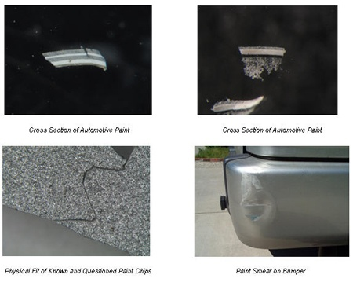
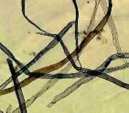
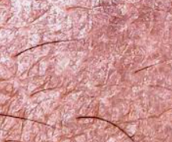
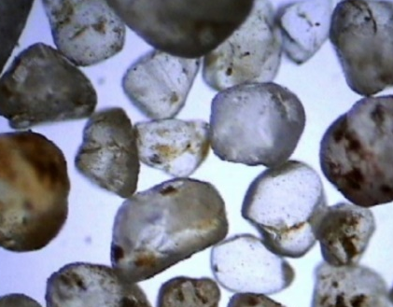
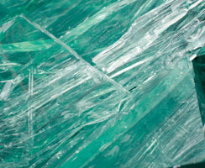
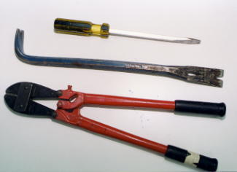
#2 - Microscopic evidence is also called _______ evidence.
TRACE
#3 – Examples of trace evidence includes:
Hairs & Fibers
Explosives
Ballistics
Paint
Biological material (skin, blood, etc.)
Dirt/Sand
Glass
Toolmarks

Slide 5
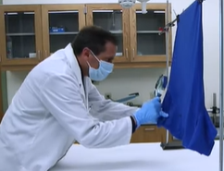
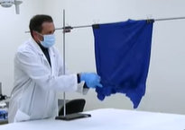
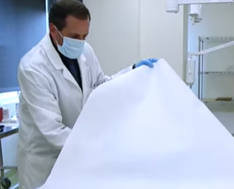
#4 - Collecting Trace Evidence
Visually examine the item to identify possible evidence.
Use methods to collect microscopic items, such as scraping clothing or using tape to lift hairs and fibers.
Collect all evidence for later examination.

Slide 6
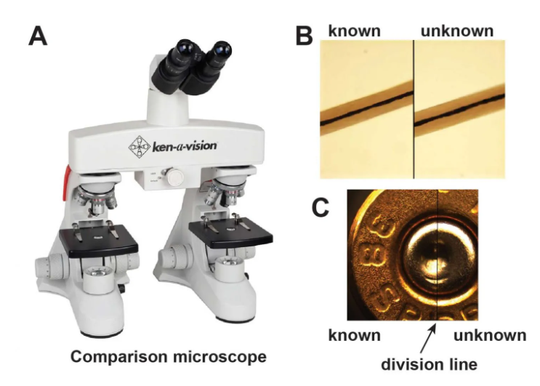
#5 – Comparison Microscope
Two compound microscopes connected to a grid allowing scientists to view two things side by side.
Evidence from a crime scene compared to known samples.
Source: https://rsscience.com/hair-under-a-microscope/

Slide 7
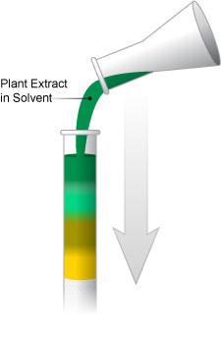
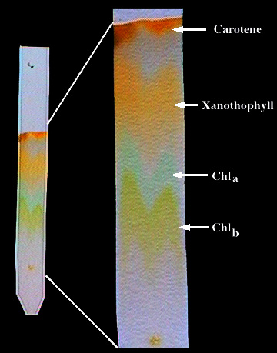
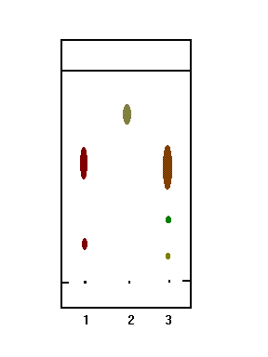
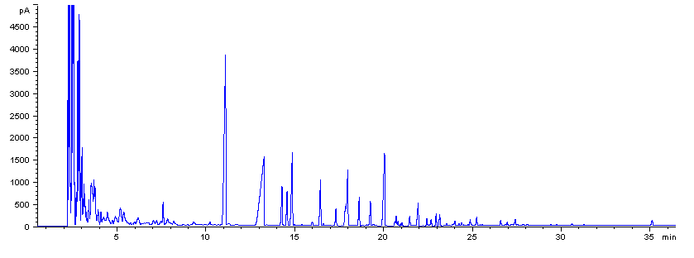
#6 – CHROMATOGRAPHY is the process is used to separate a mixture its different components.
Liquid Chromatography
Used to identify unknown plant pigments & other compounds.
Thin-Layer Chromatography
Uses thin plastic or glass trays to identify the composition of pigments, chemicals, and other unknown substances.
Gas Chromatography
Used to determine the chemical composition of unknown substances, such as the different compounds in gasoline shown by each separate peak in the graph below.
Paper Chromatography
Can be used to separate the components of inks, dyes, plant compounds (chlorophyll), make-up, and many other substances

Slide 8
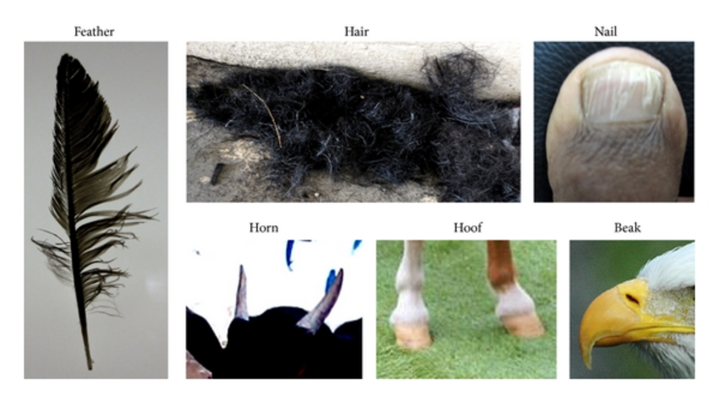
Part B: Biology of Hair
#1
Hair is composed of the protein keratin which is also the primary component of our fingernails and toenails.
Keratin can also be found in other animals, such as bird feathers, horns, hooves, beaks, and fur.
Image Source: https://www.researchgate.net/figure/Sources-of-keratin-Different-sources-such-as-feathers-hair-nails-horns-hooves-and_fig3_272827545

Slide 9
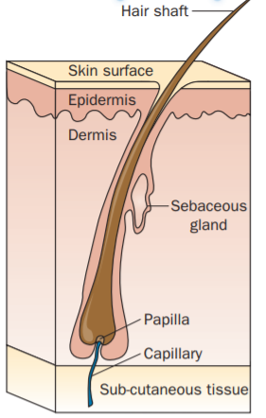
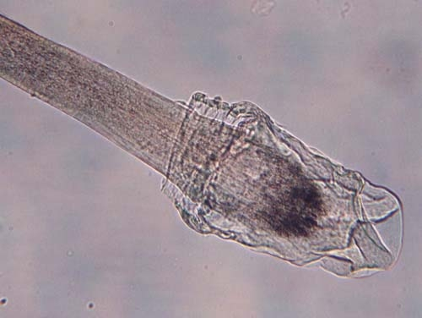
Hair is produced from a structure called the hair follicle (or root.)
Humans develop hair follicles during fetal development, and no new follicles are produced after birth.
#2 → FALSE
In order to test hair evidence for nuclear DNA, the root (or follicular tag) must be present.
Hair may also be tested for mitochondrial DNA, which is the DNA that is found in the mitochondria of our cells.
ROOT
#4 → ROOT
NOTE: Hair that normally falls out does not have a root attached, while hair that is pulled out by force does.
Image 1: https://ngl.cengage.com/assets/downloads/forsci_pro0000000541/4827_fun_ch3.pdf
Image 2: https://dps.mn.gov/divisions/bca/bca-divisions/forensic-science/Pages/trace-hair.aspx

Slide 10
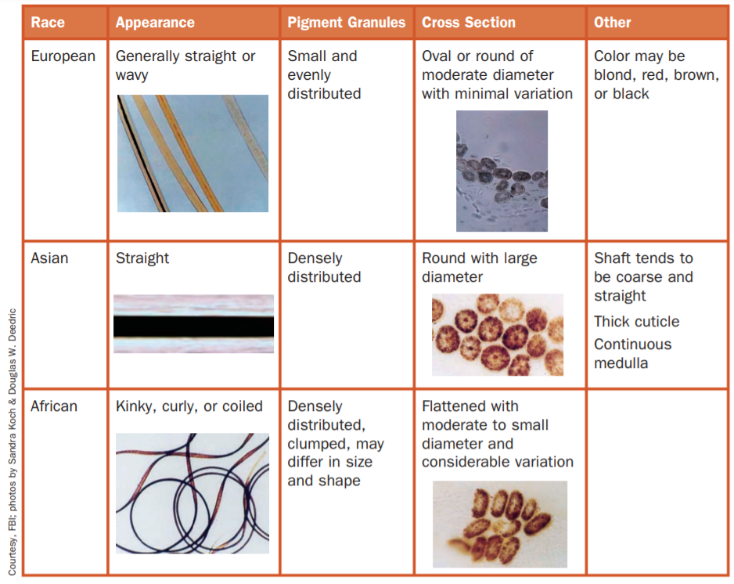
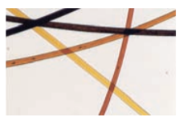
#3
What can we learn from hair evidence?
Genetic Background
Differences in the structure of hair, shape of the strand itself, and hair texture can be determined by the characteristics of a strand of hair.
Dyed hair samples
Hair color – Pigments, are chemical compounds that reflect certain wavelengths of visible light, which we see as color. Hair that has been dyed can also be helpful to connect an individual to a hair from a crime scene.
https://ngl.cengage.com/assets/downloads/forsci_pro0000000541/4827_fun_ch3.pdf

Slide 11
Diet/nutrition– Condition of the hair samples may give clues to an individual’s diet or nutritional history (especially if lacking in specific vitamins & minerals.)
Drug Use/Medications – Chemical tests and analysis can provide evidence of drug use to provide clues about a suspect or victim.
Intentional alteration, from the use of heat curling, perms, straightening, etc.) may mask natural hair color/type making identification more challenging.
Hair Trivia
How many hairs does the average human have at a given time on their scalp?
A. 100,000 B. 500,000 C. 1,000,000
How many hairs does the average person shed in a day?
A. 100 B. 300 C. 500
What is the worlds’ record for the longest hair?
A. 14 ½ feet B. 19 ½ feet C. 26 ¼ feet

Slide 12
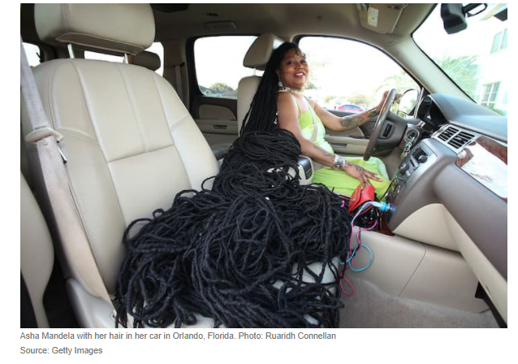

Slide 13
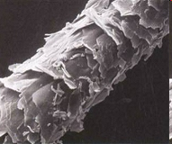
Part C: Hair Structure
CUTICLE
Outer coating composed of
overlapping scales
The cuticle varies in:
  Its scales,
  How many there are per centimeter,
  How much they overlap,
  Their overall shape, and
  How much they protrude from the surface
  Its thickness, and
  Whether or not it contains pigment.
Characteristics of the cuticle may be important in distinguishing between hairs of different species but are often not useful in distinguishing between different people.
Info: http://library.thinkquest.org/04oct/00206/lesson.htm#t_hair Image: http://www.hairdressersus.com/micro/Image5b.jpg

Slide 14
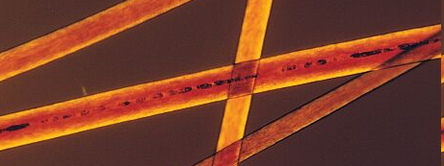
CORTEX
Protein-rich structure
around the medulla that
contains pigment
The cortex varies in:
  Thickness
  Texture
  Color
Distribution of the cortex is perhaps the most important component in determining from which individual a human hair may have come.
Microscopic examination can also reveal the condition and shape of the root and tip.
Info: http://library.thinkquest.org/04oct/00206/lesson.htm#t_hair Image: http://www.extrapersonality.com/hair.html

Slide 15
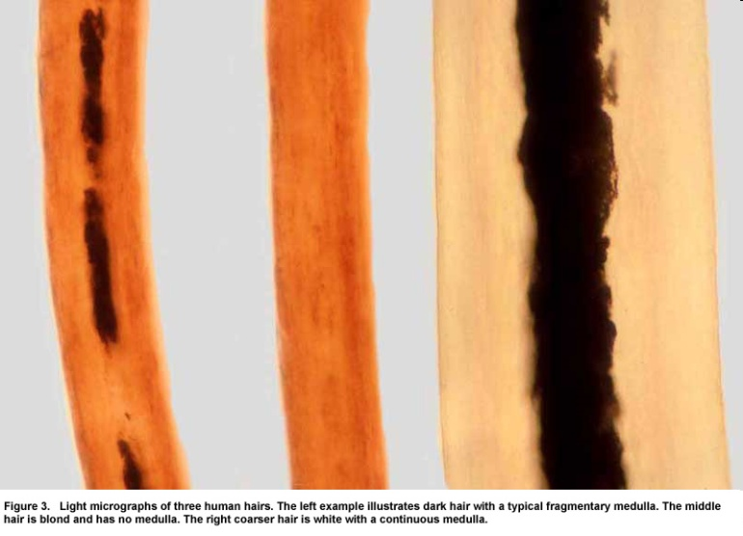

MEDULLA
Central core (may not be
present in all hair samples)
The medulla may vary in:
  Thickness
  Continuity - one continuous structure
  or broken into pieces
  Opacity - how much light is able to
  pass through it
It may also be absent in some species.
Like the cuticle, the medulla can be important for distinguishing between hairs of different species, but often does not lend much important information to the differentiation between hairs from different people.
http://library.thinkquest.org/04oct/00206/lesson.htm#t_hair
http://www.bfro.net/images/whatis/figures/Fig.%203%20with%20caption.jpg

Slide 16
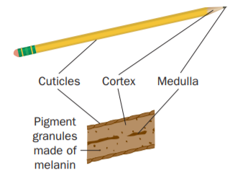
How is a hair like a pencil?
The structure of hair has been compared to that of a standard pencil with the medulla being the lead, the cortex being the wood and the cuticle being the paint on the outside.
https://ngl.cengage.com/assets/downloads/forsci_pro0000000541/4827_fun_ch3.pdf

Slide 17
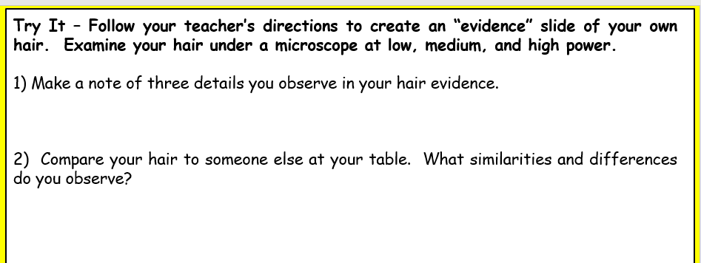
Let’s take a closer look …
Use a microscope to examine YOUR hair sample.
Change the powers of magnification (low → medium → high) and use the focus to observe the different layers of hair and the root.
Make sure examine the cuticle, cortex, and medulla if you see one.
Examine a hair sample from another student at your table and then answer questions #1 & 2 on your notes.
Things to note …
Color(s) of the hair
Cuticle pattern
Root & description
Medulla pattern
Ends (smooth or split)

Slide 18
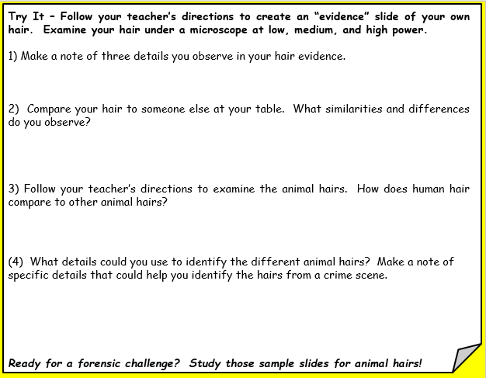
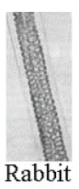
Time to examine some animal hairs …
Human vs. Other Animals
Cuticle pattern(s)
Medulla pattern(s)
Be sure to mention specific samples in your comparisons!
For each animal, make a note of specific details that would help you identify it later. You may also draw details on an index card.
Example: Rabbit hair - Squares make up its medulla.
Each table group will receive ONE set of animal hairs to examine. Do not share slides with other groups!
Image: https://www.mccrone.com/mm/untangling-hairy-science/

Slide 19
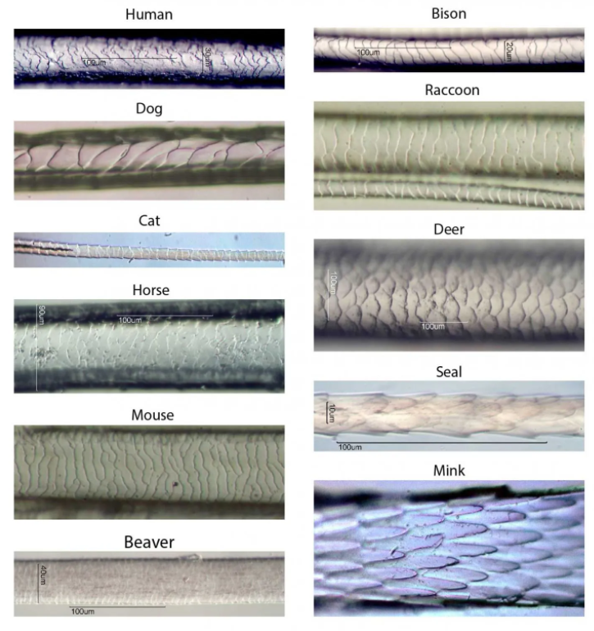
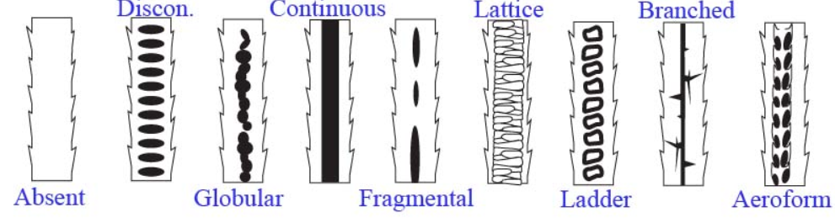

What animal is it?
Microscopic examination of animal hairs can reveal minute details to help scientists identify them. The cuticle and medulla can be helpful in identifying a specific animal species.
Cuticles - Use a microscope to examine the cuticle in the animal hairs provided by your teacher. Can you find any that match the patterns shown in this image?
Medulla – Examine the center of each strand to find the patterns shown in this image. Did you find other patterns?
Micro Challenge begins in
Images: https://rsscience.com/hair-under-a-microscope (top) and http://www.microlabgallery.com/gallery/images/medulla%20draw%202.jpg (bottom)

Slide 20
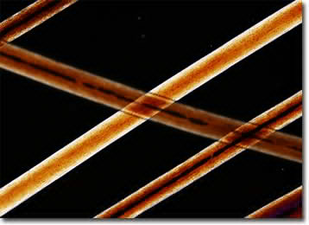
Animal Hair Challenge
Work with your table mates to examine the hair slides to identify the mystery hairs.
http://micro.magnet.fsu.edu/primer/techniques/polarized/gallery/images/humansmall.jpg

Slide 21
Challenge Rules
Your investigative team (table group) must examine the hair samples to identify the NINE mystery hairs show on the next slide.
Your team may use only TWO microscopes.
Your team must make a guess on all the samples before getting it checked by the teacher.
ONE person in your group will need to take the answer slip to get checked. After it is checked, return to your spot and fix the ones you missed. Keep checking the answers until you have it all correct.
The FIRST team with all of them correct will win soda (for tomorrow) and candy! All other teams done before the bell rings will win candy.
No Googling or sharing of answers!

Slide 22
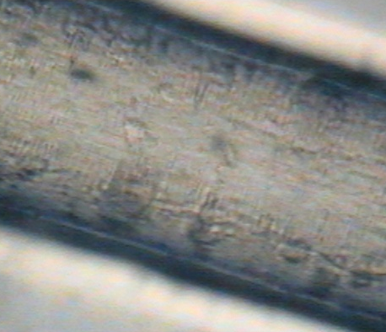
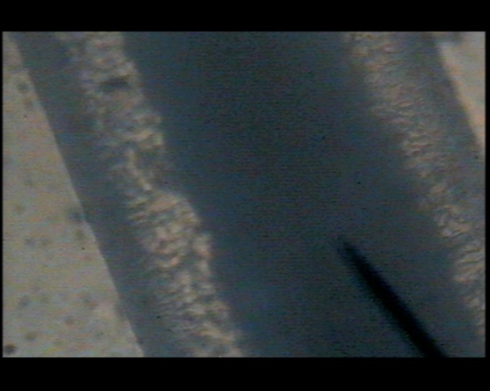
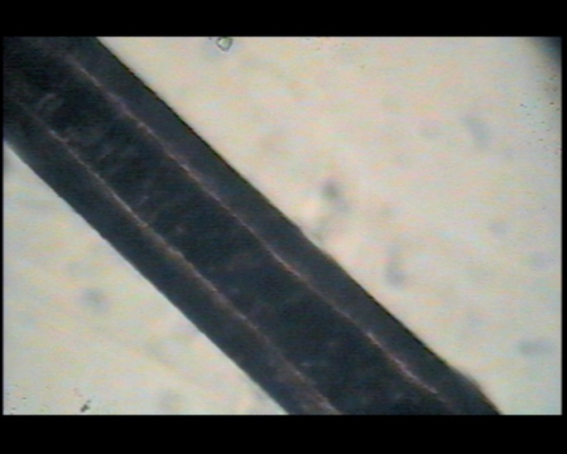
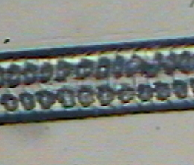
Can you identify these mystery hairs?
A
B
C
D
E
F
G
H
I
NOTE: There are 2 human samples. You do not have to tell if it is dyed, blonde, etc.
Notes:
Teacher Note: I challenge students to identify each hair sample pictured on this slide as they examine the sets of animal hairs I have prepared for them. An observation worksheet is available on my website which requires students to draw an image of what they see and add a description that highlights unique characteristics of each specimen. A key for the animal hairs is available on the last slide of this presentation!

Slide 23
Answer Key
http://micro.magnet.fsu.edu/primer/techniques/polarized/gallery/images/humansmall.jpg

Slide 24
Can you identify the animal hairs shown?
A
B
C
Cat
Horse
Pig
Human
Deer
Dog
Rabbit
Rat
Human
D
E
F
G
H
I
Notes:
Teacher Note: I challenge students to identify each hair sample pictured on this slide as they examine the sets of animal hairs I have prepared for them. An observation worksheet is available on my website which requires students to draw an image of what they see and add a description that highlights unique characteristics of each specimen. A key for the animal hairs is available on the next to last slide of this presentation!

