Slide 1

Meet the Elements
Student Digital Worksheet
https://docs.google.com/presentation/d/1VUSbLDURe0lCjYWMiuTsiYTywbWi61avL9-yy80gJxI/copy
Directions: Fill in as many of the answers as you can while you watch the video. It goes fast and we will watch it a couple times before we go over the answers on the next slide.
Elements → Give the chemical symbol (letters)
Compounds → Give the chemical formula (with subscripts if needed)
Click to watch the video →

Slide 2
ANSWERS
1. _____ + ____ = Rust
2. ____forms coal and diamonds
3. ______ is the chemical formula for sand
4. ______________ are elements are in coins
5. _____& ____are elements in glass and concrete
6. __________ is the chemical formula for sugar
7. ____& ___are the elements in propane
8. ______________ are the 4 elements are in all living things
9. ______ is the chemical formula for water
10. _____ & ___ combine to make salt
11. ________ is the chemical formula for chalk
12. ____ is used to make light bulb filaments
Fe
O
C
SiO₂
Cu, Ni, & Zn
Si
O
C₁₂H₂₂O₁₁
C
H
C, H, N, & O
H₂O
Na
Cl
Ca₂SO₄
What is this compound? CaCO₃
W

Slide 3
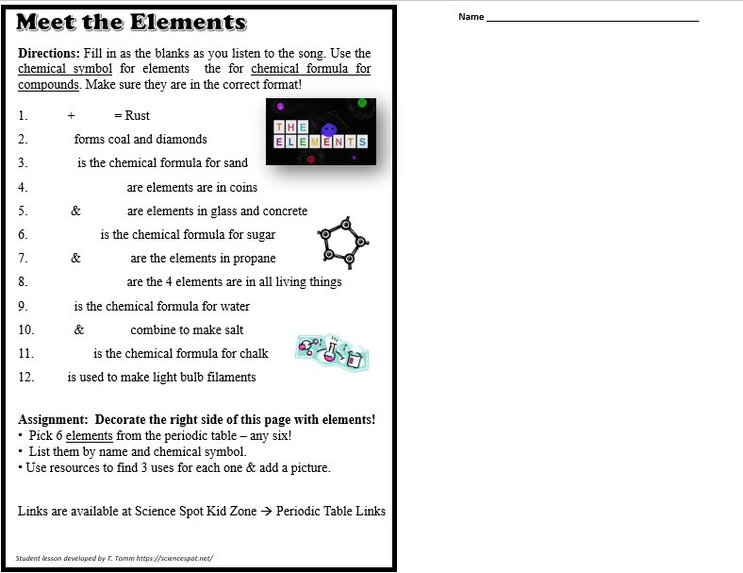

Example
Assignment: Decorate the right side of this page with elements!
Pick 6 elements from the periodic table – any six!
List them by name and chemical symbol.
Use resources to find 3 uses for each one & add a picture.
Student lesson developed by T. Tomm https://sciencespot.net/

Slide 4

Student Worksheet Master
Downloaded as PNG and added to Google Slides as a background image.
https://docs.google.com/presentation/d/1VUSbLDURe0lCjYWMiuTsiYTywbWi61avL9-yy80gJxI/copy
Meet the Elements
Name _________________________________________
Directions: Fill in as the blanks as you listen to the song. Use the chemical symbol for elements the for chemical formula for compounds. Make sure they are in the correct format!
1. _____ + _____ = Rust
2. ______ forms coal and diamonds
3. ______ is the chemical formula for sand
4. ______________ are elements are in coins
5. ______& ______ are elements in glass and concrete
6. __________ is the chemical formula for sugar
7. ______& ______ are the elements in propane
8. ______________ are the 4 elements are in all living things
9. ______ is the chemical formula for water
10. _____ & ______ combine to make salt
11. ________ is the chemical formula for chalk
12. ____ is used to make light bulb filaments
Assignment: Decorate the right side of this page with elements!
Pick 6 elements from the periodic table – any six!
List them by name and chemical symbol.
Use resources to find 3 uses for each one & add a picture.
Links are available at Science Spot Kid Zone → Periodic Table Links
Example
Student lesson developed by T. Tomm https://sciencespot.net/

