Slide 1
Estimation Challenge
How long is a meter?
T. Tomm 2013
http://sciencespot.net/
Standard Version

Slide 2
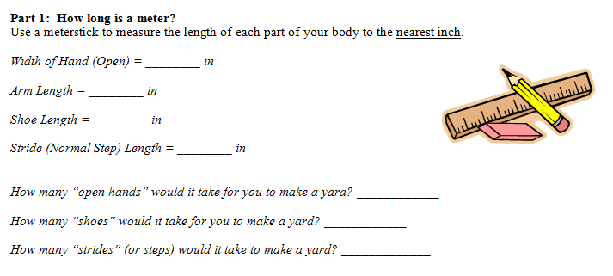

Slide 3
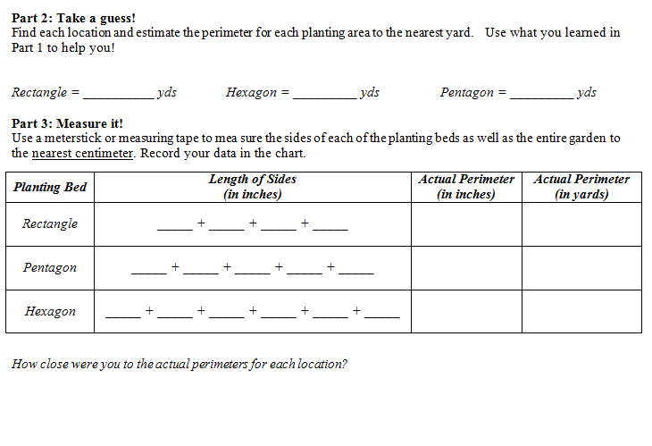

Slide 4
