Slide 1
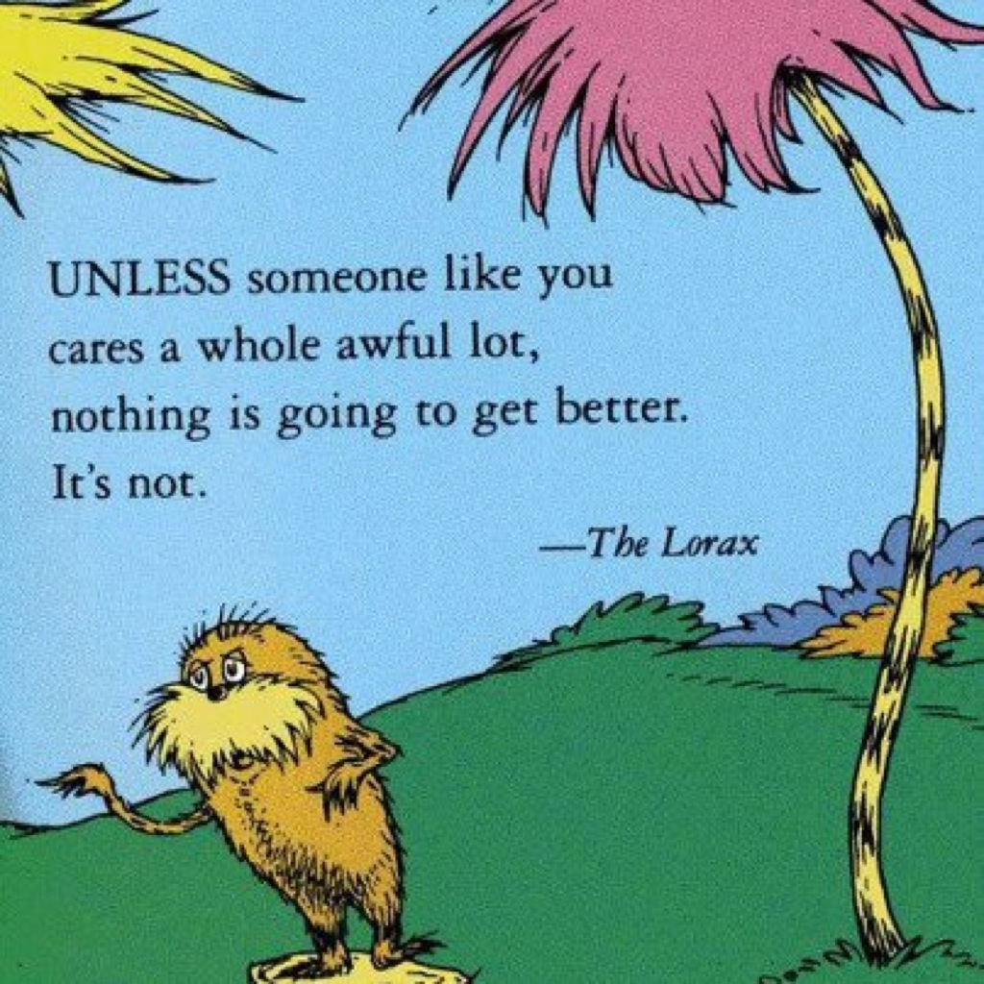
Lessons from the Lorax
Part A Part B Part C
Presentation developed by T. Tomm 2013 Updated 2020 https://sciencespot.net/

Slide 2
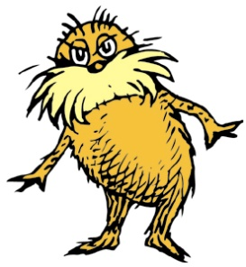

Glue the worksheet on page ___ FAF Right.
PART A: THE ORIGINAL - Answer the questions as you watch the video (also on EDPuzzle.)
Part B: Think About It – Answer the questions based on the original movie.
Part C: We will watch the newest movie in class.

Slide 3
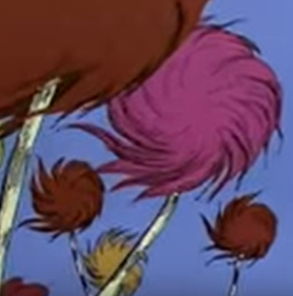
What was the job of the Lorax?
2. What did the Onceler make?
What did he use?
What are three ways they can be used?
3. Why did the Barbaloots leave?
To speak for the trees
What do you think the “trees”
represent?
Thneeds
Truffula trees
Socks, gloves, carpets, pillows, sheets
Not enough food – truffula fruits

Slide 4
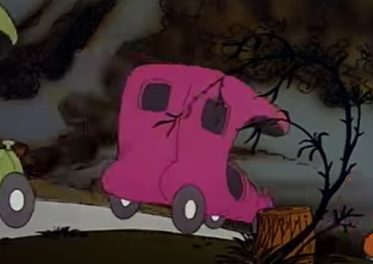
4. Why did the Swamee Swans leave?
5. What happened to the Humming Fish?
6. What did the town look
like at the end of the
movie?
Too much air pollution – couldn’t “sing”
They had to leave after the water was polluted by “gluppity-glup”
It was a barren wasteland of nothing

Slide 5
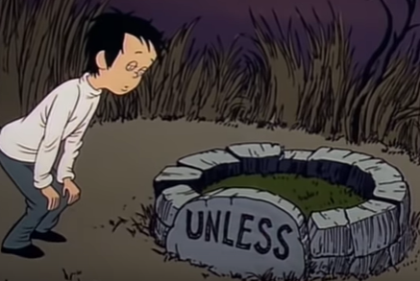
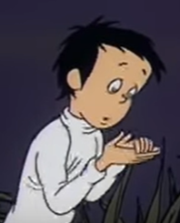
7. Complete the quote:
“Unless someone like you
cares a whole awful lot …
8. What did the Onceler give to the kid
at the end?
Nothing is going to get better its not.
The last truffula seed
What is a hoosegow?
Jail or prison

Slide 6
PART B: THINK ABOUT IT- Write responses for these questions after you finish the video.
1. What does the Onceler think is important?
2. The Lorax story is often called a “cautionary” tale. Explain why using at least 2 specific examples from the movie.
Making money or progress
The Lorax warned the Onceler that he needed to stop cutting down trees to save food for the Barbaloots. The Onceler did not stop and they had to leave to find food.
What examples did you use?

Slide 7
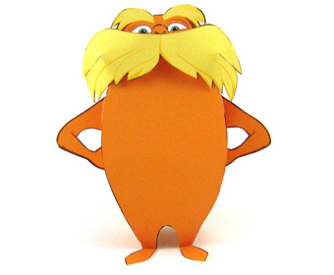
Part C: Latest Lorax
I will pause the video at various points to discuss questions.
Write your answers to the questions on page 19 (UNDER your Lorax worksheet.)
You may use page 18 if you need more room.
Absent? Go to mrstomm.com → Assignments for the questions.

Slide 8

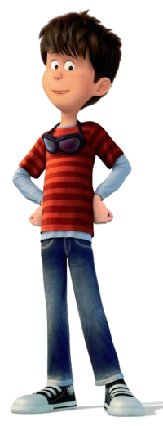
Thneedville
#1
How is
Thneedville different
from today’s world?
Describe 3 differences.
Possible answers include: plastic trees, electric trees, food looked like Jello, more technology, smaller cars, pollution outside of the city/shiny inside, paid for air
Absent? Go to mrstomm.com → Assignments for the questions.

Slide 9


Today’s Thneeds
#2
What might be considered Thneeds in today’s world?
List at least 5 things we want, but don’t really need.
Possible answers include:
Cell phones – Must need a basic phone, but we want the latest ones
Clothing – Need warm clothes for winter, but don’t need brand name expensive ones
Food – Need food to nourish our bodies, but don’t need to eat at restaurants or eat a lot of fast foods
Absent? Go to mrstomm.com → Assignments for the questions.

Slide 10
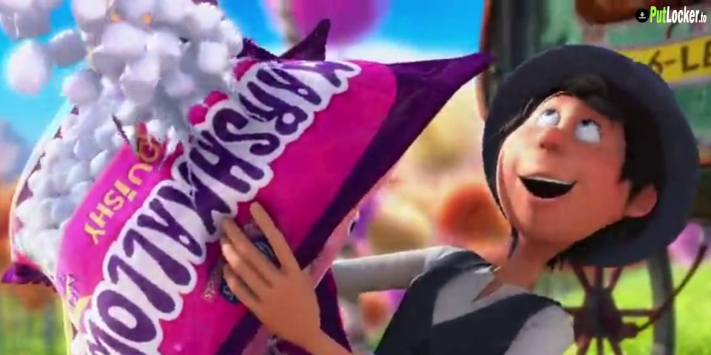
Gimmicks
#3
What tricks do companies use to make us think we “Thneeds”? List at least 5 things companies do to motivate us to buy their products.
Possible answers include: Sales & discounts, freebies, BOGO (buy one, get one free), “New & improved” products, products will save you time/effort/money, everyone else has one, celebrities sponsor/support products, or donations to charity

Slide 11

Way You Lean
#4
“A tree falls the way it leans,
so be careful how you lean.”
What did the Lorax mean by this
statement? Use at least 3
sentences in your answer.
The word “lean” refers to what we believe in or what is important to us. Our choices and decisions will be based on those beliefs. For example, the Once-ler felt that money was important and his actions helped him get more money.

Slide 12

Dr. Suess
#5
Dr. Suess wrote the original story in 1971. Is it outdated or does it still apply to today’s world? Explain your answer.
The story is still relevant today – some might argue it is more relevant today. We are still facing issues related to conserving Earth’s resources, reducing pollution, and living a more sustainable lifestyle.
Absent? Go to mrstomm.com → Assignments for the questions.

Slide 13
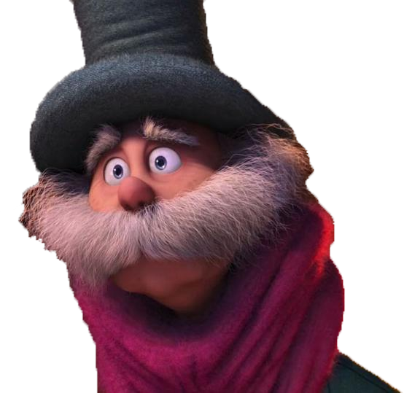
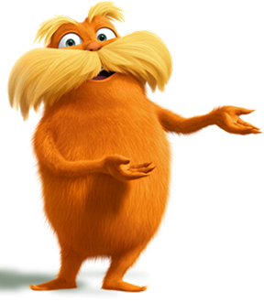
#6
Once-ler → Lorax
How does the Once-ler’s perception of the Lorax
change from the start to the
end of the newest video?
Do we view people like the “Lorax” the same way?
The Once-ler thought the Lorax was a pest in the beginning and did not believe him. By the end of the movie, he realized the Lorax was right and respected him. Many people today still have negative views of environmental activists, but others are starting to listen.

Slide 14
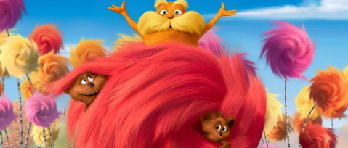
Environmental Issues
#7
What environmental issues
were illustrated in the movies
(original and most recent)?
Identify at least 3 issues.
See the next slide …

Slide 15
Today’s environmental concerns are …
Work with your tablemates to make
a list in your notebook of at least 5 concerns.
Do you know what causes each issue?
Do you know what we can do to help?
Be prepared to share with the class.

Slide 16
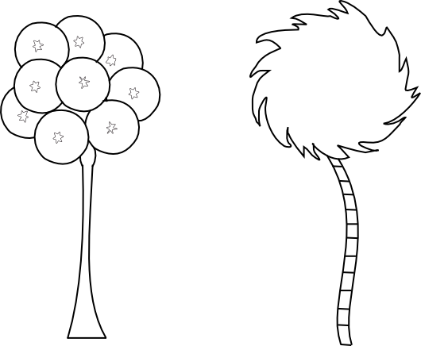
Time to share - today’s environmental concerns are …
What causes each issue? What can be done to help?

Slide 17
Environmental Concerns Summary
Overconsumption =
Using too many resources
Renewable (sun, wind, water, plants) vs. nonrenewable (fossil fuels – oil, coal, ores, etc.)
Amounts of trash/garbage, water usage,
3 Rs – reduce, reuse, recycle
Overpopulation
US vs. World,
More people = more stuff
= More resources used up
Pollution
Air, soil, water, noise, & light
Effects on animals, humans, plants
Climate Change
Greenhouse effects → global warming, rising ocean levels, effects on animals, weather patterns, etc.
Biodiversity
Deforestation & habitat loss, extinction, & invasive species
What causes each issue? What can be done to help?

Slide 18
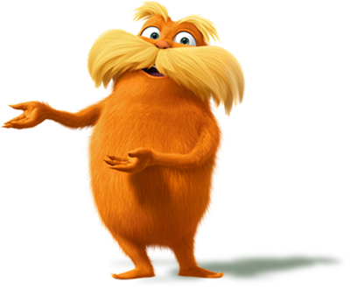
Challenge: In the newest video, Ted takes a stand against Mr. OHare just as the Lorax took a stand against the Once-ler.
What can you do to be more like Ted and the Lorax by “speaking for the trees”?
Create a game, app, online poster to teach people about the environmental concern you researched. Include things people can do to be “guys and gals who care” about our planet.

