Slide 1
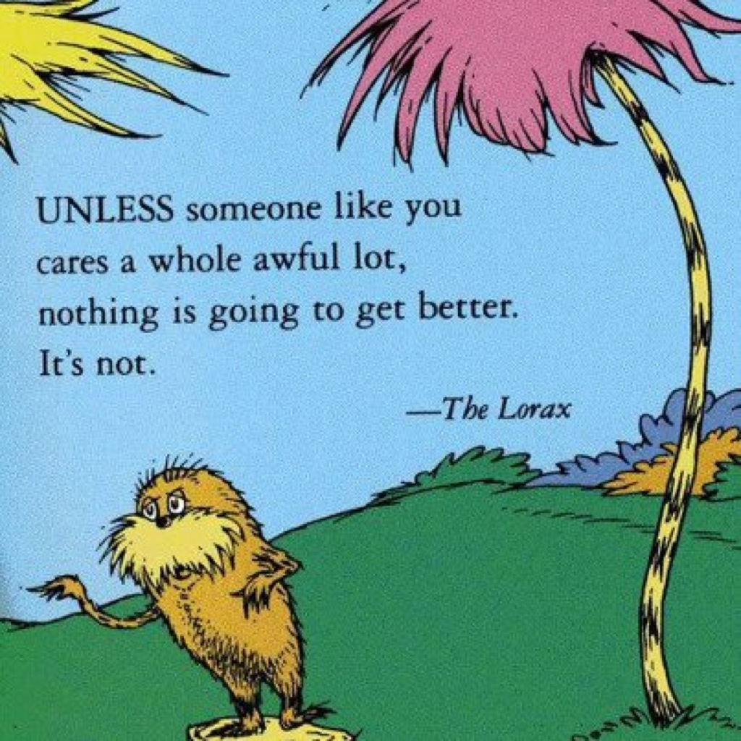
Lessons from the Lorax
Part A Part B Part C
Presentation developed by T. Tomm 2013 Updated 2022 https://sciencespot.net/

Slide 2


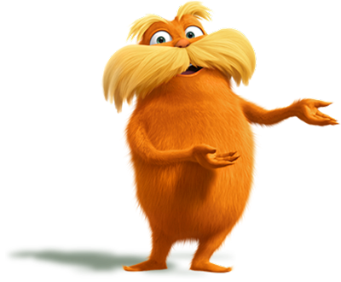
Go to Google Classroom to find the assignment.
Go to Slide 1.
PART A: THE ORIGINAL - Answer questions #1-7 on Slide 1 as we watch the video. We will review the answers after the movie.
Part B: We will watch the newest movie in class & discuss environmental issues it involves.
Part C: We will calculate our eco-footprints to see how our lifestyles impact the planet.

Slide 3
What was the job of the Lorax?
2. What did the Onceler make?
What did he use?
What are three ways they can be used?
To speak for the trees
What do you think the “trees”
represent?
Thneeds
Truffula trees
Socks, gloves, carpets, pillows, sheets

Slide 4
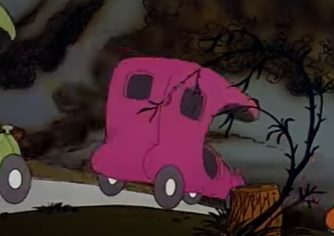
3. Why did the Barbaloots & Swamee Swans leave?
4. What happened to the Humming Fish?
5. What did the town look like at
the end of the movie?
Barbaloots - Not enough food – truffula fruits
Swans - Too much air pollution – couldn’t “sing”
Humming Fish - Water was polluted by “gluppity-glup”
A barren wasteland of nothing

Slide 5
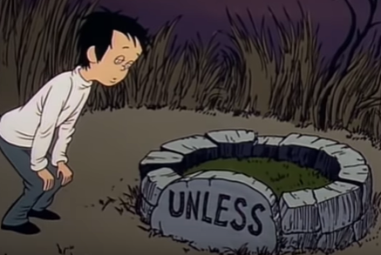
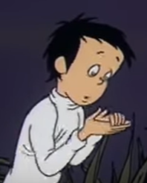
6. Complete the quote:
“Unless someone like you
cares a whole awful lot …
7. What did the Onceler give to the kid
at the end?
Nothing is going to get better its not.
The last truffula seed
What is a hoosegow?
Jail or prison

Slide 6
8. What does the Onceler think is important?
9. The Lorax story is often called a “cautionary” tale. Explain why using at least 2 specific examples from the movie.
Making money or progress
The Lorax warned the Onceler that he needed to stop cutting down trees to save food for the Barbaloots. The Onceler did not stop and they had to leave to find food.
What examples did you use?

Slide 7
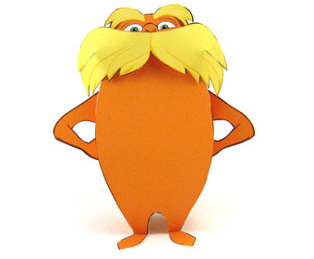
Part B: Latest Lorax
I will pause the video at various points to discuss the video questions.
You will need to write your answers to the questions on Slide 2.

Slide 8

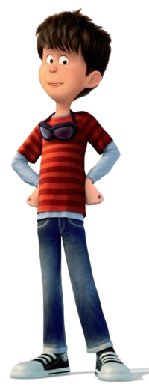
Thneedville
#1
How is Thneedville different
from today’s world?
Describe 3 differences.
Possible answers include: plastic trees, electric trees, food looked like Jello, more technology, smaller cars, pollution outside of the city/shiny inside, paid for air
Pair & Share: How does the original movie compare with the newest one? Can you think of three similarities or differences?

Slide 9


Today’s Thneeds
#2
What might be considered
Thneeds in today’s world?
List at least 5 things we want,
but don’t really need.
Possible answers include:
Cell phones – Must need a basic phone, but we want the latest ones
Clothing – Need warm clothes for winter, but don’t need brand name expensive ones
Food – Need food to nourish our bodies, but don’t need to eat at restaurants or eat a lot of fast foods

Slide 10
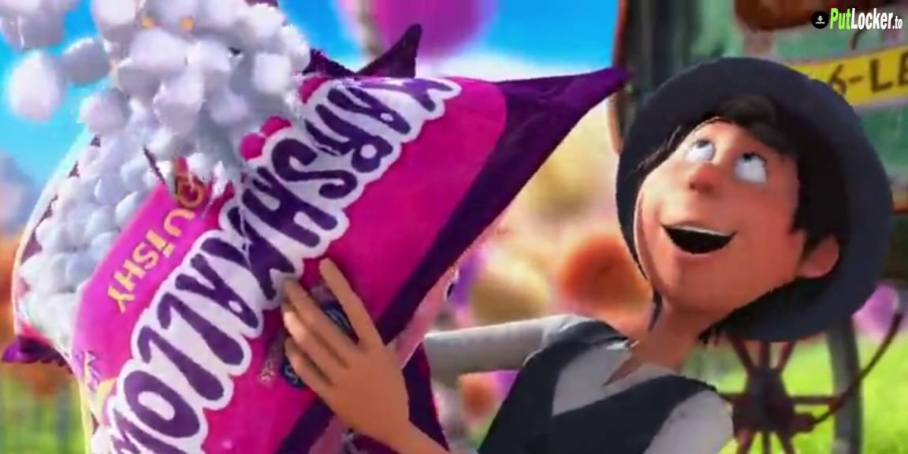
Gimmicks
#3
What tricks do companies use to make us think we need “Thneeds”? List at least 5 things companies do to motivate us to buy their products.
Possible answers include: Sales & discounts, freebies, BOGO (buy one, get one free), “New & improved” products, products will save you time/effort/money, everyone else has one, celebrities sponsor/support products, or donations to charity

Slide 11

Way You Lean
#4
“A tree falls the way it leans,
so be careful how you lean.”
What did the Lorax mean by this
statement? Use at least 3
sentences in your answer.
The word “lean” refers to what we believe in or what is important to us. Our choices and decisions will be based on those beliefs. For example, the Once-ler felt that money was important and his actions helped him get more money.

Slide 12

Dr. Suess
#5
Dr. Suess wrote the original story in 1971. Is it outdated or does it still apply to today’s world? Explain your answer.
The story is still relevant today – some might argue it is more relevant today. We are still facing issues related to conserving Earth’s resources, reducing pollution, and living a more sustainable lifestyle.

Slide 13
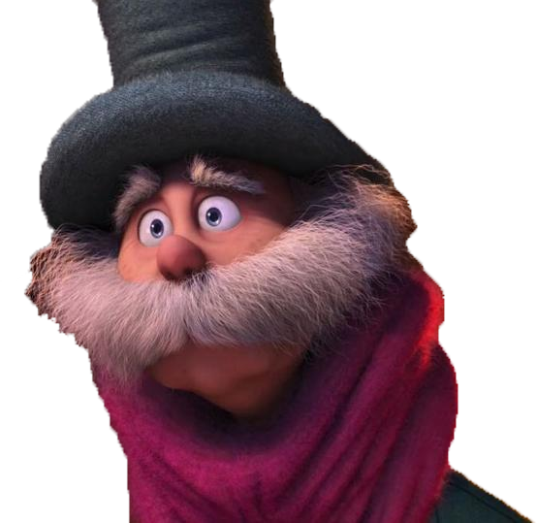
#6
Once-ler → Lorax
How does the Once-ler’s perception of the Lorax change from the start to the end of the newest video?
Do we view people like the
“Lorax” the same way?
The Once-ler thought the Lorax was a pest in the beginning and did not believe him. By the end of the movie, he realized the Lorax was right and respected him.
Many people today still have negative views of environmental activists, but many others are starting to listen and take action to protect our resources.

Slide 14
#7
Unless
What does the quote in the image at right mean?
What did you say?

Slide 15
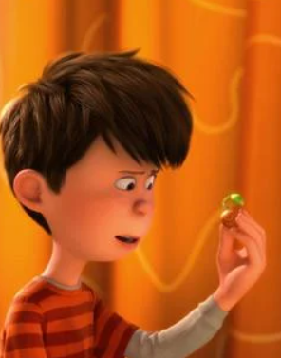
Environmental Issues
What environmental issues
are we facing today?
Identify at least 5 issues.
Be prepared to share with your classmates.
Let’s make a list on the side of your slide …
Click to go to the next slide!

Slide 16
Today’s environmental concerns are …

Slide 17
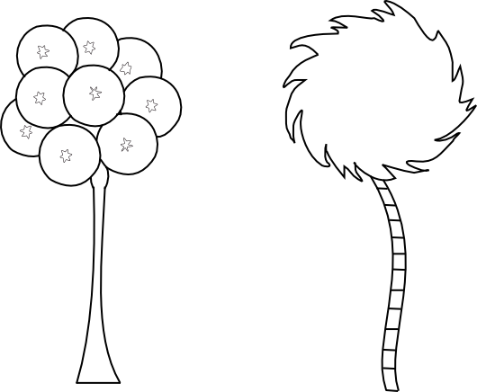
Environmental Concerns Summary
Overconsumption =
Using too many resources
Renewable (sun, wind, water, plants) vs. nonrenewable (fossil fuels – oil, coal, ores, etc.)
Amounts of trash/garbage, water usage,
3 Rs – reduce, reuse, recycle
Overpopulation
US vs. World,
More people = more stuff
= More resources used up
Pollution
Air, soil, water, noise, & light
Effects on animals, humans, plants
Climate Change
Greenhouse effects → global warming, rising ocean levels, effects on animals, weather patterns, etc.
Biodiversity
Deforestation & habitat loss, extinction, & invasive species
What causes each issue? What can be done to help?

Slide 18
Note: All points/values on the following slides are estimated and should not be taken as absolute measurements. This focus of the activity is on student awareness of their footprints and things that negatively or positively impact it.
What's your
EcoFootprint?
https://www.schooltube.com/media/t/1_octv5jyj
T. Tomm 2008 Updated: 2022 https://sciencespot.net/

Slide 19


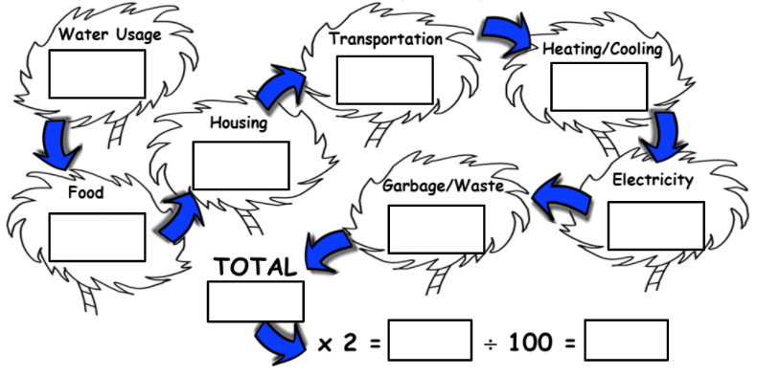
Let’s calculate your “ecological footprint” …
Your ecological footprint is the impact your lifestyle has on the
Earth and its resources.
By answering the questions on the following slides, you will calculate the points for each category in the diagram below. The points will be used to determine your footprint.
You may add a textbox to your slide or use scratch paper to help you keep track of points you need to add or subtract for each category.
If you are not sure of an answer, use your BEST GUESS!
If you live in two different places, pick ONE to answer the questions.

Slide 20

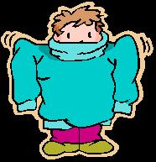
WATER USAGE
Start this SECTION WITH 50 POINTS since we all use water for cooking, drinking, cleaning, and other activities. Add or subtract points depending on your water usage.
50 POINTS
PICK ONE:
Take a bath or shower ONLY once or twice a week→ -20
Take a bath or shower every other day → -10
Take a shower every day → - 5
Subtract another 5 points if your shower is less than 5 minutes
PICK ONE: How many times do you wear your clothes before washing them?
Always wear them more than once → -10
Most of the time → -5
Never – always wash them after wearing once → -0
Water Usage
Do you turn off the water while you brush your teeth?
Yes = -10 No = -0
Does your family collect rainwater for gardening & other outdoor needs? - 10

Slide 21

FOODS
Start this SECTION WITH 100 POINTS since we all need to eat.
Add or subtract points depending on the questions below.
PICK ONE – Is your family mostly:
Carnivores? -5 Omnivores? -10 Herbivores? -20
PICK ONE - Does your family:
Buy only fresh foods (vegetables, fruit, bread, and meat)? -20
Buy a combination of fresh and processed food? -10
Buy mostly packaged foods or ready-to-cook foods? -0
100 POINTS
What else does your family do to reduce your footprint?
Does your family have a garden? -10
Does your family can or freeze foods for use during the winter? -10
Does your family hunt local wildlife or fish? -10
Does your family raise livestock or buy from a local farmer? -10
Does your family eat out at restaurants? Add TWO POINTS for EVERY MEAL you have eaten at/from a fast food or restaurant in the last week?
Food

Slide 22
HOUSING
The amount of resources needed to build and maintain the places
where we live depends on the size of it and the number of people
living with us. Start this section with 0 points and add points
based on the following items:
Add 5 points for each person in your home (the ones who stay there
overnight.)
How big is your house? Add 10 points for each level (story) that
has living space. (Example: Basement plus 2 levels = 30 points)
How many pets do you have (inside and outdoor)?
Add 2 points for each one.
Notes:
Pets include birds, lizards, turtles, hamsters, Guinea pigs, spiders, etc.
Livestock, such as pigs, cattle, chickens, goats, etc. do not count as pets.
Add 4 points for each bird cage or fish tank regardless of how many are in it.
0 POINTS
Housing

Slide 23
TRANSPORTATION
Start this 0 POINTS for this section and add points depending on the ways you and your family travel.
PICK ONE - How did you get to school today?
Rode in small car (or a school bus) →+10
Rode in a medium/large car or van →+15
Rode in a truck or SUV →+25
Walked or rode a bicycle to school →+0
ADD POINTS FOR ALL OF THESE THAT APPLY:
How many times in the last week have you traveled more than 30 mins/30 miles from home? Add +5 for each trip.
How many passenger vehicles (car, truck, van, SUV) does your family own? Add +5 points for each.
How many ATVs, motorbikes, boats, or other motorized vehicles does your family own? Add +5 points for each.
NOTE: Don’t count tractors, mowers, campers, etc.
0 POINTS
Transportation

Slide 24
HEATING/COOLING YOUR HOME
In this section START WITH 50 POINTS since heating a house usually uses energy obtained by burning fossil fuels, which releases carbon dioxide into the atmosphere. To soak it up, trees will have to be planted, using up precious land. So, subtract points for each energy-saving thing you do.
50 POINTS
SUBTRACT POINTS FOR ALL OF THESE THAT APPLY:
Your home is well insulated (no drafts or cold walls) →-10
Your home has new windows (well sealed, double/triple pane) →-5
Your family sets the thermostat low in the winter and high in the summer →-5
Your family only turns on the air conditioning when necessary →-5
Your home has a programmable thermostat → -10
Heating/Cooling

Slide 25
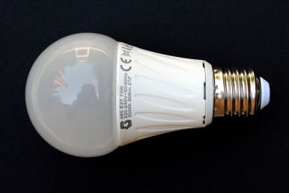

POWER (or ELECTRICITY)
For most people, the electricity they use comes from burning fossil fuels which releases carbon dioxide. START THIS SECTION WITH 100 POINTS and subtract points for every electricity-saving thing you do.
100 POINTS
Do you (& your family):
Use GREEN ENERGY (solar, hydro, or wind power) sources for your
home’s power? -25
Switch off the lights if a room is no longer in use?
Always → -20 Most of the time → -10
Electricity
ALWAYS UNPLUG THESE ITEMS when they are not in use?
TVs →-10 Computers →-10 Game systems →-10
(- 5 if you turn them off, but don’t unplug them)
ALWAYS UNPLUG CHARGERS when they are not in use? -5
Use at least 5 compact fluorescent or LED light bulbs in your home →-5

Slide 26

GARBAGE/WASTE
You can’t help but create some waste, and what you throw
away must be disposed of in landfill sites, using up valuable
land as well as resources to transport it. START WITH A
SCORE OF 50 POINTS and subtract points for everything
you do to reduce waste.
Does your family:
Recycle PAPER, METAL, PLASTIC, and GLASS? -5 points for each material recycled (20 pts max)
Use COMPOSTING for kitchen and garden waste? -5
REDUCE WASTE by buying in bulk and avoiding excess packaging? -5
FIX or REPAIR broken or damaged items instead of buying new? – 5
Buy USED items (including secondhand clothes)? -5
DONATE ITEMS that you can no longer use or wear ? -5
Use REUSABLE CONTAINERS instead of single-use plastics ? -5
Use a GLASS OR METAL WATER BOTTLE/GLASS? - 5
50 POINTS
Garbage/Waste

Slide 27
Calculate your
TOTAL POINTS.
MULTIPLY by TWO
There are a lot of other things we use & do we that use Earth’s resources that were not added in.
DIVIDE BY 100 to determine your final number

Slide 28
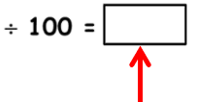
?
What is your final number?
Use the chart to determine the # of planets you would need.
Hectares | # of Planets
1.99 or less | 1
2.00 – 4.00 | 2
4.01 – 6.00 | 3
6.01 - 8.00 | 4
More than 8.01 | 5 or more
What fraction of the Earth’s population has a footprint of 1.99 or less?
2/3
What does this mean?
If everyone on the planet lived like you, then we would need ___ planets to provide enough land to support us because you are using up ___ times your share of the Earth’s resources.
2
2
3 planets =
4 planets =
3 times as much
4 times as much

Slide 29
What does it mean?
1 planet → If everyone lived like this, we would only need one planet! Human existence would be both sustainable and fair as there is enough land on the Earth to support the whole population at this level of land use. At present, about two-thirds of the global population has an ecological footprint of less than 2 hectares each.
2 planets → If everyone on the planet lived like you, then we would need two planets to provide enough land to support us because you are using up twice your share of the Earth if it were divided up equally amongst the whole population.
3 planets → If everyone on the planet lived like you, we’d need three planets to provide enough land to support us because you are using up three times your share of the Earth if it were divided up equally amongst the whole population.
4 planets → If everyone lived like you, we’d need four planets to support us because you are using up four times your share of the Earth if it were divided up equally amongst the whole population.
5 or more planets → If everyone lived like you, we’d need five or more planets to support us because you are using up five or more times your share of the Earth if it were divided up equally amongst the whole population.
How many planets do we have to use?

Slide 30

What could we do to reduce our ecological footprints?
How much TRASH does your family generate in a day? What about the trash our school generates in a day? Month? Year?
How many SINGLE-USE PLASTIC PRODUCTS does your family use? What about the school? What things do we do to reduce the use of single-use plastics?
How much WATER does your family use in a day? How much does our school use in a day? Month? Year? What things do we do to reduce the amount of water we use at school and at home?
How much ENERGY does our school use in a day? Month? Year? What things do we do to reduce the amount of energy we use at school and at home?
What options are available in our community for the 3RS (RECYCLE, REDUCE, AND REUSE)? How many people use them? What things can we do to get more people involved?
What can we do to reduce the amount of RESOURCES we use
every day – clothing, cleaning products, food and beverage
containers, entertainment, etc.?
How do most people get to school – car, bus, walk, bike?
What can we do to reduce our “CARBON FOOTPRINT”?
What else can we do?
This Photo by Unknown Author is licensed under CC BY

Slide 31
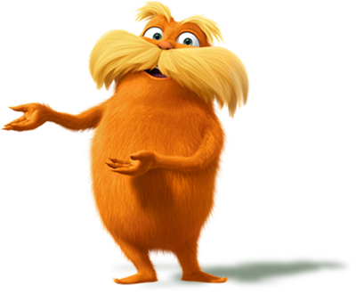
Lorax Challenge
What are the problems?
Why do we need to care?
How can we help?
How can we speak for the trees?
As we have learned, many of us have eco-footprints that are too big, and we need to take steps to reduce our impact on the environment.
Your group’s task* is to motivate your fellow students, family members, and the community to make changes in their lives to benefit the environment. Your project needs to motivate people to be “guys and gals who care” about our planet!
* Groups limited to 3 people & must be in the same class. Students may choose to work on their own.

Slide 32
Project Requirements:
Identify a specific environmental issue. Examples include water conservation, energy usage, recycling, overconsumption (resources), global warming, planting native species, etc.
Conduct research to discover facts and/or data from the school, your household, or the community to show the need for a change. You may use data you find online or conduct your own survey using Google Forms or other online survey programs. All surveys must be teacher approved before using.
Identify things people can do to help the issue. Strategies can be things we do every day to changes we might make over a longer period of time.
Create a project that will motivate people to take action by making changes in their daily lives to reduce our eco-footprints. Project can include games (regular or online), app, video, posters, or other media formats approved by the teacher.

Slide 33
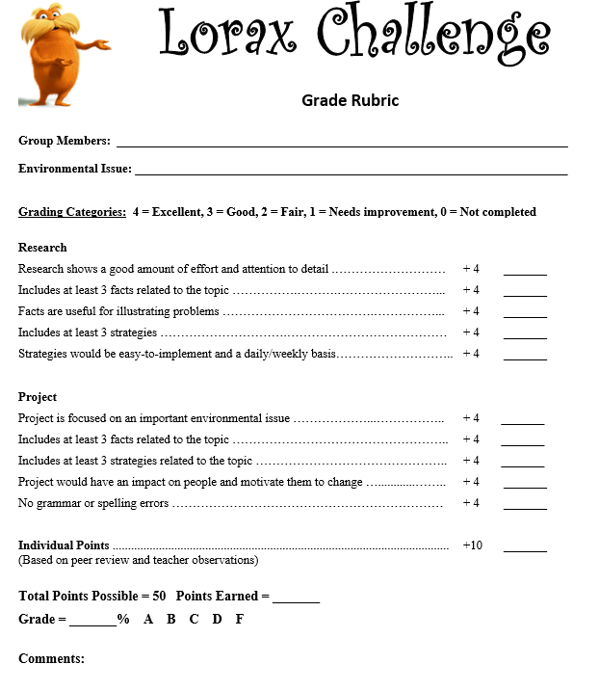
Grading:
Projects will be graded based on your group's research efforts, documentation, the quality/ accuracy of the information provided in your project, the project's appeal (appearance, grammar, spelling), and the potential impact of your campaign. See the project rubric for more details! The project will count as a test/project grade.
Due Date: ________________
You will have at least three class periods to work on this project. If you need more time, you will need work on your own during lunch, before/after school, or at home.

Slide 34
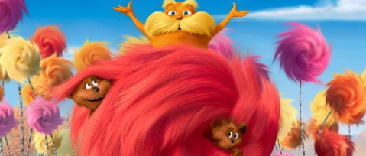
Tips for Good Projects:
Do your research to find the facts that support your project that will show why we need to change the way we are living.
Document your research, sources, and data on the slides provided in your digital notebook. This will be a large portion of your final grade.
Make your message simple and straightforward! Little changes are easier than big ones – keep your strategies focused on things that can easily be done each day/week. Your project's potential impact will be another part of your grade.

Slide 35
Group Document available at
https://docs.google.com/document/d/1iIWghhfvFYi9-m6XDHKkIdZv-B_5q7yFir5Sh7QES-o/edit?usp=sharing
You will need to MAKE A COPY to share with your students. It is a view only
Directions: Make a copy of the Google document and share everyone in with your group. Answer the questions to help you develop your project.
1. What environmental issue will you target? Pick one specific topic rather than a broad category.
2. Do your research to discover the answers to these questions.
Why is this issue a problem? List facts about this issue based on what you observe in our school, community, or your household.
Why should people care about this issue? You need at least 3 facts/data that will get people to care about your issue.
3. Make a list of things people could do in their daily lives. Describe how their actions would help the problem.
4. What type of project will your group create that will include the important information you listed above?
5. What will you do to do to complete the project? Describe the resources you’ll need, which tasks will be completed by the different group members, and how you will share it with your teacher.
Lorax Challenge
NOTE: This document must be approved by the teacher before you proceed with your project!

