Slide 1
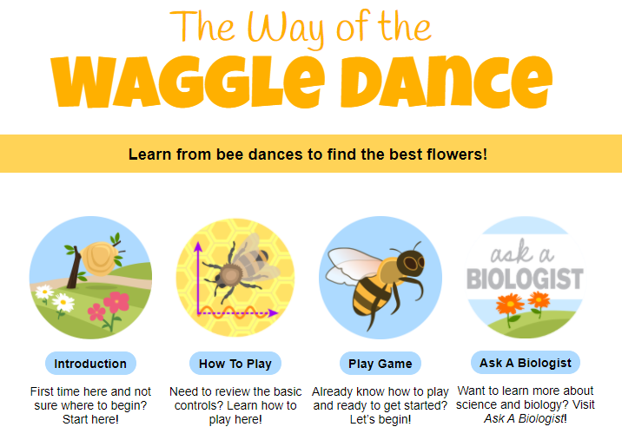
Bee Bonanza Directions
Click this image to the left of your slide to go to the website.
Click the different parts to complete your worksheet.
Part A:
INTRODUCTION
Part B: Click HOW TO PLAY for Part B and then watch the movie.
Part C: Click PLAY GAME and use what you know to help you complete each task. Read the hints next to your slide!
Student worksheet available as a Google Slide
Lesson developed by T. Tomm 2020 https://sciencespot.net/

Slide 2

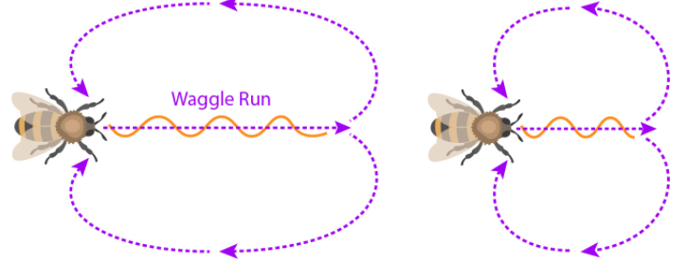
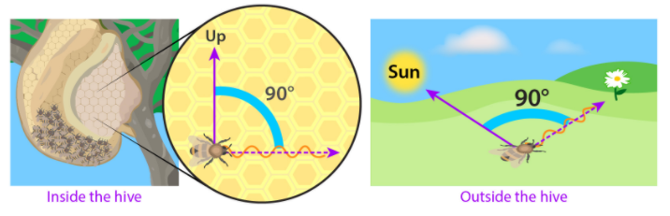
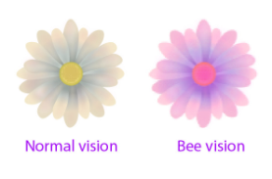
https://jeopardylabs.com/play/animal-behavior18
Activity B: Bee Bonanza
Part A: Read the INTRODUCTION to answer these questions.
1. What does the waggle dance tell other bees?
2. What does the round dance tell other bees?
3. What are the two main resources collected by bee colonies?
4. How do bees use the sun’s position?
5. How do bees see?
It tells the distance and the direction away from the hive.
It tells the watching bees that the flower patch is somewhere close to the hive.
Nectar and Pollen
Bees look at the position of the sun and fly at the same angle away from the sun.
Bees see the ultraviolet light that helps them find secret patterns flowers display to show where the nectar is hidden. Bees cannot distinguish shades of red easily.
https://quizlet.com/_8usdma?x=1qqt&i=3k3fq

Slide 3
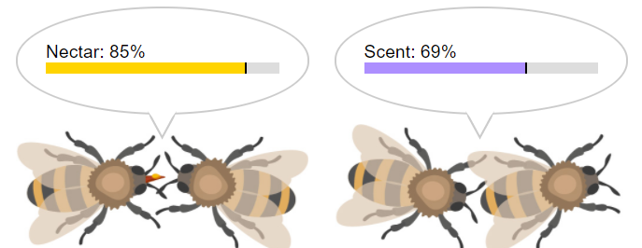
Part B: Click HOW TO PLAY.
1. What is the goal of the game?
2. How do you move?
3. What predators do you need to avoid?
Find the correct flower patch as fast as possible
Click to create a target and keep clicking to find flowers.
Wasps
Part C: Click PLAY GAME to begin. Choose BEGINNER MODE. Record your observations and data in the chart below.
Levels | 1 | 2 | 3 | 4
Flowers Inspected
Incorrect Guesses
Wasps Hit
Returns to Hive
HINTS:
Watch the dance to know which way to go and how far.
Check the % for nectar and scent. You want to find flowers that match those.
How did you do?
https://quizlet.com/_8usdma?x=1qqt&i=3k3fq

Slide 4
Part D: Final Analysis
1. How would you rate your success as a bee? Explain.
2. Which information helped you the most? Why?
Challenge: Can you beat all 8 levels of the ADVANCED MODE? If so, screen shot your final screen in the margin at right.
How did you do?
Did you include an explanation?
What was your score?
Extending the Lesson: What questions would you ask the biologist?
Write three questions related to this activity or about bees in general.
Do some research to find the answers. Record them in your notebook to share during our next class.
Discuss your questions with your classmates.

Slide 5
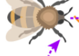
Activity Review
Which waggle dance tells other bees the flower patch is further from the hive?
A
B
C
What about these runs?
In which direction should the bees travel based on this run?
They should fly directly towards the sun.
They should fly at a 90º angle from the sun
They should fly in the opposite direction of the sun.
How would the waggle dance behavior be classified?
Innate Communication Courtship
  Learned Cooperation Competition
How do bees make honey?
https://www.youtube.com/watch?v=nZlEjDLJCmg

Slide 6

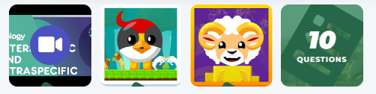
Teachers: Explore my playlists created to target concepts related to Natural and Artificial selection. Go to https://classroom.legendsoflearning.com/ to learn more about their program and the many options available to utilize their resources!
Competition for Resources playlist available at https://app.legendsoflearning.com/assignments/4b2e0098fe65/competition-for-resources/share
Click HERE to browse other Life Science topics to create your own playlist.

