Slide 1
Table of Contents
Sections 1-3
Activity A: Puzzling Pangaea
Sections 4-7
Activity B: Layers of the Earth Bonus Activity: Tasty Tectonics
Sections 8-10
Activity C: Ride the Rock Cycle
Sections 11-13
Activity D: Rock Box Challenge
This Photo by Unknown Author is licensed under CC BY
Unit developed for use with http://documentaries-plus.blogspot.com/2012/06/inside-planet-earth-discovery-channel.html

Slide 2
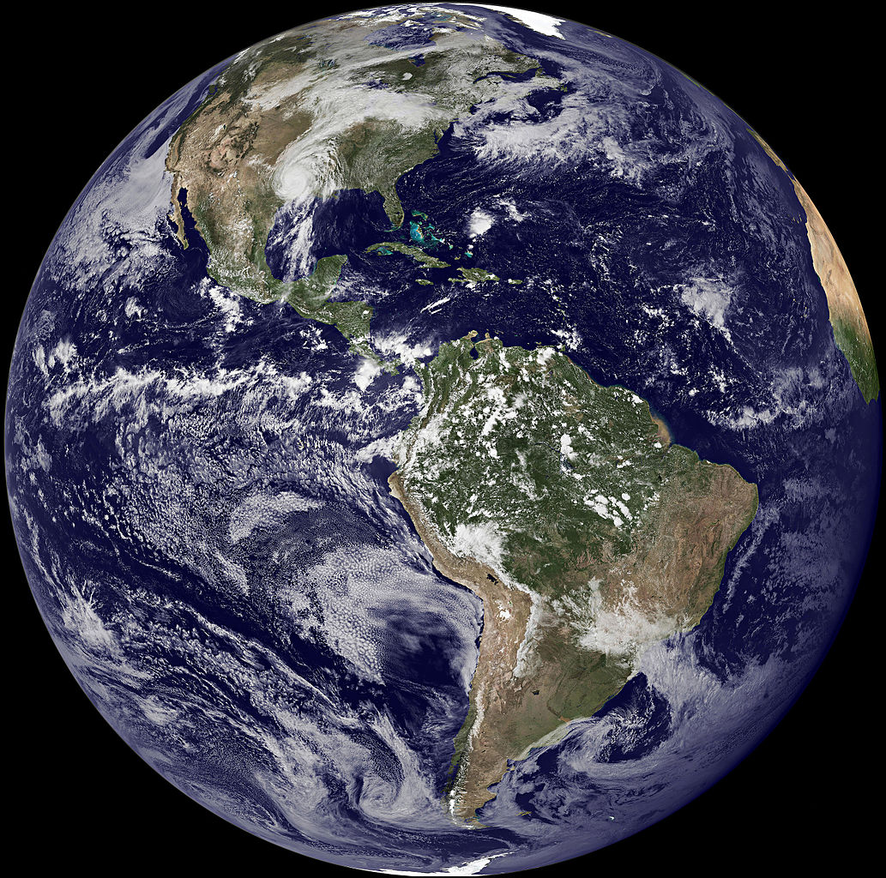
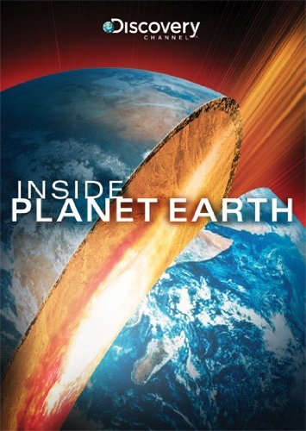
Inside Planet Earth: Surface to Center
Sections 1-3
http://documentaries-plus.blogspot.com/2012/06/inside-planet-earth-discovery-channel.html
Unit developed by T. Tomm 2015 http:/sciencespot.net

Slide 3
Getting started …
Glue the worksheets on pages ___-___
Fill in the answers as you watch the video.
We will review the answers so you can make additions or corrections

Slide 4
Section 1: Introduction
What percentage of the Earth cannot be accessed by humans? 99%
Studying the inside of the core could give us clues as to how and why life exists.
True or False: There is more water below the Earth than in all the oceans.
Why can’t we access most of the Earth?
Do you think life exists below the surface? If so, how deep?

Slide 5
Section 2: Gravity & Energy
Where does gravity come from? Earth’s core
2. What does the force of gravity do for us? Protection from meteorites, absorbs radiation, insulates earth from freezing temperatures of space, and gives us the air that we breath.
3. No gravity, no atmosphere. No atmosphere, no life.
4. True or False: The sun gives us all of our energy.
5. What are the pieces of evidence for the earth’s internal energy? Volcanoes, mountain ranges, caves

Slide 6
What can fit inside the large chamber of the Carlsbad Caverns? A jumbo jet
Stalactites grow downward, while stalagmites grow upward. “hold tight to the top” “might reach the top”
What happens to the temperature as you go deeper beneath the earth’s surface? It increases (and so does pressure)

Slide 7
Section 3: 1000 feet below Earth
How long are the crystals that formed here? 40 feet long
How did these crystals form? Water in an underground lake was boiled by magma. Crystals grew from the minerals that were dissolved in the water.
There are seven massive sections that make up the Earth’s crust. These sections are known as plates.
4. The formation of mountains at the Earth’s surface is evidence the crust is in motion.

Slide 8
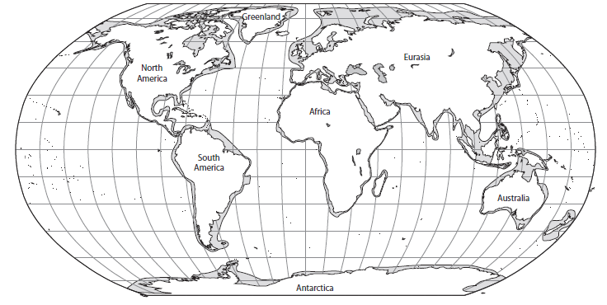
Activity A: Puzzling Pangaea
Can you solve the puzzle to discover what the Earth looked like 220 million years ago?
Source for activity and diagrams:
https://www.amnh.org/content/download/49383/751589/file/dinos_plate_tectonics.pdf

Slide 9
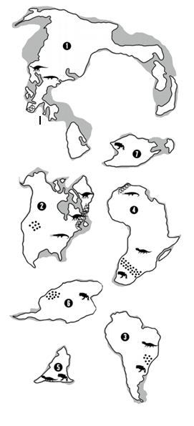
What’s the code? Label each land mass using the numbers.
Europe & Asia
Australia
North America
Use the legend to identify the symbols on each land mass. Use colored pencils to “code” each item in the last 2 columns.
Africa
Antarctica
South
America
India

Slide 10
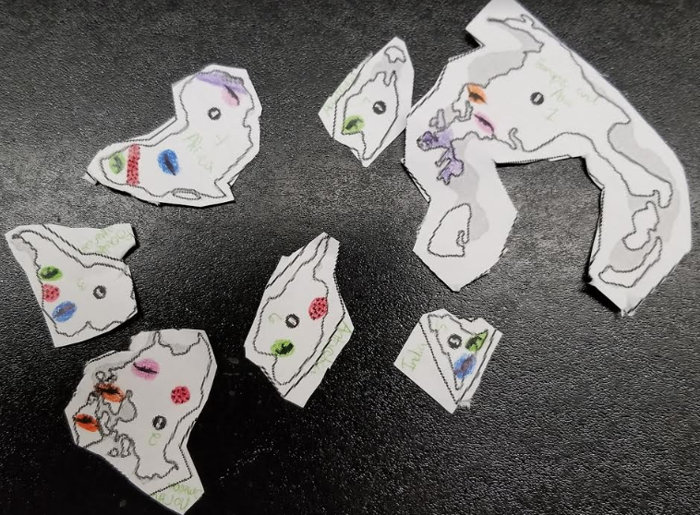
DO NOT CUT ANYTHING YET!
Puzzle Me This
Once you have all seven pieces, layout them out ON THE TABLE in the way you think they best fit.
Which coastlines seem to fit together?
Do the fossils line up?
Do the rocks and desserts line up?
?

Slide 11
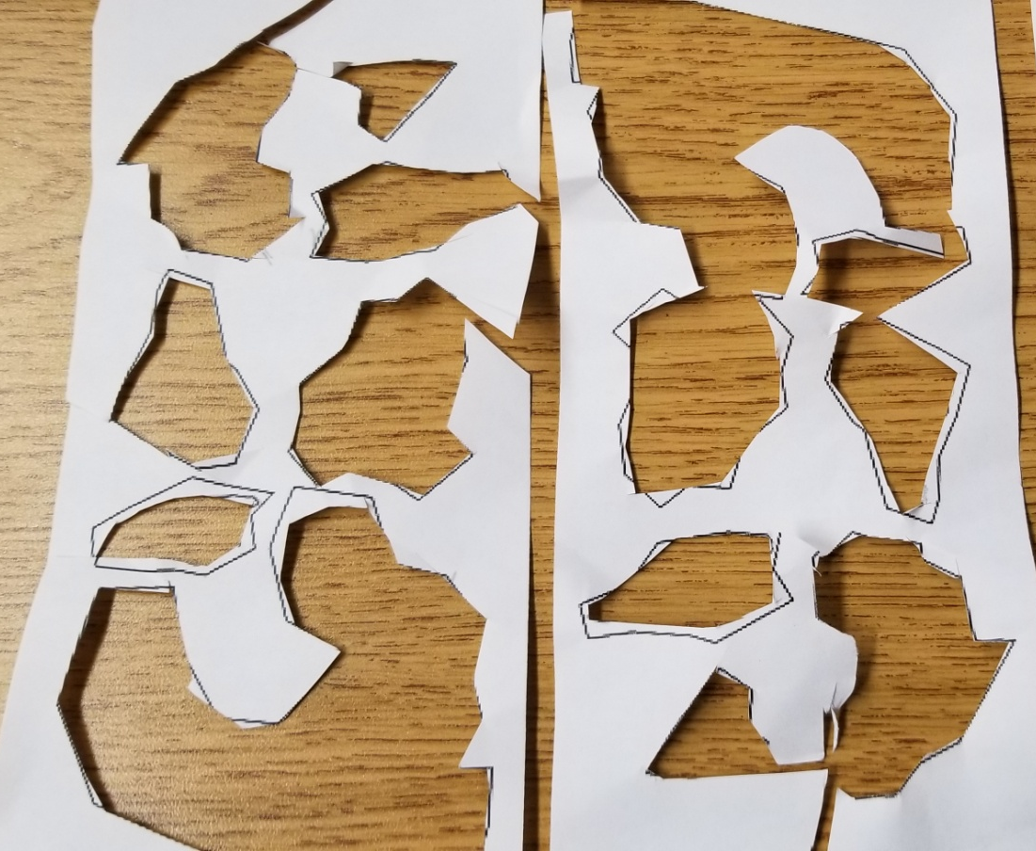
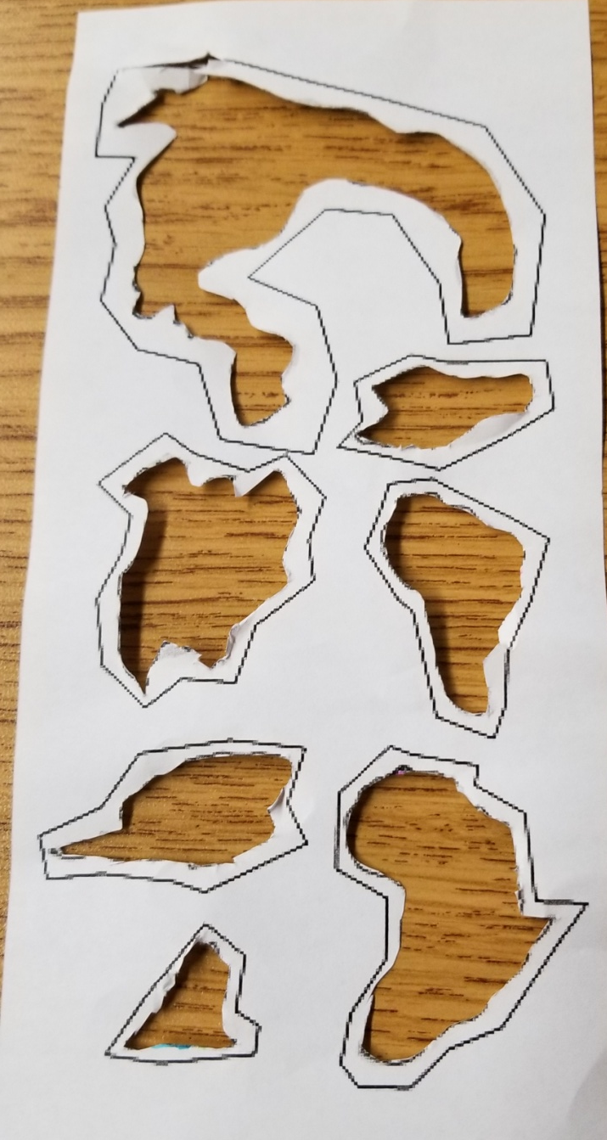
SCISSORHANDS CHALLENGE
Can you cut out all the pieces and leave only one scrap piece? If so, you’ll get a piece of candy!
You will need to cut inside the black lines to separate the continents.
Extreme Scissorhands

Slide 12
Puzzle Me This
Once you have all seven pieces, layout them out ON THE TABLE in the way you think they best fit.
Which coastlines seem to fit together?
Do the fossils line up?
Do the rocks and desserts line up?
?

Slide 13
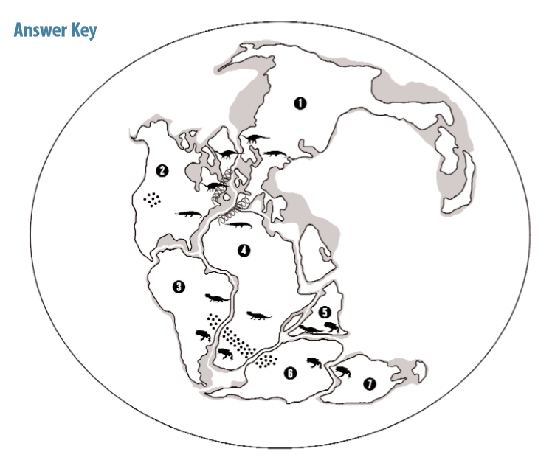
How does your “Pangaea” compare to this one?
Europe & Asia
How does it compare to the position of the continents today?
See the teacher for the answer key!
North America
Africa
South
America
India
Australia
Antarctica
Glue the pieces on page 58!
Assignment: Finish Sections 1-3 on the notes BEFORE Tuesday!

Slide 14
How does your “Pangaea” compare to this one?
Europe & Asia
Glue the puzzle pieces on page ___
North America
Africa
South
America
India
Australia
Antarctica
How does it compare to the position of the continents today?

Slide 15
Time to watch more …
Fill in sections 4-7 as you watch the video in class.
We will go over the answers after the video in case you miss any.
https://www.earth.com/news/behind-curve-netflix-earth-flat/

Slide 16
Inside Planet Earth: Surface to Center
Sections 4-7
http://documentaries-plus.blogspot.com/2012/06/inside-planet-earth-discovery-channel.html

Slide 17
Section 4: 1.5 Miles Below (Starts at 16:50)
Coal is the fossilized remains of a super forest.
Pangaea was a super continent located by the equator.
How did the giant forests affect the atmosphere? Used up CO₂ in photosynthesis and pumped out oxygen.
What role did energy from inner Earth play in the formation of Pangaea? It reshaped the landmasses

Slide 18
Section 5: 2.5 Miles Below Ground
Temperatures in the mines are 130 degrees Fahrenheit.
Why are bacteria deep in the earth’s crust interesting to scientists? They have been undisturbed for eons, which could help explain the origins of life.
What was the deepest hole ever drilled? 7.5 miles
What built the stromatolites? Bacteria
How did oxygen help turn the seas blue? The oxygen bonded with dissolved iron in H₂O to form iron oxide, which floated to the bottom and turned them from green to blue.
Do you remember the chemical formula for Iron Oxide?
FeO₂
What do we call organisms that thrive in extreme conditions?
Extremophiles

Slide 19
Section 6: 25 -30 miles below ground
There is 20 times more oxygen trapped in iron ore than floating in the atmosphere.
True or False: The mantle is liquid.
How can we access mantle rock? Find areas where it has been forced to the surface.
What did they compare the consistency of mantle rock to? Fudge
If the mantle was unable to flow, there would be no plate movement, no major ocean basins, and no mountain ranges. Add to notes – no mantle = no life!
The pressure in the mantle is 50,000 times greater than what we feel at the surface.

Slide 20
Section 7: 100 miles below ground (40:36)
What precious material is found here? Diamond
How did they get to where they are today? Violent eruptions triggered by Earth’s internal heat over a billion years ago.
Why do geologists like the “flaws” in them? They are fragments of primitive mantle that are trapped inside the diamond.
True or False: All diamonds from across the world are identical in composition.
Kimberlite = Igneous rock with diamonds in them

Slide 21
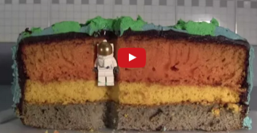
Activity B: Layers of the Earth
Glue the worksheet on page _____ FAF Left (longways or up/down)
Watch the video on EDPuzzle using this link: https://edpuzzle.com/media/5cc0a9dafcb9a74100d9f11d
Fill in the worksheet as you watch the video – BOTH sides!
You must be logged in to have the quiz recorded for you!
Video is also available at http://ed.ted.com/on/ew7l7FKI

Slide 22
Answer Key
CRUST
5
25
__________ - Thinnest layer ranging from _____ mi under the oceans to_____ mi
under continents.
ADD TO NOTES
4000 mi from crust to core
Solid rock
MANTLE
1800
____________ - Largest layer at ________ mi thick; the upper layer that includes the crust is called the ______________, which floats on top of a plastic-like layer called the ____________________; temps range from ______- _____ºF.
LITHOSPHERE
ASTHENOSPHERE
1600 - 7900
ADD TO NOTES → Convection currents move through the
asthenosphere

Slide 23
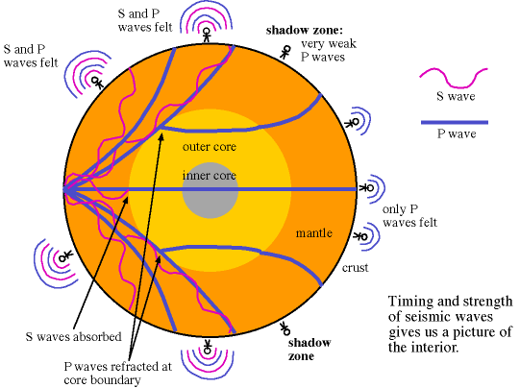
OUTER CORE
_______ _______ - 1400 mi thick liquid layer made mostly of ___________; temps range from 7900-11000ºF; the movement of these creates a ________________ field.
IRON
MAGNETIC
INNER CORE
780
IRON
_____ _______ - Solid layer that is _______ mi thick; made of ________ and ____________ with temps up to ________ºF, but kept solid due to very high ____________.
NICKEL
13,000
PRESSURE
https://www.astronomynotes.com/solarsys/s8.htm

Slide 24
Layers of the Earth Think About It
1) The video compared Earth's crust to an egg. Could an egg also be used to model all the layers of the earth?
2) If we cannot see the center of the Earth, how do we know about it? List two ways we have learned about the core.
3) Create your own model - What other items could be used as a model for the Earth's structure? Draw a picture on the page under this worksheet of one item and label it to show how each of its layers compares to earth's layers.
If you do a basic model with crust, mantle, and core, it would work. It would not work if you wanted more layers.
→ Seismic waves gives us clues about earth’s interior
→ Analyze rocks brought to the surface through volcanoes

Slide 25
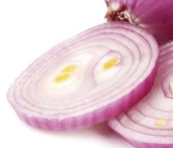
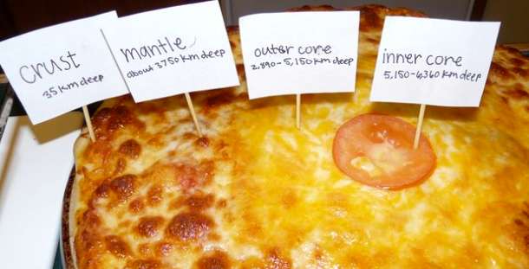
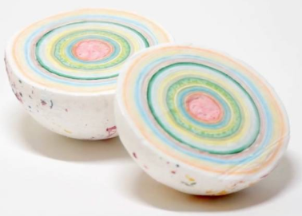
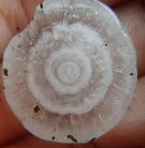
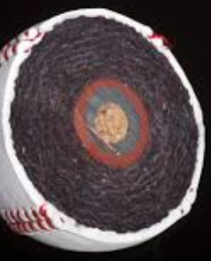
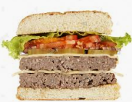
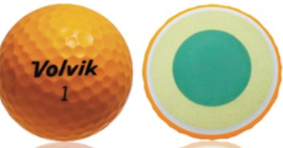
What are some models other students have used?

Slide 26
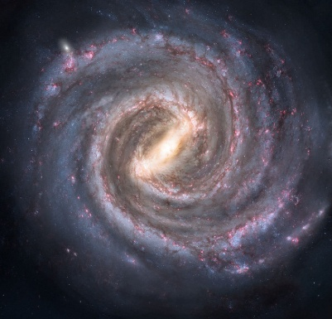
Let’s explore a milky way …

Slide 27
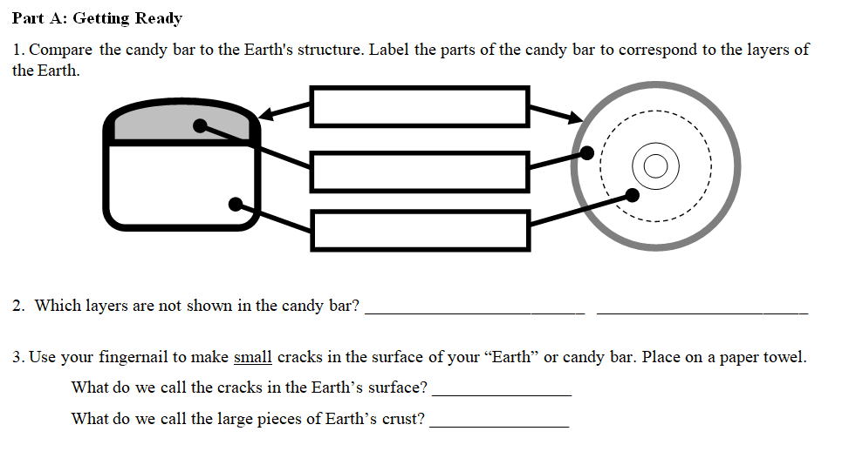
Bonus Activity: Tasty Tectonics
Glue the worksheet on page ____

Slide 28
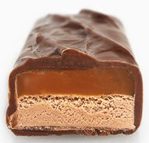
Follow your teacher’s directions to complete this section.
(Crust & Upper Mantle)
LITHOSPHERE
ASTHENOSPHERE
LOWER MANTLE
OUTER CORE
INNER CORE

Slide 29
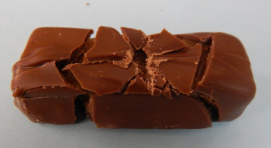
Open the candy bar.
Place on a paper towel.
Use your fingernail to make SMALL cracks in the surface (top)
FAULTS
PLATES

Slide 30
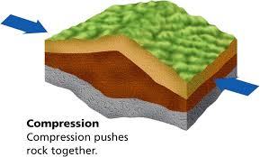
Part B: Observing Forces
4. COMPRESSION
Apply compression by slowly push the ends of the candy bar towards the middle by a couple centimeters.
What do you observe? Write it on your worksheet.
The pieces of chocolate move together with some going over the others or two pieces push upwards together (arch)

Slide 31
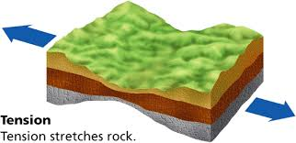
5. TENSION
Apply tension by pulling the ends of the candy bar away from the middle by a couple centimeters.
What do you observe? Write it on your worksheet.
The pieces of chocolate spread apart; some may "drop" into the caramel layer

Slide 32
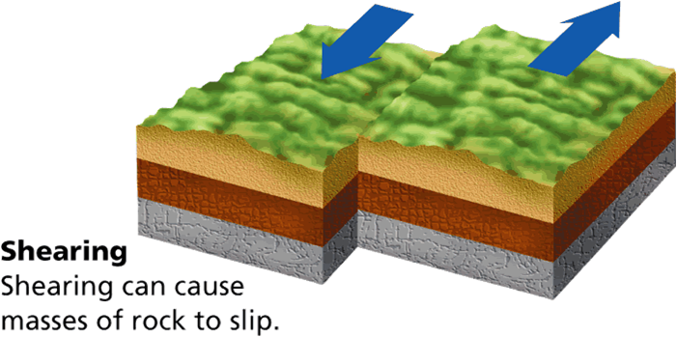
6. SHEARING
Push the candy bar back into its original position (as close as you can.)
Apply a shearing force by pushing one end to the left and the other to the right.
What do you observe? Write it on your worksheet.
The pieces of chocolate "slide" in different directions, but stay flat.
You may eat your candy bar now!

Slide 33
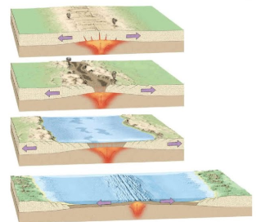
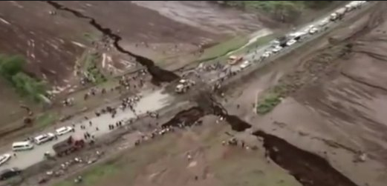
Part C: Real World Connections - Identify the type of force involved in each plate boundary and draw arrows to show how the plates move.
DIVERGENT
TENSION
RIFT

Slide 34
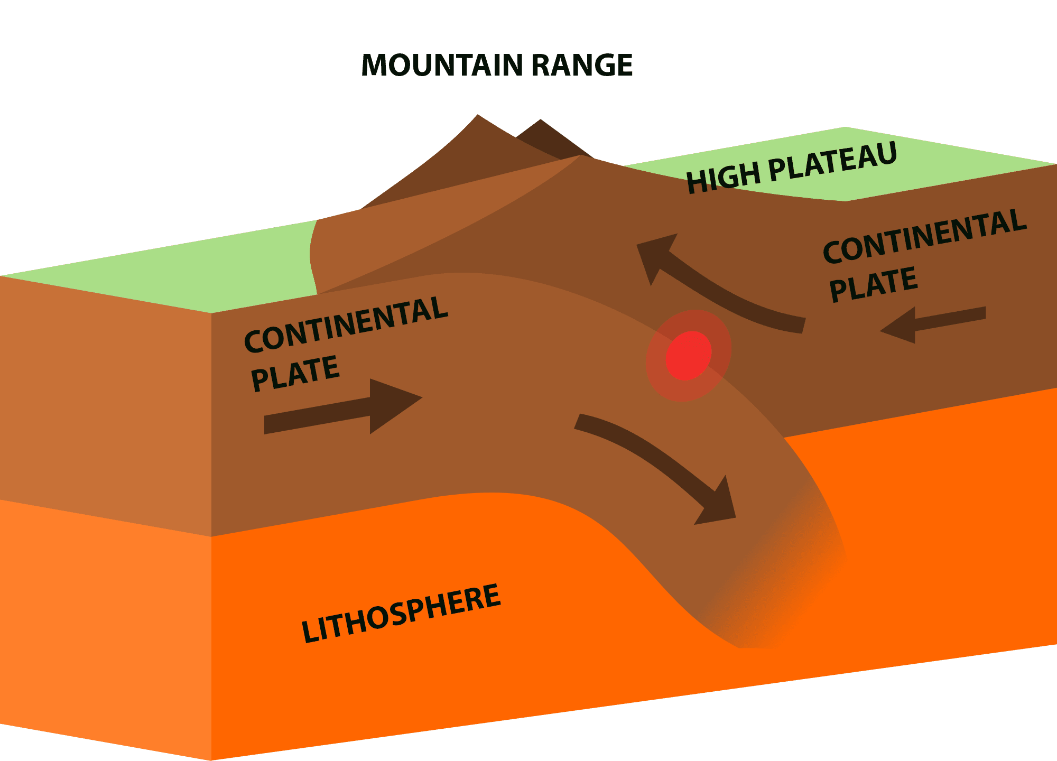
CONVERGENT
COMPRESSION
ANDES
SUBDUCTION

Slide 35
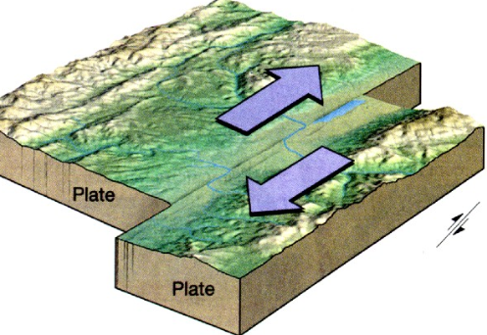
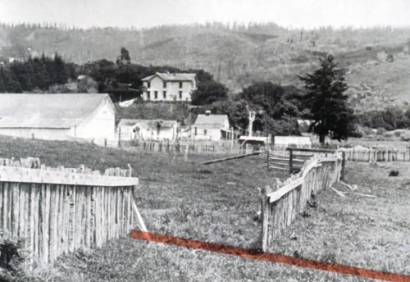
TRANSFORM
SHEARING
SAN ANDREAS

Slide 36
Think About It: What other items could be used to model plate tectonics?
Share your ideas with your tablemates!

Slide 37
Time to watch more …
Fill in sections 8-10 as you watch the video in class.
We will go over the answers after the video in case you miss any.
https://www.earth.com/news/behind-curve-netflix-earth-flat/

Slide 38
Inside Planet Earth: Surface to Center
Sections 8-10
http://documentaries-plus.blogspot.com/2012/06/inside-planet-earth-discovery-channel.html

Slide 39
Section 8: 200 miles below ground
What devastating phenomenon originates at this level? Earthquakes
Seismic data can tell us the shapes of certain features inside of the Earth.
Convection currents of hot solid rock move continuously throughout the mantle, which causes the tectonic plates to shift.
Which plates have a greater density? Continental or Oceanic (choose one)
If all underground water came to the surface, sea levels would rise 2.5 miles above the peak of Mt. Everest.
What is the Ring of Fire? Area of explosive volcanoes that is located around the Pacific Plate where it dives into the mantle.

Slide 40
Section 9: 1500 miles below ground
What do plumes from then mantle create? Hot spot volcanoes
Measured from the ocean floor, where is the tallest volcano in the world located? Hawaii
Why/How do island chains form? The mantle plume stays in one place constantly pumping out magma. While this is going on, the plate above it is moving.
A total of 3 destructive eruptions have occurred at Yellowstone, which is a giant volcano.
What would happen if the Yellowstone volcano erupted? Billions of tons of ash would be shot into the air, it would block out the sun, and we would be put into a volcanic winter.

Slide 41
Section 10: 1800 miles below ground
The outer core is larger than the moon.
True or False: Seismic waves allow scientists to “see” the outer core.
Earth’s core produces a magnetic field, which creates a “magnetic bubble” that keeps the solar wind and radiation from reaching the Earth’s surface.
What do auroras show us? They are bright lights in the sky that show a battle going on between the core and solar radiation.
Why were the astronauts exposed to the cosmic rays? They were at the edge of the safety shield created by Earth’s magnetic field.
What are the shape of the columns formed in the core? Helix or Helical

Slide 42
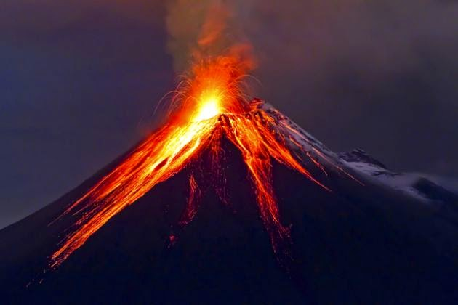
National Geographic Volcanoes 101
Click the picture to watch the video and then answer the questions on the next slide.
This Photo by Unknown Author is licensed under CC BY-NC

Slide 43
Answer these questions after the video.
How many eruptions occur each year? A. 50 B. 75 C. 90 D. Over 100
How many plates make up the Earth’s surface? A. 7 B. 17 C. 27 D. 35
How many active volcanoes are there? A. 250 B. 500 C. Over 1000
Which tectonic plate is surrounded by the Ring of Fire? A. North American B. Asian C. Pacific
What percent of all volcanoes occur around the Ring of Fire? A. 50 B. 75 C. 90
What percent of all earthquakes occur around the Ring of Fire? A. 50 B. 75 C. 90
This Photo by Unknown Author is licensed under CC BY-NC-ND

Slide 44
The answers are …
How many eruptions occur each year? A. 50 B. 75 C. 90 D. Over 100
How many plates make up the Earth’s surface? A. 7 B. 17 C. 27 D. 35
How many active volcanoes are there? A. 250 B. 500 C. Over 1000
Which tectonic plate is surrounded by the Ring of Fire? A. North American B. Asian C. Pacific
What percent of all volcanoes occur around the Ring of Fire? A. 50 B. 75 C. 90
What percent of all earthquakes occur around the Ring of Fire? A. 50 B. 75 C. 90

Slide 45
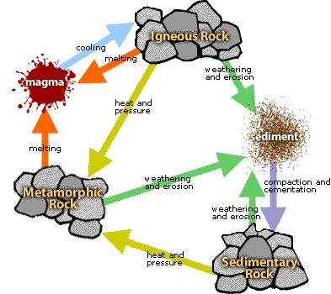
Activity C: Ride the Rock Cycle
This Photo by Unknown Author is licensed under CC BY-SA-NC

Slide 46
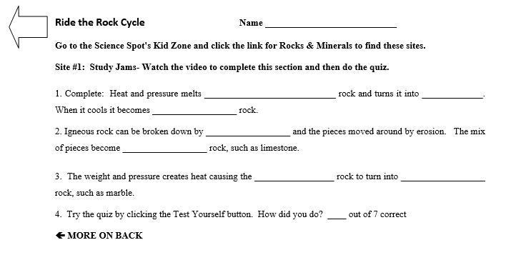
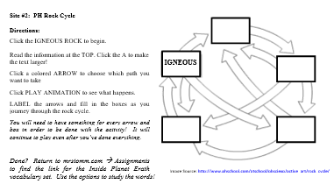
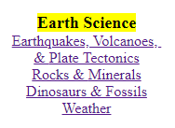
Activity Worksheet
Glue the worksheet on page ___.
Complete BOTH SIDES of the worksheet.
Go to mrstomm.com Science Spot Kid Zone
Site #2
Site #1

Slide 47
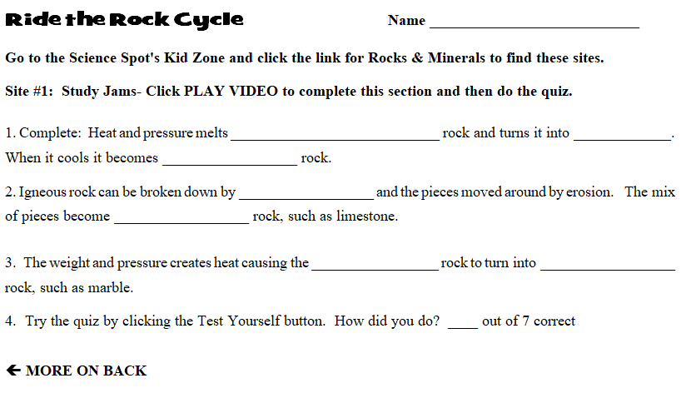
Ride the Rock Cycle
Check your answers if you are done with BOTH sides.
If you are not done, sit quietly and you’ll need to finish it on your own time.

Slide 48
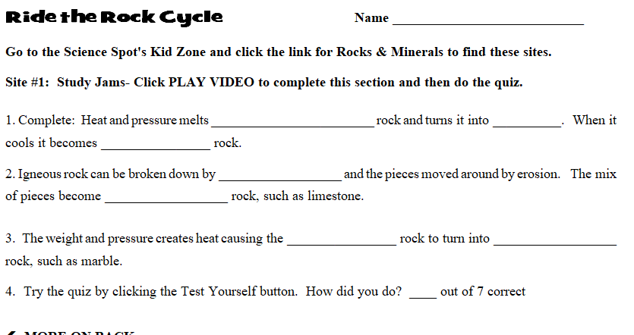
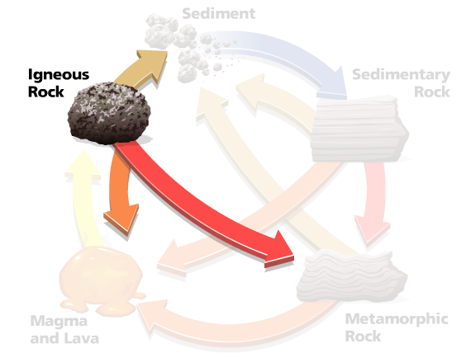
METAMORPHIC
MAGMA
IGNEOUS
WEATHERING
SEDIMENTARY
SEDIMENTARY
METAMORPHIC
?

Slide 49
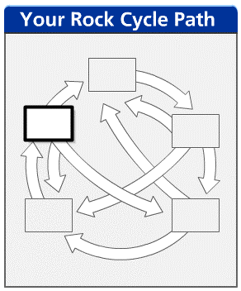
Weathering and Erosion
SEDIMENTS
Deposition
IGNEOUS ROCK
Weathering and Erosion
SEDIMENTARY ROCK
Volcanic Activity
Heat & Pressure
MELTING
Heat & Pressure
Melting
MAGMA or LAVA
METAMORPHIC ROCK
Melting

Slide 50
Time to watch more …
Fill in sections 11-13 as you watch the video in class.
We will go over the answers after the video in case you miss any.
https://www.earth.com/news/behind-curve-netflix-earth-flat/

Slide 51
Inside Planet Earth: Surface to Center
Sections 11-13
http://documentaries-plus.blogspot.com/2012/06/inside-planet-earth-discovery-channel.html

Slide 52
Section 11: 2500 miles below ground
Due to the iron, there are also electrical currents in the core. Without heat & rotation, the core wouldn’t generate a magnetic field.
Over the past century, the strength of Earth’s magnetic field has decreased by 10 percent.
What is the South Atlantic Anomaly? A weak area in our magnetic field (up to 1/3 less than normal)
What happens during a “reversal”? North and South poles switch
Where can we find evidence of reversals that have occurred in the past? Inside cooled lava. The crystals line up with the magnetic fields.
During a reversal, we would lose protection from the magnetic field for several months.

Slide 53
Section 12: 3160 miles below ground
Why is the material solid in the inner core? Very high amounts of pressure
The inner core is growing at a rate of 1 millimeter per year.
True or False: We know exactly what the surface of the inner core looks like.
One day, the inner core will freeze solid.
What happened to the heavier materials during planetary formation? They sank to the bottom/center of the newly formed planets.
How large was the object that made the crater in Arizona? 300-400 ft
Water once flowed on the surface of Mars.

Slide 54
Mars’ magnetic field is weak, but its crust is very magnetized.
Why did Mars’ magnetic field collapse? Its core froze solid
Mars core only lasted a few 100 million years.
Compared to Earth, why did Mars core cool so quickly?
Mars is only half the size of Earth.
Section 13: 3960 miles below ground
Temperatures in the inner core reach 12000 degrees Fahrenheit, which is hotter than the surface of the sun.
There is no gravity in the center of the Earth.

Slide 55
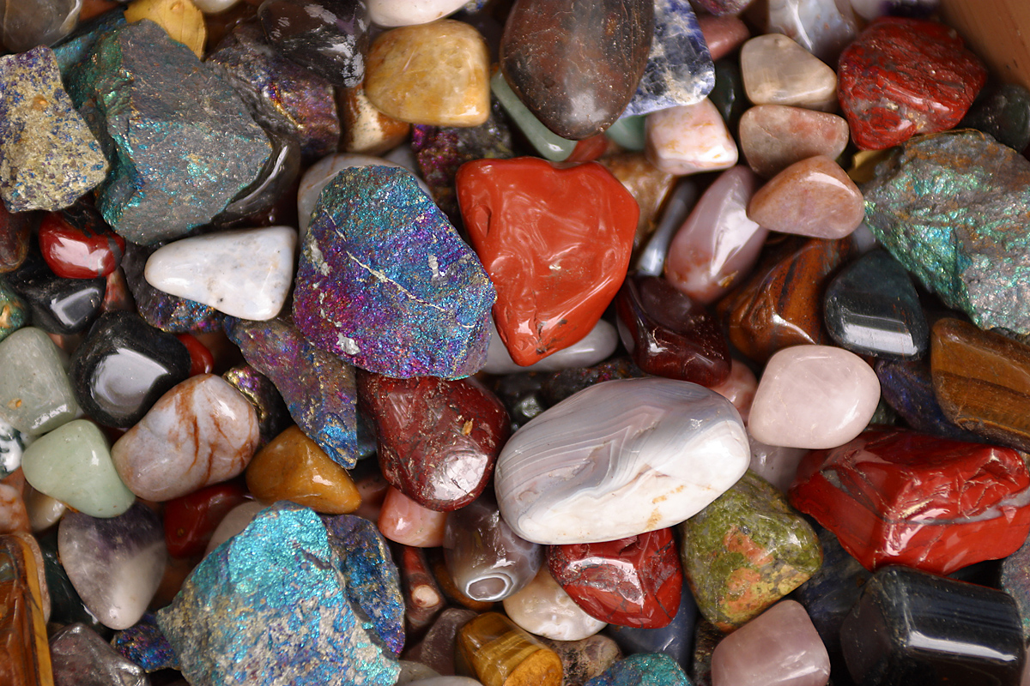
Activity D: Rock Box Challenge
How many can you identify?

Slide 56
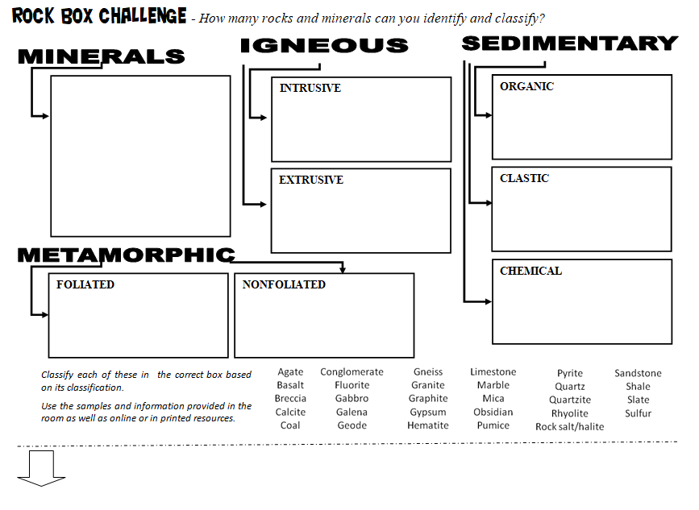
Rock Box Challenge
Directions:
Glue the worksheet on page _____
62
Fill in the BACK of the worksheet as we discuss the notes in class.

Slide 57
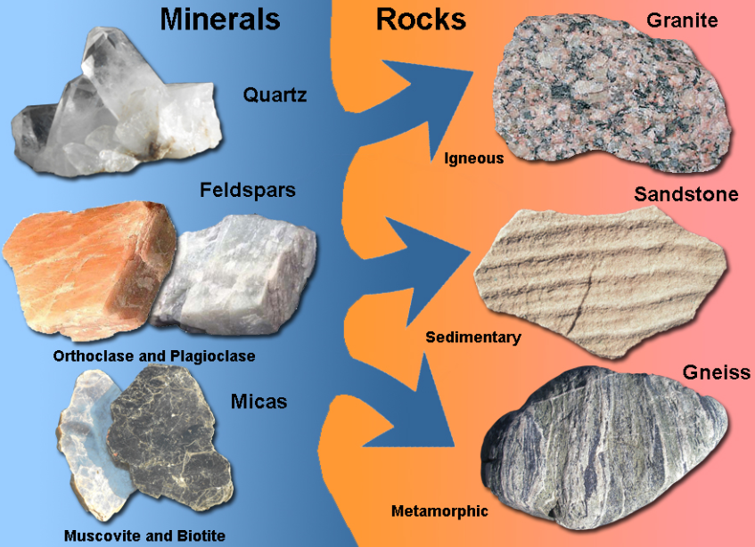
Rock Box Notes – Back of worksheet
MINERALS - Building ___________ of rocks
→____________ occurring, ___________ chemical ______________
BLOCKS
NATURALLY
INORGANIC
COMPOUNDS

Slide 58
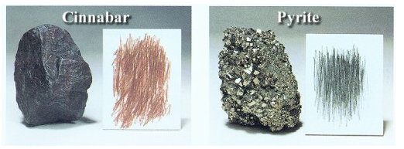
Rock Box Notes
→ Can be classified by many characteristics, such as crystal _______, ___________, __________ composition, _________, _________ & _________.
SHAPE
HARDNESS
CHEMICAL
LUSTER
STREAK
COLOR
Are streak and color the same thing?
What mineral is the hardest? Softest?

Slide 60
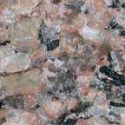
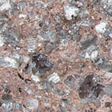
IGNEOUS - Rocks formed from _________ ________
→____________ rocks form from ____________; cools slowly underground and has _________ crystals; can often see the different _________, which depends on chemical composition.
→_____________ rocks form from _________ that cools quickly above ground; has ___________ crystals, which makes it look like the same _________ throughout.
MOLTEN ROCK
INTRUSIVE
MAGMA
LARGER
COLORS
EXTRUSIVE
LAVA
SMALLER
COLOR
GRANITE INSTRUSIVE
Cools slowly = Large crystals
RHYOLITE
EXTRUSIVE
Cools quickly = Small Crystals
Same Chemical Composition

Slide 61
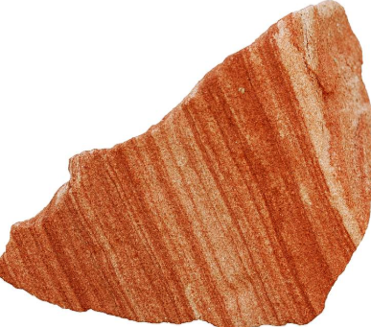
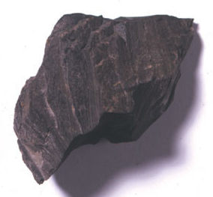
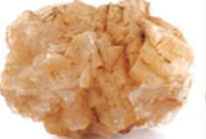
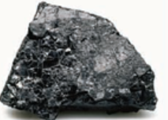
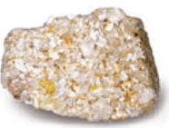
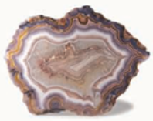
SEDIMENTARY - Rocks formed from ____________ or other compounds
→ _____________ rocks form from sediments that have been ____________ or _____________ together; may find _________ between the layers
→ __________ rocks form as dissolved minerals in a solution crystallize to form rock or form from chemical ____________.
→ ____________ rocks form from the remains of living things that have been compacted or cemented together
SEDIMENTS
SANDSTONE
CLASTIC
CEMENTED
COMPACTED
FOSSILS
CHEMICAL
REACTIONS
SHALE (MUDSTONE)
ORGANIC
ROCK SALT
AGATE (QUARTZ)
COAL
COQUINA

Slide 62
Rock Box Notes
METAMORPHIC - Rocks changed by great ________ and _________ or chemical ____________
___________ rocks have visible bands or layers, such as sedimentary rocks with __________ (layers)
→ ______________ rocks do not have visible bands or layers
HEAT
PRESSURE
REACTIONS
FOLIATED
BEDDING
NONFOLIATED
GNEISS
QUARTZITE
(from sandstone)
MARBLE
(from limestone)
SLATE
(from shale)
SCHIST

Slide 63
Work with your tablemates to identify the rocks and minerals in your rock box.
NOT ALL THE SAMPLES LISTED WILL BE IN YOUR BOX.
62
You may use the ID guides, online resources, and the classroom samples to help you.

Slide 64
Write the # on your rock box on your gold page.
TIME TO PUT AWAY YOUR ROCK BOX!
You will have time tomorrow to work on this page.
62

Slide 65
Rock Box Challenge
Do not remove samples from bags.
Do not taste any samples.
Do not damage the samples!
You may use the ID guides, online resources, and the classroom samples to help you.
Go to mrstomm.com → Science Spot Kid Zone → Earth Science Links

Slide 66
Work with your tablemates to identify the rocks and minerals in your rock box.
You must classify all the ones listed! Some may fit into more than one box (minerals + rock)
62
NOTES: NOT ALL THE SAMPLES LISTED WILL BE IN YOUR BOX.
YOUR BOX MIGHT HAVE EXTRA SAMPLES NOT LISTED.
PUT A  NEXT TO THOSE YOU FOUND.

Slide 67
Write the # on your rock box on your gold page.
TIME TO PUT AWAY YOUR ROCK BOX!
You will have time tomorrow to work on this page.
62

Slide 68
= Extra – not on list * = Listed more than once!
ANSWER KEY – If you are done!
Agate* Calcite Fluorite Galena Graphite Gypsum
HematiteMica
Pyrite
Halite
Sulfur
Quartz*
Copper
Bauxite
Beryl 
Azurite 
Gabbro
Granite
Diorite
Coal
Limestone* Coquina 
Basalt
Rhyolite
Pumice Obsidian
Conglomerate
Sandstone
Limestone * Concretion
Andesite 
Scoria  Tuff 
Breccia
Shale Clay 
Agate*
Quartz*
Geode
Chert
Limestone*
Rock Salt*
Rock Gypsum 
Gneiss
Slate
Schist
Marble
Quartzite

Slide 69
Rock Box Challenge - Conclusion
Compare your results to those of another team by discussing these questions:
What samples were the same as those in your box?
What samples were not in your box?
Which samples were not identified?
Did your team have some of the same challenges as the other team? Explain.

