Slide 1
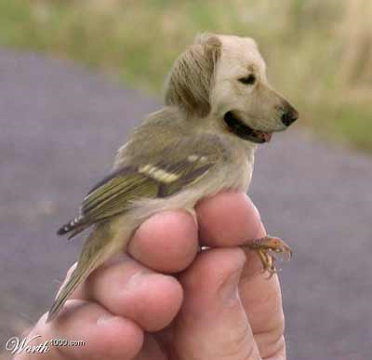
Genetics & Ethics
Just because we can,
does it mean we should?
Image: http://www.mediorta.com/cloning-research/

Slide 2
DNA Database
Forensic DNA – Human Rights Issue & DNA Database
1. Should we have all adults submit DNA samples for CODIS?
2. Should DNA evidence be used to free criminals?
3. Should we give DNA tests to all babies for their samples to be entered into CODIS?
4. Should DNA test results be shared with your employers?
5. Should DNA test results be shared with your insurance company?
Links: https://www.youtube.com/watch?v=JwSdJ0dUH7E&list=PLeTUNVQGxd0jjCWh-i6F866z8Uhi9rbqy&index=4
http://www.dailymotion.com/video/x97l96_thousands-to-be-deleted-from-dna-da_news

Slide 3
How scientists grow “made to order” lungs?
Popular Science Video
Is it ok to use cloning to create organs or gene therapies for humans?
Is it ok to use genetic engineering to create clones of endangered species?
3. Is it ok to use genetic engineering to create clones of humans?
4. Is it ok to use genetic engineering to design a baby with specific traits?
Link: http://www.popsci.com/technology/article/2010-09/made-order-lungs

Slide 4
Genetic Engineering – The World’s Greatest Scam?
Green Peace Video or 5 GMO Myths Busted
1. Is it ok to use genetic engineering to create plants/crops that are better able to handle drought, diseases, pests, etc.?
2. Is it ok to use genetic engineering to create plants/crops that are healthier, better tasting, or more attractive?
3. Should the FDA be required to test GMO foods?
4. Should GMO foods be required to have labels?
Links: http://www.youtube.com/watch?v=1H9WZGKQeYg
https://www.youtube.com/watch?v=ptDd9ftNaq8

