Slide 1
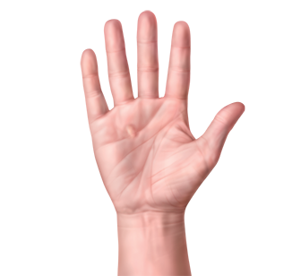
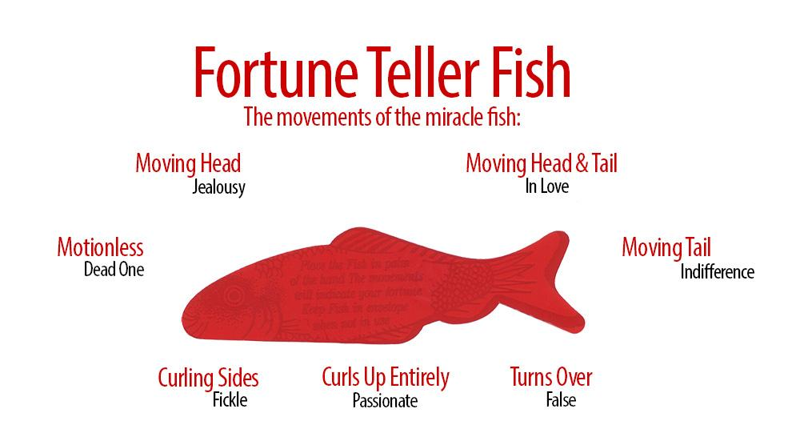
What’s your fortune?
Get a “miracle fish” from your teacher.
Find the open end of the package and take out the fish CAREFULLY.
Place the fish (longways) in the palm of your RIGHT hand & make observations.
Use the chart on the package to interpret the movements.
What does your
fish say?
T. Tomm 2020 https://sciencespot.net/

Slide 2
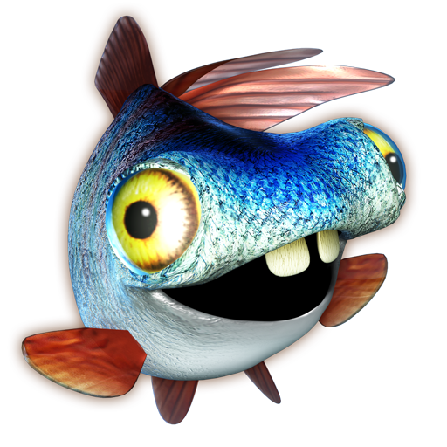
How does your fish “read” your mind?
Can you get your fish to say something different? Do some experimentation!
Try placing it on the palm of your left hand.
Try placing it on your arm.
Try placing it on your pants or clothing.
Try placing it on the table.
Try laying it flat and placing it under your laptop.
What would be different about your hand compared to other surfaces?

Slide 3

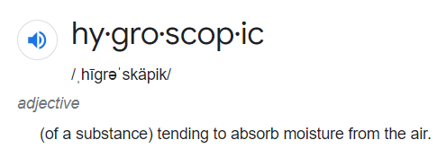

What’s the science?
What happens to a sponge when it is near water?
What if only part of the sponge is in water?
Only the parts of the fish that touch water absorb it, causing those parts to expand. This causes the fish to “move”.
CHALLENGE: Find other items that are hygroscopic. How do they compare to the Fortune Fish?

Slide 4
What should the fish really be telling you?
I think these would be better options …
Needs candy
Needs candy
Needs to wake up
Needs candy
Needs candy
Needs candy
Give your teacher all your candy

