Slide 1
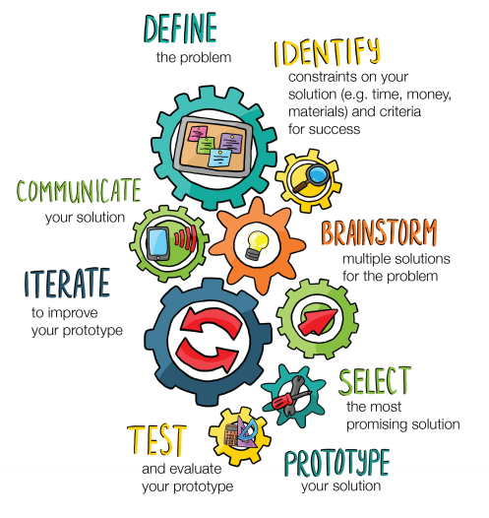
An introduction to the
Engineering
Design Process
Presentation developed for use with the
Engineering for Good Unit
from PBS Learning Media
Engineering Design Process Illustration | Engineering for Good downloaded from PBS LearningMedia, https://www.pbslearningmedia.org/resource/eg-design-process/et-design-process/. Rights to use this asset do not expire.
Asset Copyright: c. 2017 KQED San Francisco
Presentation by T. Tomm 2019 http://sciencespot.net

Slide 2
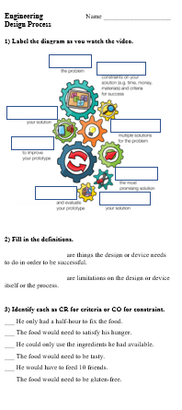

Glue your worksheet on page ____.
Label the diagram in #1 as you watch the video.
https://illinois.pbslearningmedia.org/resource/tacoparty/
Engineering for Good Unit

Slide 3
Engineering for Good Unit

Slide 4
#2. Criteria vs. Constraints
Criteria are things the design needs to do in order to be successful.
Constraints are limitations on the design itself or the process.
VS.
#3 - Identify each as CR for criteria or CO for constraint.
___ He only had a half-hour to fix the food.
___ The food would need to satisfy his hunger.
___ He could only use the ingredients he had available.
___ The food would need to be tasty.
___ He would have to feed all his friends.
___ The food would need to be gluten-free.
CO
CR
CO
CR
CR
CO
Engineering for Good Unit

Slide 5
Add to your Engineering Design Notes as you answer the questions
1st
Start
A. What is the first step in the process?
B. What is the “last” step in the process?
C. During which step do you evaluate your prototype?
D. What helps you improve your device?
E. When you do think of multiple solutions?
F. When do you decide your limitations?
G. When do you choose a prototype?
H. When do you build your device?
Engineering for Good Unit

Slide 6
Check your answers …
1st
Start
A. What is the first step in the process?
Limitations
2nd
B. What is the “last” step in the process?
Last Step
8th
C. During which step do you evaluate your prototype?
3rd
D. What helps you improve your device?
Feedback
E. When you do think of multiple solutions?
= choose
7th
4th
F. When do you decide your limitations?
G. When do you choose a prototype?
6th
= device
5th
H. When do you build your device?

Slide 7
Pumpkin Chuckin’ - Criteria vs. Constraints
Identify each as CR for criteria or CO for constraint as related to the Pumpkin Chuckin’ project in class.
_____ A. Teams have two class periods to build the device
_____ B. The projectile must hit the wall high enough to earn 50 points.
_____ C. Teams are limited to the number of cups they could use.
_____ D. The device must launch a projectile.
_____ E. Teams has three trials for each challenge to earn points.
_____ F. The projectile must land on a points area to score.
_____ G. The power for the catapult must be from the mousetrap’s spring.

Slide 8
The answers are …
Identify each as CR for criteria or CO for constraint as related to the Pumpkin Chuckin’ project in class.
_____ A. Teams have two class periods to build the device
_____ B. The projectile must hit the wall high enough to earn 50 points.
_____ C. Teams are limited to the number of cups they could use.
_____ D. The device must launch a projectile.
_____ E. Teams has three trials for each challenge to earn points.
_____ F. The projectile must land on a points area to score.
_____ G. The power for the catapult must be from the mousetrap’s spring.
CO
CR
CO
CR
Limited to 3 tries
CO
CR
CO

