Slide 1
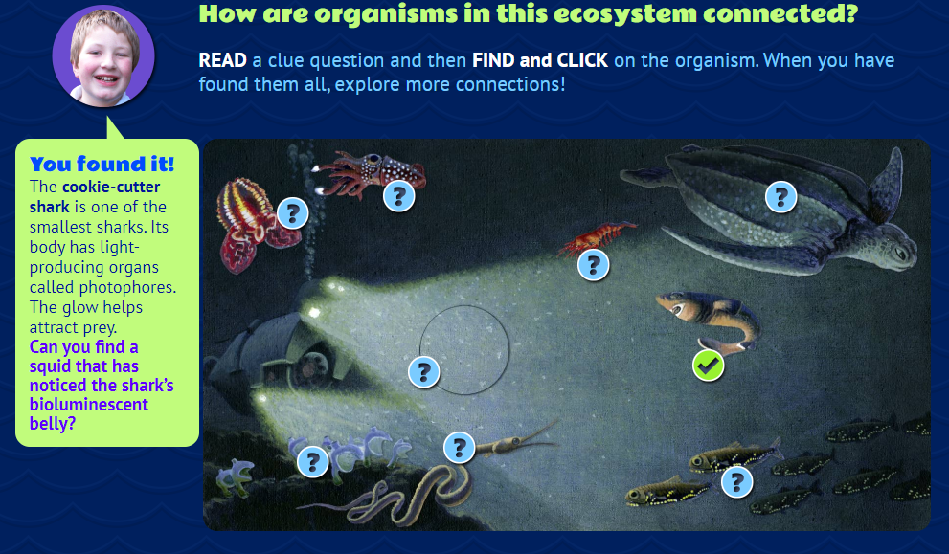
The digital slide for this activity is available at https://docs.google.com/presentation/d/1Br3uc2RRI-hgsGOk3qAr4FnLjEp9gEGfQOCTSFMdsfY/edit?usp=sharing.
You will need to make a copy of the digital file in order to use it with your students.
The full Ecology Basics unit is available at https://sciencespot.net/Pages/classbio.html#EcoBasics
OLOGY THINK & LINK
Read the information and then find the answer to link the animals together.
Find all the links needed and then click EXPLORE MORE connections when it appears.
Click the links shown to find any answers you may have missed along with the questions marked with an *.
NOTE: Site #2 is the same – connect all the dots needed and then explore more connections
T. Tomm Updated 2021 https://sciencespot.net/

Slide 2
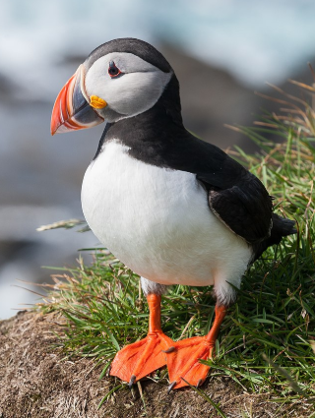
Site #1: AMNH Think & Link
1) Continental Shelf
What mammal was the great white shark’s meal?
How do dolphins “hear” clicks from other dolphins?
What does an ocean pout do to avoid predators?
How do scallops get their food?
What does phytoplankton use to make food?
*What organism is called the "parrot of the sea"?
Dolphins & other sea mammals
Uses its teeth
Tries to hide in the mud
Filter-feeding
Energy from the sun
Puffins (due to their beak)
What challenges do puffins face in their habitat? Why?

Slide 3
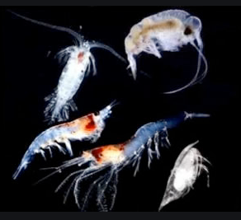
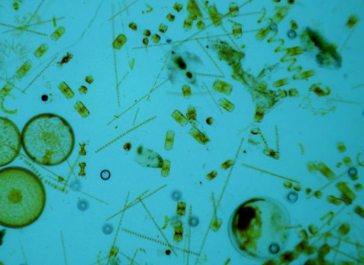
(2) Coral Reef
How is a moray eel classified: snake or fish?
How does the spiny lobster defend itself?
What does the crown-of-thorns starfish eat?
What is plankton?
*What organism do farmer fish eat that give coral its color?
Fish
Uses it thorny antennae
Elkhorn coral
Tiny algae and animals that drift in the water
Algae
Do you remember the two types of plankton we discussed last week?
Phytoplankton = Microscopic plant life
Zooplankton = Microscopic animal life

Slide 4
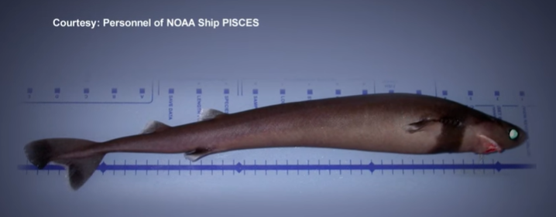
(3) Deep Sea
What are photophores?
What did the squid eat?
What does it mean when it says tunicates are sessile?
What is sea snow?
*What does the sea turtle eat?
*How did the cookie-cutter shark get its name?
Light producing organs on the shark’s body
Lantern Fish
They stay in the same place
A blend of dead plankton, animal carcasses and fecal matter
Jellyfish and small fish (lantern fish)
It cuts out a cookie shaped chunk of flesh from its prey
What adaptations does a cookie-cutter shark have to help it survive?

Slide 5
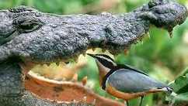
Site #2: Ology - Connect the Dots
(1) Explore the RIVER to answer these questions.
What does the fishing spider eat? What eats the fishing spider?
What type of lizard eats toads, fish, & birds?
What creature feeds on the lizards?
What type of bird acts as a "dentist" for this predator?
* What does the giant otter shrew eat?
Golden barbs
Square-marked toad
Nile Monitor
Slender-snouted Crocodile
Egyptian Plover
Fish
What type of symbiosis exists between plovers and crocodiles? Why?
Mutualism – Plovers get a meal and the crocodiles remove debris from its teeth

Slide 6
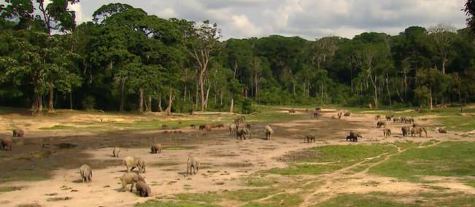
(2) Explore the BAI to answer these questions.
What is a "bai"?
What eats the dung beetle?
What creature provides the beetle's food?
*What insect would visit the water pools? Why?
* How is the gorilla classified: herbivore, omnivore, or carnivore?
Marshy clearing
Mabuya
Forest Elephants
Butterflies - Minerals in the water
Omnivore
What resources does the habitat provide for the elephant?

Slide 7
(3) Explore the FOREST to answer these questions.
What insect tastes like almonds? What creature eats them?
What bird eats lizards, fruits, and insects?
Which plant provides shelter for many animals?
What eats the bat as well as birds, insects, and fruit?
*What creature would be prey for a leopard?
* What do the butterflies feed on?
Termites
Agama Lizard
African Pied Hornbill
Palm Tree
African Harrier Hawk
Blue Duiker
Mineral-rich dung
Done? Test your knowledge of Biodiversity
https://www.amnh.org/explore/ology/biodiversity/what-do-you-know-about-biodiversity2

