Slide 1
Ecology Unit Teacher Notes
Topics:
Lesson 1: Levels of Organization
Lesson 2: Population Ecology
Lesson 3: Symbiosis (includes activity)
Lesson 4: Case Study – Ponds*
Lesson 5: Food Webs
Activity 1: Food Web Challenge
Activity 2: Pond Water Webs Activity 3: Food Fight (BrainPop)
Lesson 6: Biodiversity
Activity 1: Think & Link
Activity 2: Madagascar Video
Lesson 7: Succession
Lesson 8: STEM Case – Ecosystem*
Lesson 9: Human Impacts (Lorax Lessons)
* = Explore Learning Gizmos activity
The full Ecology Basics unit is available at https://sciencespot.net/Pages/classbio.html#EcoBasics
This presentation was used to guide classroom lessons and activities for the topic(s) highlighted in the list at right. It is one of several used during my ecology unit, which was developed for 7th & 8th grade students with very little background knowledge of the topics covered in the unit lessons. The unit covered a 14-week period during the fall of 2021, which was a few weeks longer than in the past thanks to the challenges of teaching during a pandemic. The students needed more time to complete the lesson activities and I felt the need to include more discussion time for them to fully develop understanding of a concept before moving to the next topic.
The digital student notebook (with slides for ALL the lessons & activities listed above) is available at https://docs.google.com/presentation/d/15CoXAsd1zWZDy5RCGS37CKUXmfl9M2WAk58-qgwMRjE/edit?usp=sharing I do not assign the entire notebook at the start of the unit. Instead, I create a Master Copy as a “material” on Google Classroom and add the slides as the students need them. They copy the new slides and paste them into their HDSN in the correct spots. You will need to make a copy of the digital file in order to use it with your students. The digital notebook was set up as 14” x 8.5” which can be scaled down to fit a standard page on landscape to allow for printing for students needing paper copies.
T. Tomm Updated 2023 https://sciencespot.net/

Slide 2
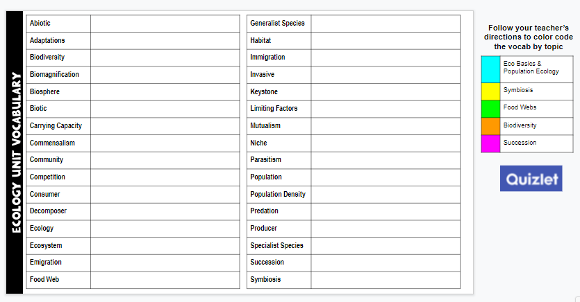
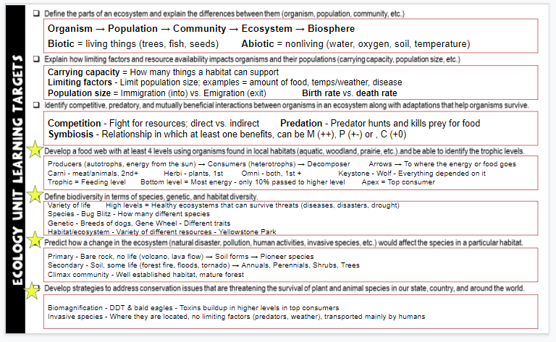
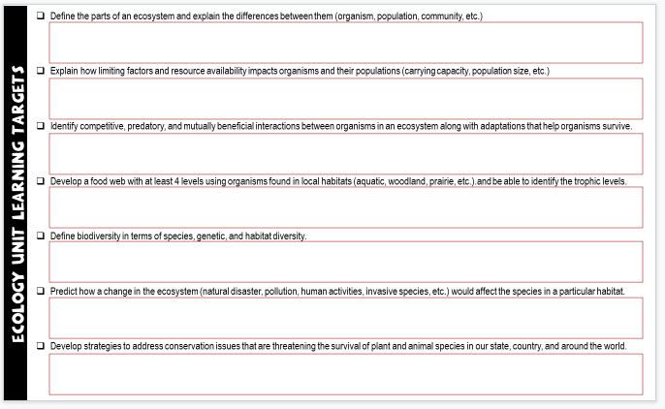
Unit Vocabulary Time
The last slide in the student digital notebook lists the main vocabulary from each lesson. After each topic, I have students color code the terms and then write definitions. All the definitions from the unit are available on the Quizlet page linked below.
Classroom Sample
https://quizlet.com/28845277/ecology-unit-vocabulary-all-terms-flash-cards/
Learning Targets
The next to last slide in the digital notebook is a list of learning targets for the entire unit. Prior to any quiz/test, we review the targets and discuss possible questions that relate to each one. This allows the students to connect the lessons to the learning expectations.
The last learning standard will be included in our Earth Day lessons.

Slide 3
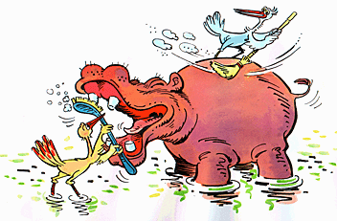
Ecology
Basics
Lesson 3: Symbiosis
T. Tomm Updated 2023 https://sciencespot.net/

Slide 4
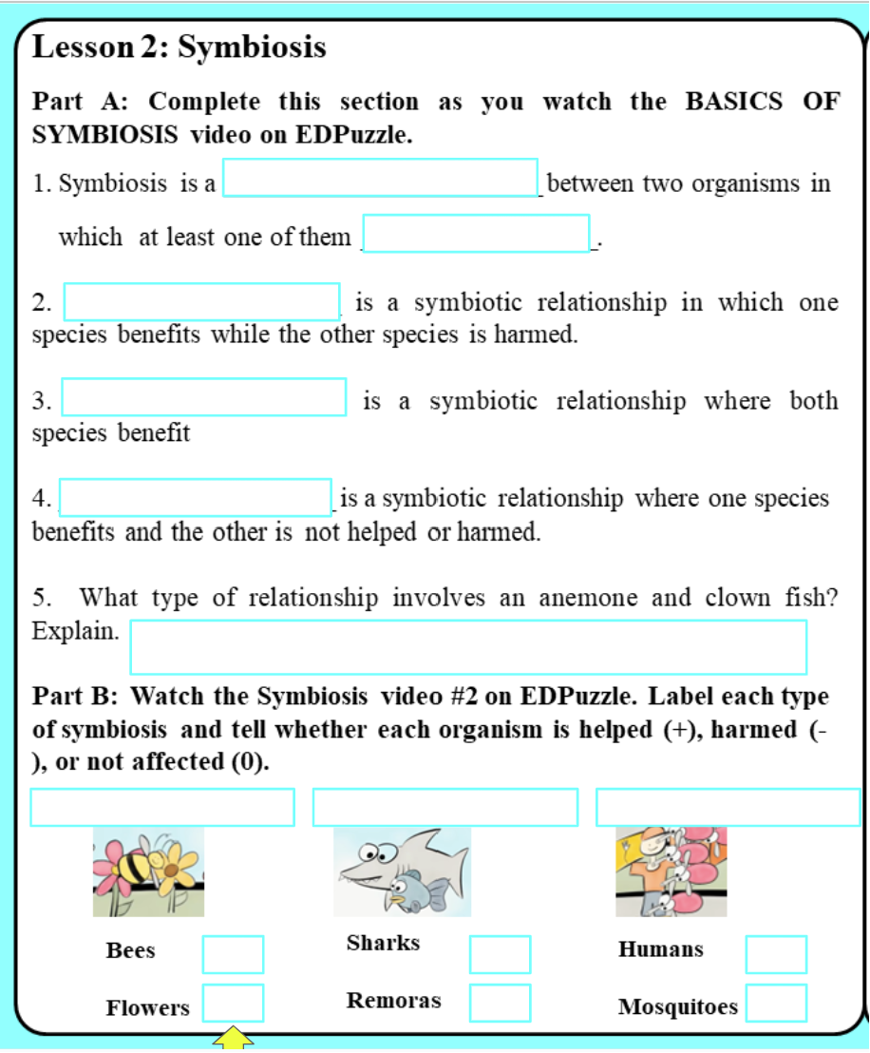
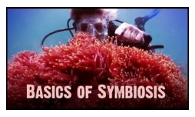
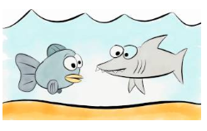
Go to SLIDE 5 → Watch the TWO EDPuzzle videos to complete the LEFT SIDE of SLIDE 5 by the start of class tomorrow.
Basics of Symbiosis (Video #1)
Grades will be averaged and counted as one grade on ALMA.
Use the links on Google Classroom to find the videos.
Symbiosis (Video #2)
We will discuss the RIGHT SIDE in class.

Slide 5
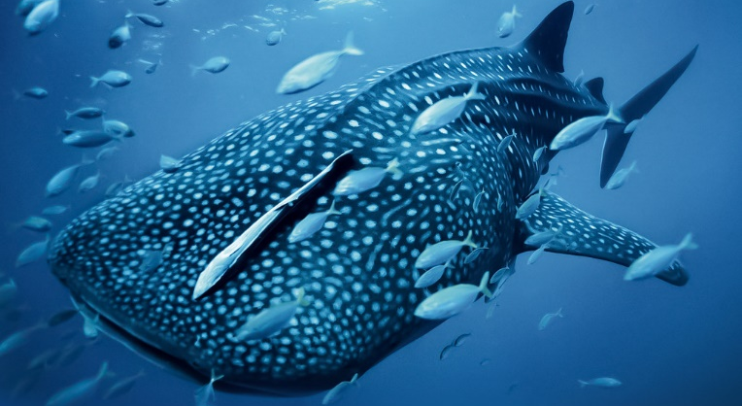
Lesson 2 - Symbiosis → BASICS OF SYMBIOSIS video
1. Symbiosis is a _______________________ between two organisms in which at least one of them _________________.
2. ____________________ is a symbiotic relationship in which one species benefits while the other species is harmed
3. ____________________ is a symbiotic relationship where both species benefit
4. ____________________ is a symbiotic relationship where one species benefits and the other is not helped or harmed.
RELATIONSHIP
BENEFITS
+ -
PARASITISM
+ +
MUTUALISM
+ 0
COMMENSALISM

Slide 6
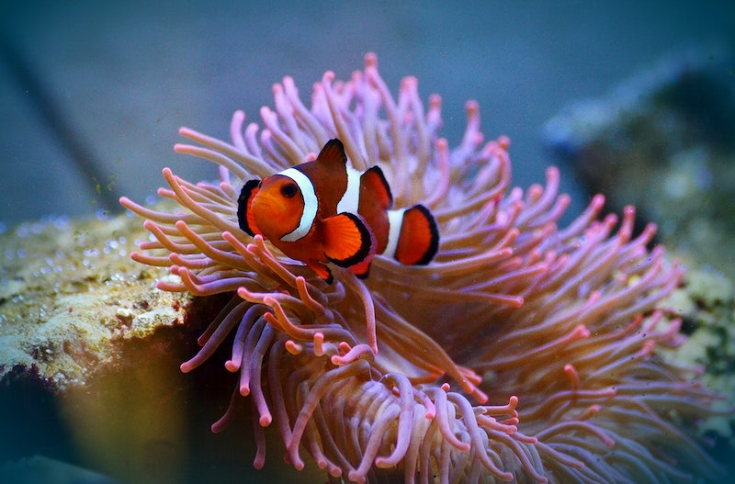
5. What type of relationship occurs between anemones & clownfish? Explain.
MUTUALISM
+
ANEMONES – Provide protection for clownfish CLOWNFISH - Attracts fish for the anemone
+

Slide 7
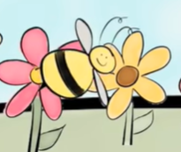
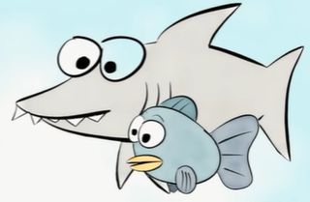
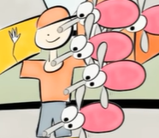
Part B: What examples were discussed in the Symbiosis Video #2? Explain how each organism is affected.
MUTUALISM
COMMENSALISM
PARASITISM
+
+
O
+
- +
Bees & Flowers
Sharks & Remoras
Humans & Mosquitoes

Slide 8
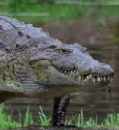
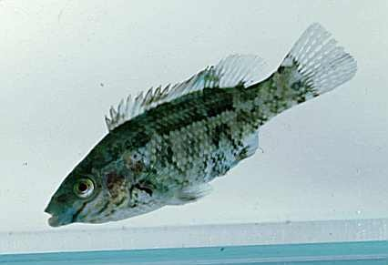
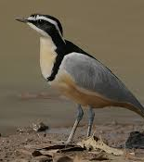
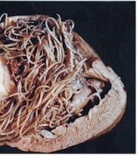
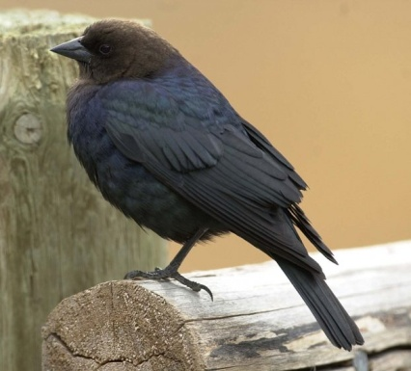
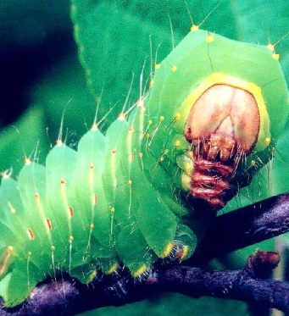
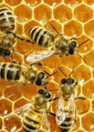
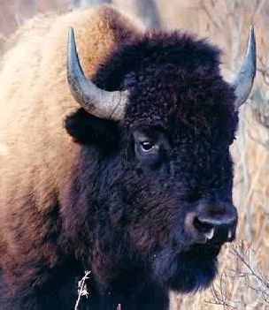
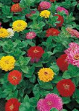
Symbiosis
Watch the video for directions
Check out Project Wild for lesson information and resources.

Slide 9
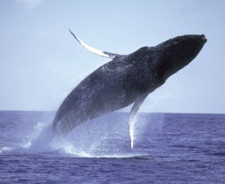
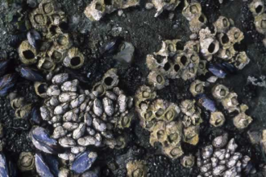
Barnacle +
Whale 0
Good Buddies (or NOT)
Barnacles create home sites by attaching themselves to whales, but it does not hurt them.
Barnacles & Whales

Slide 10
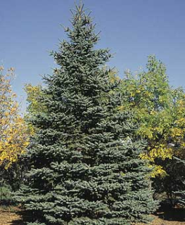
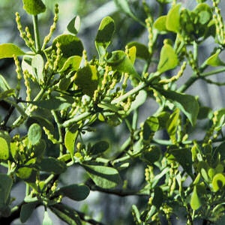
Barnacle +
Whale 0
Mistletoe +
Spruce Tree -
Good Buddies (or NOT)
Mistletoe extracts water and nutrients from a spruce tree and may kill it.
Spruce Tree & Mistletoe

Slide 11
Barnacle +
Whale 0
Yucca flower +
Yucca moth +
Mistletoe +
Spruce Tree -
Good Buddies (or NOT)
Yucca flowers are pollinated by yucca moths. The moths lay their eggs in the flowers where the larvae hatch and eat some of the developing seeds. They do not harm the plant. Both species benefit.
Yucca Flowers & Yucca Moths

Slide 12
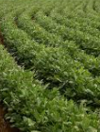
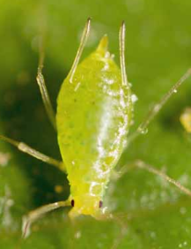
Barnacle +
Whale 0
Yucca flower +
Yucca moth +
Mistletoe +
Spruce Tree -
Good Buddies (or NOT)
Aphids +
Soybeans -
Aphids are small green, yellow, or red insects that can kill many types of plants, such as soybeans, by eating their sap.
Soybeans & Aphids

Slide 13
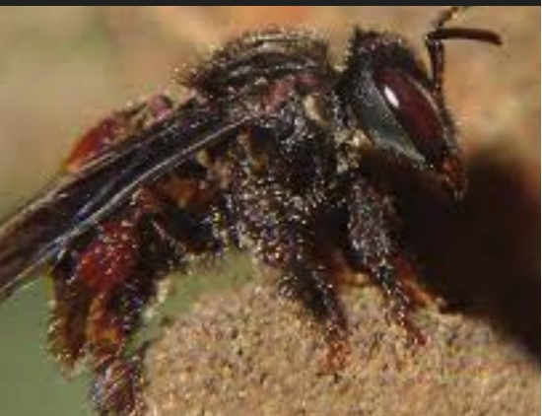
Barnacle +
Whale 0
Yucca flower +
Yucca moth +
Mistletoe +
Spruce Tree -
M. Stork 0
Bees +
Aphids +
Soybeans -
Good Buddies (or NOT)
Marabou storks use their saw-like bill to cut up the dead animals it eats. The carrion bees benefit by having easy access to the dead animal carcass for food and egg laying.
Marabou Stork &
Carrion Bees

Slide 14
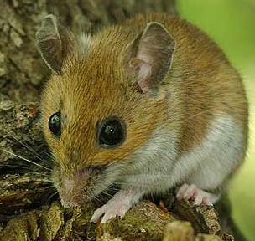
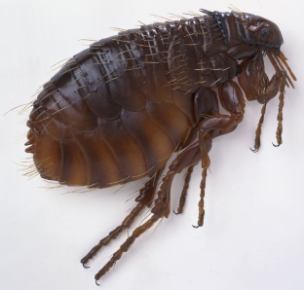
Barnacle +
Whale 0
Yucca flower +
Yucca moth +
Mistletoe +
Spruce Tree -
M. Stork 0
Bees +
Aphids +
Soybeans -
Flea +
Mouse -
Good Buddies (or NOT)
A flea feeds on a mouse’s blood and harms the mouse.
Flea & Mouse

Slide 15
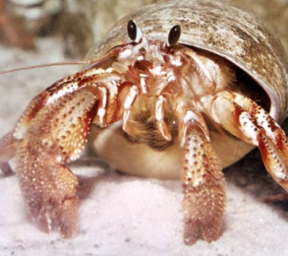
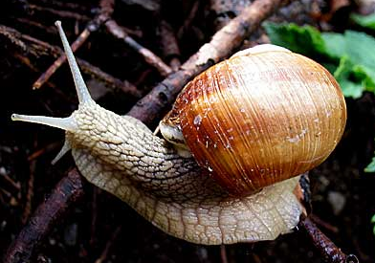
Barnacle +
Whale 0
Yucca flower +
Yucca moth +
Mistletoe +
Spruce Tree -
M. Stork 0
Bees +
Aphids +
Soybeans -
Hermit crabs +
Snails 0
Flea +
Mouse -
Good Buddies (or NOT)
Hermit crabs live in shells made and then abandoned by snails. This relationship neither helps nor harms the snails.
Hermit Crab & Snails

Slide 16
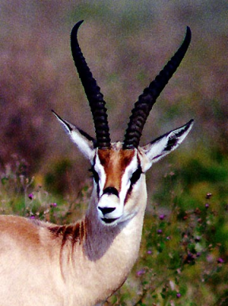
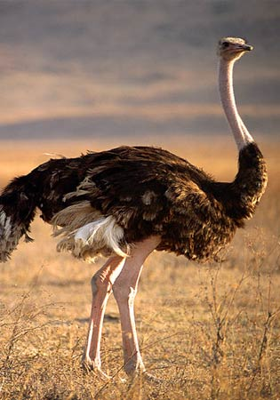
Barnacle +
Whale 0
Yucca flower +
Yucca moth +
Mistletoe +
Spruce Tree -
M. Stork 0
Bees +
Ostrich +
Gazelles +
Aphids +
Soybeans -
Hermit crabs +
Snails 0
Flea +
Mouse -
Good Buddies (or NOT)
Ostriches and gazelles feed next to each other. They both watch for predators and alert each other to danger. Because their visual abilities are different, they can identify threats that the other animal would not see as readily.
Gazelles & Ostriches

Slide 17
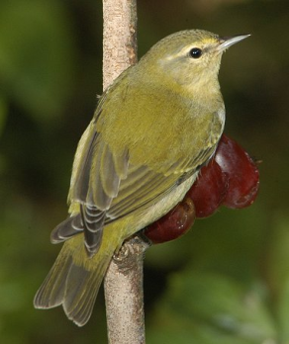
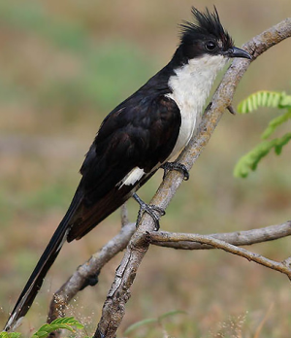
Barnacle +
Whale 0
Yucca flower +
Yucca moth +
Mistletoe +
Spruce Tree -
M. Stork 0
Bees +
Ostrich +
Gazelles +
Aphids +
Soybeans -
Hermit crabs +
Snails 0
Flea +
Mouse -
Good Buddies (or NOT)
Cuckoo +
Warbler -
A cuckoo may lay its eggs in a warbler’s nest. The cuckoo’s young will knock the warbler’s eggs out of a nest and the warbler will raise the cuckoo’s young.
Warblers & Cuckoos

Slide 18
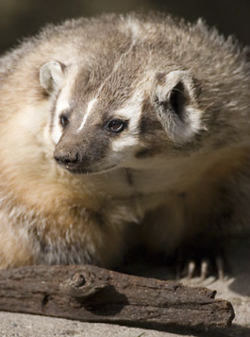
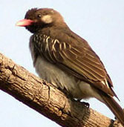
Barnacle +
Whale 0
Yucca flower +
Yucca moth +
Mistletoe +
Spruce Tree -
M. Stork 0
Bees +
Ostrich +
Gazelles +
Aphids +
Soybeans -
Hermit crabs +
Snails 0
HG Bird +
Badger +
Flea +
Mouse -
Good Buddies (or NOT)
Cuckoo +
Warbler -
Honey guide birds alert and direct badgers to beehives. The badgers then expose the hives and feed on the honey first. Next the honey guide birds eat. Both species benefit.
Badgers & Honey Guide Birds

Slide 19
YOUR TURN – Fill in the rest of the chart!
Click the image for the list of Good Buddies to fill up the chart!
Barnacle +
Whale 0
Yucca flower +
Yucca moth +
Mistletoe +
Spruce Tree -
M. Stork 0
Bees +
Ostrich +
Gazelles +
Aphids +
Soybeans -
Hermit crabs +
Snails 0
HG Bird +
Badger +
Flea +
Mouse -
Cuckoo +
Warbler -
You will have the same # of examples to fill the columns.

Slide 20
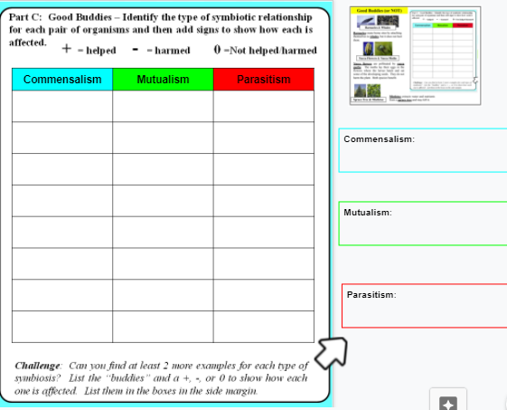
Find examples for these boxes!

Slide 21
Check your answers and make corrections if you are done!
Commensalism | Mutualism | Parasitism
Barnacles + Whales 0 | Yucca Flowers + Yucca Moths + | Mistletoe + Spruce tree -
Stork 0 Bees + | Ostrich + Gazelles + | Soybeans – Aphids +
Hermit crab + Snails 0 | Honey guide bird + Badgers + | Flea + Mouse -
Bison + Cowbirds + | Wrasse Fish + Sea Bass + | Cuckoo + Warbler -
Orchids + Bromeliad 0 | Shrimp + Goby Fish + | Tick + Deer 0
Sparrow + Osprey 0 | Crocodiles + Plovers + | Heartworms + Dog -
Cattle egrets + Cattle 0 | Monarchs + Milkweed + | Parasitic wasp + Caterpillar -
Puffins + Rabbits 0 | Good bacteria + Humans + | Tapeworm + Cats -

Slide 22
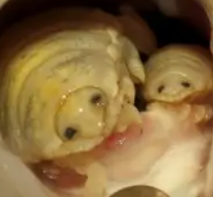
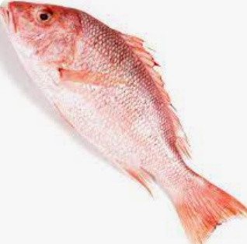
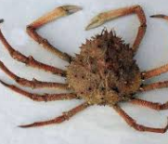
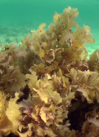
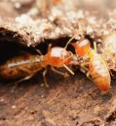
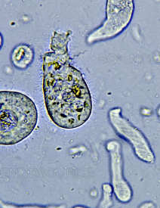
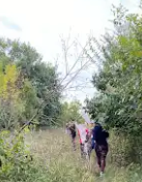
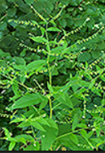
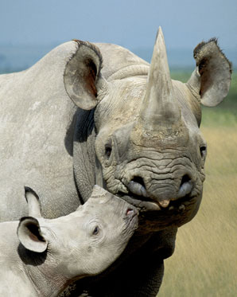
Did you add these examples to slide 5? If not, check the class notes!
Marine Louse
Zinnia (or other flowers)
-
+
+
+
Snapper
Honey Bee
The marine (tongue) louse eats the tongue of the fish and takes its place.
Honeybees pollinate the flowers and get a meal.
+
+
+
+
Spider Crab
Brown Algae
Termite
Protozoa
The brown algae has a home on the back of the crab helping it camouflage in its habitat.
The protozoa live inside the digestive system of the termite to help it break down the wood it eats.
0
+
+
+
Humans
Rhino
Oxpecker
Plant Seeds
The bird rides on the back of the rhino and eats the parasites living on it.
We helped plants with seed dispersal as we walked in the area.

Slide 23
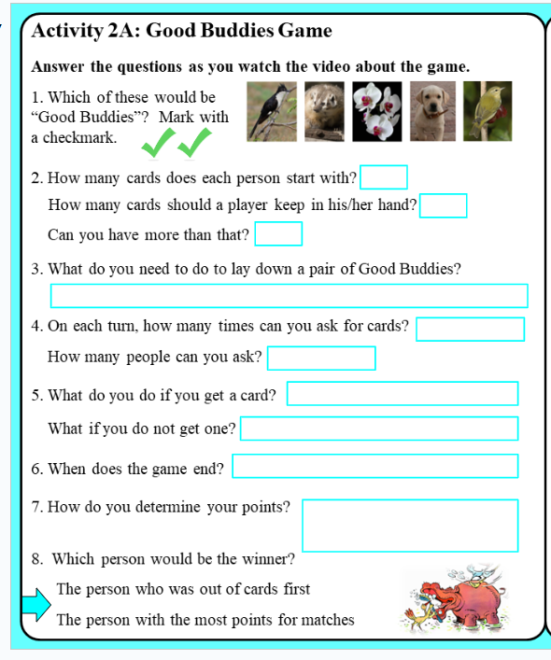
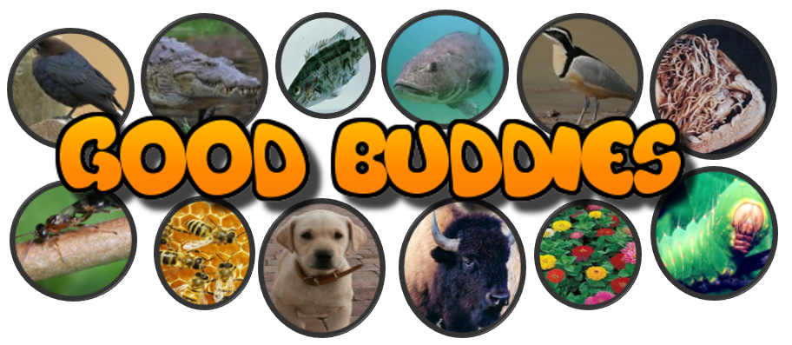
Watch the video to fill in the left side of slide 6.
Use your Slide 5 in your notes to help you during the game.
Teachers: Go to the Good Buddies page from Project Wild for the original game cards. Click HERE for a PDF version of the cards I use for the Good Buddies game. I print them on card stock and then laminate them to make the sets for students to use.

Slide 24
Watch the video to fill in the left side of slide 6.
5
5
Yes
A pair from our examples (Slide 5)
Once
1
Lay down the pair, tell symbiosis
Draw a card
Someone runs out of cards
Add points for pairs, subtract cards in
your hand

Slide 25
Open your Ecology HDSN and go to slide 5. Use your notes to help you during the game.
Feel free to fix your chart if you discover errors as you match the cards up. You may also add notes to help you!
It’s time to play the game!
Use CTRL + F to help you find buddies in the chart.
You cannot play unless all of Slide 5 is done AND checked by the teacher!

Slide 26
SYMBIOSIS SMILLIONAIRE CHALLENGE
What is a smillionaire? It’s a version of “Who Wants To Be a Millionaire” except you earn 1 million smileys instead of $$. You have three hints you can use!
You may use your notes, but no Google or asking classmates for answers.
Add notes on the right side of Slide 6 for any questions you miss.
Use the link to find the Symbiosis Smillionaire game. Earn at least one smillionaire and take a screenshot to turn in for the assignment.
https://www.quia.com/rr/1143526.html

