Slide 1
Ecology Unit Teacher Notes
Topics:
Lesson 1: Levels of Organization
Lesson 2: Population Ecology
Lesson 3: Symbiosis (includes activity)
Lesson 4: Case Study – Ponds*
Lesson 5: Food Webs
Activity 1: Food Web Challenge
Activity 2: Pond Water Webs
Lesson 6: Biodiversity
Activity 1: Think & Link
Activity 2: Madagascar Video
Lesson 7: Succession
Lesson 8: STEM Case – Ecosystem*
Lesson 9: Human Impacts (Coming Soon)
* = Explore Learning Gizmos activity
The full Ecology Basics unit is available at https://sciencespot.net/Pages/classbio.html#EcoBasics
This presentation was used to guide classroom lessons and activities for the topic(s) highlighted in the list at right. It is one of several used during my ecology unit, which was developed for 7th & 8th grade students with very little background knowledge of the topics covered in the unit lessons. The unit covered a 14-week period during the fall of 2021, which was a few weeks longer than in the past thanks to the challenges of teaching during a pandemic. The students needed more time to complete the lesson activities and I felt the need to include more discussion time for them to fully develop understanding of a concept before moving to the next topic.
The digital student notebook (with slides for ALL the lessons & activities listed above) is available at https://docs.google.com/presentation/d/15CoXAsd1zWZDy5RCGS37CKUXmfl9M2WAk58-qgwMRjE/edit?usp=sharing I do not assign the entire notebook at the start of the unit. Instead, I create a Master Copy as a “material” on Google Classroom and add the slides as the students need them. They copy the new slides and paste them into their HDSN in the correct spots. You will need to make a copy of the digital file in order to use it with your students. The digital notebook was set up as 14” x 8.5” which can be scaled down to fit a standard page on landscape to allow for printing for students needing paper copies.
T. Tomm Updated 2021 https://sciencespot.net/

Slide 2
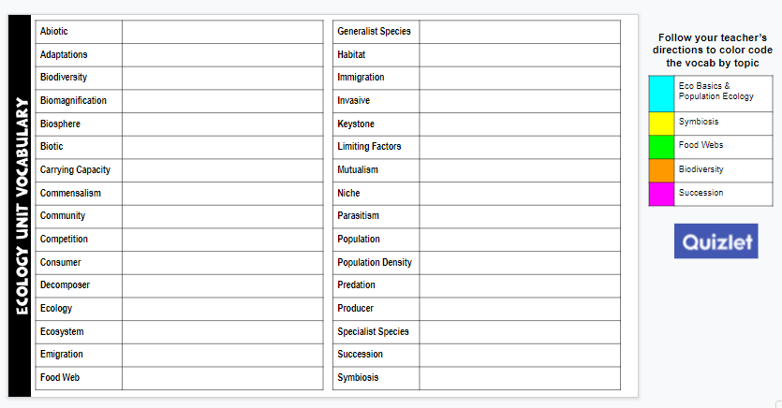
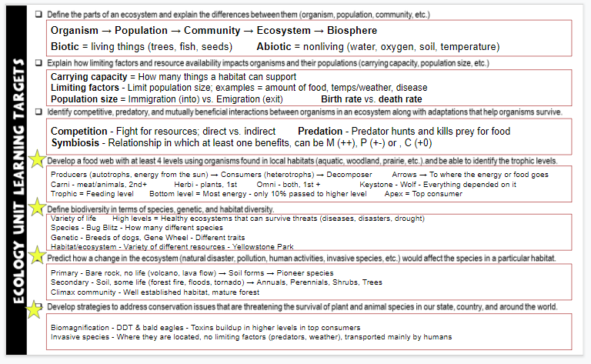
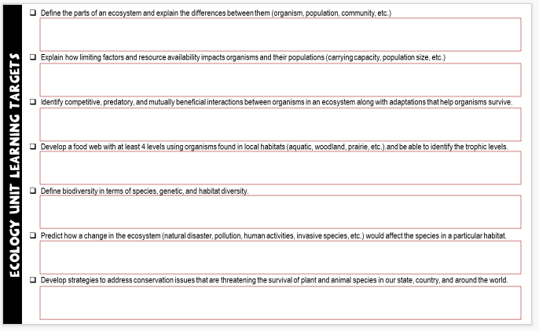
Unit Vocabulary Time
The last slide in the student digital notebook lists the main vocabulary from each lesson. After each topic, I have students color code the terms and then write definitions. All the definitions from the unit are available on the Quizlet page linked below.
Classroom Sample
https://quizlet.com/28845277/ecology-unit-vocabulary-all-terms-flash-cards/
Learning Targets
The next to last slide in the digital notebook is a list of learning targets for the entire unit. Prior to any quiz/test, we review the targets and discuss possible questions that relate to each one. This allows the students to connect the lessons to the learning expectations.
The last learning standard will be included in our Earth Day lessons.

Slide 3

ECOLOGY BASICS
STEM Case – Ecosystems
T. Tomm Updated 2021 https://sciencespot.net/

Slide 4
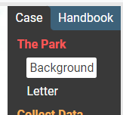
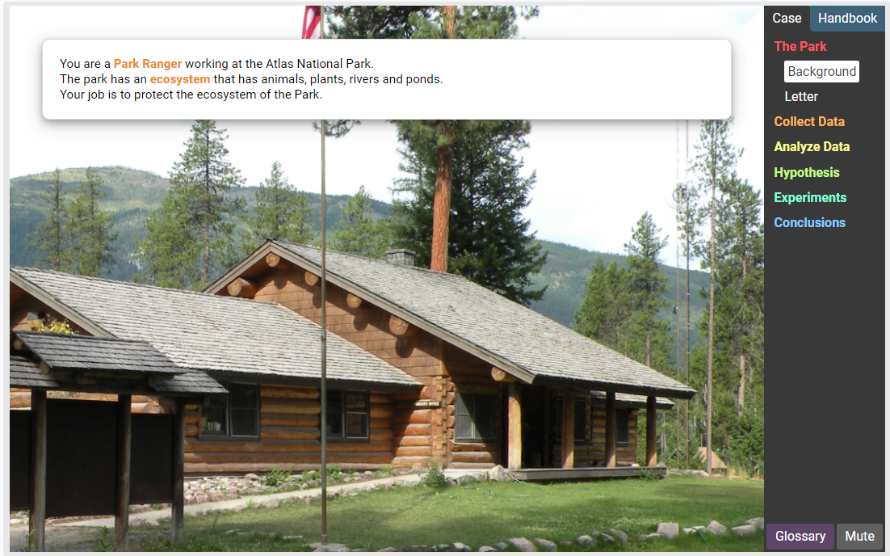
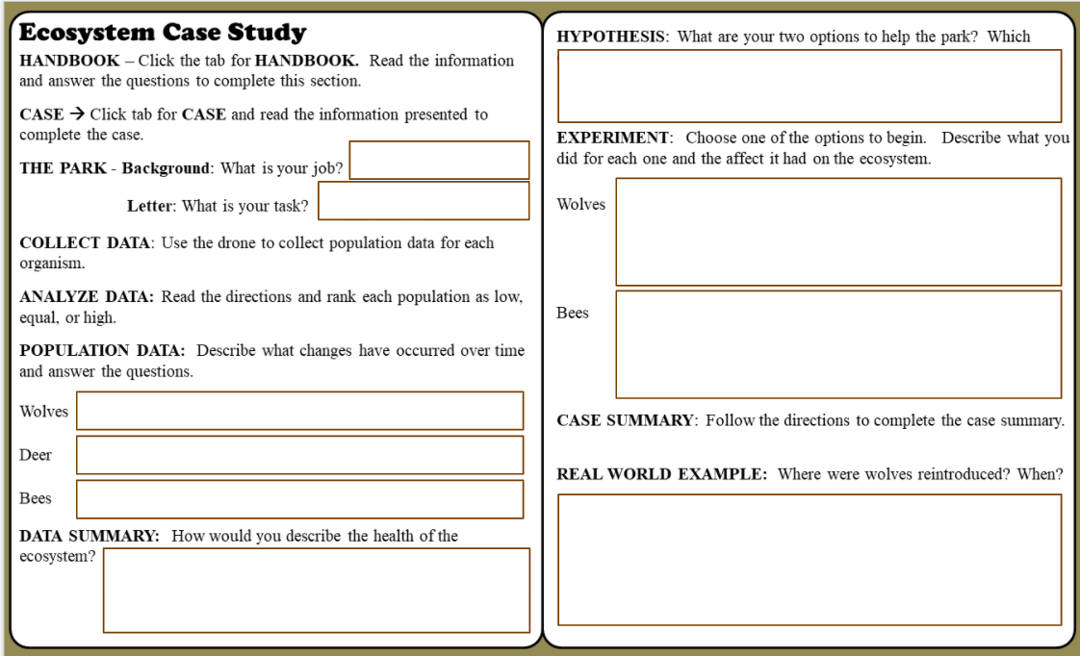
You have TWO TASKS – the HANDBOOK and the CASE.
After you finish the HANDBOOK, you will need to solve the CASE by reading the information and completing the tasks.
To solve the case, READ the information and complete all the tasks.
You will NOT add to your slide until you are working on the case.

Slide 5
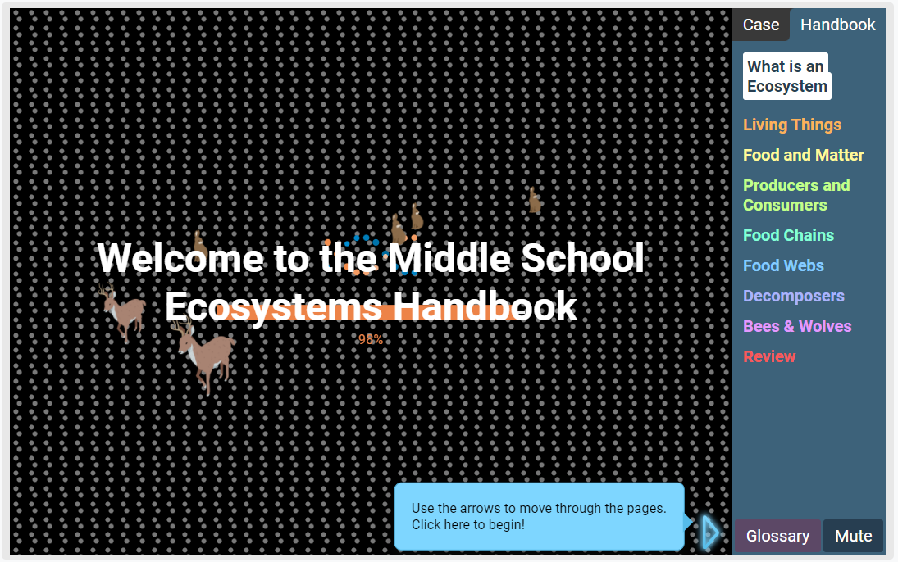
Read the information to review some of the concepts we have studied in class.
Work your way through each section.
Click the CASE tab after you finish the review.
Remember to fill in Slide 14 as you solve the case.

Slide 6
After you finish the HANDBOOK, you will need to solve the case. Read the information and complete the tasks.
Start HERE
To solve the case,
READ the information and complete all the tasks.
You will NOT add to Slide 14 until you are working on the case.

Slide 7
GIZMOS
Ecosystems: STEM Case
Answer Key

Slide 8
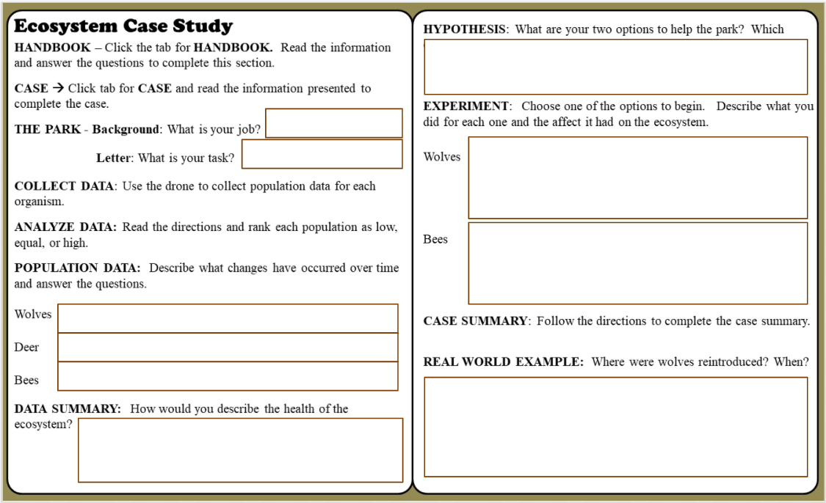
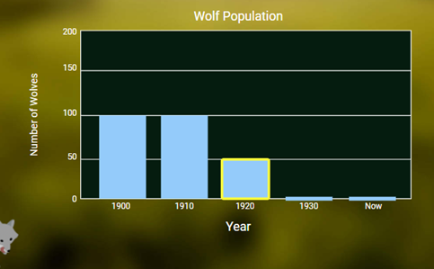
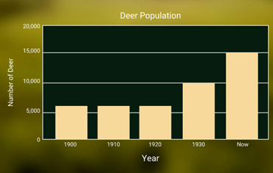
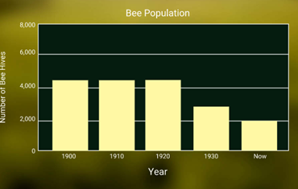
Park Ranger
Fix ecosystem
Population declined starting in 1920
Population increased starting in 1930
Population declined starting in 1930
The lack of wolves allowed the deer population to increase, which lead to less grass/plants available to the bees. Populations are not in normal ranges for this type of ecosystem.

Slide 9
Add more bees or more wolves
Adding more wolves decreased the deer and coyote populations to normal ranges. Grasses increased along with bees.
Adding more bees increased the bee population, but it did not help the other populations move into the normal range.
Yellowstone National Park, 1995

Slide 10
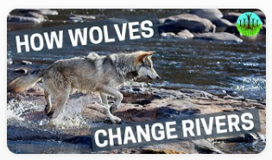
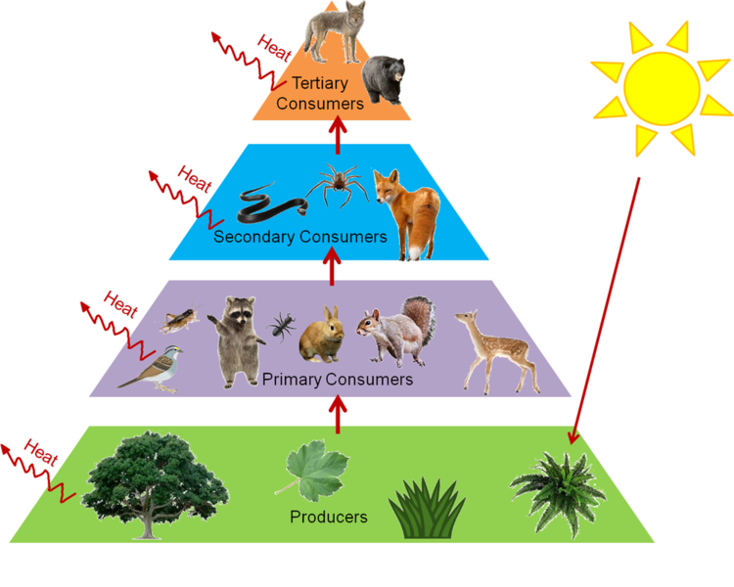
How Wolves Change Rivers
1. What is a trophic cascade?
2. What changes occurred once the wolves were
reintroduced? Describe how each was affected.
Deer
Coyotes
Bears
Beavers
River
A change that occurs at top levels (tropic levels) of an ecosystem and changes all levels below it.
APEX Predators →
https://www.seversondells.com/blog/6b5df6kz2xk9gb6cheel52l55ttal7

Slide 11
2. What changes occurred once the wolves were reintroduced? Describe how each was affected.
FISH
?
DEER
TREES
BIRDS
DAMS → HABITATS
WATER FOWL
FORESTS
BEAVERS
FURBEARERS
?
HAWKS
COYOTES
MICE
BADGERS
?
RABBITS
BEARS
FOX
EAGLES
How did wolves change the river? Why?
KEYSTONE SPECIES – A species on which all things in an ecosystem depend

Slide 12
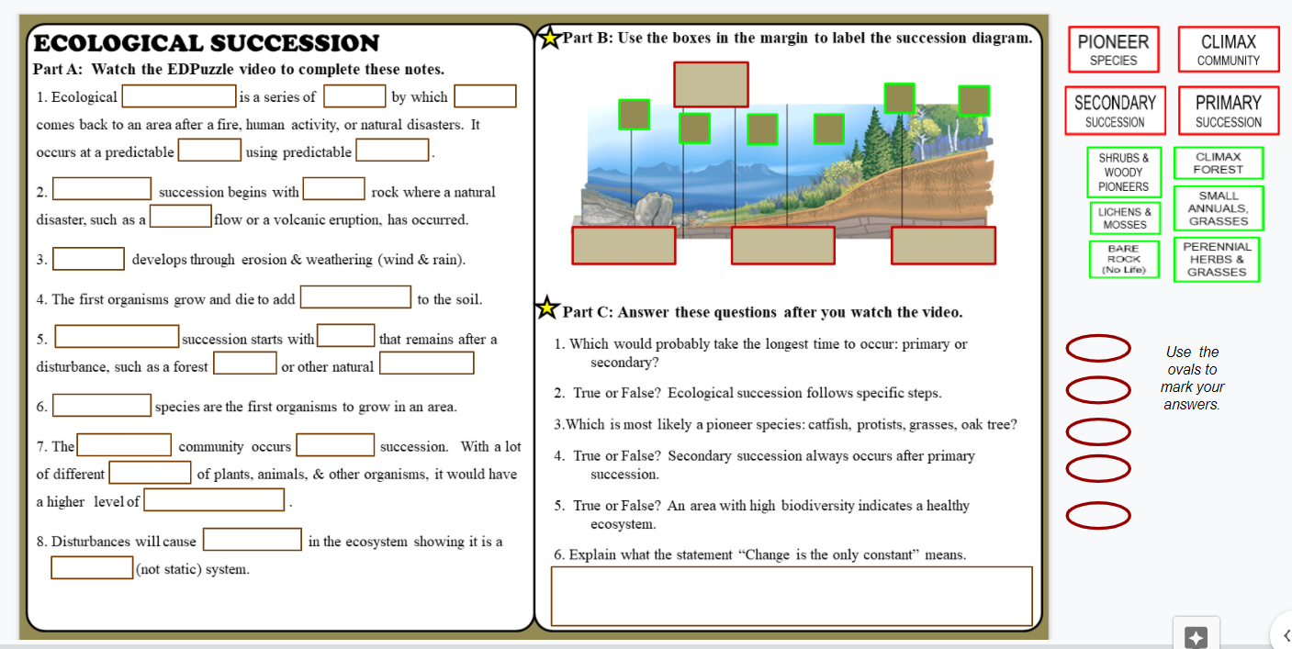
Add the new slide (#15) to your Ecology HDSN.
Watch the EDPuzzle video to complete PART A.
Parts B & C are starred = Do in class tomorrow.
Done?
1st - Finish ALL DEFINITIONS on your vocabulary slide
2nd - Finish Blooket and turn in
3rd - Check out Santa Tracker

