Slide 1
Ecology Unit Teacher Notes
Topics:
Lesson 1: Levels of Organization
Lesson 2: Population Ecology
Lesson 3: Symbiosis (includes activity)
Lesson 4: Case Study – Ponds*
Lesson 5: Food Webs
Activity 1: Food Web Challenge
Activity 2: Pond Water Webs
Activity 3: Food Fight (BrainPop)
Lesson 6: Biodiversity
Activity 1: Think & Link
Activity 2: Madagascar Video
Lesson 7: Succession
Lesson 8: STEM Case – Ecosystem*
Lesson 9: Human Impacts (Lorax Lessons)
* = Explore Learning Gizmos activity
The full Ecology Basics unit is available at https://sciencespot.net/Pages/classbio.html#EcoBasics
This presentation was used to guide classroom lessons and activities for the topic(s) highlighted in the list at right. It is one of several used during my ecology unit, which was developed for 7th & 8th grade students with very little background knowledge of the topics covered in the unit lessons. The unit covered a 14-week period during the fall of 2021, which was a few weeks longer than in the past thanks to the challenges of teaching during a pandemic. The students needed more time to complete the lesson activities and I felt the need to include more discussion time for them to fully develop understanding of a concept before moving to the next topic.
The digital student notebook (with slides for ALL the lessons & activities listed above) is available at https://docs.google.com/presentation/d/15CoXAsd1zWZDy5RCGS37CKUXmfl9M2WAk58-qgwMRjE/edit?usp=sharing I do not assign the entire notebook at the start of the unit. Instead, I create a Master Copy as a “material” on Google Classroom and add the slides as the students need them. They copy the new slides and paste them into their HDSN in the correct spots. You will need to make a copy of the digital file in order to use it with your students. The digital notebook was set up as 14” x 8.5” which can be scaled down to fit a standard page on landscape to allow for printing for students needing paper copies.
T. Tomm Updated 2023 https://sciencespot.net/

Slide 2
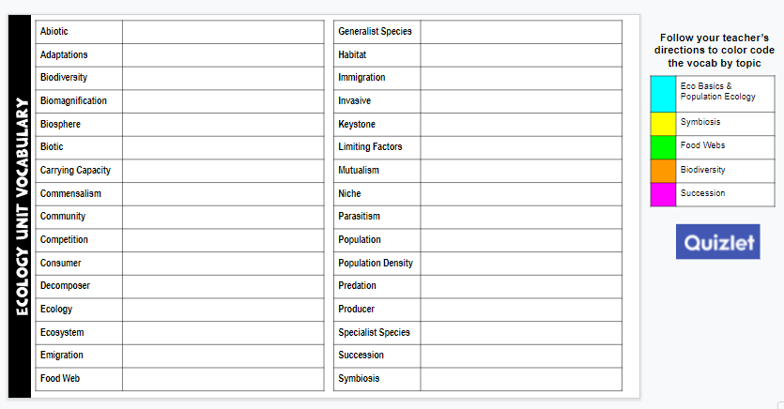
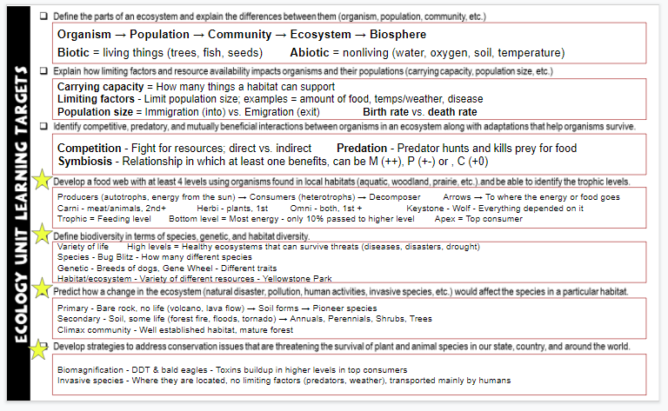
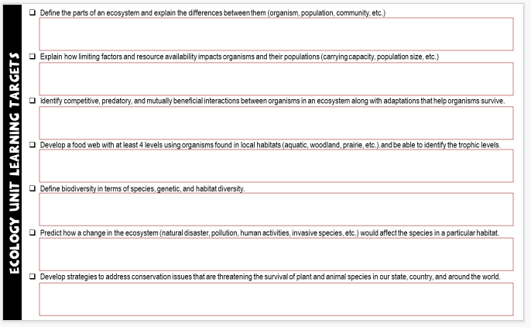
Unit Vocabulary Time
The last slide in the student digital notebook lists the main vocabulary from each lesson. After each topic, I have students color code the terms and then write definitions. All the definitions from the unit are available on the Quizlet page linked below.
Classroom Sample
https://quizlet.com/28845277/ecology-unit-vocabulary-all-terms-flash-cards/
Learning Targets
The next to last slide in the digital notebook is a list of learning targets for the entire unit. Prior to any quiz/test, we review the targets and discuss possible questions that relate to each one. This allows the students to connect the lessons to the learning expectations.
The last learning standard will be included in our Earth Day lessons.

Slide 3
Ecology
Basics
Teacher Note: You will need to have access to this activity on the Explore Learning website. Once you have an account and have added classes & students, you will need to update the following slides to reflect the information they will need to log in.
If you do not have access, delete the slides in this presentation and on the digital notebook version.
Lesson 1C: Pond Case Study
Simulation available through Gizmos from Explore Learning.
Introduction (Left side)

Slide 4

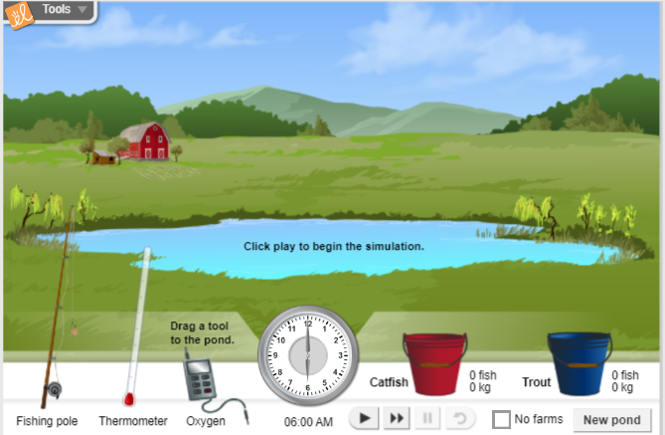
Lesson 4 Case Study – Pond Ecosystem
Part A Part B Ecosystem Builder

Slide 5


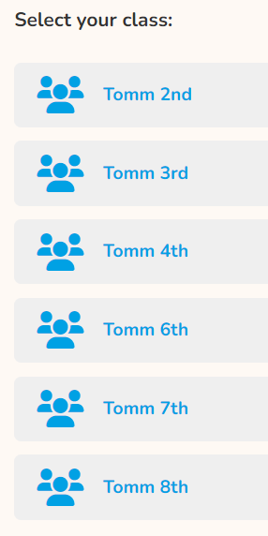
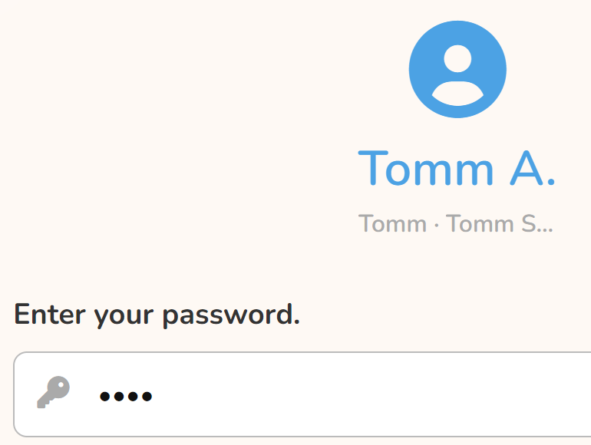
Case Study – Pond Ecosystem
Follow these directions to login.
Teacher Note: You will need to have access to this activity on the Explore Learning website. Once you have an account and have added classes & students, you will need to update the following slides to reflect the information they will need to log in.
Use this username
ttomm2023
Click your class period
Click your name
126S#
WAIT for everyone to get logged in!
126S12345

Slide 6
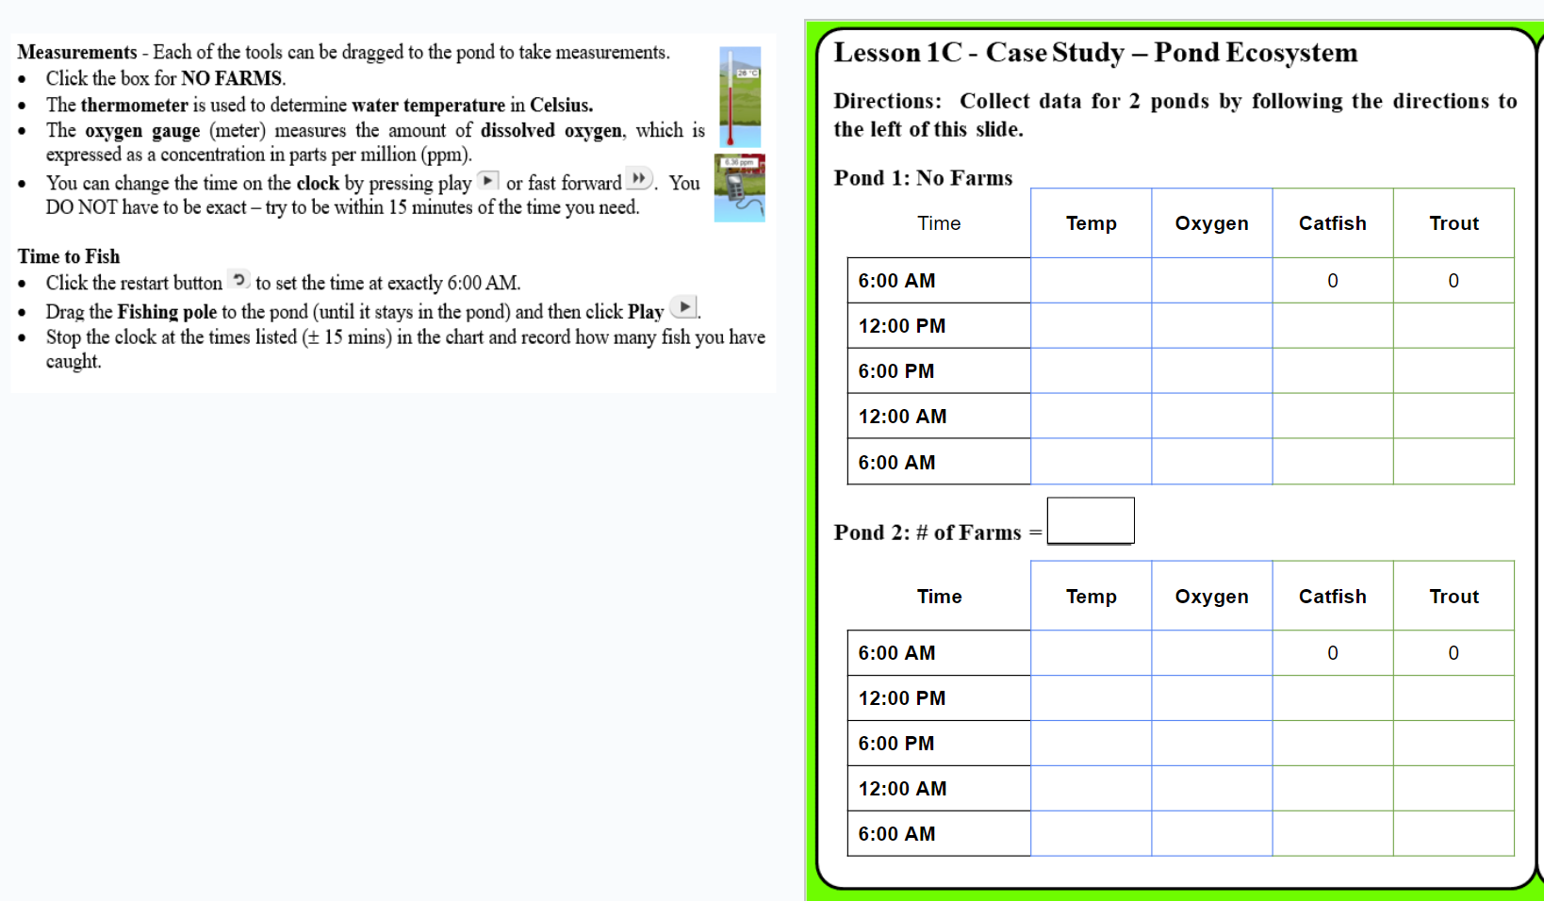
Slide 4 – Left Side
Collecting Data – Follow the direction to the left of the slide to record water temperature and oxygen concentration. You will also need to keep track of the # of fish you catch for each pond.
Click NEW POND and choose one with farms.

Slide 7
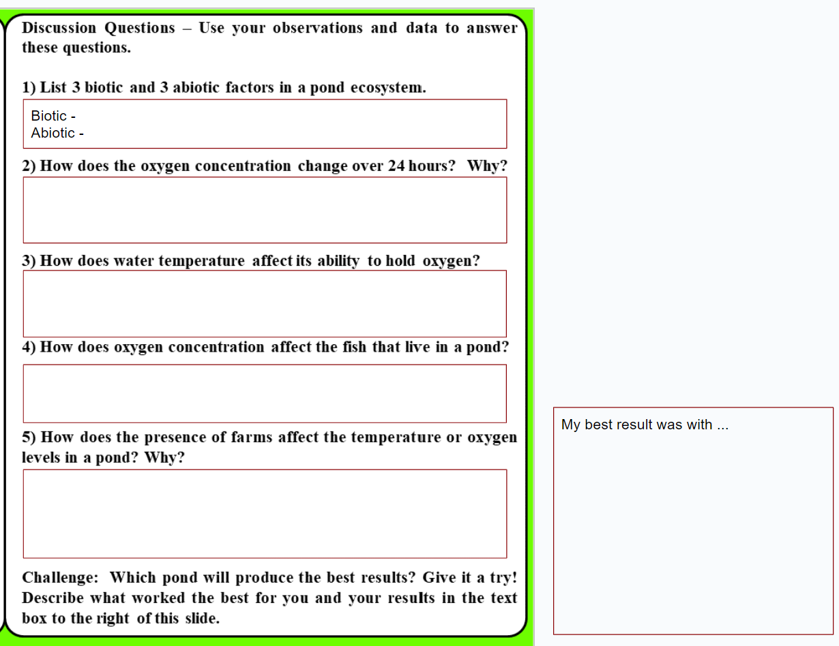
Slide 4 – Right Side
Discussion Questions – Use your observations and data to answer the questions. Be prepared to discuss your answers in class.
Try for a record! Describe the pond that was the best fishing spot!

Slide 8
Ecology
Basics
Teacher Note: You will need to have access to this activity on the Explore Learning website. Once you have an account and have added classes & students, you will need to update the following slides to reflect the information they will need to log in.
If you do not have access, delete the slides in this presentation and on the digital notebook version.
Lesson 3: Pond Case Study
Simulation available through Gizmos from Explore Learning.
Discussion Questions (Right side)

Slide 9
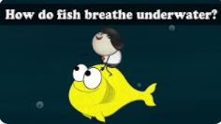
Not in your notebook!
Think About It
1) Animals that live on land obtain their oxygen from the air. How do fish and other animals that live in water get their oxygen?
Gills
2) What gas is dissolved in soda to make it bubbly?
Carbon Dioxide (CO₂)
3) What happens to an open bottle of soda that is allowed to sit for awhile?
It will go “flat” – all the dissolved CO₂ will separate out of the solution.
4) Does the temperature of the soda affect what happens?
Warm soda will lose CO₂ faster than a cold soda.

Slide 10
Open your Ecology HDSN & go to Slide 4.
Done? You may fix or correct your answers.
Not done? Close your laptop and listen. You will need to finish it and see the teacher for the class notes.

Slide 11
Discussion Questions – Use your observations and data to answer these questions.
1) List 3 biotic and 3 abiotic factors in a pond ecosystem.
Biotic → Living things
Abiotic → Nonliving things
Catfish
Trout
Other fish
Algae
Plants
Insects & larvae/nymphs
Frogs/tadpoles
Birds
Snakes
Water
Oxygen/air
Temperature
Sunlight
Soil
Rocks
Chemical compounds from
fertilizers & other chemicals
Most popular answers

Slide 12
2) How does the oxygen concentration change over 24 hours? Why?
Time | Temp | Oxygen
6:00 AM | 15 | 5.93
12:00 PM | 17 | 7.52
6:00 PM | 19 | 9.10
12:00 AM | 16 | 7.56
6:00 AM | 14 | 5.69
Time | Temp | Oxygen
6:00 AM | 19 | 5.37
12:00 PM | 22 | 6.95
6:00 PM | 23 | 8.37
12:00 AM | 21 | 6.90
6:16 AM | 19 | 5.37
Time | Temp | Oxygen
6:00 AM | 23 | 5.00
12:00 PM | 26 | 6.44
6:00 PM | 27 | 7.88
12:00 AM | 25 | 6.50
6:00 AM | 23 | 5.00
What happens?
Oxygen levels → Increase during the day and decrease down at night.
Hint: What is taking place when the sun is out?
Why?
Day → Algae & plants make oxygen by photosynthesis
Night → Animals use up oxygen, no photosynthesis

Slide 13
3) How does water temperature affect its ability to hold oxygen?
Warm water holds less dissolved oxygen than cold water.
Calculate the average temperature and oxygen concentration for each pond listed below.
Which pond is warmer?
Which pond has a lower average concentration?
POND A | Temp | Oxygen
6:00 AM | 15 | 5.93
12:00 PM | 17 | 7.52
6:00 PM | 19 | 9.10
12:00 AM | 16 | 7.56
6:00 AM | 14 | 5.69
POND B | Temp | Oxygen
6:00 AM | 23 | 5.00
12:00 PM | 26 | 6.44
6:00 PM | 27 | 7.88
12:00 AM | 25 | 6.50
6:00 AM | 23 | 5.00
Pond B
Pond B
16.2
24.8
Average Temp = _____
Average Concentration = _____
Average Temp = _____
Average Concentration = _____
7.16
6.16

Slide 14
4) How does oxygen concentration affect the fish that live in a pond?
NO FARMS | Temp | Oxygen | Catfish | Trout
6:00 AM | 15 | 5.93 | 0 | 0
12:00 PM | 17 | 7.52 | 3 | 5
6:00 PM | 19 | 9.10 | 5 | 8
12:00 AM | 16 | 7.56 | 6 | 14
6:00 AM | 14 | 5.69 | 9 | 17
Look at your data …
Most fish overall?
More catfish?
More trout?
Higher oxygen concentration?
1 FARM | Temp | Oxygen | Catfish | Trout
6:00 AM | 19 | 4.77 | 0 | 0
12:00 PM | 21 | 6.10 | 2 | 3
6:00 PM | 23 | 7.40 | 6 | 5
12:00 AM | 20 | 6.18 | 10 | 8
6:00 AM | 19 | 4.81 | 13 | 9
Generalist vs specialist
Trout need more oxygen, while catfish can survive with less oxygen.

Slide 15
5) How does the presence of farms affect the temperature or oxygen levels in a pond? Why?
1 FARM | Temp | Oxygen | Catfish | Trout
6:00 AM | 19 | 4.77 | 0 | 0
12:00 PM | 21 | 6.10 | 2 | 3
6:00 PM | 23 | 7.40 | 6 | 5
12:00 AM | 20 | 6.18 | 10 | 8
6:00 AM | 19 | 4.81 | 13 | 9
4 FARMS | Temp | Oxygen | Catfish | Trout
6:00 AM | 27 | 2.69 | 0 | 0
12:00 PM | 30 | 3.50 | 4 | 0
6:00 PM | 31 | 4.27 | 9 | 0
12:00 AM | 29 | 3.51 | 14 | 0
6:00 AM | 27 | 2.69 | 17 | 0
The more farms you had, the lower your oxygen levels.
Why?
Fertilizers and other chemicals can lower oxygen levels.
High levels of run off = More sediments in the pond & less light reaching the plants on the bottom

Slide 16
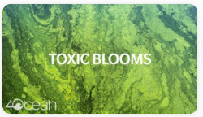
What causes a toxic bloom?
Fertilizers cause algal blooms
Bacteria decompose dead algae
& use up oxygen
Low oxygen kills fish
What other places contribute to the problem?
Yards, golf courses, parks, factories

Slide 17
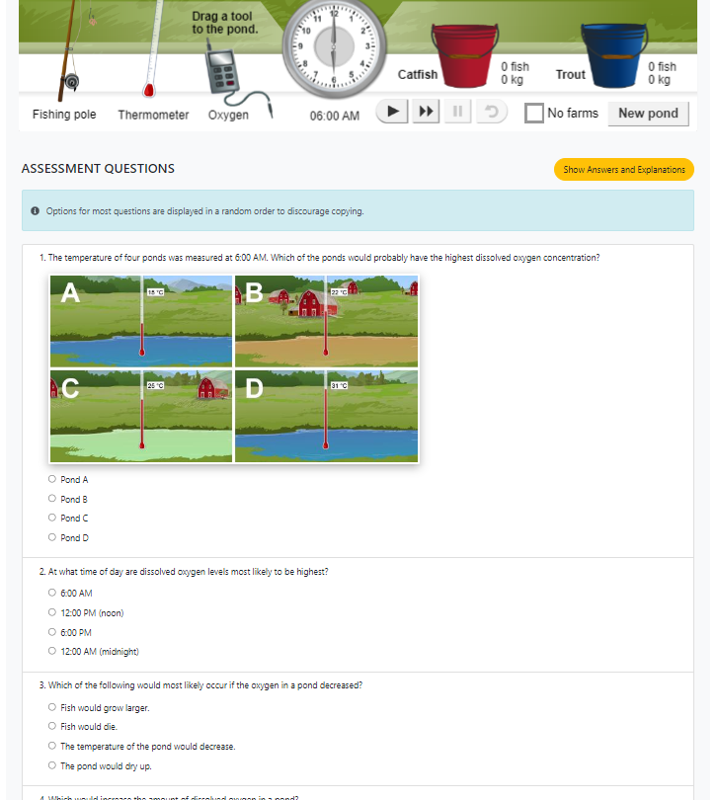
LOG IN
Open the activity and then click LAUNCH
ttomm2023
Click the BLUE ARROW.
Click your class
Click your name
Use your 126S# as the password.
Scroll down to find the 5 questions.
?
?
How did you do?
Extra time? Try fishing again, look at the
Bio Blitz pictures, or work on other work.

Slide 18
Challenge: Which pond will produce the best results? Give it a try! Describe what worked the best for you and your results in the text box to the right of this slide.
What temperature worked best – warmer or colder?
Did you want to start with a higher or lower oxygen concentration?
Who was able to catch more trout than catfish?

