Slide 1
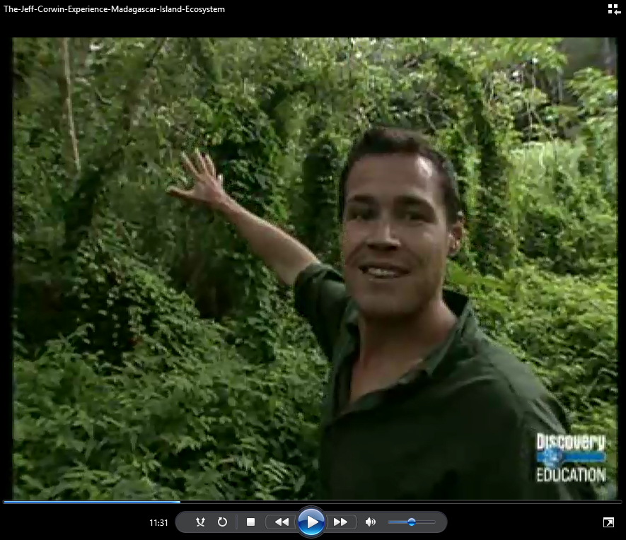
Jeff Corwin: Madagascar Island
The digital slide for this activity is available at https://docs.google.com/presentation/d/1H70AA4vg92UyeMxCs5DiuqNM9sde3Y87YXHWmjYFFmw/edit?usp=sharing
You will need to make a copy of the digital file in order to use it with your students.
The full Ecology Basics unit is available at https://sciencespot.net/Pages/classbio.html#EcoBasics
Fill in the slide as you watch the video. We will go over the answers to allow you to fix/add any you miss.
Questions during the video? Create a textbox to write your questions!
T. Tomm Updated 2021 https://sciencespot.net/

Slide 2
1. Answer these questions about Madagascar as you watch the video.
Near which continent is Madagascar located?
Africa
b) Why are most of the creatures living on Madagascar not found anywhere else in the world?
c) What percentage of creatures are found only on the island? _____%
d) How many new species are discovered each year?
It's been isolated from the rest of the world.
90
5
Factoid

Slide 3
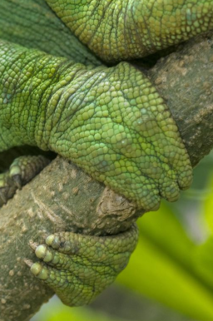
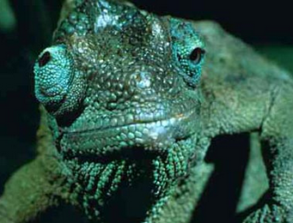
Where could we use the Large Chameleon in the chart?
Color?
Large Chameleon – Changes color for mood, blend in, find a mate
Large Chameleon - "toes" are fused to help them climb
Toes?
Large Chameleon - Eyes move independently to see in many directions.
Eyes?

Slide 4
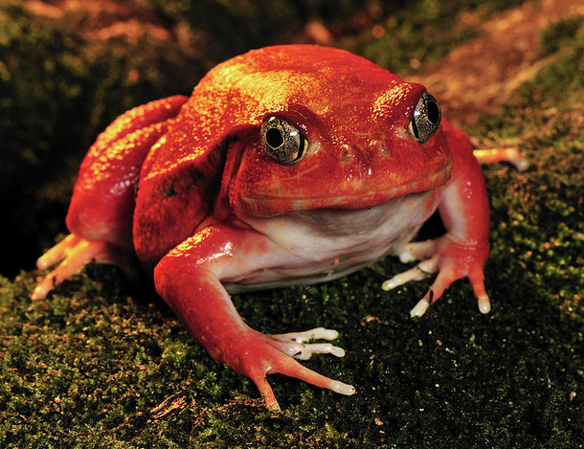
Tomato Frog
Skin?
Chemical Defenses
Secretes a gooey slime that acts as paste in a predator’s mouth
Example: The tomato frogs are sensitive to their ecosystems. They breath with their lungs and through their skin.
2. Vocabulary
Indicator species
Is sensitive to changes in the ecosystem and air quality; can indicates a problem
Insectivore Diet consists mainly of insects

Slide 5
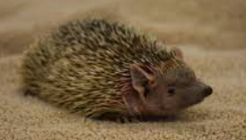
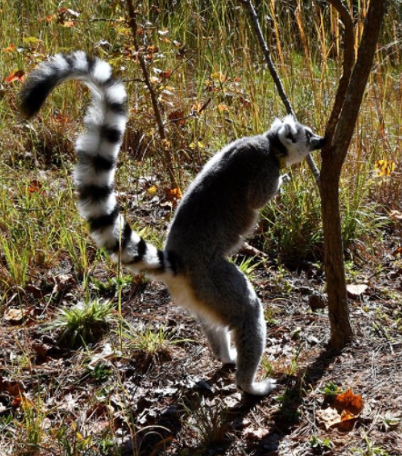
Tenrecs
Special Senses→ Whiskers are used to detect the movements of their prey.
Whiskers?
Lemurs
Chemical Defenses (or Special Behaviors)
Leave behind chemical clues by spraying or rubbing to mark their territory.
What animals do we know that use scents to mark territory?
Territory?

Slide 6
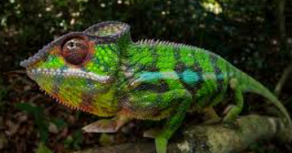
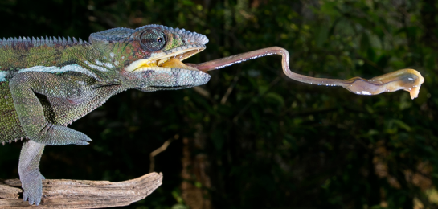
Panther Chameleon
Puffs up?
Special Behaviors
He puffs up with air to make himself look bigger and fierce.
Weapon/Tools
Tongue can stretch out more than the length of its body to catch food from a hiding place further away.
Tongue?

Slide 7
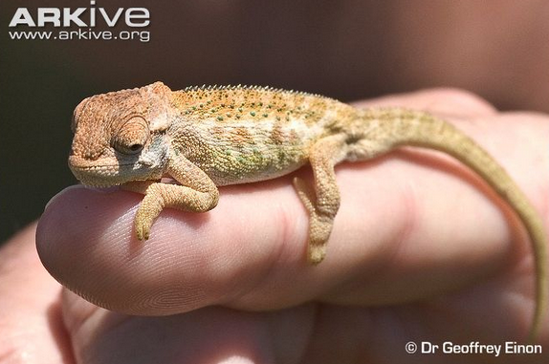
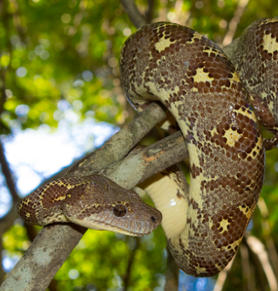
Dwarf Chameleon
Physical Appearance → It is colored to match the trees & legs look like sticks.
Color? Legs?
Hidden?
Madagascar Tree Boa
Special Behaviors → It squeezes its body around its prey to suffocate it (constriction.)
Physical Appearance→ Cryptic – blends in with habitat
Kills by?

Slide 8
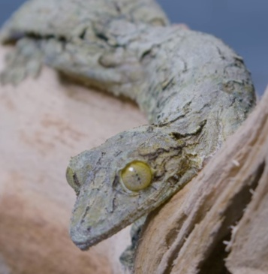
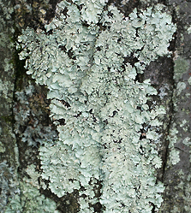
Leaf-tailed Gecko
Skin?
Physical Appearance
Camouflage – Colored to blend in
Uses mimesis – leaf-shaped tail and looks as if it has lichen & moss on its body.
Special Behaviors
Uses tongue as “wiper” to clean eyes
Eyes?
Vocabulary
Crypsis – Coloring that blends into a habitat
Mimicry – Mimics an object – leaf or branch
Did you know … Lichen is a symbiotic relationship between fungi and bacteria. What type of symbiosis is this?
Mutualism

Slide 9
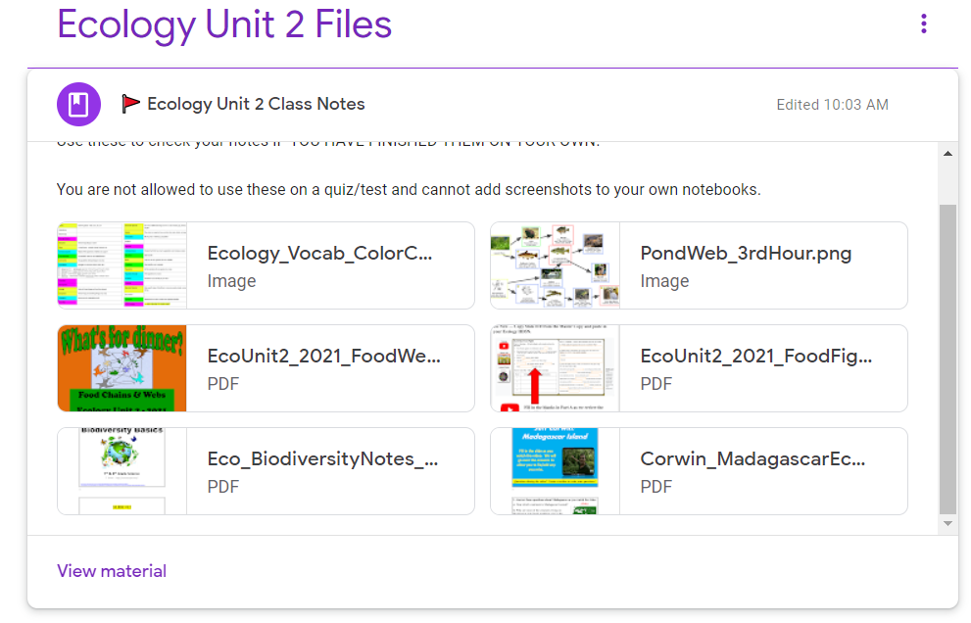
Back to Madagascar …
NOTE: Use the class notes to check the rest of Slide 13.

Slide 10
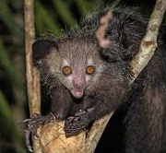
2. Vocabulary
Toilet Claw
Used for grooming
Nocturnal
Active at night
Active at night?
Aye-aye
Special Behaviors → Nocturnal
Special Senses → Excellent hearing - able to hear insect movements behind the bark on trees
Hearing?

Slide 11
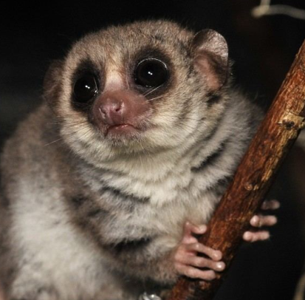
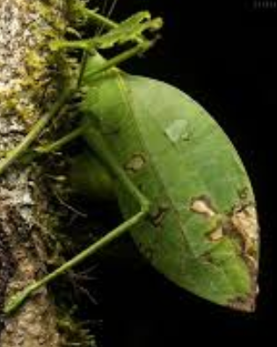
Greater Dwarf Lemur
Eyes?
Weapon/Tools → Uses claws to help it eat
Special Senses → Stereoscopic vision = depth perception.
Special Behaviors → Can store fat in its tail (up to 30% of body weight)
Claws?
Tail?
Katydid
Physical Appearance → Is cryptic (green color) and mimesis (looks like leaf)
Appearance?

Slide 12
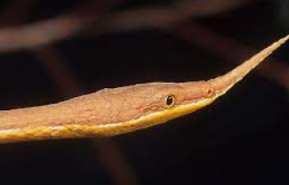
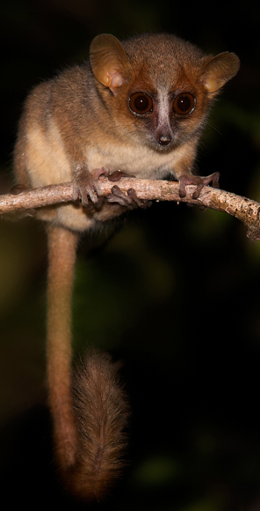
Leaf-nosed Snakes
Hidden?
Physical Appearance → Cryptic (color blends in)
Chemical Defenses → Venomous
Dangerous?
Brown Mouse Lemur
Special Senses → Excellent hearing
Best sense?

Slide 13
Possible Answers – You may have different examples than those listed. You need at least 2 animals per category with the defense listed and how it is used.
Item |  | Possible Examples
Physical Appearance | Leaf-nosed snake Female = Camo | Dwarf Chameleon Camo to blend in, legs looks like twig | Katydid Colored like green and dead leaves
Weapons Or Tools | Large Chameleon Fused toes used for climbing | Tomato Frog Has nasty stuff that gunks up in predator’s mouth | Aye-Aye Claws used for getting food
Special Senses | Large Chameleon Eyes move on their own (different directions) | Tenrecs Use whiskers to find insects & other food | Aye-Aye Good hearing
Chemical | Leaf-nosed snake Has venom | Tomato Frog Has nasty slime that acts as glue | White-fronted Lemurs Use scat and urine to mark territory
Special Behaviors | White-fronted Lemur Rubs rectum on branches to mark territory | Tree Boa Uses body to constrict and kill prey | Panther Chameleon Puffs up to look bigger and scare predators

Slide 14
Questions we asked …
How far is it to Madagascar from Havana, IL?
How much would it cost to travel there?
What islands are ranked 1st, 2nd, & 3rd in size?
Do people live on the island?
How big are the dwarf chameleon babies?
What color are “baby” tomato frogs?
Do all chameleons change colors?
How powerful is the venom in the leaf-nosed snake?
Work together to find the answers to these questions. Add more when you think of them!

