Slide 1
Ecology Unit Teacher Notes
Topics:
Lesson 1: Levels of Organization
Lesson 2: Population Ecology
Lesson 3: Symbiosis (includes activity)
Lesson 4: Case Study – Ponds*
Lesson 5: Food Webs
Activity 1: Food Web Challenge
Activity 2: Pond Water Webs
Activity 3: Food Fight
Lesson 6: Biodiversity
Activity 1: Think & Link
Activity 2: Madagascar Video
Lesson 7: Succession
Lesson 8: STEM Case – Ecosystem*
Lesson 9: Human Impacts (Lorax Lessons)
* = Explore Learning Gizmos activity
The full Ecology Basics unit is available at https://sciencespot.net/Pages/classbio.html#EcoBasics
This presentation was used to guide classroom lessons and activities for the topic(s) highlighted in the list at right. It is one of several used during my ecology unit, which was developed for 7th & 8th grade students with very little background knowledge of the topics covered in the unit lessons. The unit covered a 14-week period during the fall of 2021, which was a few weeks longer than in the past thanks to the challenges of teaching during a pandemic. The students needed more time to complete the lesson activities and I felt the need to include more discussion time for them to fully develop understanding of a concept before moving to the next topic.
The digital student notebook (with slides for ALL the lessons & activities listed above) is available at https://docs.google.com/presentation/d/15CoXAsd1zWZDy5RCGS37CKUXmfl9M2WAk58-qgwMRjE/edit?usp=sharing I do not assign the entire notebook at the start of the unit. Instead, I create a Master Copy as a “material” on Google Classroom and add the slides as the students need them. They copy the new slides and paste them into their HDSN in the correct spots. You will need to make a copy of the digital file in order to use it with your students. The digital notebook was set up as 14” x 8.5” which can be scaled down to fit a standard page on landscape to allow for printing for students needing paper copies.
T. Tomm Updated 2023 https://sciencespot.net/

Slide 2
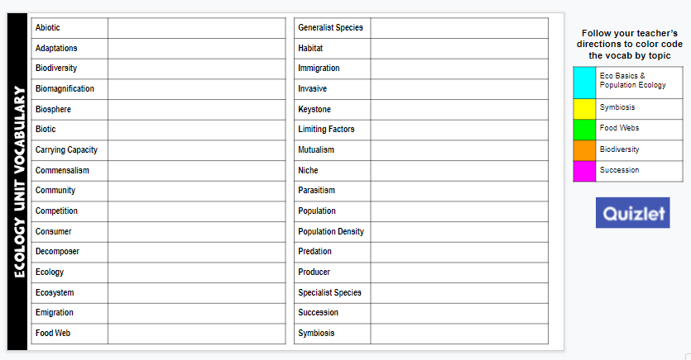
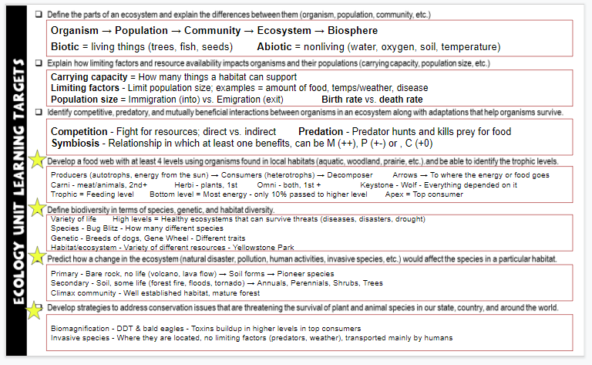
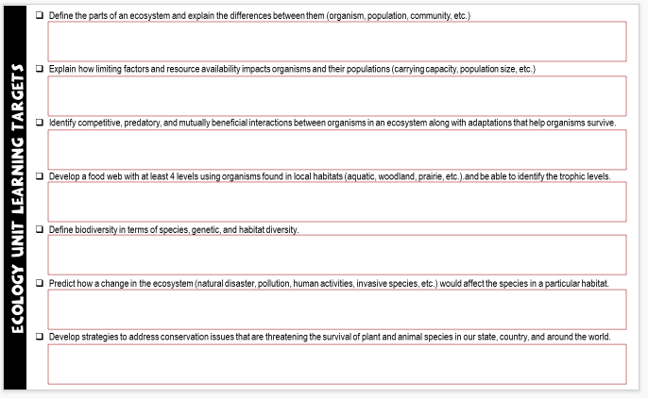
Unit Vocabulary Time
The last slide in the student digital notebook lists the main vocabulary from each lesson. After each topic, I have students color code the terms and then write definitions. All the definitions from the unit are available on the Quizlet page linked below.
Classroom Sample
https://quizlet.com/28845277/ecology-unit-vocabulary-all-terms-flash-cards/
Learning Targets
The next to last slide in the digital notebook is a list of learning targets for the entire unit. Prior to any quiz/test, we review the targets and discuss possible questions that relate to each one. This allows the students to connect the lessons to the learning expectations.
The last learning standard will be included in our Earth Day lessons.

Slide 3
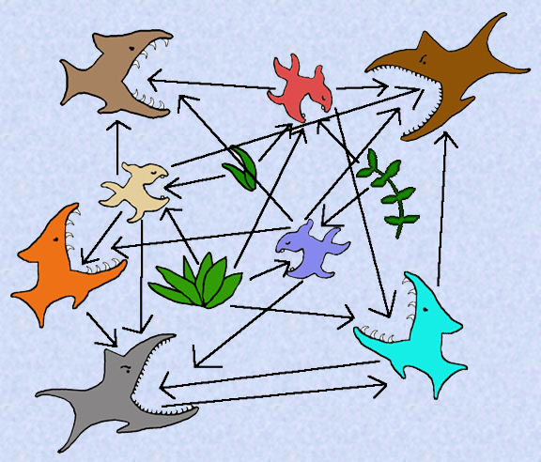
What's for dinner?
Food Chains & Webs
Additional Lessons: Food Web Challenge,
Pond Water Webs, & Food Fight Game
http://www.cod.edu/people/faculty/fancher/FoodChain.htm

Slide 4
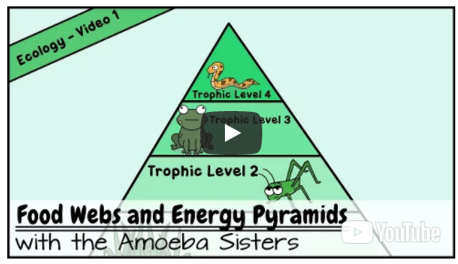
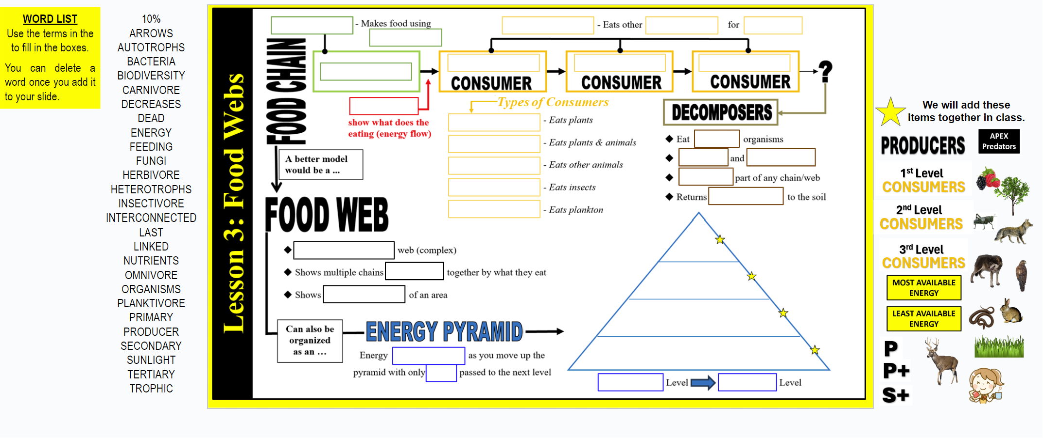
Directions: Copy and paste the terms from the word list as you watch the EDPuzzle video. Due at the start of class tomorrow
Use COPY/PASTE to move the words from the list to the textboxes
We will do the pyramid with and add these items together in class.
Food Webs & Energy Pyramids (Amoeba Sisters)

Slide 5
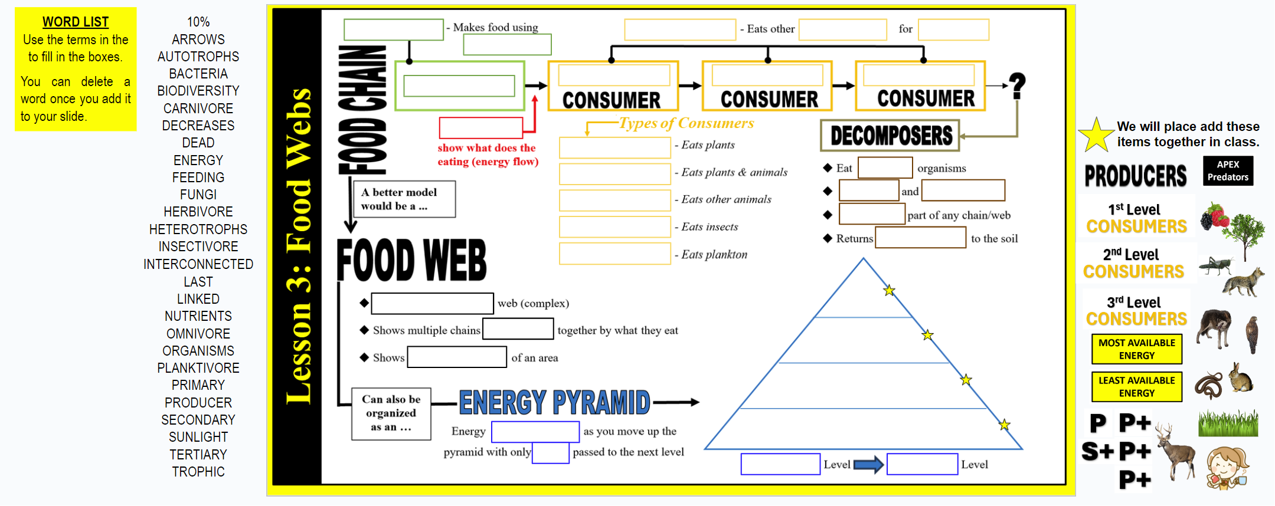
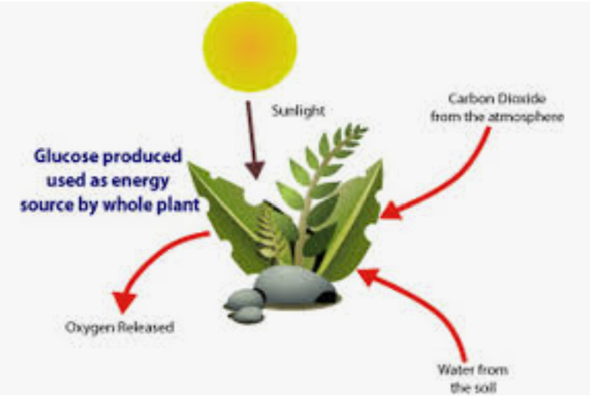
AUTOTROPHS
SUNLIGHT
ADD INFO IN YELLOW TO YOUR SLIDE
PRODUCER
Always 1st
What is the process used by producers to make energy?
ARROWS
PHOTOSYNTHESIS
Points to what does the eating
What resources do producers need to create glucose?
Sunlight, water, & CO₂

Slide 6



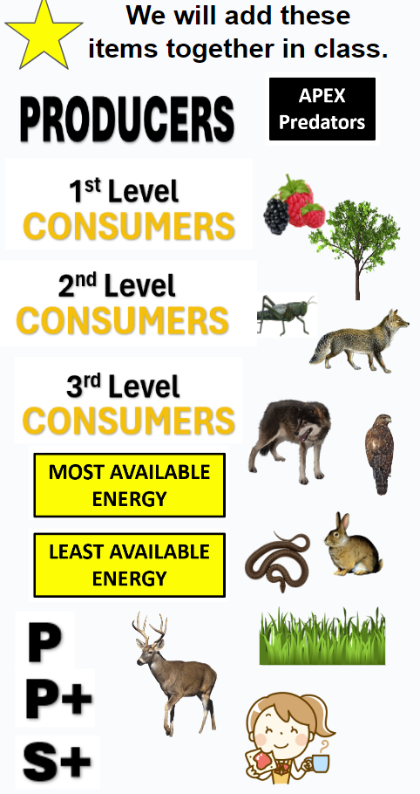

HETEROTROPHS
ORGANISMS
ENERGY
1st Level
2nd Level
3rd Level
PRIMARY
SECONDARY
TERTIARY
PRODUCER
What level is each one:
Primary, Secondary, Tertiary?
HERBIVORE
OMNIVORE
Drag the letters from the right side of your slide. Use Copy/Paste to make more.
CARNIVORE
INSECTIVORE
PLANKTIVORE
What is plankton?
PHYTO = Plant
ZOO = Animal
What are the 2 types?
(Answer in the video)
https://www.youtube.com/watch?v=yS1Rk4CMpSE

Slide 7

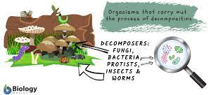
What are fungi?
DEAD
A real food web would have all arrows pointing to the decomposers.
FUNGI
BACTERIA
LAST
NUTRIENTS
https://www.biologyonline.com/dictionary/decomposer
https://www.youtube.com/watch?v=IMWOmCcxUjw&t=18s

Slide 8
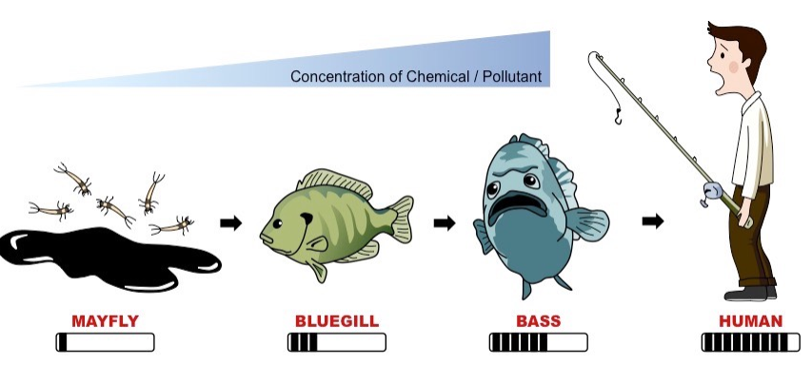
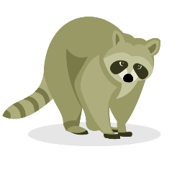
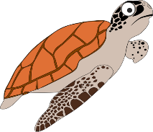
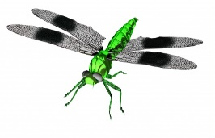

How would other organisms be connected to this food chain?
ALGAE
MAYFLY LARVA
BLUEGILL
BASS
HUMAN
What did we create?
A food chain shows a limited number of organisms. A food web is a better representation of how many organisms are connected.
DEAD
INTERCONNECTED
FUNGI
LINKED
BIODIVERSITY
https://www.youtube.com/watch?v=IMWOmCcxUjw&t=18s

Slide 9
DEAD
DECREASES
FUNGI
10%
Where does the other 90% go?
Used by organisms to live
Time to fill in the pyramid
Think of a trophy for
1st, 2nd, & 3rd.
TROPHIC
FEEDING
https://www.youtube.com/watch?v=LnPRHcp5_vo
https://www.youtube.com/watch?v=IMWOmCcxUjw&t=18s

Slide 10
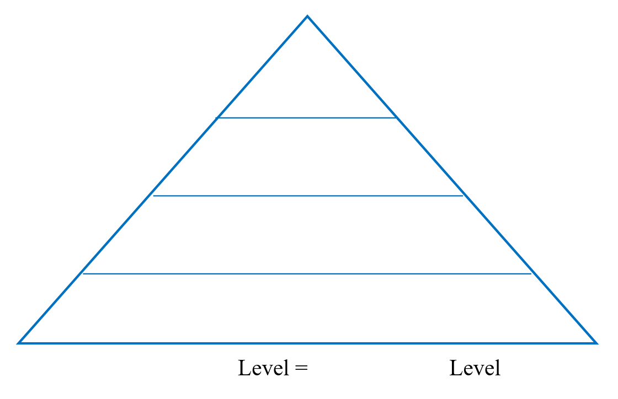


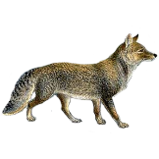
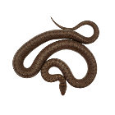


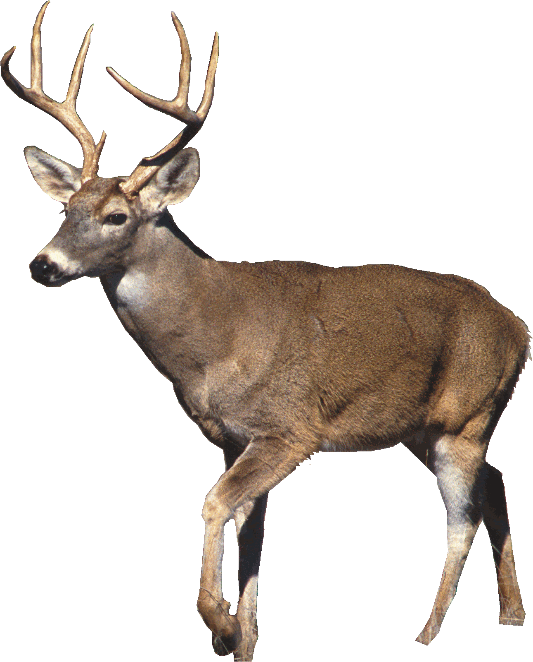
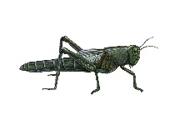



ENERGY PYRAMID
?
?
LEAST AVAILABLE ENERGY
APEX Predators
3rd Level
CONSUMERS
2nd Level
CONSUMERS
1st Level
CONSUMERS
Drag the remaining items to fill in the pyramid.
PRODUCERS
MOST AVAILABLE ENERGY
TROPHIC
FEEDING
?
LEAST AVAILABLE ENERGY
MOST AVAILABLE ENERGY
?

Slide 11
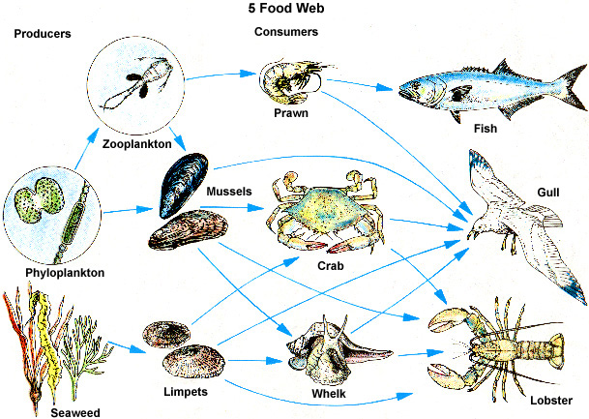
Food Webs Challenge
Food Web #1: Use the food web to answer
the questions.
1. Which organisms are the producers?
2. Identify the consumers using the
letters provided: C – Carnivore
O – Omnivore, or H – Herbivore.
3. Create three food chains using the food
web organisms.
4. Which level consumer would the mussels be? Why?
C
Food Web #1
H
C
O
Seaweed & Phytoplankton
C
C
C
C
H
NOTE: Your food chains may be different! If they start with seaweed or phytoplankton, they should be ok!
Seaweed
Limpets
Gull
Seaweed
Limpets
Whelk
Lobster
P.plankton
Z.plankton
Mussels
Crab
Gull
It could be a primary (1st level) if it eats phytoplankton.
It could be secondary (2nd level) if it eats phytoplankton and then zooplankton.

Slide 12
5. If the prawn population was to double in size, what would likely happen to the zooplankton population? Why?
6. How would the loss of limpets due to a disease affect the fish population? Explain.
The zooplankton population would decrease.
There would be twice as many predators (prawns) eating them.
Decrease? Why?
The gull would have to eat more prawns, which would cause more competition for the fish. This could make their population decrease.
OR
Increase? Why?
The whelk, crab, lobster, and gull would eat more mussels, which could help the zooplankton population. The prawn would have more food, which helps them and would help the fish.

Slide 13
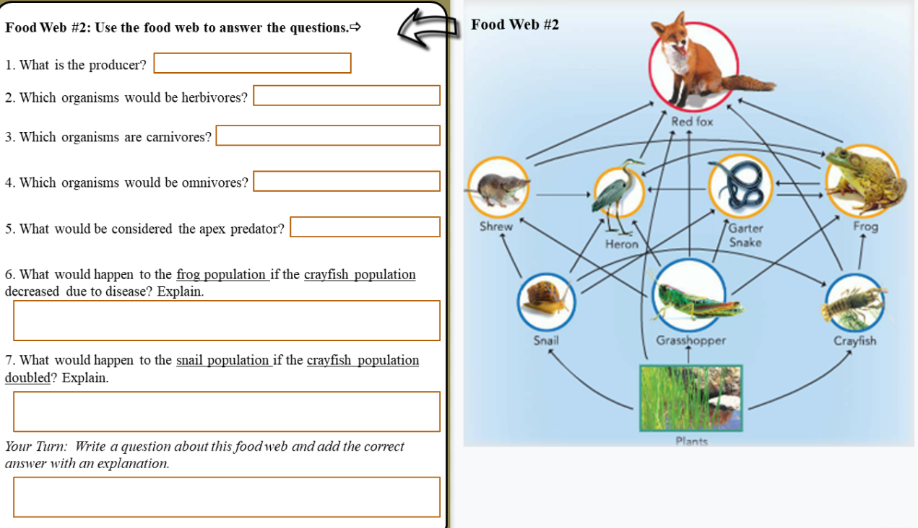
Assignment: Finish the right side of Slide 7 using Food Web #2.
We will review the answers tomorrow during class.

Slide 14
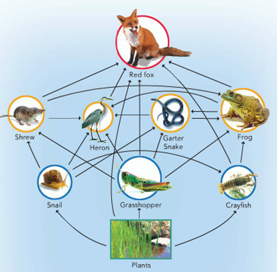
Food Web #2
1. What is the producer?
2. Which organisms would be herbivores?
3. Which organisms are carnivores?
4. Which organisms would be omnivores?
5. What would be considered the apex predator?
Plants
Snail & Grasshopper
Shrew, Heron, Garter Snake, & Frog
Crayfish & Red Fox
Red Fox

Slide 15
6. What would happen to the frog population if the crayfish population decreased due to disease? Explain.
?
Increase, decrease, or stay the same?
DECREASE – If the crayfish were one of its main food sources, frogs would have trouble finding enough to eat.
OR
STAY THE SAME – Frogs would still have plenty food to eat besides the crayfish.

Slide 16
7. What would happen to the snail population if the crayfish population doubled? Explain.
Increase, decrease, or stay the same?
Snail population would likely DECREASE since it would have MORE PREDATORS (crayfish) and MORE COMPETITION for plants.
?

Slide 17
Your Turn: Share your questions with the class. Do we agree with your answer?
Questions shared in class …
How would the food web be affected if the red fox was hunted to extinction?
What would happen if the grasses and other plants were destroyed by a forest fire?
How would the garter snake be affected if the herons were not in this food web?
How would the frog be affected if the snails doubled?

Slide 18
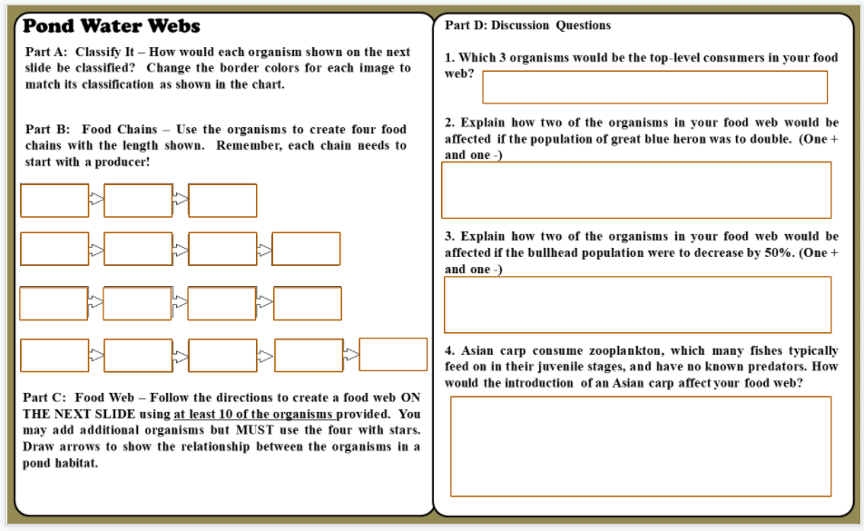
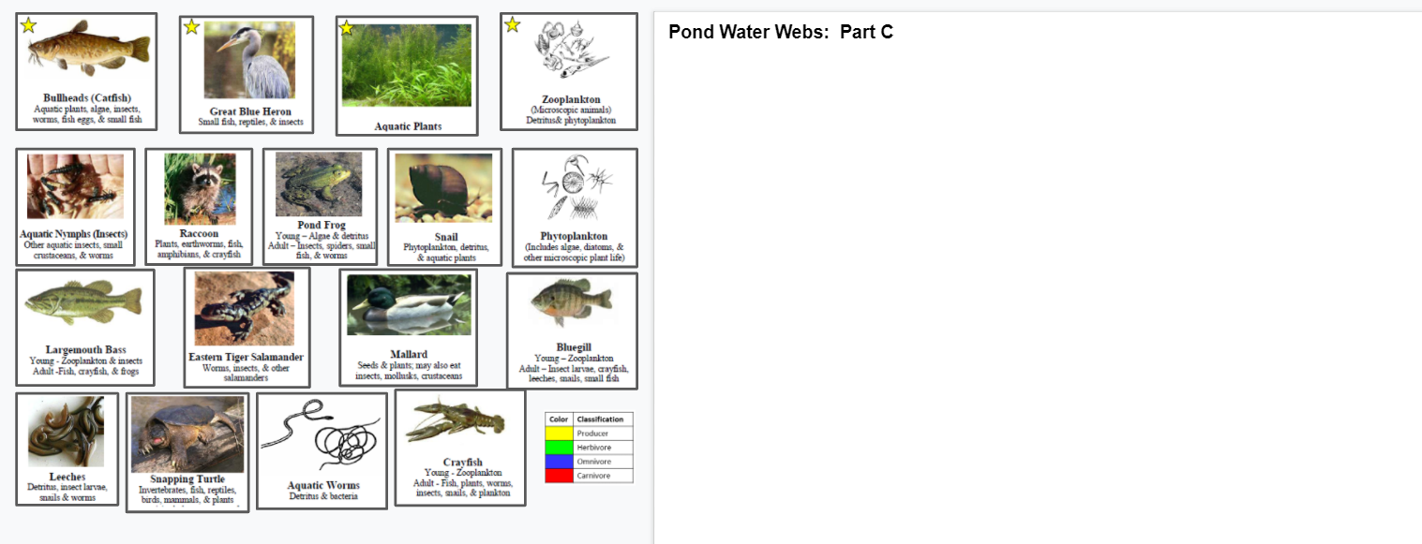
Teacher Note: We completed the Micro Basics unit prior to starting the Food Webs lesson. Students were able to view many microorganisms that they could add to their food webs.
Pond Water Webs – Slides 8 & 9
Follow your teacher’s directions to complete Parts A-C.

Slide 19
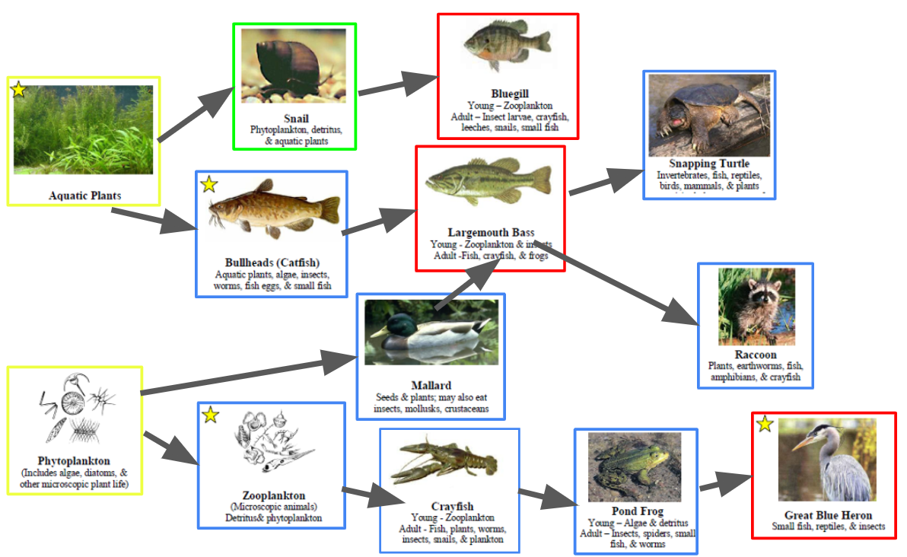
Pond Water Webs – Slides 8
Add arrows to make at least 15 links in your food web.
Use your Food Web to answer the questions in Part D.

Slide 20
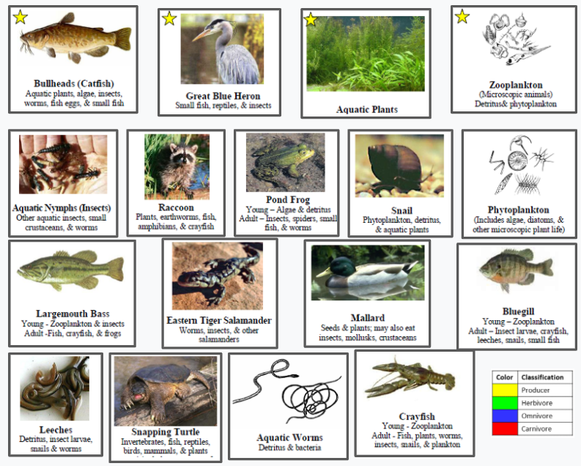
Part A: Classify It – How would each organism shown on the next slide be classified? Change the border colors for each image to match its classification as shown in the chart.

Slide 21
Part B: Use the organisms to create four food chains with the length shown. Remember, each food chain must start with a producer!
Remember – Arrows point to the
organism that does the eating!
Part C: Food Web – Follow the directions to create a food web using at least 10 of the organisms provided. You may add additional organisms but MUST use the FOUR with STARS. Draw arrows to show the relationships between the organisms in a pond habitat.

Slide 22
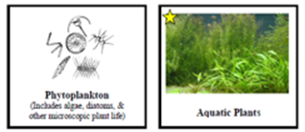
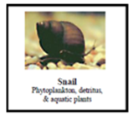
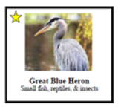
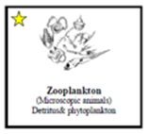
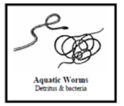
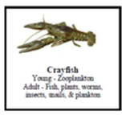
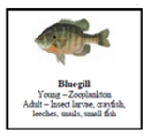
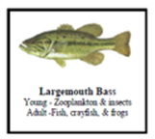
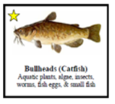
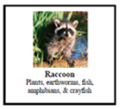
Use the pictures to recreate your food chains on the right side of the slide.
Each picture can only be used ONCE! You will have to use arrows to show the organisms it eats and those that eat it.
Make sure you have at least 10 organisms including the 4 with s.

Slide 23
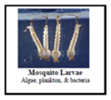
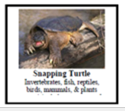
Add arrows to show the relationships. You do not need to draw every possible connection – try to include at least 15 arrows.
Done? Answer the questions for Part D to the right of the slide.

Slide 24
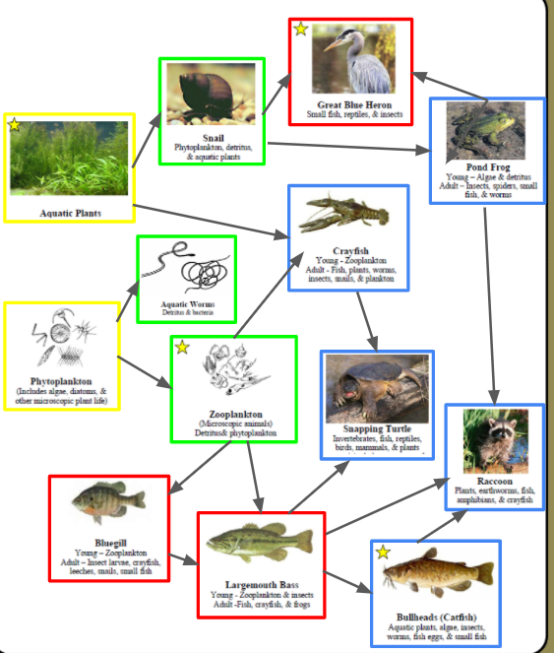
Part D: Discussion Questions
1. Which 3 organisms would be the top-level consumers in your food web?

Slide 25
2. Explain how two of the organisms in your food web would be affected if the population of great blue heron was to double. (One + and one -)

Slide 26
3. Explain how two of the organisms in your food web would be affected if the bullhead population were to decrease by 50%. (One + and one -)

Slide 27
4. Asian carp consume zooplankton, which many fishes typically feed on in their juvenile stages, and have no known predators. How would the introduction of an Asian carp affect your food web?

Slide 28

Answer these questions after you watch the video.
1) DDT was a chemical pesticide used to kill:
A. weeds. B. pests. C. both weeds & pests.
2) Which consumer would be higher in a food pyramid?
A. Primary consumer B. Secondary consumer C. Tertiary consumer
3) How would bald eagles be classified?
A. Primary consumer B. Secondary consumer C. Tertiary consumer
4) What other issues do bald eagles face?
Habitat Destruction & Poaching
Add this definition to your vocabulary page
Biomagnification: The concentration of toxins in organisms at higher levels in a food chain/web.

Slide 29
On average, each mayfly larva contains
2 poison units.
If a human ate two bass, how many poison units would it have?
If each bluegill ate 5 mayflies, how many units would it have?
If each bass ate 5 bluegill, how many units would it have?
1st Level Consumer
2nd Level Consumer
3rd Level Consumer
4th Level Consumer
+2
+10
+50
+50
https://ib.bioninja.com.au/options/untitled/b3-environmental-protection/biomagnification.html

Slide 30

Vocabulary Time
Which terms were discussed in Lesson 1 & 2? Use the bucket tool to shade in the boxes with those terms and then write a definition for each one.
https://quizlet.com/28845277/ecology-unit-vocabulary-all-terms-flash-cards/
You do not have to write definitions for all terms – just those you shaded that were in our first two lessons.

Slide 31

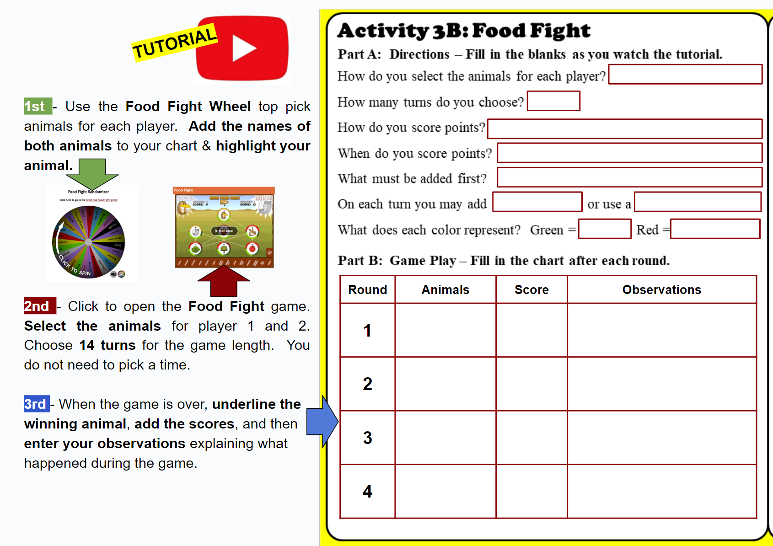
Time for a Food Fight…
Fill in the blanks in Part A as we review the directions.

Slide 32
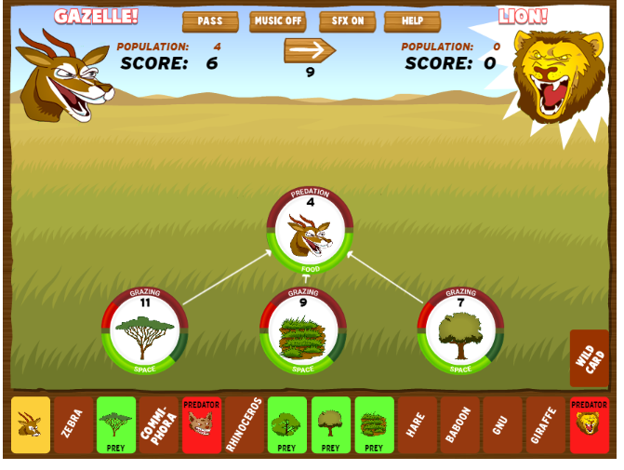
REMEMBER … During the game, you will be playing as one animal against another student with a different animal. Use what you know about food webs to help your animal win the “food fight.”
What will you have to add first?
PRODUCERS
No points until your animal is in the food web!
Roll over the organisms to see prey and predators
to help you decide what you need to add.
Wild Cards
Good & Bad

Slide 33
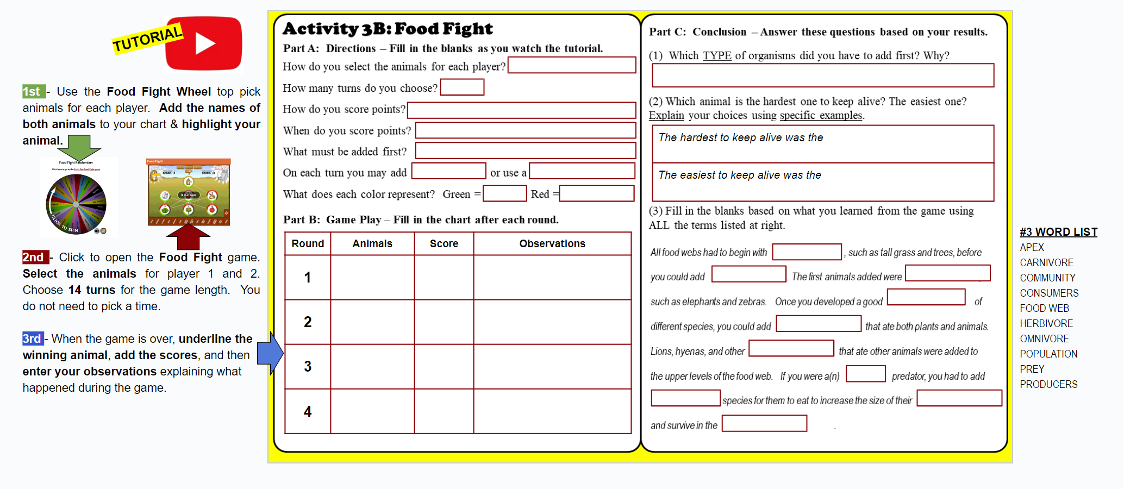
Your Assignment
Complete 4 rounds and record the results in the chart.
Fill in the blanks in Part C based on your results.

Slide 34
BrainPOP Food Fight – Part B
Did you fill out the chart by:
(1) highlighting your animals?
(2) underlining the winners?
(3) entering the scores?
(4) writing observations?

Slide 35
BrainPOP Food Fight – Part C
(1) Which TYPE of organisms did you have to add first? Why?
(2) Which animal is the hardest one to keep alive? Explain your choice using specific examples.
PRODUCERS (or plants, grasses, trees) → Herbivores needed food to eat to support the other animals in the community
The hardest (animal) to keep alive was the
The easiest (animal) to keep alive was the
Finish each sentence based on your observations!

Slide 36
PRODUCER
CONSUMERS
HERBIVORES
COMMUNITY
OMNIVORES
CARNIVORES
APEX
PREY
POPULATION
FOOD WEB

