Slide 1
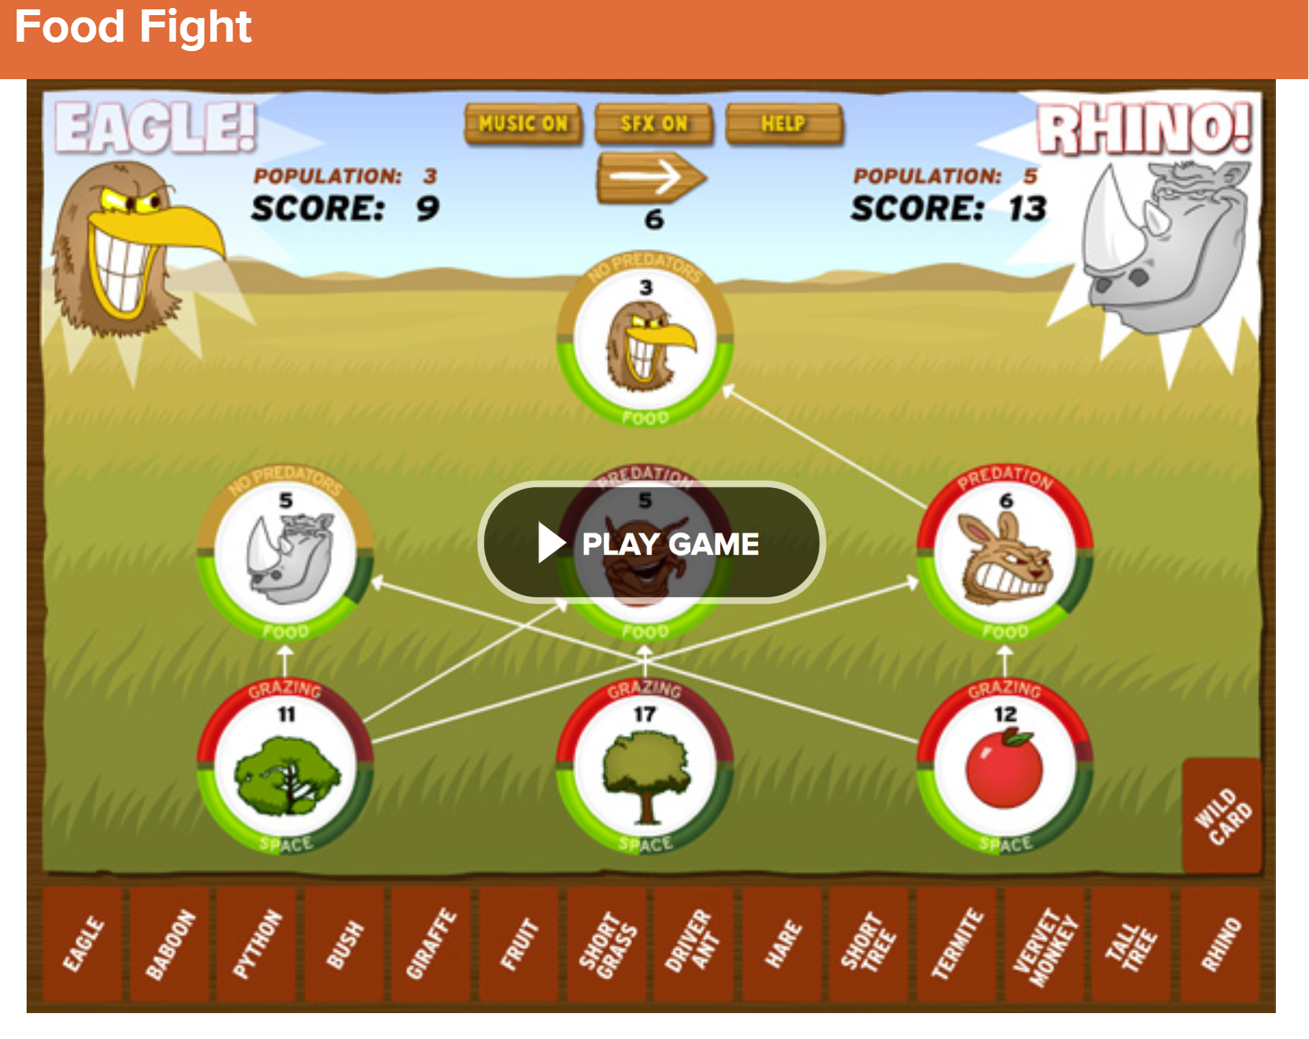
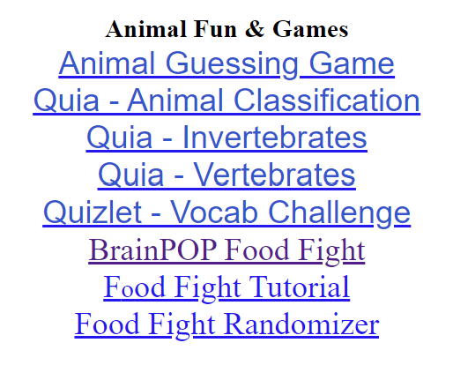
Click HERE for the digital version of this activity – just one slide that can be used with this activity.
A paper version is available HERE. The sites are listed on the digital slide or available on the Plants & Animals page in the Sites for Students area at https://sciencespot.net/Pages/rdss_biopa.html .
NOTE: The full Ecology Basics unit is available at https://sciencespot.net/Pages/classbio.html#EcoBasics. Read the information in this section on my website for more details and resources.
Time for a Food Fight…
https://www.brainpop.com/games/foodfight/
T. Tomm Updated 2023 https://sciencespot.net/

Slide 2

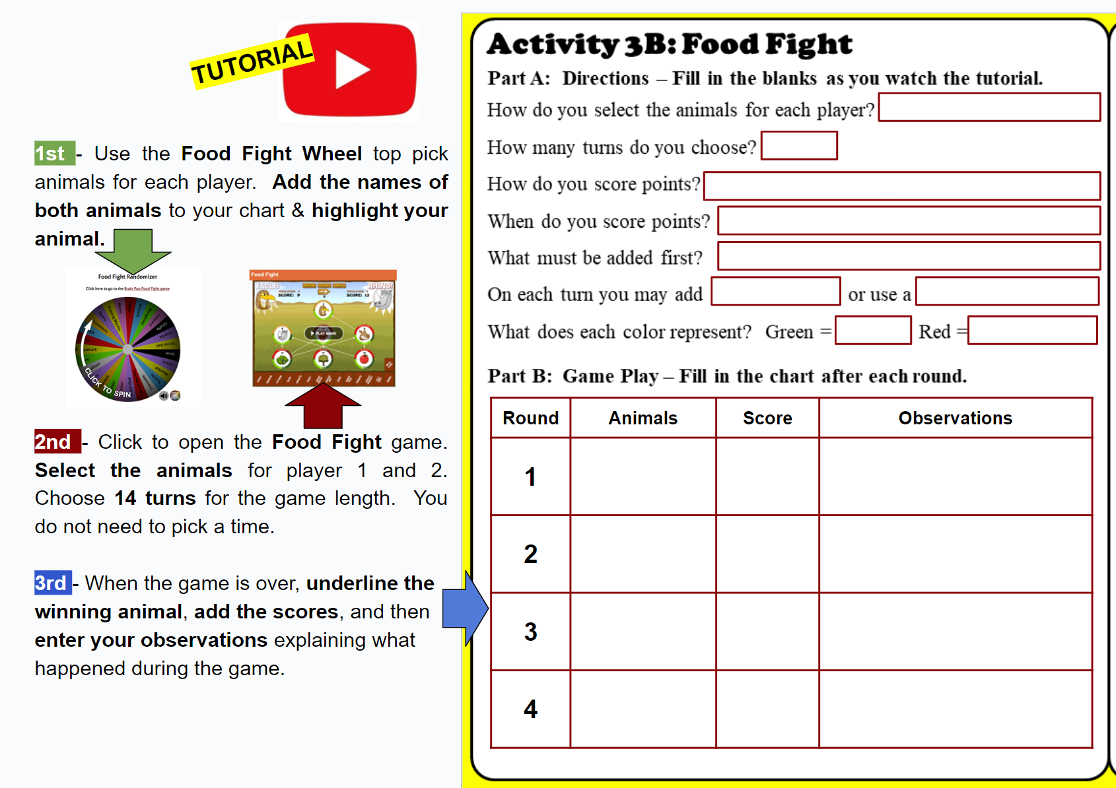
Time for a Food Fight…
Fill in the blanks in Part A as we review the directions.

Slide 3
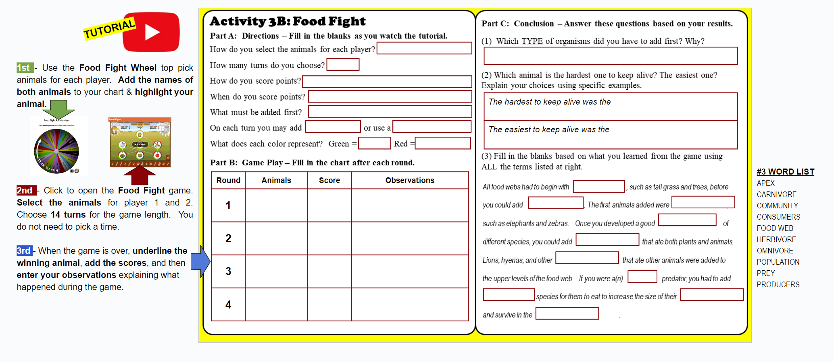
Part A: Directions – Did you fill in all the information?
Food Fight Wheel
14
← Do not click a time!
Grow the population of your species
When your species is in the food web
Producers – grasses and trees
1 species
wild card
Prey
Predators

Slide 4
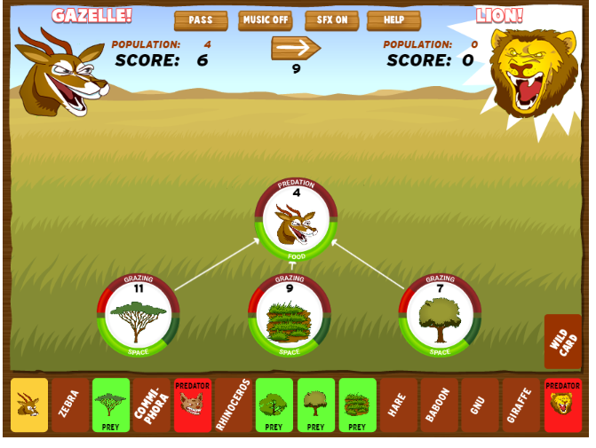
REMEMBER … During the game, you will be playing as one animal against another student with a different animal. Use what you know about food webs to help your animal win the “food fight.”
What will you have to add first?
PRODUCERS
No points until your animal is in the food web!
Roll over the organisms to see prey and predators
to help you decide what you need to add.
Wild Cards
Good & Bad

Slide 5
Your Assignment
Complete 4 rounds and record the results in the chart.
Fill in the blanks in Part C based on your results.

Slide 6
BrainPOP Food Fight – Part B
Did you fill out the chart by:
(1) highlighting your animals?
(2) underlining the winners?
(3) entering the scores?
(4) writing observations?

Slide 7
BrainPOP Food Fight – Part C
(1) Which TYPE of organisms did you have to add first? Why?
(2) Which animal is the hardest one to keep alive? Explain your choice using specific examples.
PRODUCERS (or plants, grasses, trees) → Herbivores needed food to eat to support the other animals in the community
The hardest (animal) to keep alive was the
The easiest (animal) to keep alive was the
Finish each sentence based on your observations!

Slide 8
PRODUCER
CONSUMERS
HERBIVORES
COMMUNITY
OMNIVORES
CARNIVORES
APEX
PREY
POPULATION
FOOD WEB

