Slide 1
Ecology Unit Teacher Notes
Topics:
Lesson 1: Levels of Organization
Lesson 2: Population Ecology
Lesson 3: Symbiosis (includes activity)
Lesson 4: Case Study – Ponds*
Lesson 5: Food Webs
Activity 1: Food Web Challenge
Activity 2: Pond Water Webs
Lesson 6: Biodiversity
Activity 1: Think & Link
Activity 2: Madagascar Video
Lesson 7: Succession
Lesson 8: STEM Case – Ecosystem*
Lesson 9: Human Impacts (Coming Soon)
* = Explore Learning Gizmos activity
The full Ecology Basics unit is available at https://sciencespot.net/Pages/classbio.html#EcoBasics
This presentation was used to guide classroom lessons and activities for the topic(s) highlighted in the list at right. It is one of several used during my ecology unit, which was developed for 7th & 8th grade students with very little background knowledge of the topics covered in the unit lessons. The unit covered a 14-week period during the fall of 2021, which was a few weeks longer than in the past thanks to the challenges of teaching during a pandemic. The students needed more time to complete the lesson activities and I felt the need to include more discussion time for them to fully develop understanding of a concept before moving to the next topic.
The digital student notebook (with slides for ALL the lessons & activities listed above) is available at https://docs.google.com/presentation/d/15CoXAsd1zWZDy5RCGS37CKUXmfl9M2WAk58-qgwMRjE/edit?usp=sharing I do not assign the entire notebook at the start of the unit. Instead, I create a Master Copy as a “material” on Google Classroom and add the slides as the students need them. They copy the new slides and paste them into their HDSN in the correct spots. You will need to make a copy of the digital file in order to use it with your students. The digital notebook was set up as 14” x 8.5” which can be scaled down to fit a standard page on landscape to allow for printing for students needing paper copies.
T. Tomm Updated 2021 https://sciencespot.net/

Slide 2
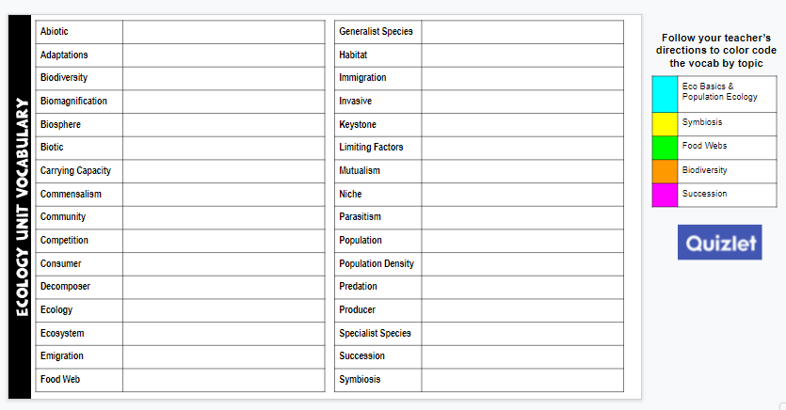
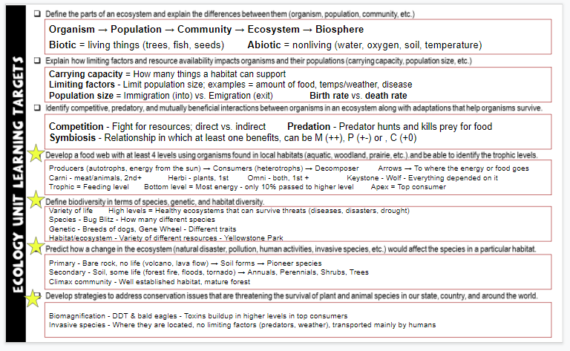
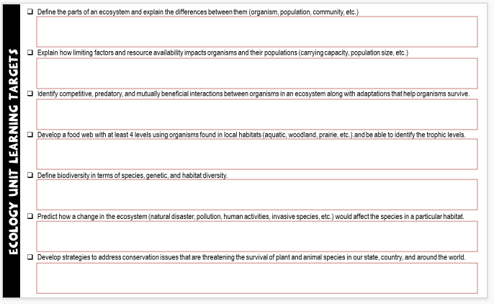
Unit Vocabulary Time
The last slide in the student digital notebook lists the main vocabulary from each lesson. After each topic, I have students color code the terms and then write definitions. All the definitions from the unit are available on the Quizlet page linked below.
Classroom Sample
https://quizlet.com/28845277/ecology-unit-vocabulary-all-terms-flash-cards/
Learning Targets
The next to last slide in the digital notebook is a list of learning targets for the entire unit. Prior to any quiz/test, we review the targets and discuss possible questions that relate to each one. This allows the students to connect the lessons to the learning expectations.
The last learning standard will be included in our Earth Day lessons.

Slide 3

ECOLOGY BASICS
Lesson 7–
Ecological Succession
T. Tomm Updated 2021 https://sciencespot.net/

Slide 4
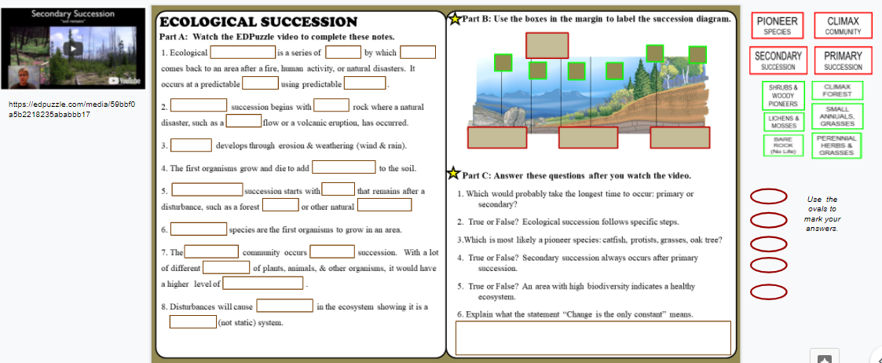
ED Puzzle – Ecological Succession Video Notes
Watch the EDPuzzle video to fill in the blanks for Part A. We will complete Parts B & C together in class.
https://edpuzzle.com/media/59bbf0a5b2218235ababbb17

Slide 5
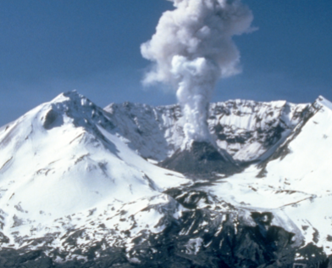
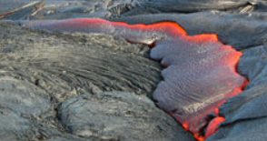
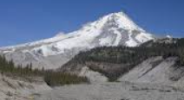
ECOLOGICAL SUCCESSION
Part A: Watch the EDPuzzle video to complete these notes.
LIFE
1. Ecological is a series of by which comes back to an area after a fire, human activity, or natural disasters. It occurs at a predictable using predictable .
2. succession begins with rock where a natural disaster, such as a flow or a volcanic eruption, has occurred.
3. develops through erosion & weathering (wind & rain).
4. The first organisms grow and die to add to the soil.
SUCCESSION
EVENTS
RATE
SPECIES
PRIMARY
BARE
LAVA
SOIL
NUTRIENTS

Slide 6
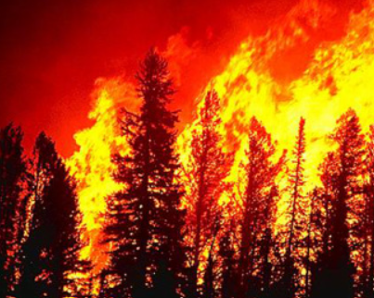
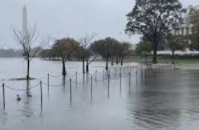
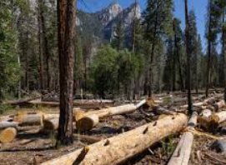
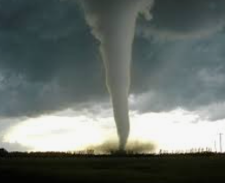
5. succession starts with that remains after a disturbance, such as a forest or other natural
6. species are the first organisms to grow in an area.
SECONDARY
SOIL
FIRE
DISASTER
PIONEER

Slide 7
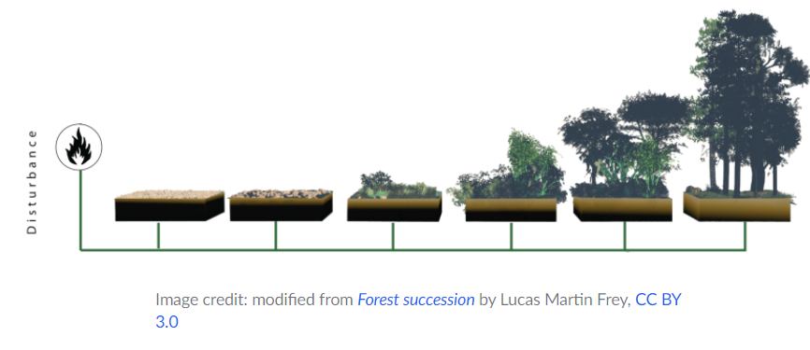
7. The community occurs succession. With a lot of different
of plants, animals, & other organisms, it would have a higher level of
.
8. Disturbances will cause in the ecosystem showing it is a
(not static) system.
CLIMAX
AFTER
SPECIES
BIODIVERSITY
CHANGES
DYNAMIC

Slide 8
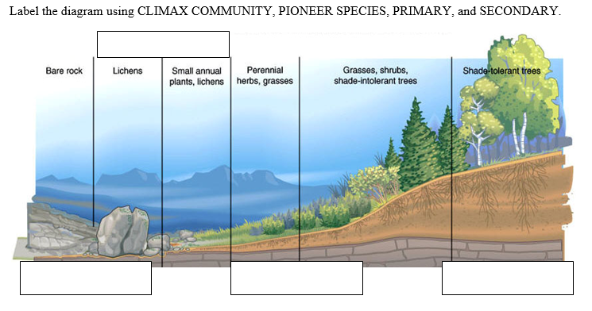
Part B: Succession Diagram
PIONEER SPECIES
SHRUBS & WOODY PIONEERS
CLIMAX FOREST
BARE ROCK
(No Life)
LICHENS & MOSSES
SMALL ANNUALS, GRASSES
PERENNIAL HERBS & GRASSES
PRIMARY
SUCCESSION
SECONDARY
SUCCESSION
CLIMAX
COMMUNITY
THINK ABOUT IT: What do you notice about the layers of soil as succession progresses?
http://visityellowstonenationalparkyall.weebly.com/uploads/1/9/1/2/19128651/4659793_orig.jpg

Slide 9
Part C: Answer these questions after you watch the video.
1. Which would probably take the longest time to occur: primary or secondary succession?
3. True or False? Ecological succession follows specific steps.
3.Which is most likely a pioneer species: catfish, protists, grasses, oak tree?
4. True or False? Secondary succession always occurs after primary succession.
5. True or False? An area with high biodiversity indicates a healthy ecosystem.
6. Explain what the statement “Change is the only constant” means.
CHANGES will always occur – it will not stay the same.

Slide 10

Vocabulary Time
Which terms were discussed in this lesson? Use the bucket tool to shade in the boxes with those terms and then write a definition for each one.
https://quizlet.com/28845277/ecology-unit-vocabulary-all-terms-flash-cards/
You do not have to write definitions for all terms – just those you shaded that were in our first two lessons.

