Slide 1
Ecology Unit Teacher Notes
Topics:
Lesson 1: Levels of Organization
Lesson 2: Population Ecology
Lesson 3: Symbiosis (includes activity)
Lesson 4: Case Study – Ponds*
Lesson 5: Food Webs
Activity 1: Food Web Challenge
Activity 2: Pond Water Webs
Activity 3: Food Fight (BrainPop)
Lesson 6: Biodiversity
Activity 1: Think & Link
Activity 2: Madagascar Video
Lesson 7: Succession
Lesson 8: STEM Case – Ecosystem*
Lesson 9: Human Impacts (Lorax Lessons)
* = Explore Learning Gizmos activity
The full Ecology Basics unit is available at https://sciencespot.net/Pages/classbio.html#EcoBasics
This presentation was used to guide classroom lessons and activities for the topic(s) highlighted in the list at right. It is one of several used during my ecology unit, which was developed for 7th & 8th grade students with very little background knowledge of the topics covered in the unit lessons. The unit covered a 14-week period during the fall of 2021, which was a few weeks longer than in the past thanks to the challenges of teaching during a pandemic. The students needed more time to complete the lesson activities and I felt the need to include more discussion time for them to fully develop understanding of a concept before moving to the next topic.
The digital student notebook (with slides for ALL the lessons & activities listed above) is available at https://docs.google.com/presentation/d/15CoXAsd1zWZDy5RCGS37CKUXmfl9M2WAk58-qgwMRjE/edit?usp=sharing I do not assign the entire notebook at the start of the unit. Instead, I create a Master Copy as a “material” on Google Classroom and add the slides as the students need them. They copy the new slides and paste them into their HDSN in the correct spots. You will need to make a copy of the digital file in order to use it with your students. The digital notebook was set up as 14” x 8.5” which can be scaled down to fit a standard page on landscape to allow for printing for students needing paper copies.
T. Tomm Updated 2023 https://sciencespot.net/

Slide 2
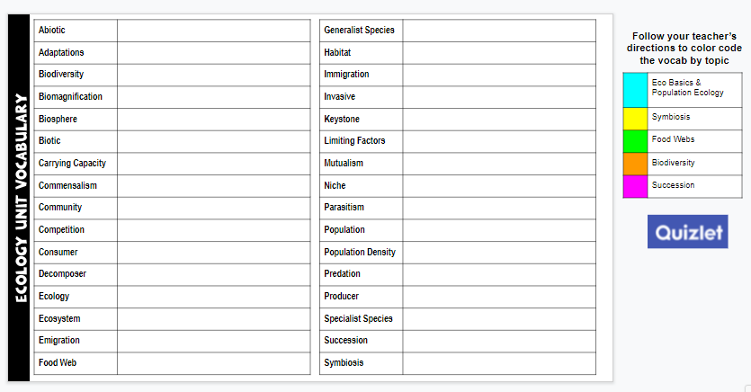
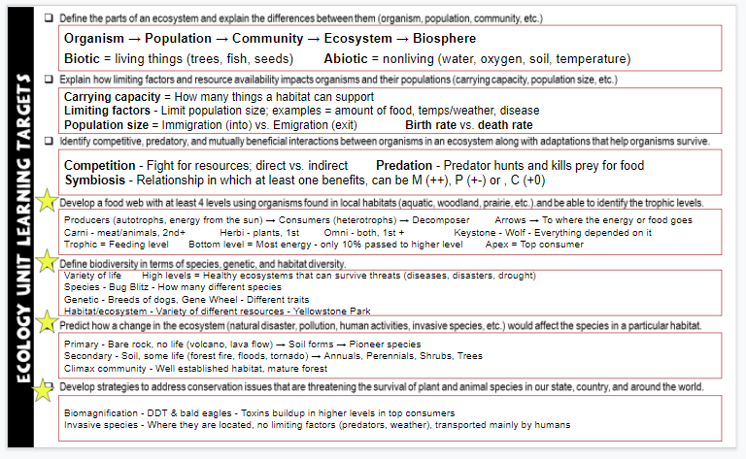
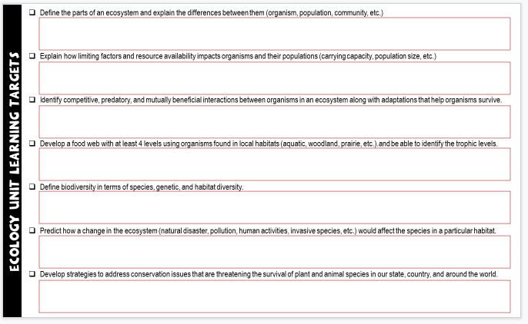
Unit Vocabulary Time
The last slide in the student digital notebook lists the main vocabulary from each lesson. After each topic, I have students color code the terms and then write definitions. All the definitions from the unit are available on the Quizlet page linked below.
Classroom Sample
https://quizlet.com/28845277/ecology-unit-vocabulary-all-terms-flash-cards/
Learning Targets
The next to last slide in the digital notebook is a list of learning targets for the entire unit. Prior to any quiz/test, we review the targets and discuss possible questions that relate to each one. This allows the students to connect the lessons to the learning expectations.
The last learning standard will be included in our Earth Day lessons.

Slide 3
Biodiversity Basics
T. Tomm Updated 2023 https://sciencespot.net/
http://www.motherearthnews.com/~/media/Images/MEN/Editorial/Articles/Magazine%20Articles/1981/05-01/The%20Importance%20of%20Preserving%20Biodiversity/069%20preserving%20biodiversity%20-%20Fotolia%20-%20Danielle%20Bonardelle.jpg

Slide 4
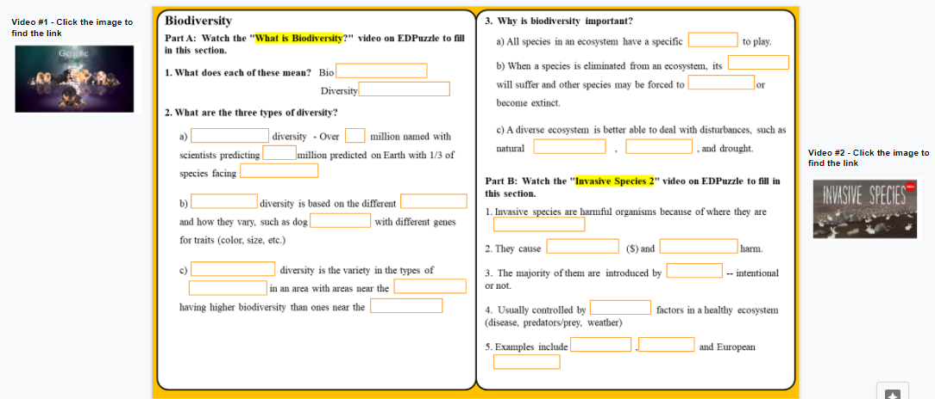
Watch both videos to complete this slide.
Video #1: What is Biodiversity?
https://edpuzzle.com/media/5810e444391e2ff93ecfe654
Video #2: Invasive Species
https://edpuzzle.com/media/5810e444391e2ff93ecfe654

Slide 5
Part A: "What is Biodiversity?"
1. What does each of these mean?
Bio = ______________ Diversity = _________________
2. What are the three types of diversity?
a) _____________ diversity - Over ____ million named with scientists predicting ___-___ million predicted on Earth with 1/3 of species facing _________________
b) _____________ diversity is based on the different _________ and how they vary, such as dog ____________ with different genes for traits (color, size, etc.)
c) _______________ diversity is the variety in the types of ______________ in an area with areas near the ________________ having higher biodiversity than ones near the __________.
LIFE
VARIETY
SPECIES
1.7
3 30
EXTINCTION
GENETIC
GENES
BREEDS
ECOSYSTEM
RESOURCES
EQUATOR
POLES
Think about it … Why would there be more biodiversity at the equator than the poles?

Slide 6
3. Why is biodiversity important?
a) All species in an ecosystem have a specific _______ to play.
b) When a species is eliminated from an ecosystem, its ___________ will suffer and other species may be forced to _______________ or become extinct.
c) A diverse ecosystem is better able to deal with disturbances, such as natural _____________, _____________, and drought.
or NICHE
ROLE
BALANCE
MIGRATE
DISASTERS
DISEASE

Slide 7
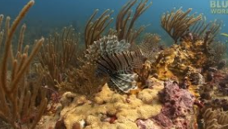
Part B: "Invasive Species 2"
1. Invasive species are harmful organisms because of where they are _________________.
2. They cause ________________ ($) and __________________ harm.
3. The majority of them are introduced by ______________ (intentional or not)
4. Usually controlled by ____________ factors in a healthy ecosystem (disease, predators/prey, weather)
5. Examples include____________, _____________, and European ________________.
(Not necessarily WHAT they are, but WHERE)
LOCATED
ECONOMIC
ECOLOGICAL
HUMANS (or human activity)
LIMITING
KUDZU
PYTHONS
RABBITS

Slide 8
What INVASIVE SPECIES are threats to Illinois?
Let’s make a list of some of these alien invaders …
Wanted Poster Project
https://docs.google.com/presentation/d/171zye5EStyJ1V0WXcDZq7gHPo8oSwG8WlZWDgWdgdJE/edit?usp=sharing

Slide 9
Vocabulary Time
Which terms were discussed in this lesson? Use the bucket tool to shade in the boxes with those terms and then write a definition for each one.
https://quizlet.com/28845277/ecology-unit-vocabulary-all-terms-flash-cards/
You do not have to write definitions for all terms – just those you shaded that were in our first two lessons.

Slide 10
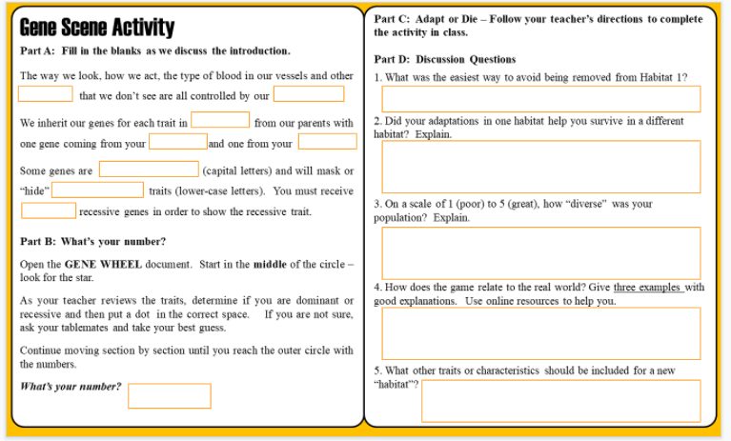
Complete the left side of slide 13 as we review the notes and complete the Gene Wheel activity.
Teacher Note; The Gene Scene lesson has been adapted from the activity available at https://www2.illinois.gov/dnr/education/Documents/BioBasics_Activity_1-4.pdf
The “Adapt or Die” game can be modified to fit your student population/characteristics.

Slide 11
Part A: Gene Scene
The way we look, how we act, the type of blood in our vessels and other ________ that we don’t see are all controlled by our _________.
We inherit our genes for each trait in _______ from our parents with one gene coming from your __________ & one from your ________.
Some genes are _____________ (capital letters) and will “hide” _____________ traits (lower-case letters). You must receive ______ recessive genes in order to show the recessive trait.
TRAITS
GENES
PAIRS
MOTHER
FATHER
DOMINANT
RECESSIVE
TWO

Slide 12
EXAMPLE:
C = Dominant gene for tongue curling
c = Recessive gene
CC
Cc
cc
Dominant (Capitals)
At least one CAPITAL letter = Dominant
Can curl tongue
Recessive (Lower case)
2 LOWERCASE letters = Recessive
Cannot curl tongue

Slide 13
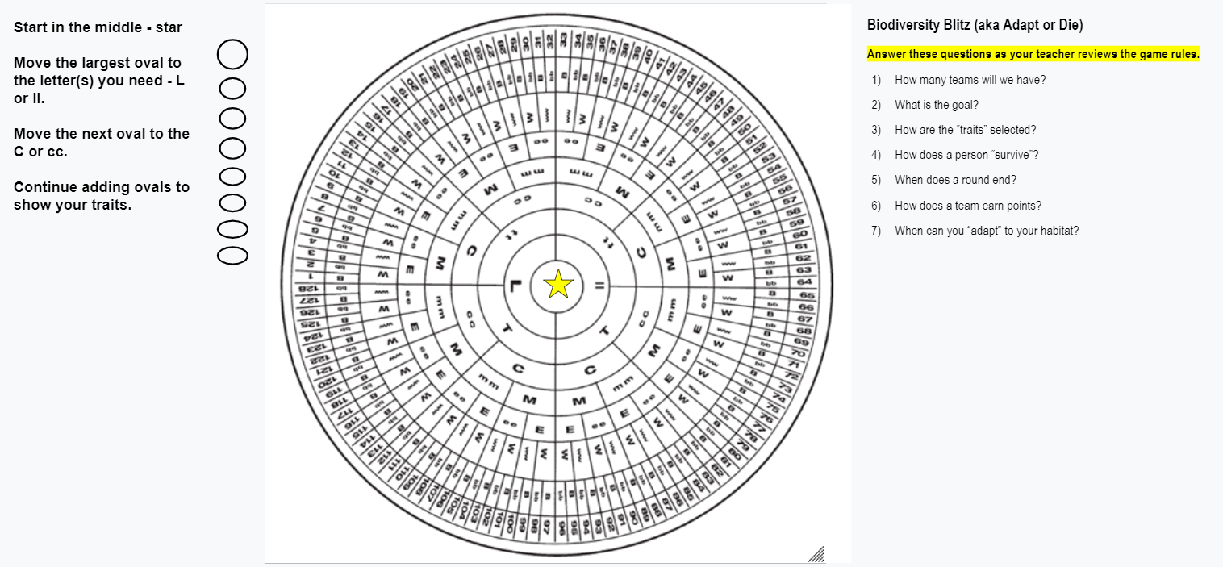
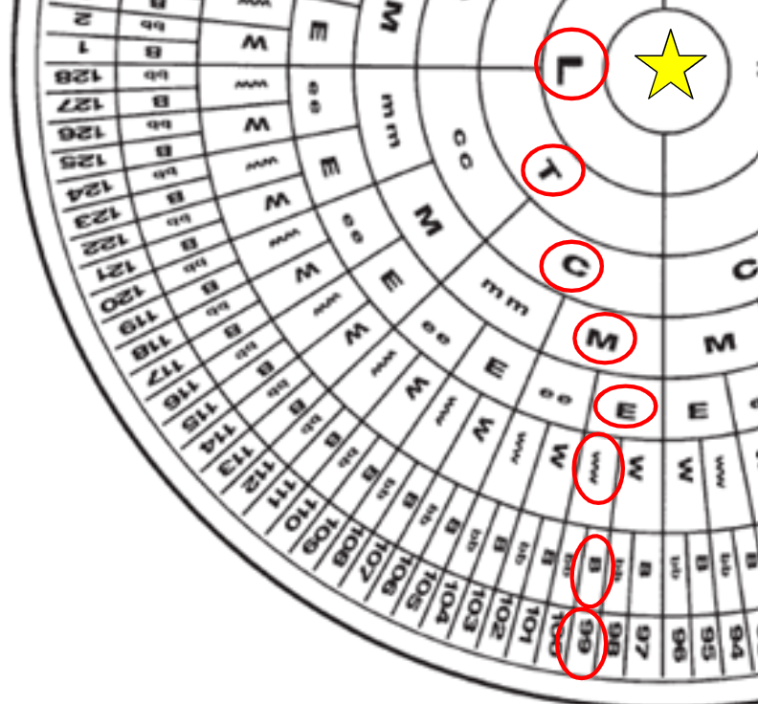
Open the BIODIVERSITY BLITZ – GENE WHEEL assignment on Google Classroom
Directions:
Start in the middle of the circle.
Determine your trait – either dominant or recessive – and then use a circle/oval to mark them.
Continue moving section by section until you reach the outer circle with the numbers.

Slide 14
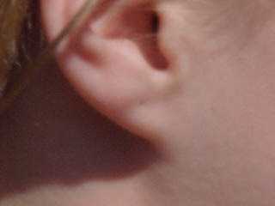
Ear Lobes
C
cc
ll
L
Can curl Tongue Curl Can’t curl
NOTE: Some people have different types of “curls”, while others can teach themselves to do so.
Attached or Loose (Lobe)
Hair Type (Natural)
Straight or Wavy/Curly
tt
T
What happens if you let your hair dry on its own?

Slide 15
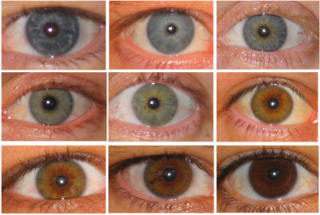
45º
Hitchhiker’s Thumb
←Mostly straight
Bends past 45º
?
M
mm
Pigmented Iris
Note: Eye color is determined by several different genes – not just one!
ee
E
Light eyes - Blue or green
Dark eyes (Brown)

Slide 16
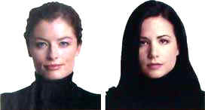
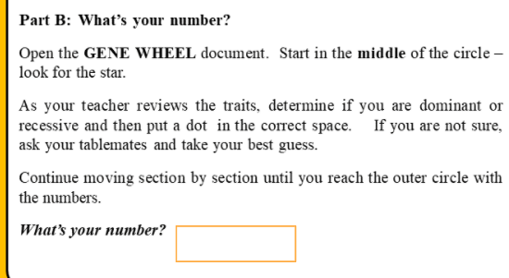
No V?
Second Toe Length
V shape?
bb
B
W
ww
Equal to or shorter than “big toe”
Longer than “big toe”
Widow’s Peak
Has peak OR Does NOT have peak
What’s Your #?

Slide 17
Biodiversity Blitz (aka Adapt or Die)
Answer the questions as we review the rules
Student Assignment – Make a copy to assign to your students: https://docs.google.com/drawings/d/1V3f1uH0nfY71o0kWxiClDxOrteSGsmiJWAab8Bh7pjc/edit?usp=sharing

Slide 18
How many teams?
I will divide you into two teams. One team will “live” on the EAST side of the room, while the other will “live” on the WEST side.
Remember to keep spread out – arms length away from each other!
What is the goal?
Be the population that has the highest biodiversity to survive longer than the other team.
Teams will have chances to “adapt” what they are wearing (within reason) to help them survive in a habitat.
WARNING: If you or your classmates cannot control themselves to pay attention and not goof around, we will NOT play the game.

Slide 19
How will the teacher select the traits?
I will use a spinner to select “traits” or characteristics that will determine if you survive or “die”.
How does a person survive?
If the trait does not apply to you, you SURVIVE and should stay STANDING.
If the trait applies to you, you are DEAD and must SIT DOWN in your area.
NOTE: We will discuss how to adapt in a bit!

Slide 20
Scores/Winning:
A round will end when one population dies out completely (all sitting down.)
The winning team will earn points equal to the # of people remaining alive when the other dies out completely.
The team with the most points after 5 rounds will be the winner!
Population earns 4 points
NOTE: If a trait would wipe out all members (both sides), everyone standing will continue to live and we will spin again until one side is wiped out.

Slide 21
Adaptation Rules:
You can only adapt BETWEEN rounds – NOT DURING a round! Each population will have a chance to make adaptations before we start a new round.
No adaptations allowed after the first trait has been read!
Individuals can “adapt” to their habitats by changing what they are wearing within reason!
All adaptations must be school appropriate!
Remember, some traits can be “adapted”, while others cannot.
Examples: Wearing socks or shoes – Only applies if you have on BOTH socks or BOTH shoes on
Wearing jeans – Only applies if you have on jeans (not jeans modified to capris or “jhorts”)
Wearing jewelry – Applies to all jewelry – ears, neck, face, etc.
Put your backpacks/bags under your chairs!
Let’s see who will survive in Habitat 1!

Slide 22
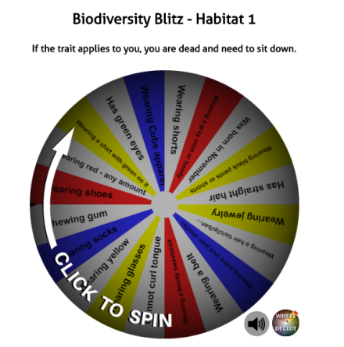
Plan for Habitats 1 & 2 tomorrow.
The habitat “wheels” are located at mrstomm.com → More → Science Pages → Biodiversity Challenge

Slide 23
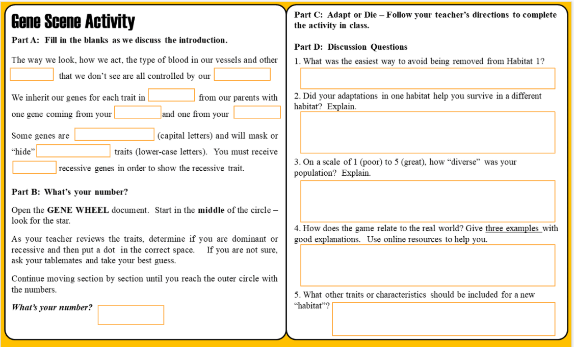
Assignment: Complete Part D on Slide 12 before class tomorrow.

Slide 24
Part D: Think About It
What was the easiest way to avoid “dying” in Habitat 1?
Did your adaptations help you survive in a different habitat? Explain.
On a scale of 1 (poor) to 5 (great), how “diverse” was your population? Explain.
What did you say?
Did one adaptation “protect” you from many “traits”? If so, which ones?
How many people survived in the last couple rounds compared to the first round?
If you had a lot of survivors, your habitat was more diverse (#4 or 5) – one trait did not wipe out all of you.
If you had a hard time keeping people alive, your diversity was low (#1 or 2)

Slide 25
Part D: Think About It
4) How does the game relate to the real world? Give three examples with good explanations. Use online resources to help you.
5) What other traits or characteristics should be included for a new habitat?
If an animal had to be able to curl its tongue to eat, what would happen if it couldn’t adapt?
Gardening – Planting a lot of different variations of beans or corn would be helpful if one of them does not grow well that summer.
What other examples did you explain?
Would the number of different plants in a food web make a difference?
Crops engineered to be resistant to drought, pests, and reduce weeds. They can withstand challenges from many environmental factors.
Did you need to be a generalist or specialist to survive longer in a habitat?
Need to list at least THREE things!

Slide 26
Tomorrow →New Habitats = New Challenges
Which population will survive the longest?
Biodiversity Challenge
Habitat 1 Habitat 2 Habitat 3 Habitat 4 Habitat Characteristics
All adaptations must be school appropriate!

Slide 27
New Habitats = New Challenges
Reminders …
If the trait applies to you, you are DEAD
and must SIT DOWN in your area.
If the trait does not apply to you, you survive
and should stay standing.
The round is over when one population goes extinct. The other team earns points equal to the # of people left alive. The team with the most points after 5 rounds will win!
Each population will have a chance to make adaptations before we start a new round.
You can only make adaptations BETWEEN rounds. Once the round has started, you must “keep” the traits you have.
Put your backpacks/bags under your chairs!
Biodiversity Challenge Game Habitat 2 or Habitat 3

