Slide 1
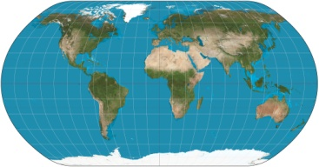
Earth Watch
Monitoring Earth’s Changes
Project developed by T. Tomm 2016 Full lesson available at http://sciencespot.net/

Slide 2
Earth Watch
What significant events have happened since the first of the year?
Which of Earth’s system were involved?
What data do we need?
Where would we find it?
What do we predict will happen in the next several months?
What would each of these scientists monitor?
Geologists
Seismologists
Meteorologists
Volcanologists

Slide 3
Earth Watch
What questions do we need to answer?
What do we need to do today to get started?
Let’s set up the teams …
Geologists
Seismologists
Meteorologists
Volcanologists
Go to Google Drive → Shared With Me → Earth Watch to find your team’s folder and other resources.

Slide 4
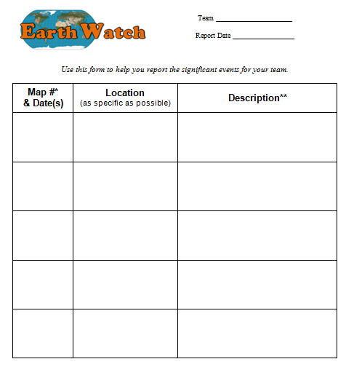
Earth Watch Reports
Our first report day will be ______________________.
Each team will need to share a list of significant events that includes the dates, location, and a description of the event.
You may use the report form provided or create your own methods using Google tools.
Go to Google Drive → Shared With Me → Earth Watch to find your team’s folder and other resources.

