Slide 1
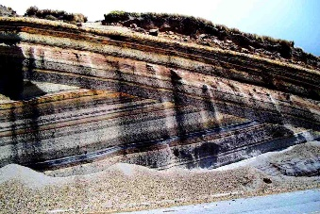
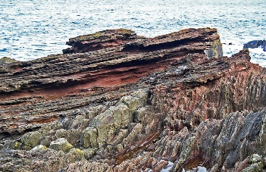
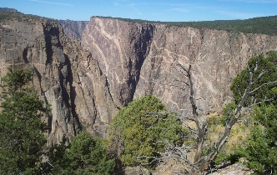
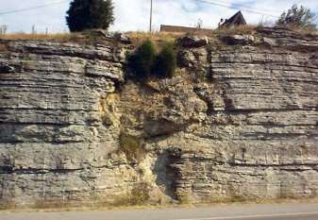
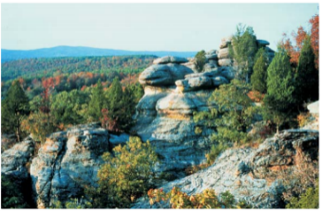
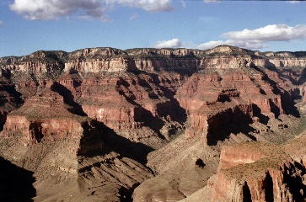

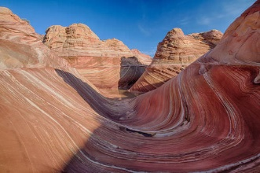
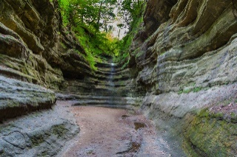
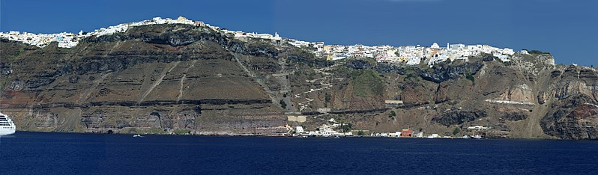
Rock Detectives
Exploring the Earth one “rock” at a time
This Photo by Unknown Author is licensed under CC BY-SA
T. Tomm 2019 http://sciencespot.net/

Slide 2
Rock Detectives – Part 1
Get a piece of “earth” and glue on page ____
Find the other students in your class with the same piece.
Examine the picture to identify key features for clues to its formation and history.
Make a list of:
At least 3 things you notice in the picture.
At least 3 questions you have.
This Photo by Unknown Author is licensed under CC BY-SA

Slide 3
Rock Detectives – Part 2
Get together with your “rock” partners to take another look at your picture. What do you know about the rock based on what we discussed yesterday?
Can you answer these questions?
1) Where are the rocks located (region or area) on Earth?
2) What types of rocks do you see: igneous, sedimentary, or metamorphic? How can you tell?
3) What types of forces have acted upon the rock: tension, compression, shearing, weathering/erosion?
Do you have new questions?
This Photo by Unknown Author is licensed under CC BY-SA

Slide 4

Rock Detectives – Part 3
Rock Detectives – Part 3
Get together with your “rock” partners to take another look at your picture.
Go to mrstomm.com → Assignments to find links to learn more about the pictures you investigated.
Open this file and click on the picture you investigated.
The link will get you started, but you’ll have to use other websites to learn more about your “rock” .
How will you share what you have learned with the class?
This Photo by Unknown Author is licensed under CC BY-SA

Slide 5

Are you able to answer all these questions?
Where is this rock formation located?
How old is it? What is the proof of its age?
What type(s) of rock are in it?
What types of forces have acted on the rock: tension, compression, shearing, weathering/erosion, other forces?
Can you give more information?
  Can you find other pictures of the rock formation?
  Can you 3 interesting facts about the rock formation, such as how it formed, it’s size compared to a human’s height, or # of people who visit it each year?
Remember – This link has this slide in it if you need to look at the questions again!
This Photo by Unknown Author is licensed under CC BY-SA

Slide 6
Presentations will start tomorrow.
Go to mrstomm.com → Assignments to find the
grading sheet I will use.
Make sure your group can answer all the questions.
Share your final presentation (doc or slides) with me at ttomm@havana126.net so I can show it on the Smart Board.
Remember – This link has this slide in it if you need to look at the questions again!
Click to start the time.
This Photo by Unknown Author is licensed under CC BY-SA

