Slide 1
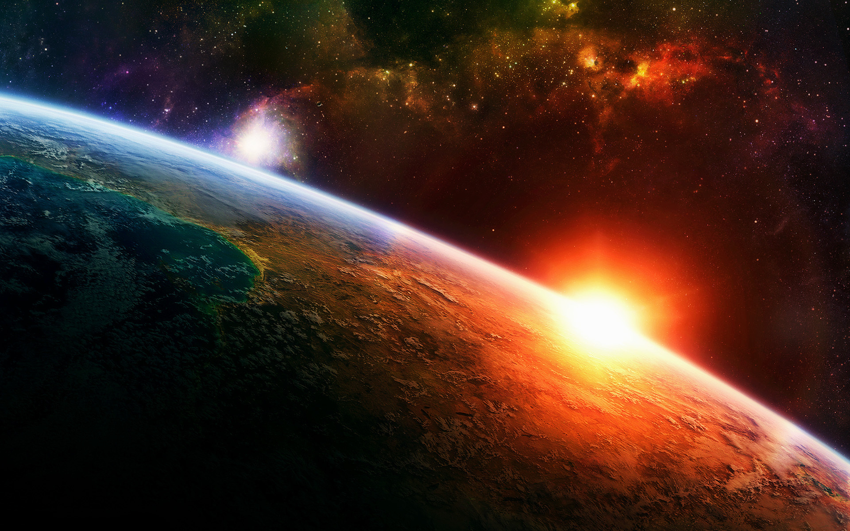
Earth Science: Exploring Our Planet
Student digital slides available at https://docs.google.com/presentation/d/17CkH2smxRGf9qsJnPAil41ysl70oO0FinYkqEYEY888/edit?usp=sharing
You will need to make a copy to assign to your students.
Quick Links
Lesson 1-1- Ologies
Lesson 1-2 – Earth Science Intro
Lesson 2 -1 – Stratigraphy
Lesson 2-2 – Fun w/ Stratigraphy
Lesson 3 – Geologic Time Scale
T. Tomm 2019 Updated 2022 https://sciencespot.net

Slide 2
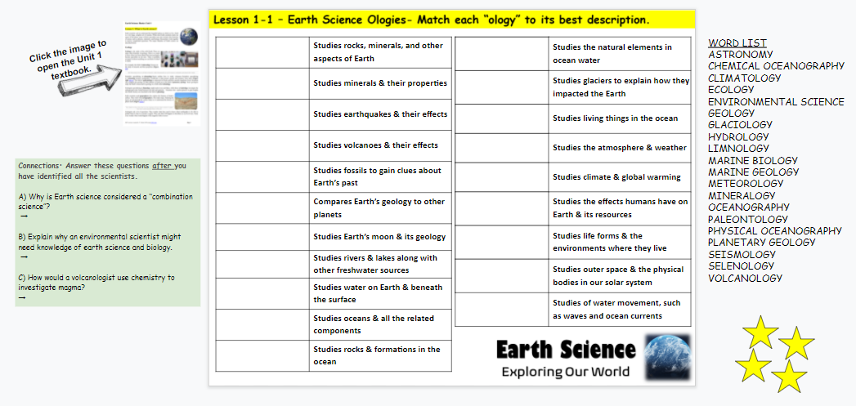
Assignment: Lesson 1-1 Earth Science Ologies
Open the Earth Science HDSN on GC.
Click the textbook image to open the textbook. Read the information on PAGES 1-3 to identify each “ology” and fill in the chart.
Use the word list to help you.
You’ll use the stars after we review the answers in class.
Done? Answer the questions to the left of the slide.

Slide 3
WORD LIST
ASTRONOMY
CHEMICAL OCEANOGRAPHY
CLIMATOLOGY
ECOLOGY
ENVIRONMENTAL SCIENCE
GEOLOGY
GLACIOLOGY
HYDROLOGY
LIMNOLOGY
MARINE BIOLOGY
MARINE GEOLOGY
METEOROLOGY
MINERALOGY
OCEANOGRAPHY
PALEONTOLOGY
PHYSICAL OCEANOGRAPHY
PLANETARY GEOLOGY
SEISMOLOGY
SELENOLOGY
VOLCANOLOGY
1. Identify these specialized sciences.
or MARINE CHEMISTRY
“Ology” | Description
 | Studies rocks, minerals, and other aspects of Earth
 | Studies minerals and their properties
 | Studies earthquakes and their effects
 | Studies volcanoes and their effects
 | Studies fossils to gain clues about Earth’s past
 | Compares Earth’s geology to other planets
 | Studies Earth’s moon and its geology
 | Studies rivers and lakes along with other freshwater sources
 | Studies water on Earth and beneath the surface
 | Studies oceans and all the related components
 | Studies rocks and formations in the ocean
“Ology” | Description
 | Studies the natural elements in ocean water
 | Studies glaciers to explain how they impacted the Earth
 | Studies living things in the ocean
 | Studies the atmosphere and weather
 | Studies climate and global warming
 | Studies the effects humans have on Earth and its resources
 | Studies life forms and the environments in which they live
 | Studies outer space and the physical bodies in our solar system
 | Studies of water movement, such as waves and ocean currents
GEOLOGY
CHEMICAL OCEANOGRAPHY
MINERALOGY
GLACIOLOGY
SEISMOLOGY
MARINE BIOLOGY
VOLCANOLOGY
METEOROLOGY
PALEONTOLOGY
PLANETARY GEOLOGY
CLIMATOLOGY
Lesson 1-1 – Earth Science Ologies
ENVIRONMENTAL SCIENCE
SELENOLOGY
LIMNOLOGY
ECOLOGY
HYDROLOGY
ASTRONOMY
OCEANOGRAPHY
PHYSICAL OCEANOGRAPHY
MARINE GEOLOGY
Which FOUR are the MAIN branches of Earth Science? Put a star next to them!

Slide 4
2. Think About It – Use the information in Lesson 1 to answer these questions. Write your answers on the page below this worksheet.
Why is Earth science considered a “combination science”?
B) Explain why an environmental scientist might need knowledge of earth science and biology.
C) How would a volcanologist use chemistry to investigate magma?
Branches of Earth science COMBINE life & physical science.
Biology – Living things (humans)
Earth Science – Abiotic resources water, soil, air, etc.
Chemistry – Study of elements & compounds → rocks → magma
Note: Changes in chemical composition might signal an eruption is possible

Slide 5
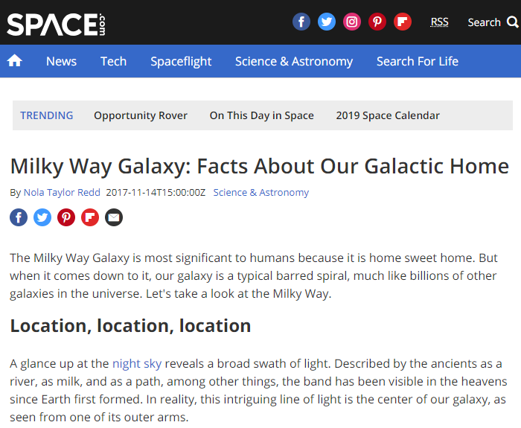
Lesson 1-2 – EDPuzzle - Earth Science Intro 2022
Go to GC → EDPuzzle Slide 2 Video → Earth Science Intro 2022.
READ THIS → Unlike other videos we’ve done on EDPuzzle, you will need to use the links provided to find the answers to the questions. The answers will not be in the video!
Click the word HERE to open a link where you can find the answer(s) you need.
Use CTRL + F with keywords to find the info you need.
The video quiz will count as a grade – Click RESUBMIT on GC when you are done.
PLUS – Questions from this slide will be on the note quiz - Hint! Hint!

Slide 6
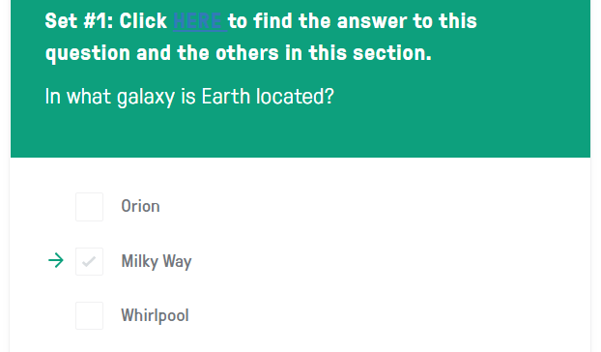
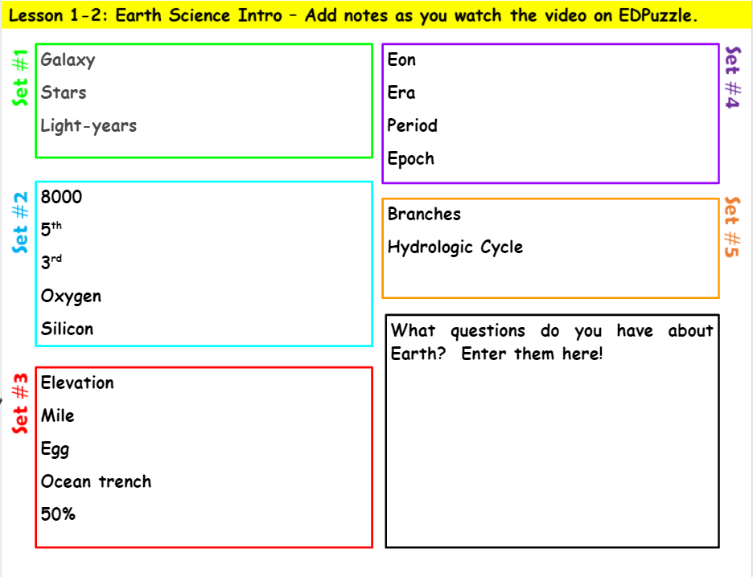
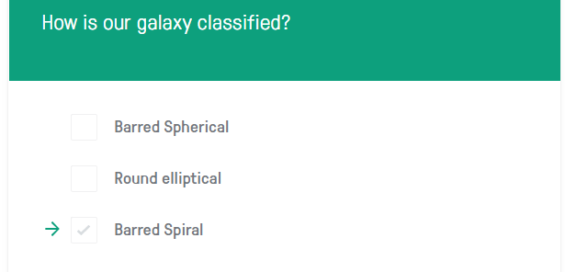
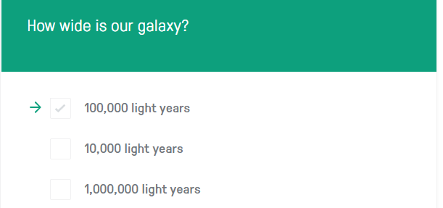
Review the answers and add notes to each word/number in the lists for each question set.
SET 3 LINK – If the link doesn’t work, use the one attached to this assignment on GC.
The video quiz will count as a grade – Click RESUBMIT on GC when you are done.
PLUS – Questions from this slide will be on the note quiz - Hint! Hint!

Slide 7
Lesson 1-2: EDPuzzle - Earth Science Intro
Did you finish Slide 2 by writing notes for each term in each set 1-5?
Yes – You may make additions and corrections
No – You need to close your laptop and finish iton your own time before class tomorrow

Slide 8
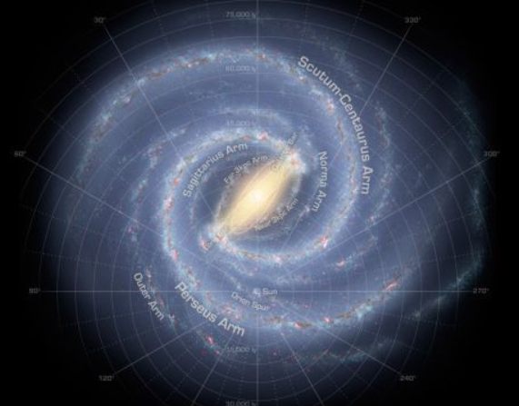
Intro to Earth Science - What notes did you add as you watched the video?
Set #1
Galaxy – Milky Way → Barred spiral
Stars – 200 billion (or more) in our galaxy
Light-years – 100,000 light years wide

Slide 9
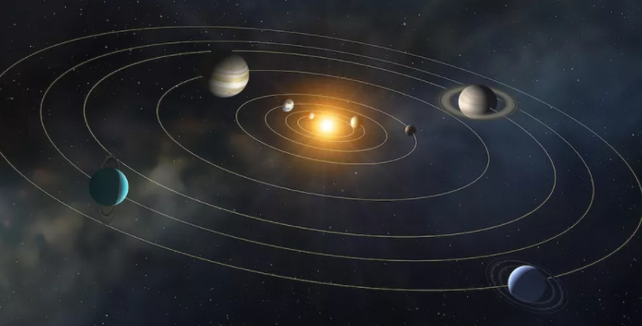
Set #2
8000 miles = Earth’s diameter
EARTH → 5th largest planet, 3rd from the sun
Oxygen – Most common element in Earth’s crust making up 47% if all rocks on earth; 2nd most common element in Earth’s atmosphere
Silicon – 2nd most common element in Earth’s crust making up 27% of all rocks on Earth
You are here

Slide 10
Set #3
Elevation = Distance above sea level Egg = Boiling time increases with elevation
Mile = 5280 ft = Denver’s elevation
Ocean trench – Depth of Mariana Trench > (greater than) Height of Mount Everest
50% of life supported by the oceans
71% of Earth covered by oceans
Where would it take longer to boil an egg?
Mt. Everest or Havana, IL
How much longer?
18.5 mins - 4 mins = 14.5 mins longer
This Photo by Unknown Author is licensed under CC BY-SA-NC

Slide 11
Set #4
Eon – Phanerozoic
Era – Cenozoic (“Recent Life”)
Period – Quaternary
Epoch - Holocene
Set #5
Branches – Geology, Oceanography, Meteorology, Astronomy
Hydrologic Cycle – Water Cycle – Involves all four branches
Which PERIOD is called the COAL AGE?
Jurassic
Mississippian
Pennsylvanian

Slide 12
What are your questions about Earth?
Add them in the box on slide #2
Time to review our vocabulary from Lessons 1 & 2 → Go to GC and find the link for the vocab set.
Study the terms using the options provided.
Hint! Hint! Note Quiz tomorrow!

Slide 13
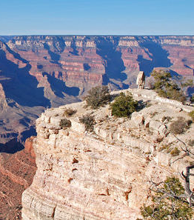
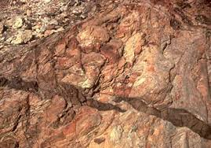
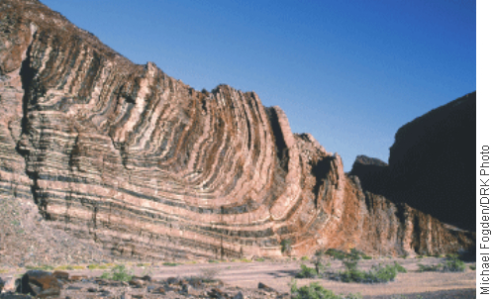
Lesson 2: Stratigraphy Basics
Unit 1: Exploring Our Earth
T. Tomm 2019 Updated 2022 https://sciencespot.net

Slide 14
Assignment: Lesson 2-1 – Stratigraphy Basics
Open the Earth Science HDSN on GC.
Click the TEXTBOOK IMAGE on Slide 3 to open the textbook.
Read the information on PAGES 4-7 to answer each question EXCEPT #4.

Slide 15
Lesson 3 – Stratigraphy Basics
#1
Scientists learn about the Earth’s past by studying STRATIGRAPHY, which is the study of rock strata (or layers).
What do you see in this image?
Three things we notice are:
Three questions we have are:
https://www.ck12.org/earth-science/principles-of-relative-dating/lesson/Principles-of-Relative-Dating-MS-ES/
Scientists look for UNCONFORMITIES, which are gaps in the rock sequence that can provide clues that a disturbance has occurred.

Slide 16
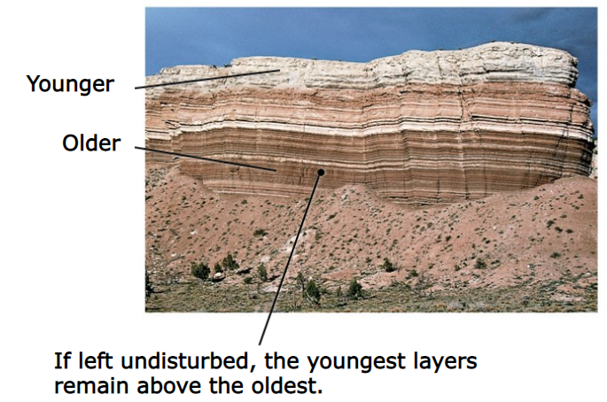
#2
The law of SUPERPOSITION explains why newer rock layers are found above older ones, such as the rocks at the bottom of a cliff being older than those at the top.
https://slideplayer.com/slide/7052339/

Slide 17
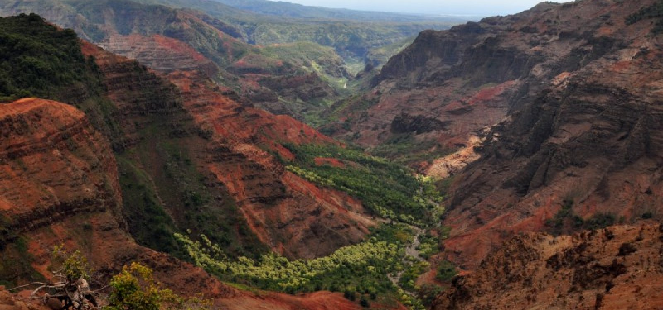
#2
The law of LATERAL CONTINUITY can be seen in the Grand Canyon where layers of the same rock are found on opposite sides of the canyon.
https://www.hawaii-guide.com/kauai/sights/waimea_canyon

Slide 18
#2
The law of ORIGINAL HORIZONTALITY explains how sedimentary rocks form as sediments are in horizonal layers.
Sedimentary rock layers that are tilted tell scientists the rock must have been moved after they were deposited.
http://cosscience1.pbworks.com/f/1248192600/Module9-004.jpeg
https://slideplayer.com/slide/7052339/

Slide 19
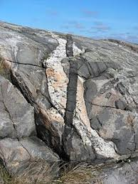
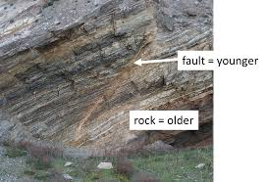
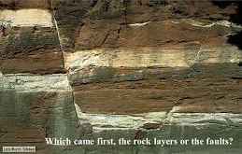
#2
The law of CROSS-CUTTING RELATIONSHIPS tell us that the rocks cutting across layers from top to bottom are younger than the surrounding rock where it is found.
https://encrypted-tbn0.gstatic.com/images?q=tbn:ANd9GcR5_GB0cDJ-8dakWIalUKxGwa-n8FJWvqZmSZFL7VJT3WzpAwfp
https://encrypted-tbn0.gstatic.com/images?q=tbn:ANd9GcSVOYfgiGtChKLiDxEovNQrNkaIt0w_2Y--2juKAeTQDlia1cbAaQ
https://encrypted-tbn0.gstatic.com/images?q=tbn:ANd9GcQWITN9w7xHF2KE651O5IWeHY-kfkDF8KmvbgV93ifj3OMGDqnW

Slide 20
#3
What does the statement, “the present is the key to the past” mean?
We can use what we observe/know today to explain things from the past.
Things we see today …
Water running downhill
Erosion due to water or wind
Rock uplifted or moved near a fault
Things we see from the past…
Cuts in rock due to ancient streams or rivers
Spires or ridges at the top of rock being worn away
Matching rock layers being higher or lower
UNIFORMITARIANISM → Present is the KEY to the Past
Definition: Principle that geologic processes that occurred in the past can be explained by present geologic processes

Slide 21
#3
What does the statement, “the present is the key to the past” mean?
We explain geologic processes that occurred in the past by using what we know about current geologic processes (present time).
Things we see today ….
Water running downhill
Erosion due to water or wind
Rock uplifted or moved near a fault
Things we see from the past….
Cuts in rock due to ancient streams or rivers
Spires or ridges at the top of rock being worn away
Matching rock layers being higher or lower
Make the Connection: How would you classify the features we noted in this image when you started the lesson?
We will come back to this question.

Slide 22
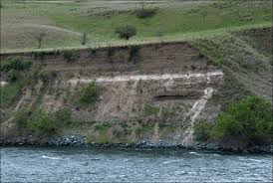
#4
Explain how each of these features can help scientists determine the age of rocks.
Key beds -
A rock layer that is distinctive enough to be useful in correlation in matching rock from different areas/regions
Can you see the white layer of volcanic ash?

Slide 23
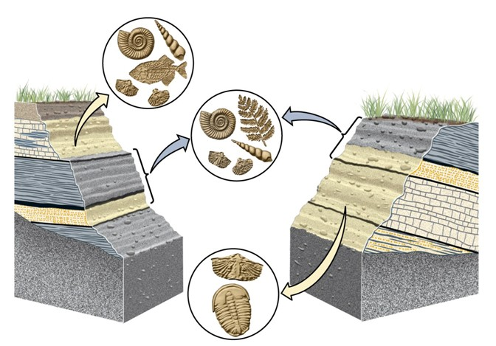
#4
Index fossils -
Fossils used to determine the relative ages of rock layers and the fossils they contain
https://player.slideplayer.com/33/7052339/data/images/img27.jpg
Relative Age – The age of a fossil relative to other fossils or rock layers; older or younger
Absolute Age – Using specific methods to determine the actual age of fossil; 2 billion years old

Slide 24
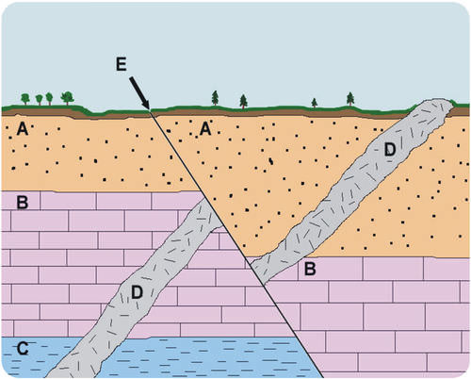
Identify each letter based on the notes we just discussed.
#5
A = Superposition
B = Lateral Continuity
C = Original Horizontality
D = Cross-Cutting Relationships
E = Fault Line
Answer these questions based on the laws of stratigraphy.
Oldest = Layer C (lowest)
Which layer is the oldest? Youngest?
Which laws explains why a layer of rock like B could be found on opposite banks (sides) of a river?
Which is older: B or D?
Which is older: E or D?
Youngest = Layer A (top)
Lateral Continuity
B – had to be there before D cut across it
D – E cut across it, so it was there before fault E occurred

Slide 25
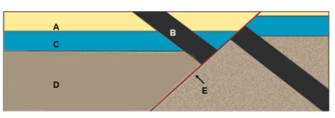
#6
Organize the layers from oldest to youngest.
D
C
A
B
E
______ → ______ → ______ → ______ → ______
Oldest
Youngest
https://www.youtube.com/watch?v=SKUoNrMZZmo

Slide 26
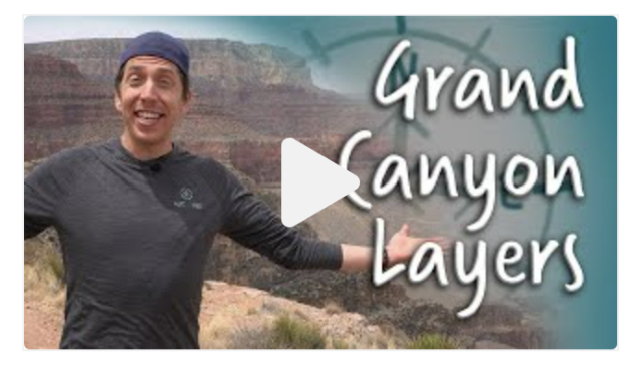
Make the Connection: How would you classify the features we noted in this image when you started the lesson?
Superposition
Horizontality
Lateral Continuity
Cross-Cutting Relationships
Directions:
Go to Google Classroom to find the link to the EDPuzzle video for this question.
Add examples for all FOUR laws as you watch the video.
Answer the questions in the video – your score will count as a grade.

Slide 27
Make the Connection: How would you classify the features we noted in this image when you started the lesson?
Superposition – The lowest layers in the canyon are the oldest with younger layers at the top.
Horizontality – The layers were laid down flat and any changes (uplifts, slants, tilts, etc.) were created by forces that caused those rock layers to move.
Lateral Continuity – Layers on opposite sides of the canyon were once part of the same layer. Erosion from the Colorado River carried away the middle portion.
Cross-Cutting Relationships – Faults or fractures (or other inclusions) in the rock are younger than the rock layers as they occurred after the rock layers had already been formed.
What is an UNCONFORMITY? They are gaps in the rock sequence that can provide clues that a disturbance has occurred.

Slide 28
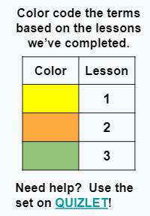
Assignment: Write definitions for terms from Lessons 1 & 2
Term
Absolute age
Amber
Astronomy
Casts & Molds
Cenozoic
Cross-Cutting Relationship
Eons
Epochs
Eras
Extinct
Fossils
Geologic time scale
Geology
Impression
Index fossils
Key beds
Lateral Continuity
Meteorology
Oceanography
Original Horizontality
Periods
Petrification
Phanerozoic
Radiometric dating
Relative age
Rocks
Stratigraphy
Superposition
Quaternary
Unconformity
Uniformitarianism
https://docs.google.com/presentation/d/17odNPk3G2In9gDtTz50HNGrM5S_K3kOp2grjNiVQ6Pk/edit?usp=sharing

Slide 29
Lesson 2-2: Fun with Stratigraphy
Use what you learned from Lesson 2 & the evidence provided to complete this slide!
Due at the start of class tomorrow!

Slide 30
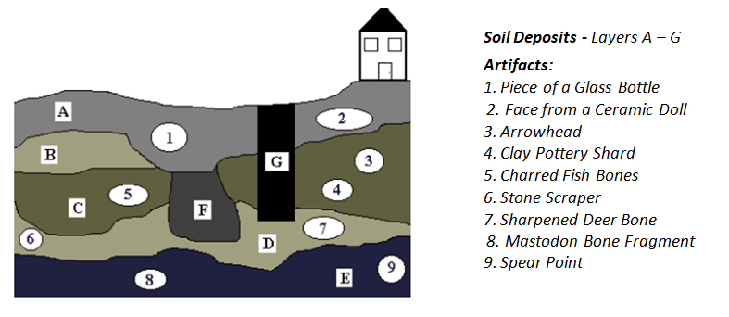
Fun with Stratigraphy Answer Key
1. Which is older out of these items? Circle your answers.
a) The arrowhead or the spear point
b) Layer B or Layer D
c) Clay pottery shard or sharpened deer bone
d) Charred fish bones or Layer D
e) Layer C or Layer G
Source: https://www.wssd.org/cms/lib/PA01001072/Centricity/Domain/725/Fun%20with%20Stratigraphy.pdf

Slide 31
2. If G is a well, what can we learn about its creation and age from the artifacts found.
The glass bottle and ceramic doll, items that were found in the top layers of soil, would suggest the well was dug close to the time the house was built.
Its position close to the house would indicate the people who live there dug it to provide water for the house.

Slide 32
3. How might the mastodon have been killed? Give your evidence.
The mastodon may have been killed by a spear, since a spear point was found in the same layer. The spear might have been carved by Native Americans living in the area at that time.

Slide 33
4. Were there humans living here when layer E was being formed? Give your evidence.
5. Were there humans living here when layer B was being formed? Give your evidence.
Yes, the mastodon bone fragment was found, which may have been damaged by the spear point found in that layer
No, there were no artifacts found in that layer OR
Yes, there were artifacts in the layers above and below Layer B that indicated people lived in that area before and after the layer was formed.

Slide 34
6. What type of formation could F be? Why?
Quick Question: Knowing that layer E is older than layer D is an example of: A) Absolute age B) Geologic age C) Relative age

Slide 35
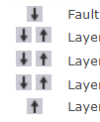
Quiz Time
Log in to Quia → Class Period → Class web page
Complete the ES Unit 1 Note Quiz B 2022 using only your notebook to help you. - One tab/browser open during the quiz - No help from other people or resources
Click the arrows to move each item up or down the list.

Slide 36
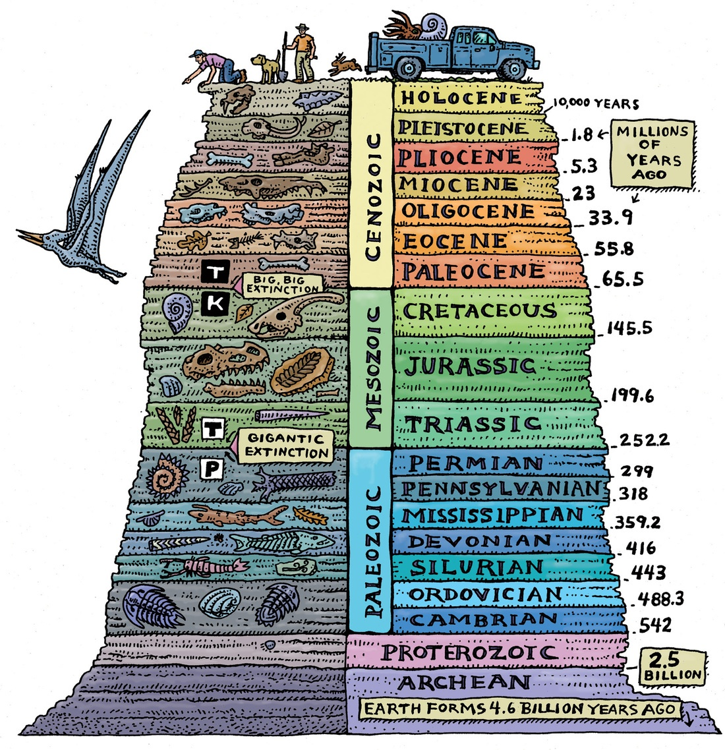
Lesson 3: Geologic Time Scale
Unit 1: Exploring Our Earth
T. Tomm 2019 Updated 2022 https://sciencespot.net

Slide 37
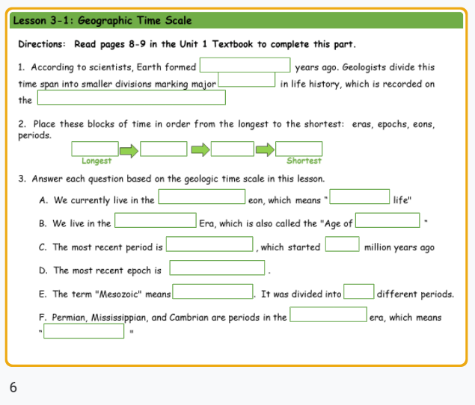
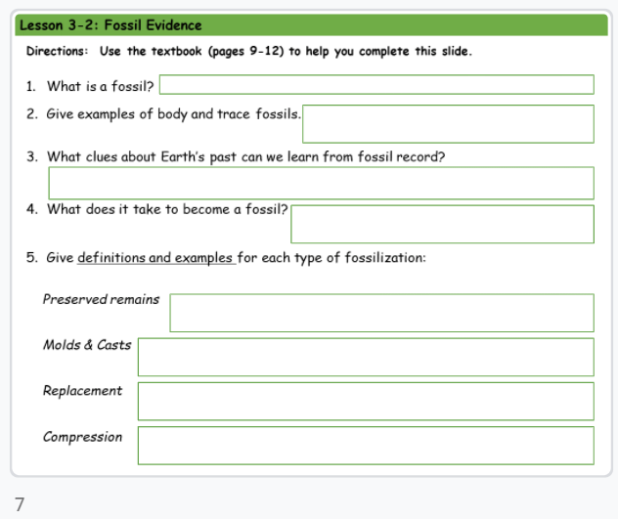
Assignment: Lesson 3 – Geologic Time Scale
If your note slide #6 is done, you may add or correct your work.
If you are NOT DONE, you need to close your laptop and just listen. Finish the notes on your own time.
Be sure to finish this before class tomorrow!

Slide 38
Part 1: Use pages 8-9 in the Unit 1 Textbook to complete this part.
1. According to scientists, Earth formed ____ _______ years ago. Geologists divide this time span into smaller divisions based on major __________ in life history, which is recorded on the ____________ __________ __________.
2. Place these blocks of time in order from the longest to the shortest: eras, epochs, eons, periods
_________ → _________ → ___________ → __________
4.5 BILLION
EVENTS
GEOLOGIC TIME SCALE
EONS
ERAS
PERIODS
EPOCHS
https://samnoblemuseum.ou.edu/common-fossils-of-oklahoma/how-paleontologists-tell-time/geological-timescale/

Slide 39
3. Answer each question based on the geologic time scale in this lesson.
A. We currently live in the __________________ eon, which means "_____________ life”.
B. We live in the _____________ Era, which is also called the "Age of ______________"
C. The most recent period is__________________, which started ___ million years ago
D. The most recent epoch is _______________.
E. The term "Mesozoic" means ________________. It was divided into ____ different periods.
F. Permian, Mississippian, and Cambrian are periods in the _______________ era, which means “_____ ______”.
PHANEROZOIC
VISIBLE
CENOZOIC
MAMMALS
QUATERNARY
1.6
HOLOCENE
MIDDLE LIFE
3
PALEOZOIC
OLD LIFE

Slide 40
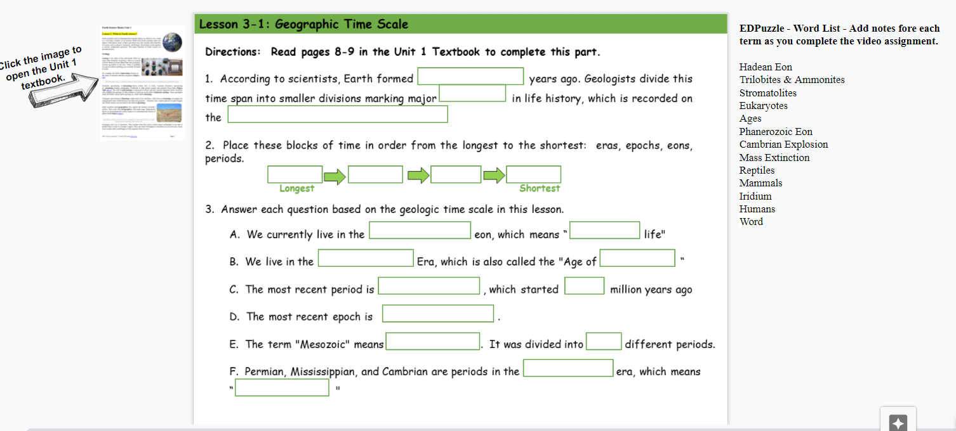
Today’s Assignment:
Find the text box next to slide 6.
Take notes as you complete the video assignment on EDPuzzle.
You need to add something about each term/terms.
Be sure Slide #7 is done for tomorrow!

Slide 41
Hadean Eon
Trilobites & Ammonites
Stromatolites
Eukaryotes
Ages
Phanerozoic Eon
Cambrian Explosion
Mass Extinction
Reptiles
Mammals
Iridium
Humans
Word
First eon = Hades
Trilobites older than ammonites
Earliest known fossils made of bacteria and sediments
Cells with a nucleus
Epochs divided into ages
Current eon
Explosion of life (huge increase in life on earth)
EDPuzzle Video Notes – Geologic Time Scale
Loss of life on a huge scale
Mesozoic – Age of Reptiles
Cenozoic – Age of Mammals
Traces found in gulf suggest meteorite or asteroid
Changed Earth’s history faster than anything else
Humans time on earth is equal to the last word on the last page of the last chapter of the earth’s story

Slide 42
Earth’s Age - https://www.youtube.com/watch?v=tkxWmh-tFGs

Slide 43
Assignment: Lesson 3-2 – Fossils
If your note slide 7 is done, you may add or correct your work.
If you are NOT DONE, you need to close your laptop and just listen. Finish the notes on your own time.

Slide 44
Directions: Use the textbook (pages 9-12) to help you complete this slide.
What is a fossil?
Give examples of body and trace fossils.
Any remains or traces of an ancient organism.
Body fossils – Fossils of body parts/structures, bones, teeth, claws, shell
Trace fossils – Fossils left behind that show evidence of an animal or plant, but not the actual remains
How many of these are body fossils?
B
?
T
B
T
B
T
Depends on the amount of actual leaf preserved – often left as just an imprint, which would be a trace fossil

Slide 45
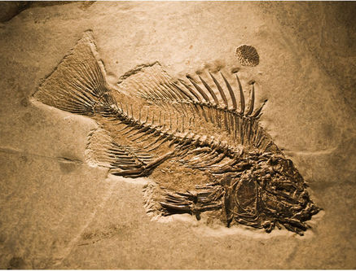
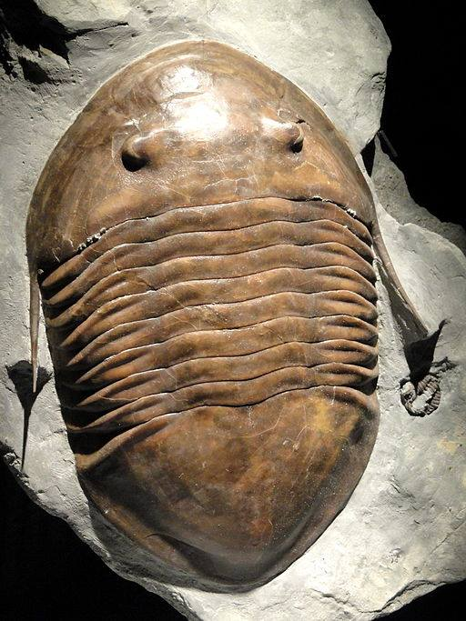
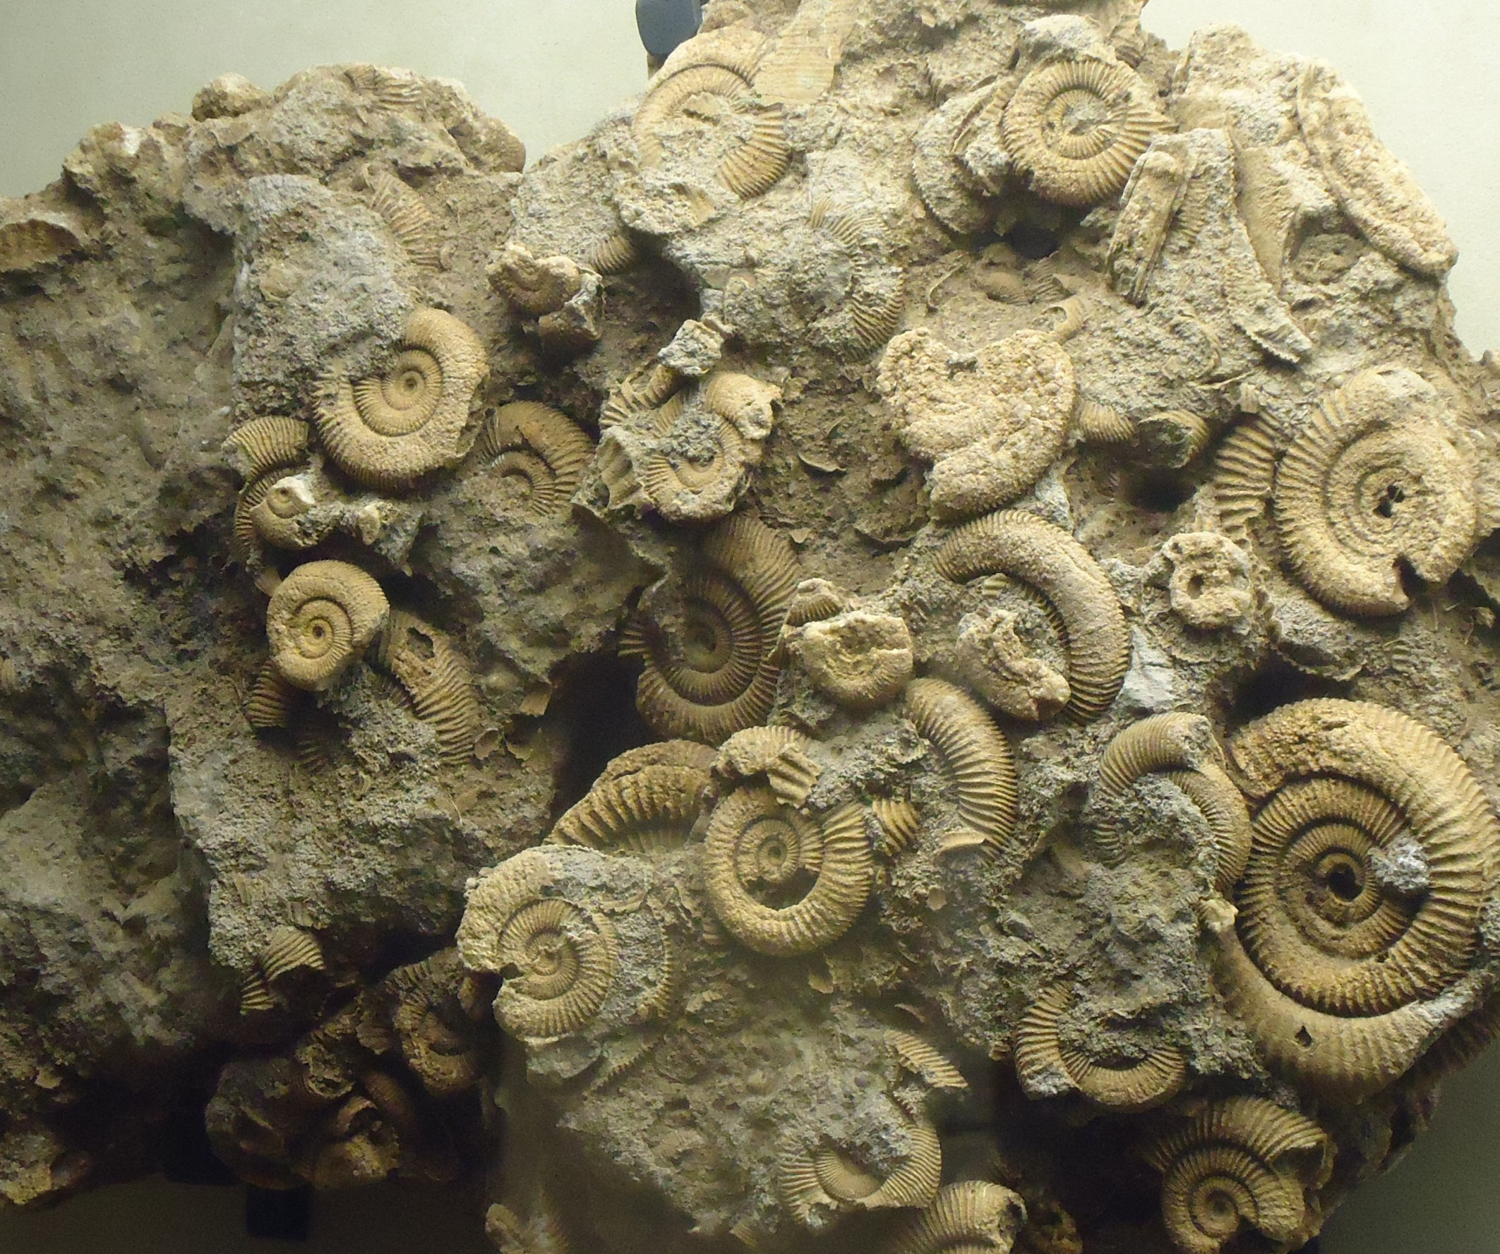
3. What clues about Earth’s past can we learn from fossil record?
4. What does it take to become a fossil?
This Photo by Unknown Author is licensed under CC BY-NC
Fossils can give us clues about past climates, the motions of plates, major geological events, mass extinctions, and biodiversity.
Hard parts – Exoskeleton, bones, teeth, etc.
This Photo by Unknown Author is licensed under CC BY-NC
Quick burial – Prevents damage from other animals or environmental factors (sun, rain, wind, etc)

Slide 46
Copy & Paste Link: https://www.youtube.com/watch?time_continue=77&v=4WljOabDTrs&feature=emb_logo

Slide 47
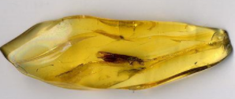
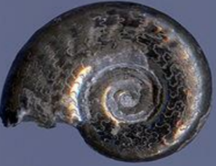
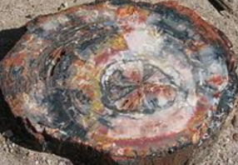
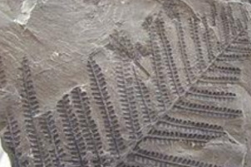
5. Give definitions and examples for each type of fossilization:
Preserved remains
Actual remains – fossilized bones, skin, organs, etc.
Examples: Insect in amber; mammoth frozen in a glacier; tar pit fossils
Molds & Casts
A mold is the empty space left behind that is later filled with other sediments to form a matching cast.
Examples: Many mollusks are found as molds and casts
Replacement
Fossils are created by replacing the original shell, bone, or plant material with minerals.
Examples: Petrified wood
Compression
Remains are compressed by pressure by layers of sediments top of them.
Examples: Plant leaves and stems that have been carbonized

Slide 48
Copy & Paste Link: https://www.youtube.com/watch?v=bRuSmxJo_iA&feature=emb_logo

Slide 49
Let’s examine some fossils …
Directions: Analyze the fossil(s) at your table. You may use the hand lenses provided, the mini microscopes, and your cell phone camera (if you use it wisely.) Create a textbox next to slide 7 to record your notes and observations to share with the class next week.
Identify it as a body or trace fossil.
Determine how the fossil was formed.
Identify the organism that it is or that made it (as specific as possible.)
Determine its relative age → Cenozoic, Mesozoic, or Paleozoic.
Use the Earth Science Links on mrstomm.com.

Slide 50
Vocabulary
Which Lesson 3 terms have we discussed so far?
Term
Absolute age
Amber
Astronomy
Casts & Molds
Cenozoic
Cross-Cutting Relationship
Eons
Epochs
Eras
Extinct
Fossils
Geologic time scale
Geology
Impression
Index fossils
Key beds
Lateral Continuity
Meteorology
Oceanography
Original Horizontality
Periods
Petrification
Phanerozoic
Radiometric dating
Relative age
Rocks
Stratigraphy
Superposition
Quaternary
Unconformity
Uniformitarianism
https://docs.google.com/presentation/d/17odNPk3G2In9gDtTz50HNGrM5S_K3kOp2grjNiVQ6Pk/edit?usp=sharing

Slide 51
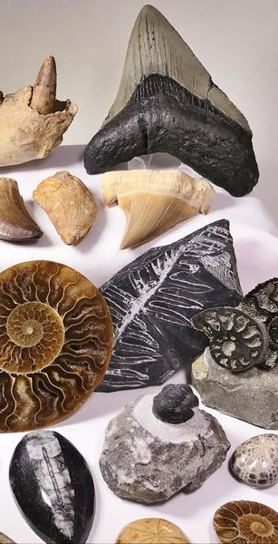
Who’s on First?
Lesson 3-3
Relative Dating Activity
Original Source: https://ucmp.berkeley.edu/fosrec/BarBar.html#SETB

Slide 52
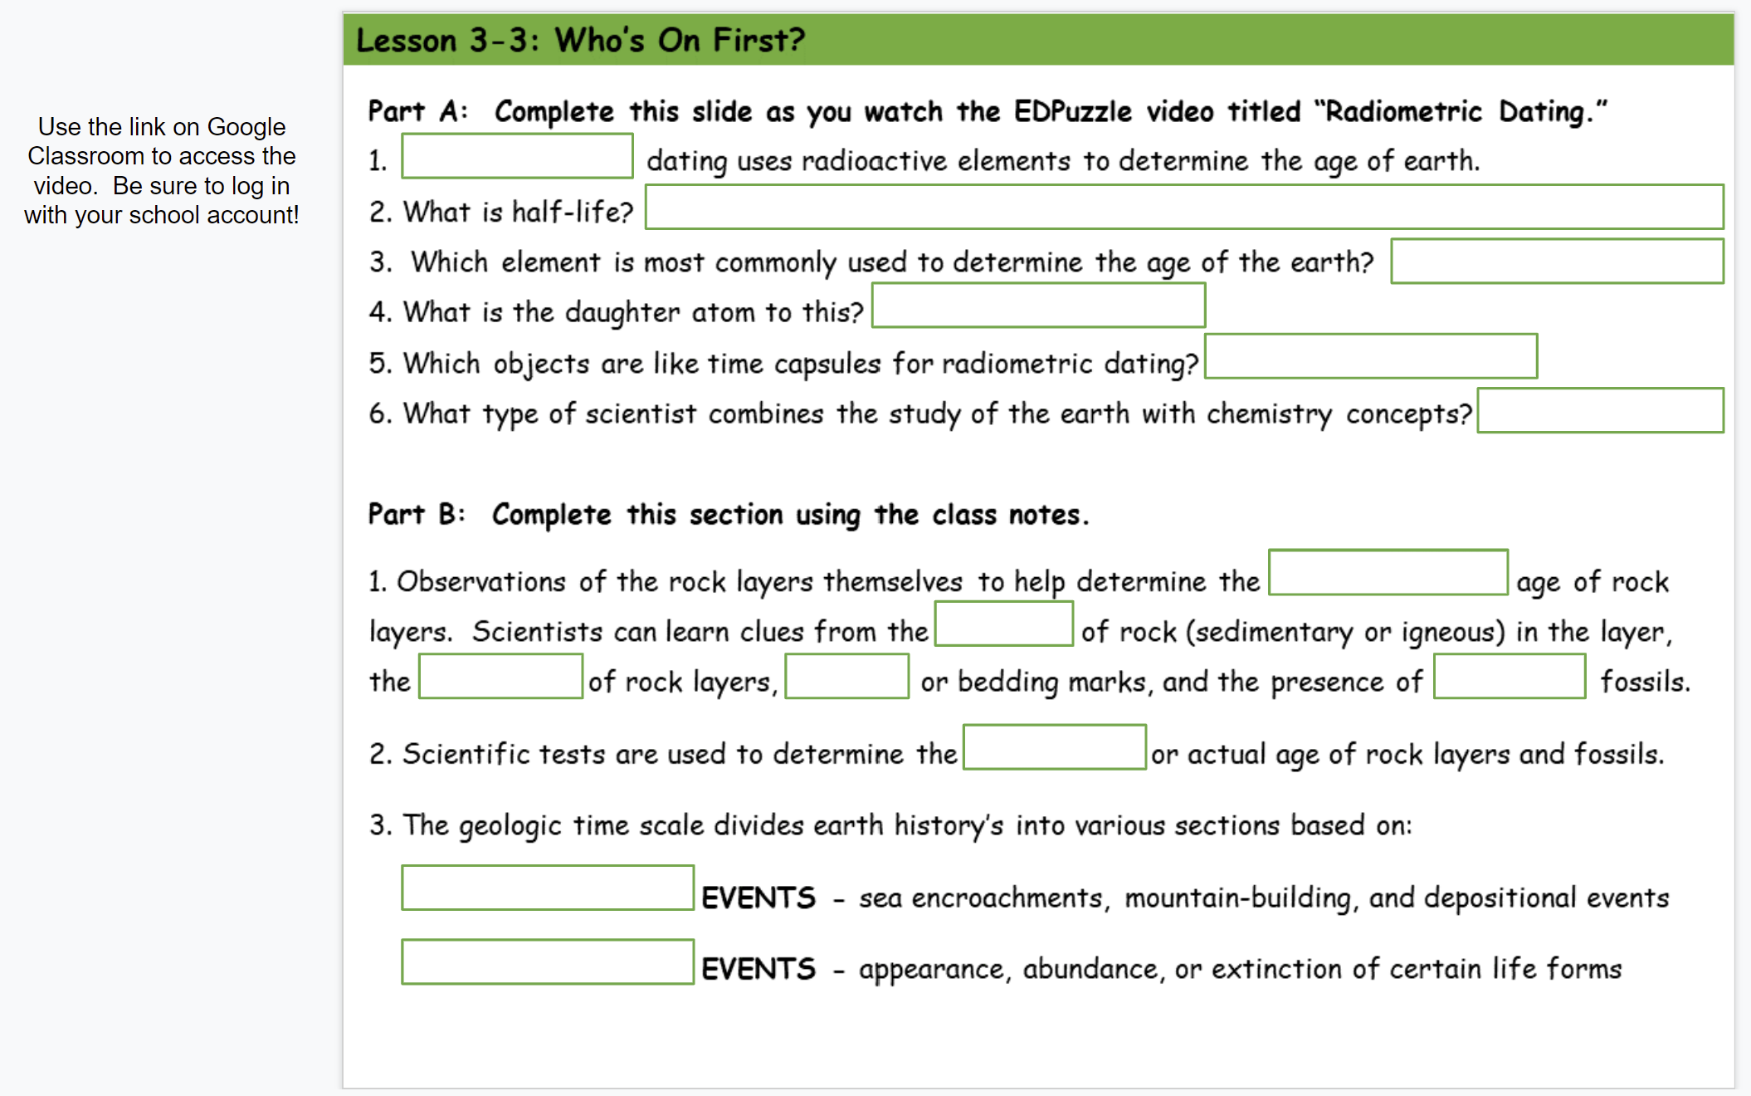
Assignment: Lesson 3-3 – Who’s On First Part A
Directions: Watch the EDPuzzle video to fill in PART A on Slide 8. Be sure to use the link on Google Classroom to access the video!
Done? Start the new Legends playlist!

Slide 53
Assignment: Lesson 3-2 – Fossils
If your Part A is done, you may add or correct your work.
If you are NOT DONE, you need to close your laptop and just listen. Finish the notes on your own time.

Slide 54
Part A: Complete this slide as you watch the EDPuzzle video titled “Radiometric Dating.”
1. ____________dating uses radioactive elements to determine the age of earth.
2. What is half-life? ___________________________________________
3. Which element is most commonly used to determine the age of the earth?
4. What is the daughter atom to this?
5. Which objects are like time capsules for radiometric dating?
6. What type of scientist combines the study of the earth with chemistry concepts?
RADIOMETRIC
Time it takes for the PARENT element to decay into the DAUGHTER element
URANIUM (U)
LEAD (Pb)
METEORITES
GEOCHEMIST

Slide 55
Part B: Complete this section using the class notes.
1. Observations of the rock layers themselves to help determine the _________ age of rock layers. Scientists can learn clues from the ______ of rock (sedimentary or igneous) in the layer, the ______ of rock layers, _________ or bedding marks, and the presence of ______ fossils.
2. Scientific tests are used to determine the __________ or actual age of rock layers and fossils.
RELATIVE
TYPE
AGE
RIPPLE
INDEX
ABSOLUTE
Identify each as a relative age or absolute age.
My dog is older than my cat.
My granddaughter is 2 ½ years old.
The trilobite fossil is older than the ammonite one.
The T-Rex bone is 65 million years old.
A fish fossil was in a layer of rock that was deeper than the layer with the mammoth bone.
R
A
R
A
R

Slide 56
3. The geologic time scale divides earth history’s into various sections based on:
EVENTS - sea encroachments, mountain-building, and depositional events
EVENTS - appearance, abundance, or extinction of certain life forms
GEOLOGICAL
BIOLOGICAL
https://www.nhm.ac.uk/discover/the-triassic-period-the-rise-of-the-dinosaurs.html
Layers of Time activity - https://www.amnh.org/explore/ology/paleontology/layers-of-time2

Slide 57
Part C: Sequence Challenge
Goal: Organize the cards from OLDEST to most RECENT.
1^{st –} Look for the card with TC on it. The T & C represent fossils found in that layer, which is the OLDEST layer in your set.
2nd- Find a card that could go on top of the "TC" card and represents a layer with fossils YOUNGER than those in the bottom layer. HINT: Similar fossils can be found in layers above and below others.
3rd – Continue sequencing the remaining cards by using the same process. When you finish, you should have a vertical stack of cards with the top card representing the youngest fossils of this rock sequence and the "TC" card at the bottom of the stack representing the oldest fossils.
4th – Have your answers checked by the teacher. If you have them all correct, answer the question on your slide.

Slide 58
DM
Part C: Question
After your teacher has checked your work, explain how your team determined the correct order.
OXD
NO
What did you say?
We had to use the letters representing fossils as clues to which layers were found close to each other.
The order depended on finding similarities between layers.
We also had to make sure any fossil found in one layer was in a layer directly above or below it – a species could not appear in layers that skipped any in between, i.e. a species couldn’t go extinct and then reappear later.
BN
UBN
AU
CGA
TC

Slide 59
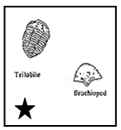
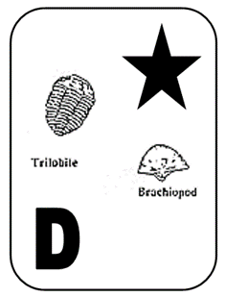
Part D: Fossil Challenge – What’s the Order?
YOUNGEST
Each card represents a particular rock layer with a collection of fossils that are found in that particular rock stratum. The oldest rock layer is marked with a star.
Find a rock layer that has at least one of the fossils you found in the oldest rock layer. This rock layer would be younger as indicated by the appearance of new fossils in the rock layer. Keep in mind that extinction is forever. Once an organism disappears from the sequence it cannot reappear later.
Use this information to sequence the cards in a horizontal line from OLDEST to YOUNGEST. Have your answers checked by the teacher and make changes until you have them all correct.
Answer the questions.

Slide 60
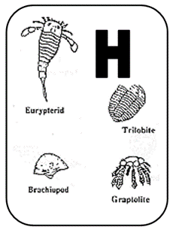
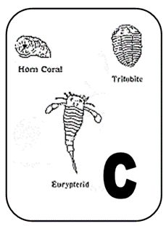
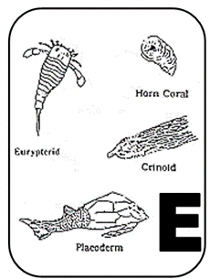
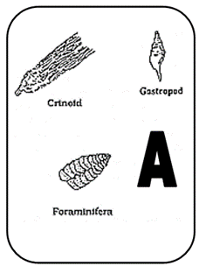
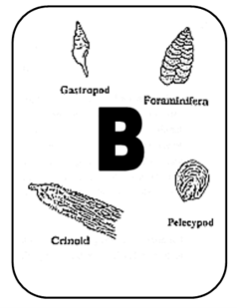
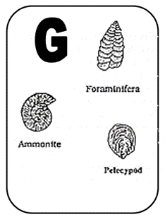
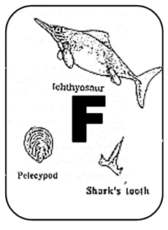
?
?
OLDEST LAYER
YOUNGEST LAYER
Part D Questions: Which fossil organisms could possibly be used as index fossils? Which ones could not be used as index fossils? Explain using two examples for each.
The fossils found in only one layer would be the most useful as index fossils.
Examples: graptolite, placoderm, and ammonite
The fossils found in more than one layer would NOT be useful as index fossils.
Examples: brachiopod, crinoid, eurypterid, foraminifera, gastropod, horn coral, pelecypod, and trilobite.

Slide 61
Here are layers shown in their rock strata.
How does the Law of Superposition relate to this activity?
The oldest fossils will be on the bottom with successively younger fossils on top.
Quick Question: In what type of rock do we find most fossils?
Igneous
Sedimentary
Metamorphic

Slide 62
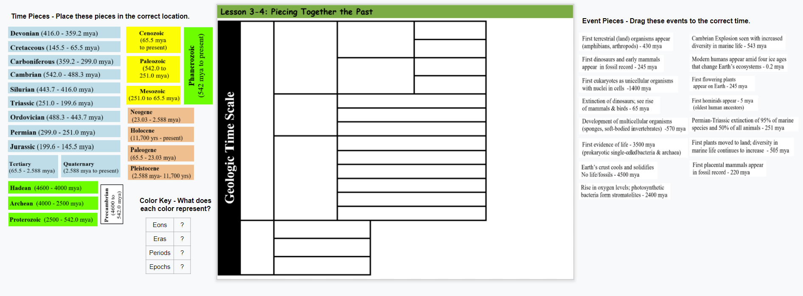
Putting Together the Pieces
https://edpuzzle.com/media/623110ec78072042a292684e
Watch the EDPuzzle video & follow the directions to place all the Time Pieces (colored blocks) on the left side of the chart.
You do not have to do anything with the EVENT PIECES yet!
Shade in the ? Boxes to show which colors represent each time piece.

Slide 63
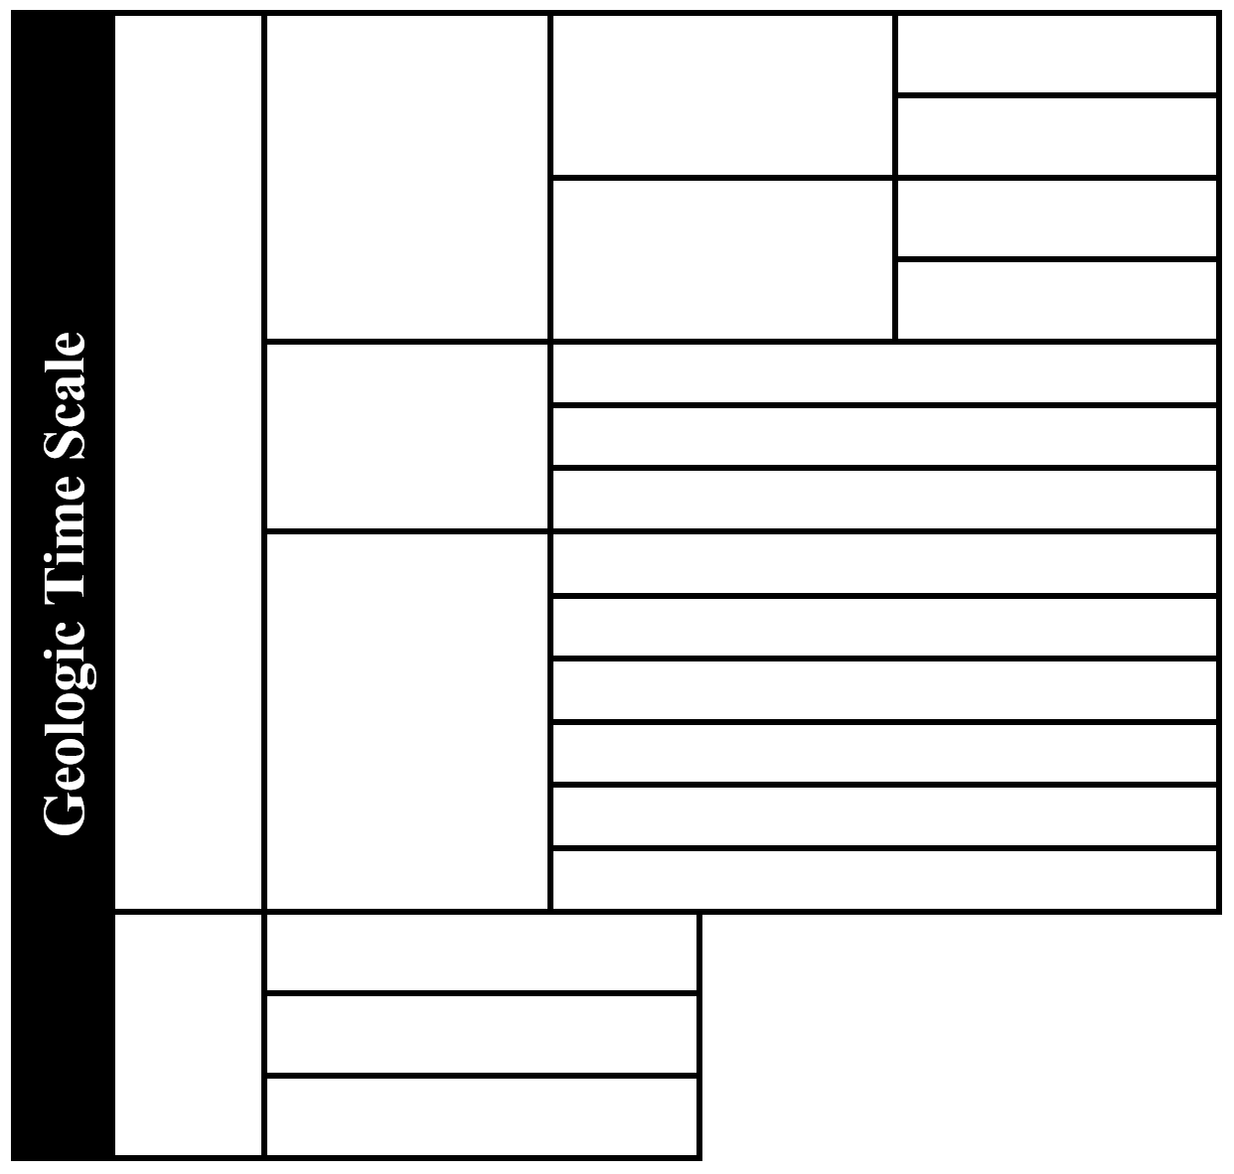
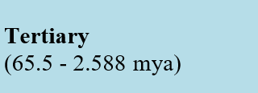
Did you place the PRECAMBRIAN piece in the bottom left-hand corner?

Slide 64
What is our current eon?
And the next?
What was one next?
What was the first eon?

Slide 65
What is our current era?
What was the “middle” era?
Which era was “old life”?

Slide 66
EPOCHS
What is last division in your chart?
What is the next division?
PERIODS

Slide 68
Let’s add to our timescale …
MOST RECENT
EON
ERA
PERIOD
EPOCH
Eons | ?
Eras | ?
Periods | ?
Epochs | ?
GREEN = EON
YELLOW = ERA
BLUE = PERIOD
ORANGE = EPOCH
OLDEST

Slide 69
Piecing Together the Puzzle
Yesterday we talked about how scientists used rock strata and index fossils to give us “pieces” of the past.
Today we have reviewed the “blocks” or pieces of the Geologic Time Scale.
Now it’s time to add more details …

Slide 70
Let’s piece together Earth’s history …
We will go to the hallway to the timeline rope – the long rope you saw me putting up on Tuesday.
Each table group will have 2 events to add to the rope.
Your groups will help me place the events on the timeline in the correct place.
Pay attention because you will need to remember what you learned for our next activity.
Quick Question: What does “mya” mean?

Slide 71
Let’s fill in the gaps …
Each class will be assigned a specific time period.
You need to find ONE event in that time period to add to the “rope” timeline.
Get a card from the front table & colored pencils/gel pens/markers to make it pretty.
On the BLANK SIDE, write the event on the along with the “date” in terms of mya. Draw a picture (or two) that goes with the event.
Put your name on the back.
Show the teacher for a grade and then hang in the hallway in the correct location.
Earth’s moon formed
4500 mya
This Photo by Unknown Author is licensed under CC BY-ND

Slide 72
Your Assignment: Organize the events listed on your slide from oldest to the most recent. Use arrows to show where they would go in the GTS.
?
Continue organizing the events and adding arrows.
OLDEST →

Slide 73
Think About It
Work with a partner to answer all these questions. Be prepared to share with the class.
Which EON is the longest? Shortest?
How long ago did life begin on Earth?
How did living things change from the time life began to present day?
In which ERA did modern humans appear?
Which came first: marine or terrestrial organisms?
Which came first: prokaryotic or eukaryotic organisms?

Slide 74
Things to do …
Finish organizing all the events to your geologic time scale.
Work on the new playlist on Legends – Due Friday
Find something else to do after you are done.

Slide 75
Time to review … Geo Time Smillionaire
Activity Link: https://www.quia.com/rr/1268031.html
If all parts of all slides in your Earth Science HDSN are done, you may use it to help you answer the questions in the Smillionaire challenge. You have to complete any parts that are not done before you can play!
You may NOT ASK CLASSMATES or USE ONLINE RESOURCES → the answers are in your notebook or are some you should remember from Legends and the Science Starters.
Show the teacher if you earn a Smillionaire during class time to earn a piece of candy and add a tally mark to the chalkboard. Five tally marks = a super sticker or sucker!
You can only earn Smillionaires in class, but are welcome to use the game to study for your note quiz. You will have time after the quiz to earn more tally marks for rewards!
NOTE: A Smillionaire is equal to a million smileys!

Slide 76
How did you do? Check your answers and make corrections if needed.

