Slide 1
Density Challenge
Digital “pages” for student notebook or worksheets available at https://docs.google.com/presentation/d/1GKeE-H1TyvuM5p_FOsC-bKIMIP7yhzunt91hDXoSz7w/copy
Teacher Notes:
I used this activity during Lesson 1 in the Chemistry unit about matter. After we reviewed mass, volume, and weight, we discussed density in the notes and then students started this activity.
For Part A, students use the website provided (free to use for anyone). Directions are on the left side of the slide to help them get the information they need to fill in the chart. We did the first three together in class. They finished the rest of the chart and answered the questions before the next class period. I also had them make predictions for Part B by dragging the layers and items to the glass cylinder based on what they knew about them.
For the socially-distanced lab for Part B, I set up a large graduated cylinder in a spot that was visible from all the tables in my room. I had extra graduated cylinders to allow several kids to help me measure the liquids. I also recruited other students to help me add items to the cylinder. For most of my classes, every student was able to help with the lab. This would also be a great lab to demo for remote learning. The students made corrections on their slides as we observed what happened with each liquid and item.
For Part C, students were allowed time to write their responses before we discussed them in class. Several of the students found great videos of 7 and 9 layer density columns to share with their classmates.
NOTES:
A list of the liquids and items you will need are on slide 4. I used 100 ml of each liquid, which made a layer 2” thick in the large cylinder I used. I had additional liquids and items on hand to use when we had extra time to do more testing.
This lab also ties in with the Gas Laws Lab completed in Lesson 2 of the Chemistry unit, which will also be available on the Chemistry page of the Science Spot’s Science Classroom!
Lesson developed by T. Tomm 2020 https://sciencespot.net/

Slide 2
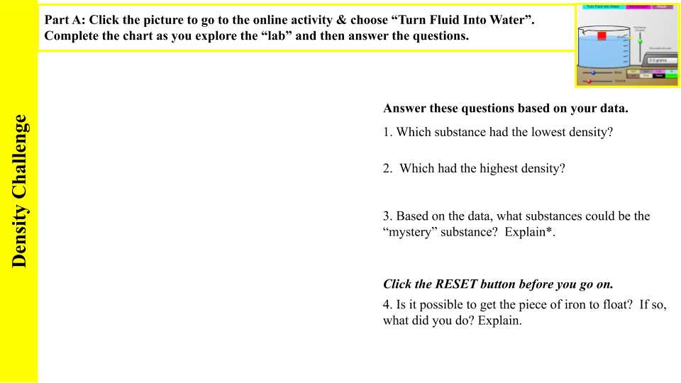
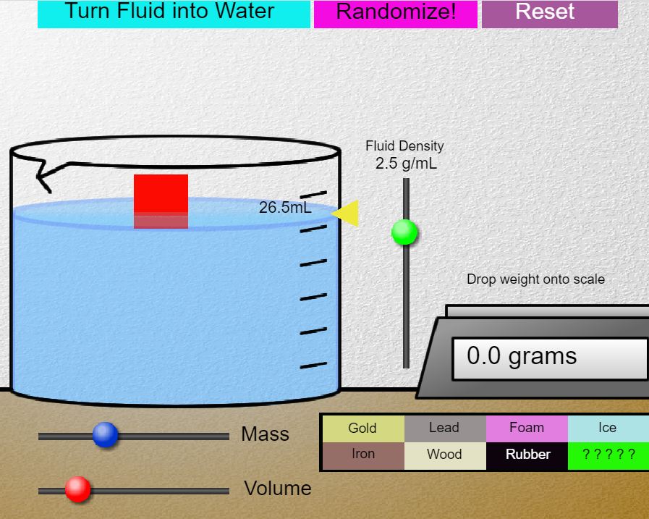


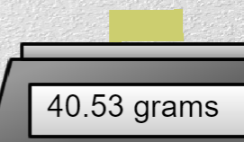
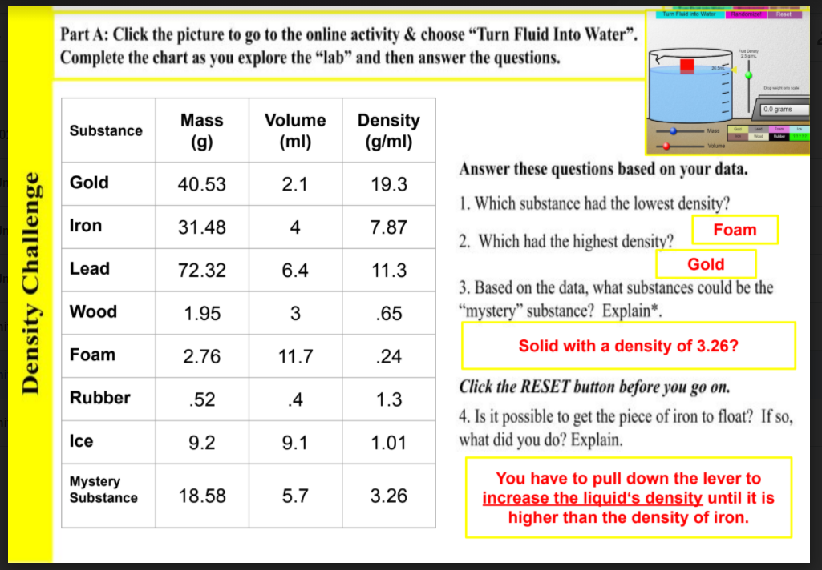
STUDENT SLIDE
TEACHER SLIDE
Teacher Notes: I completed the first three substances with the students in class to show how to use the website and calculate density.
The student slides also include the information on the left-hand side of this page.
Students finished the other substances and then answered the questions. I also instructed them to complete Part B by making predictions where each layer and item would be in a column.
Volume (using water displacement): Measure how much the water level changes when the object is added. You may need to hold objects under the surface if they want to float.
Mass - Drag the object to
the scale the determine its
mass.
Density = Mass ÷ Volume
Use a calculator to determine the mass of each substance and round to the nearest hundredth place if needed.
*Use online resources to find items that match the density of the mystery substance. Which ones are solids?
Substance | Mass (g) | Volume (ml) | Density (g/ml)
Gold
Iron
Lead
Wood
Foam
Rubber
Ice
Mystery Substance

Slide 3
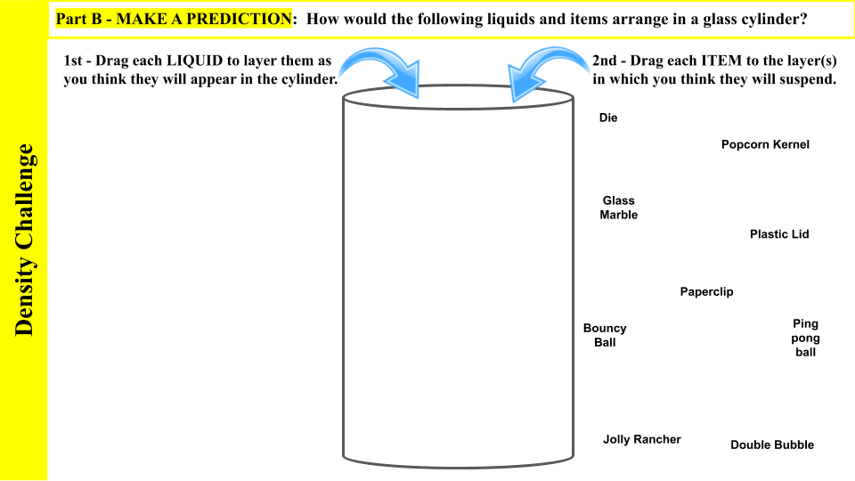

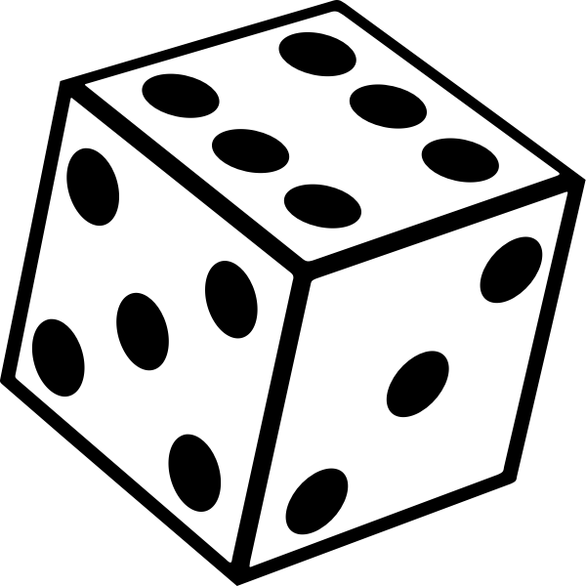
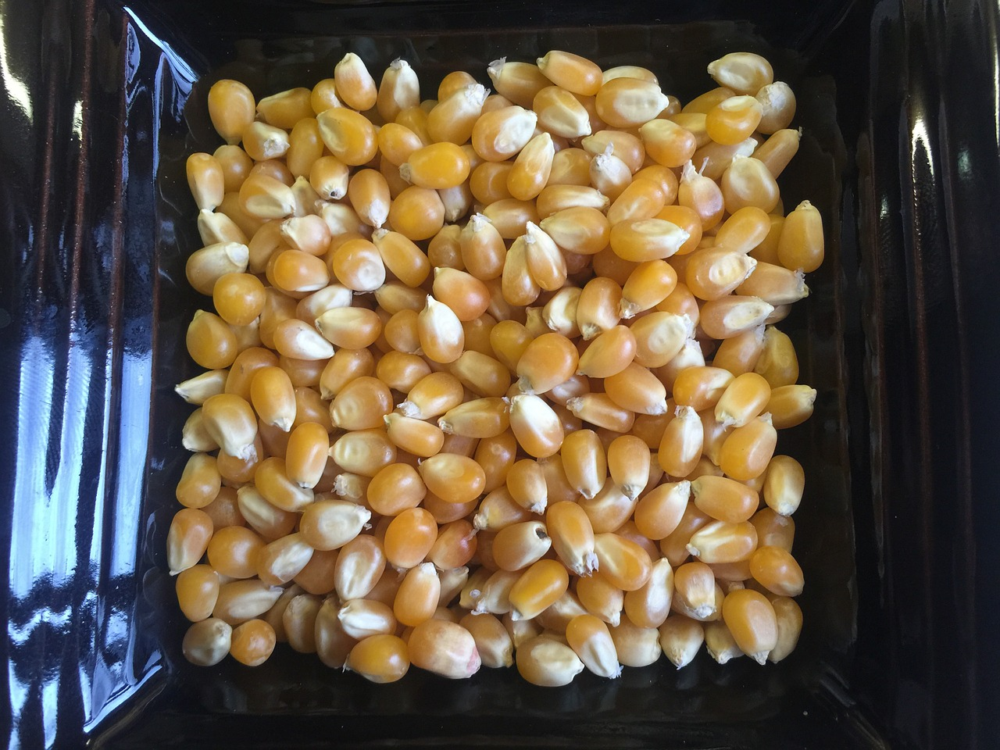
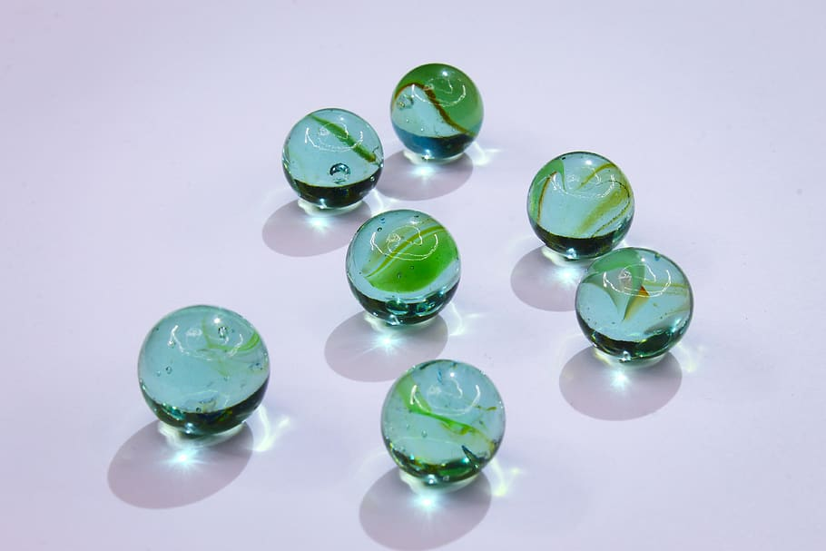
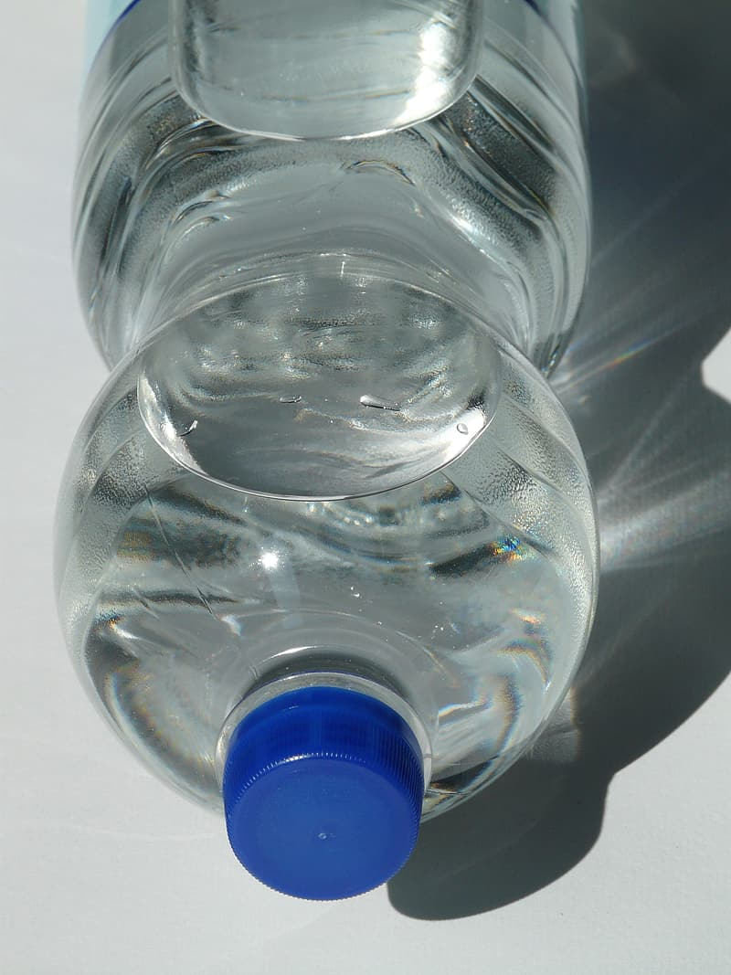

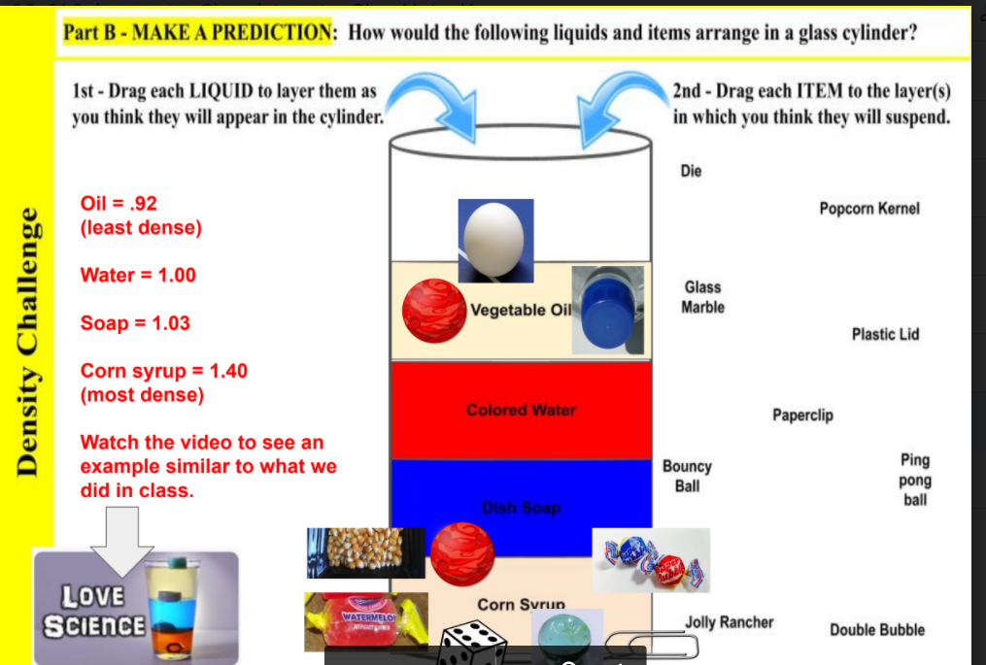
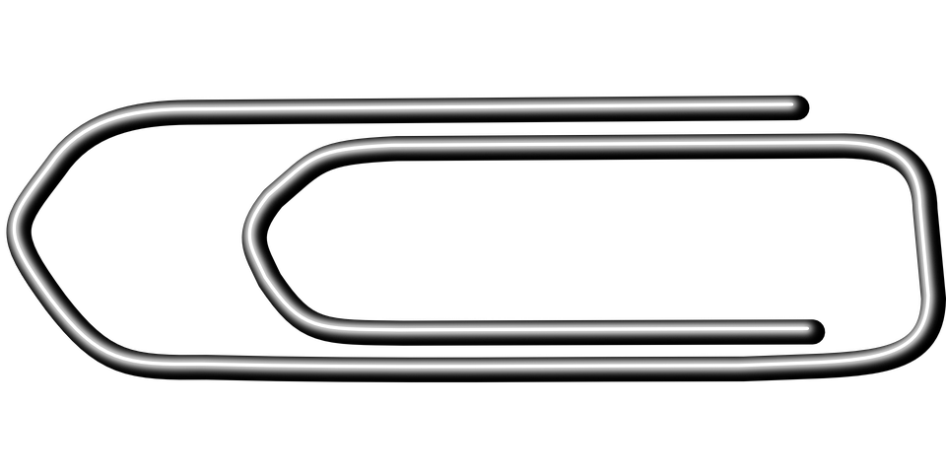

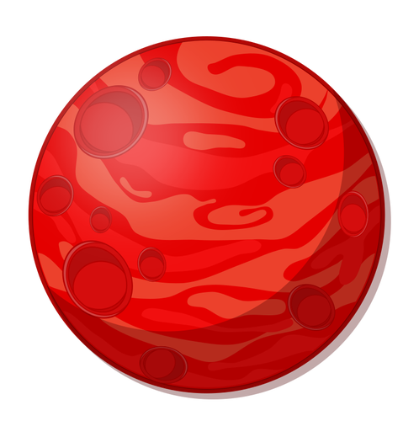
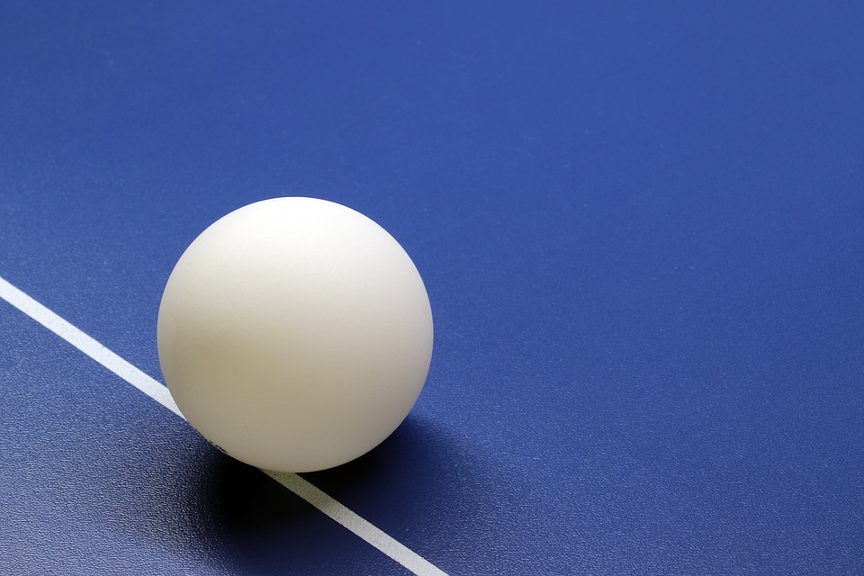

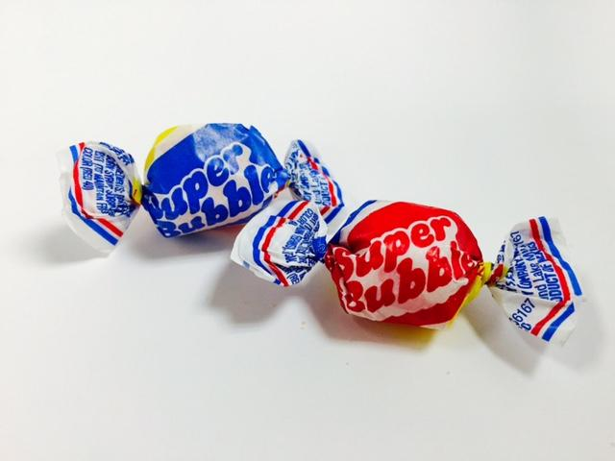
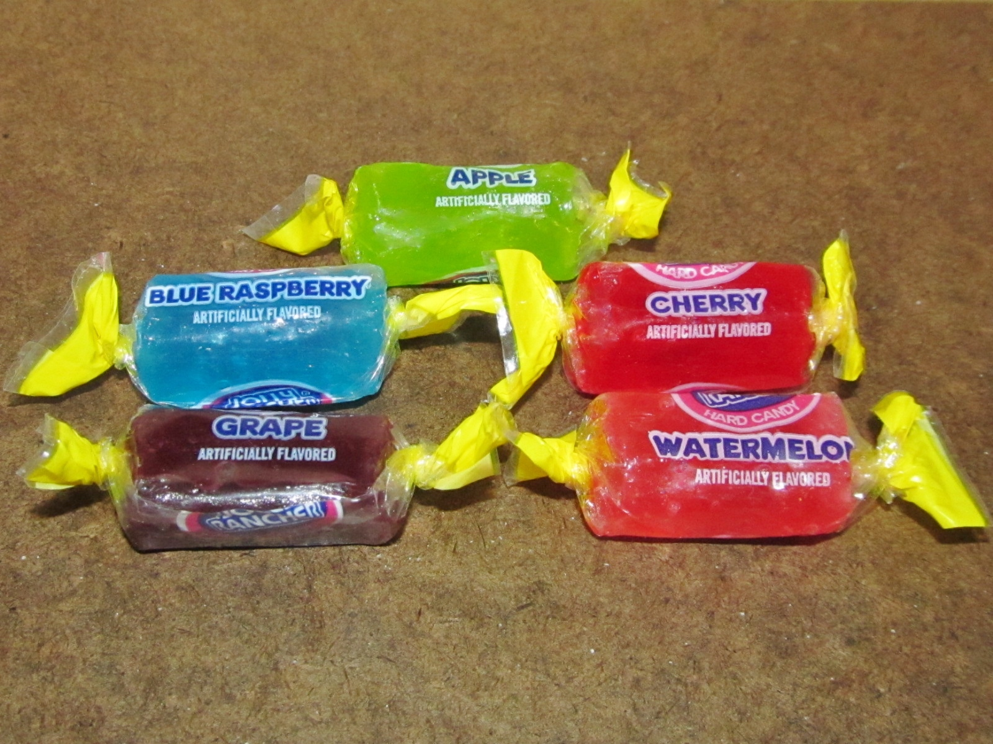
TEACHER SLIDE
Teacher Notes: I updated this slide as after we added all four liquids. Students could make changes to their slides as well as update their prediction for the items after they knew where the liquids would be.
The objects were placed in the locations where they ended up.
Example:
https://video.link/w/KwwEb

Slide 4
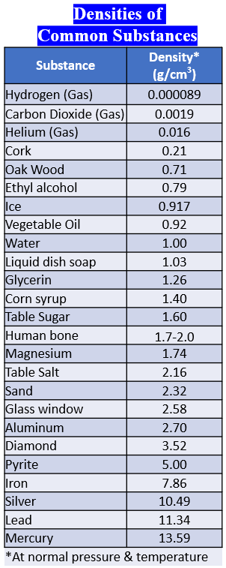
TEACHER SLIDE
Part C: Answer these questions based on what you have learned about mass, volume, and density.
1. What was the correct order of the liquids from least dense to most dense?
_________________ →_________________ → ________________ → _________________
(Least dense) (Most dense)
2. Hand sanitizer has a density of 0.79 g/cm³. If you were to add 100 mL of this liquid to our density column, where it be located? Why?
3. The mass of a large bouncy ball is 125 grams and has a volume of 145 cm³. What is its density? Where would it end up in our density column? Explain.
4. A piece of wood that measures 3.0 cm by 6.0 cm by 4.0 cm has a mass of 80.0 grams. What is the density of the wood? Would the piece of wood float in water? Explain.
5. An aluminum boat made in science class has a mass of 15 g and a volume of 450.00 cm³. If each penny has a mass of 2.50 g, how many pennies can be added to the boat before it sinks? Explain how you determined your answer.
Answer Key::
Vegetable oil → Colored water → Dawn dish soap → Corn syrup
It has a density less than vegetable oil. It would “float” on top of the oil and be the very top layer in our column.
125/145 = .86 g/cm3
Based on its density, it would partially float in the vegetable oil with a density of 0.92 g/mL The two densities are very close.
100/96 = 1.04 g/cm3
Based on its density compared to water at 1.0 g/cm3, it would partially float in the water as the two densities are very close.
Using D=m/v, D=1.0 at the minimum as that is the density of water at normal pressure/room temp. The total mass would be 15+2.5x, with x equal to the number of pennies. The volume was given in the problem as 450 cc. You would be able to put approximately 174 pennies* before it would sink assuming no leaks or other problems occured prior to that point.
1.0 = (2.5x + 15)/450
x = 174 pennies *
Estimate based on 2.5 g mass for a penny, but they are not all the exact same.
Density Challenge

