Slide 1

Christmas
Cookie
Challenge
Quick Links:
Introduction Initial Testing Final Testing Discussion
Image: http://www.zastavki.com/pictures/originals/2012/New_Year_wallpapers_Preparation_of_Christmas_cookies_036018_.jpg T. Tomm 1999 http://sciencespot.net/

Slide 2

Day 1
Introduction
Image: https://www.pinterest.com/pin/334533078543742750/ T. Tomm 1999 http://sciencespot.net/

Slide 3
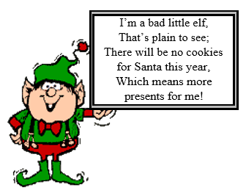
Help Mrs. Claus save Christmas!
North Pole Bureau Of Investigations Case #1225:
Case of the Christmas Cookie Mystery
Mrs. Claus needs your help! Each Christmas, Mrs. Claus makes a batch of her special sugar cookies to give Santa all the energy he needs to deliver presents to all the good little boys and girls around the world. A bad little elf has snuck into the kitchen and messed up all the special baking powders. He has left a note with three mystery bags of white powder.
The North Pole Bureau of Investigations has provided samples of six white powders found at Santa's house and the three mixtures left by the elf. Without your help, Mrs. Claus will not be able to make her cookies and there will be no Christmas!
Mrs. Claus' Special Sugar Cookies
Mix 15 cups of flour, 6 teaspoons of baking powder, 5 cups of powdered sugar, 3 pounds of butter, and 10 eggs in a large red bowl. Add lots of tender loving care and a bit of magic dust, then bake until golden brown. Decorate with frosting and colored sugar when cool.

Slide 4
What does your team need to do?
Each team will receive a testing kit from the teacher with a set of white powder samples and the testing materials.
Your team will need to follow the directions to test each mystery powder to help you determine its physical and chemical properties.
IMPORTANT: Each may test up to 2 powders at a time!
DO NOT ALLOW SAMPLES TO MIX TOGETHER!
(3) Pay close attention to what you observe to help you identify each one. You’ll need to know what reactions to look for when you test the final evidence samples!
Remember your safety rules?

Slide 5
Safety Rules/Procedures
Do not MIX substance or TEST anything without permission. Also be careful not to cross CONTAMINATE the samples by mixing a little bit of one with another on accident!
Do not TASTE any of the substances – even if you know what it is. This would also include washing your hands to prevent getting anything in your mouth, eyes, or nose.
WAFT if you need to smell something – don’t SNIFF right from the container.
Wear GOGGLES and an APRON while doing the tests.
Pull back long HAIR, push up your SLEEVES, and keep PAPERS away from the flame when testing at the heat station.
Keep the LIDS on the containers when you are not using them. Also be sure to clean up SPILLS immediately.
Tell your teacher if you have an ACCIDENT or need HELP.
Follow your teacher’s DIRECTIONS.

Slide 6

More things to think about …
Are there other rules we need to follow?
What do we need to do to obtain accurate and reliable results?
And more things to think about … Click the gingerbread man!

Slide 7
Days 2 -3
Initial Testing
Image: https://www.pinterest.com/pin/334533078543742750/ T. Tomm 1999 http://sciencespot.net/

Slide 8
Initial Powder Testing Procedure
Case #1225: Case of the Christmas Cookie Mystery
FOR EACH SAMPLE:
Physical Properties: Describe the physical properties of your powder sample and write your observations in the evidence chart.
Sample | Description | Water | Vinegar | Iodine | Heat | What is it?
1
Set Up:
1ST - Place the wax paper on a small plate to help prevent messes!
2ND - Use the small spoon to place a SMALL pile of the powder in the MIDDLE of wax paper.
3RD - Split the pile into 3 smaller ones as shown in the picture →
Spoons are for scooping!
Toothpicks are for mixing!

Slide 9
WATER TEST:
1 - Add 4 to 5 drops of WATER to the TOP LEFT pile.
2 - Mix using a clean toothpick being careful not to
allow the water to run into the other piles!
3 - Record whether it dissolved (sugar present), clumped (starch), or did not mix.
Sample | Description | Water | Vinegar | Iodine | Heat | What is it?
1

Slide 10
VINEGAR TEST
1 - Add 4 to 5 drops of VINEGAR to the TOP RIGHT pile
2 - Mix using a clean toothpick – keep it out of the other piles.
3 - Record whether it fizzed (baking soda present) or not.
Spoons are for scooping!
Toothpicks are for mixing!
IODINE TEST
1 - Add 2 to 3 drops of IODINE to the BOTTOM pile.
2 - Mix using a clean toothpick.
3 - Record whether it turned black or brown (starch present) or no reaction.
CAUTION: Iodine will stain clothing, hands, and anything it touches!
Sample | Description | Water | Vinegar | Iodine | Heat | What is it?
1

Slide 11

HEAT TEST
1 –Get a piece of aluminum foil and bend the edges up to create a “cup”.
2 - Place a small amount of powder in the cup
3 - Go to the heating station and use a pair of tongs or tweezers to hold the sample over the candle flame to see if anything happens when it is heated.
4 - Record whether or not the sample melted and bubbled (sugar present), charred, gave off a distinctive odor, or did nothing.
Sample | Description | Water | Vinegar | Iodine | Heat | What is it?
1
If you know what it is, write the name of the powder in the last box. If not, wait until you know for sure!

Slide 12
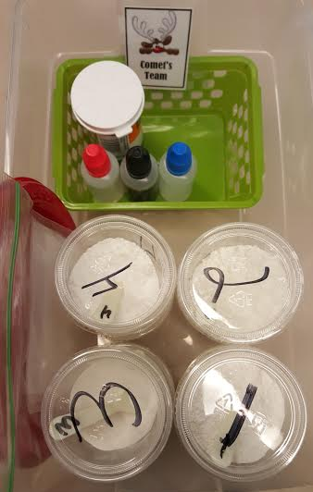
Monday
Complete all but the heat tests for powders 1 – 4
Tuesday
Test powders 5-8
Wednesday
Do heat tests for ALL powders
Clean Up (After you finish all four tests on one powder)
Throw away the wax paper, toothpicks, and used samples
AFTER everyone is done recording their observations.
Clean the plate to reuse for more testing.
Clean up your table to prevent cross contamination.
Wash your hands
When everyone is ready, test the other powder samples one at a time following the same procedures!
END OF CLASS:
Your team will need to clean up your area and wipe off the
table.
 Return the testing kit to the teacher (organized and restocked
if needed).
 Don’t forget to wash your hands before you leave!

Slide 13
Day 4
Final Testing
Image: https://www.pinterest.com/pin/334533078543742750/ T. Tomm 1999 http://sciencespot.net/

Slide 14
Mystery Powder Testing
Case #1225: Case of the Christmas Cookie Mystery
FOR EACH MYSTERY SAMPLE:
1st - Get a small sample of one of the mystery mixtures to test.
2nd - Follow the same procedures as we did for the other powders, but pay close attention to what happens for each test. It may be harder to see specific reactions or observations, since they are a mixture of powders.
3rd - Write your observations and results in the Mystery Powder chart (on the bottom of the worksheet).
4th - Prepare your FINAL REPORT for your teacher AFTER your team has tested all 3 mystery mixtures.

Slide 15
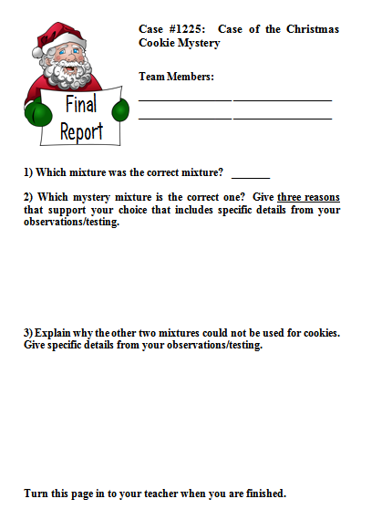
Final Reports
After you have finished ALL the on the mystery powders, get a copy of the Final Report and fill it out.
Turn the page into your teacher when you are finished.
You may try the Hour of Code activities or visit Google’s Santa Tracker.
Go to google.com and enter Santa Tracker to find the link!
Mrs. Claus' Special Sugar Cookies
Mix 15 cups of flour, 6 teaspoons of baking powder, 5 cups of powdered sugar, 3 pounds of butter, and 10 eggs in a large red bowl. Add lots of tender loving care and a bit of magic dust, then bake until golden brown. Decorate with frosting and colored sugar when cool.

Slide 16
Final
Discussion
7th Grade Science Activity
Image: http://www.zastavki.com/pictures/originals/2012/New_Year_wallpapers_Preparation_of_Christmas_cookies_036018_.jpg T. Tomm 1999 http://sciencespot.net/

Slide 17
Final Discussion
Case #1225: Case of the Christmas Cookie Mystery
Which mixture was the correct mixture?
How did you know?
Why couldn’t you use the other two mixtures? Explain.

