Slide 1
CHEMISTRY OF FIREWORKS
What’s the connection?
Digital student notebook available at https://docs.google.com/presentation/d/11Zkbs9y3OBY96K6ZM6qndYRoUzmAqFUnyfrkuI70VHM/edit?usp=sharing
T. Tomm Updated 2023 https://sciencespot.net/

Slide 2
Chemistry of Fireworks
https://www.khanacademy.org/college-careers-more/bjc/2015-challenge/2015-physics/v/bjc-science-of-fireworks
Site #1 - Khan Academy - Science of Fireworks
A) Explain how Newton’s Third law of motion is related to a firework.
B) What are the “concentrated sparklers” called? How do they make shapes?
For every action there is an equal and opposite reaction.
Action - Rocket pushes on the exhaust
Reaction - Exhaust pushes back on the rocket
Stars → Packed into a shell in a pattern to create specific shapes (stars, circles, etc.).

Slide 3
C) Explain the three components of the “fire” in a firework.
Fuel –
Oxidizer –
Metal powder -
D) Which part of an atom is involved in making light? How does it happen?
Charcoal – Fuels the fire
Adds oxygen - Fire burns brighter
Produces colors by using elements in different ratios.
Electrons - Give off photons (light) when they change energy levels.
Different wavelengths produce different colors (electromagnetic spectrum)

Slide 4
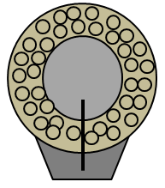
Site #2 - Chemistry of Fireworks
A) _________ include potassium nitrate, potassium perchlorate, and strontium nitrate.
B) ______ include sulfur, charcoal, aluminum powder, and magnesium powder.
C) Label the parts of a shell.
OXIDIZERS
FUELS
EFFECT PELLETS
BLASTING CHARGE
PROPELLANT
TIME FUSE

Slide 5
D) A _________ (or launching) tube connected to a ______ is used to hold the shell before it is ignited.
E) Different elements emit different ________________ of light when they are heated to high temperatures.
MORTAR
FUSE
WAVELENGTHS
Time for a song …
Do you know … How fast does a firework travel?
80 mph 150 mph 200 mph

Slide 6
Click the link & follow the directions to explore the periodic table.
Enter the symbols for the elements.

Slide 7
Site #3: Pyrotechnics: It's Elemental
Click "Launch Interactive" or click the image to access the periodic table. Click on the different elements to help you complete the chart.
Colors and/or Effects | Elements
Red | Li, Sr
Gold & Yellow | Na
Blue | Cu
Green | Ba
Silver & white sparks | Al
Bright white light | Mg
Deepens colors | Ca
Sparks | Ti, Fe
Smoke clouds | Zn
Glitter effects | Sb
Top 10 USA

Slide 8
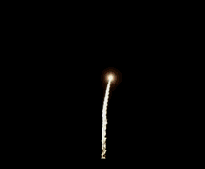
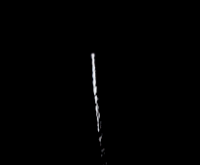
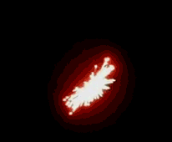
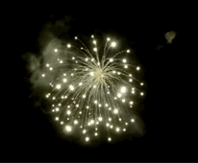
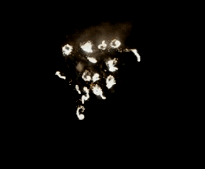
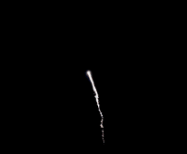
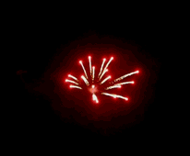
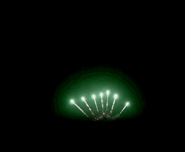
Pistil
Palm Tree
Rising Tail
Brocade
What is your favorite pattern?
Waterfall
Strobe
Tourbillion (Spinning Stars)
Chrysanthemum
Peony
Pearls
Crossette
Flying Fish
Comet
https://keystonefireworks.com/news/types-of-fireworks-effects/

Slide 9
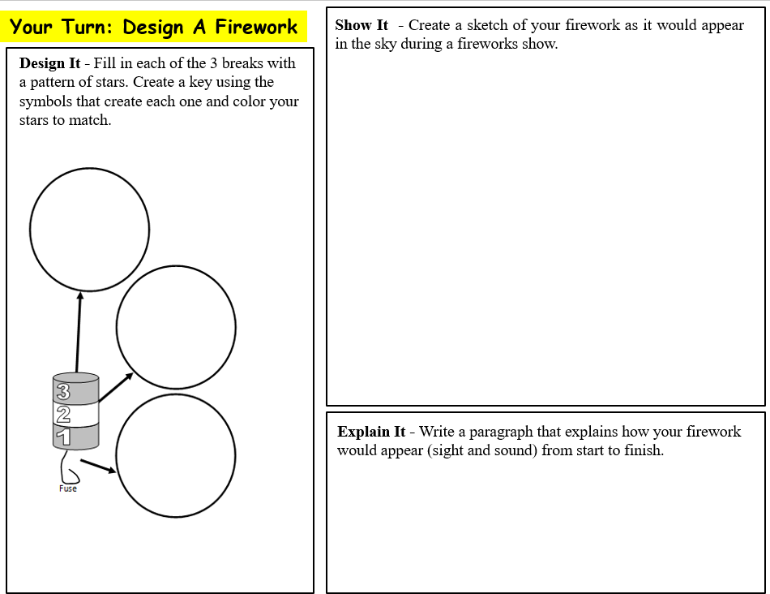
Links to the digital and paper versions are listed on slide in the student notebook that goes with this one.
Click HERE to access the Google Drawing template. You will need to make a copy to edit. Students take a screenshot to insert onto their slide.
Click HERE for the PDF version you can print for your students.
Design It
Fill in each of the 3 breaks with a pattern of stars. Create a key to label your stars (or color and label them instead.)
Show It
Draw a sketch of your firework as it would appear in the sky.
Explain It
Write a paragraph that explains how your firework would look from start to finish.
Turn in paper copies to the bins when you are done.
After the initial launching charge (big boom), break #1 would explode to form a purple and red butterfly. Break #2 would create a big yellow minion with sparks shooting out of its eyes. Break #3 will create a big T for TOMM with a bunch of glitter effects going off around it.
Label your stars OR create a key
= Ba = Green
= Na = Gold & yellow
= Mg = Bright white
■ = Sr +  = Cu = Purple
= Li = Red
Sb= Glitter Effect
A little inspiration

Slide 10
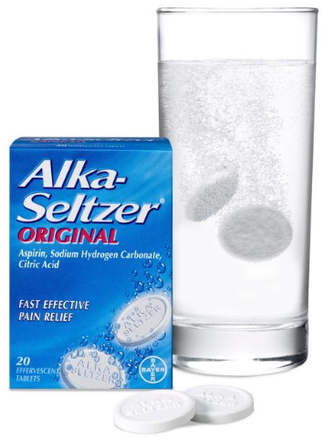
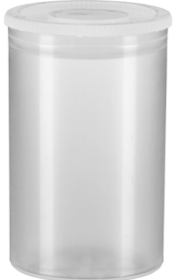
Bonus Lab: Rocket Reactions
Part A: Complete each section.
1. Identify each change below as either physical or chemical.
____ Ripping the package to get the tablet out
____ Breaking a tablet into smaller pieces
____ The tablet dissolving in water
____ The citric acid in the tablet reacting with bicarbonate to produce CO₂ gas.
P
P
P
C
Physical or Chemical?
A physical change is a change in size, shape, or state of matter.
A chemical change is a change in the chemical composition resulting in the production of a new substance.

Slide 11
2. How would these variables affect the rate and/or force of the reaction? Make a prediction for each one.
Size of the tablet → Whole, ½, ¼ → How will the size of the tablet affect the reaction?
The amount of water → Full, ½ full, ¼ full → How will the amount of water in the canister affect the reaction?
Water temperature → Cold, warm, hot → How would the temperature of the water affect the reaction?
Surface area → Whole, small pieces, crushed to a powder → How would the amount of surface exposed to the water change the reaction?
Concentration → Plain water, soda water, vinegar → Would more acidic substances change the reaction or its rate?
Shaken or stirred → Will shaking the canister affect the reaction?
Challenge: Which AMOUNT OF WATER will make the lid reach the ceiling?
NOTE: The only variable we are testing is the amount of water. Keep the tablet size and all other variables the same.

Slide 12
SAFETY RULES
You must wear SAFETY GOGGLES!
You need to stay out of the way of “loaded” canisters. Keep your tablets out of the way as well!
Set the canisters down carefully and move out of the way.
Make sure your launching area is not located under any lights.
Pay attention and listen to your teacher’s instructions.
Everything must be cleaned up at the end of class.
Wash your hands!
Make smart choices – you should know what those would be!

Slide 13
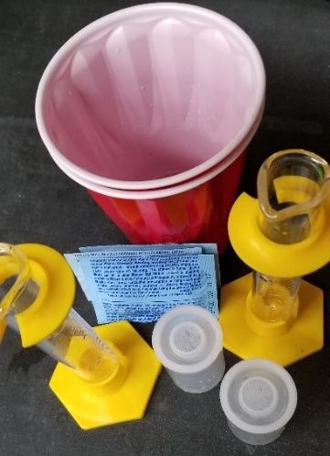
Directions
1 – Get your supplies – 1 film canister, 3 packets of Alka Seltzer tablets, 1 graduated cylinder, and 1 cup for water (half full). YOUR TABLE ONLY HAS 6 tablets to use for ALL 5 trials!
Only use ½ of a tablet for EACH trial – you should ½ left!
2 – Create a launching spot on your table using paper towels (at least 2 layers thick) making sure it isn’t under a light.
3 – Work with your tablemates to measure the water using a graduated cylinder and prepare the tablet.
4 - When you are ready, have one person drop in the tablet and then another person snaps on on the lid. Set on the paper towels. Stand back and wait for the reaction!
Do not shake the canisters → we are NOT testing this variable!
4 - Snap the lid back on to keep testing until your tablet is gone. RECORD your rating and observations in the chart based on the FIRST reaction.
5 – Clean up the canister and repeat the experiment for a total of 5 trials.
Change the amount of water (25 ml → 20 ml → 10 ml → 5 ml) to see which amount works the best with ½ tablet to get the lid to hit the ceiling. Can you discover the secret combination?

Slide 14
Part B: Experiment - Complete the experiment following your teacher’s directions. Record your data and observations in the table as you complete the experiment.
Trial | Tablet Size | Water (mL) | Reaction Rating  | Observations
1 | 1/2 | 25 | 
2 | 1/2 | 20
3 | 1/2 | 15
4 | 1/2 | 10
5 | 1/2 | 5
Fill in the chart as you do the experiments!
Part C: Wrapping It Up
What combinations resulted in the highest rating? Why?
2. Describe your results and the reaction in scientific terms after watching the video in class.
Less water = more space for gas = more pressure
Sodium bicarbonate (baking soda) reacts with citric acid to create CO2 gas.
The gas fills up the canister. When the pressure gets too high, the cap flies off.
Alka Seltzer Reactions

Slide 15
Upside-Down Missiles
As we saw in the video, she sat the canister on the lid rather than with the lid facing upwards.
Task: Can your team get the canister to hit the ceiling?
Materials/Time: Your team will have 1 packet (2 tabs) and 10 minutes to see if you can be successful. You may shake the canister if you think it will help.
Record your results and observations in the bottom section on Slide #6.

Slide 16
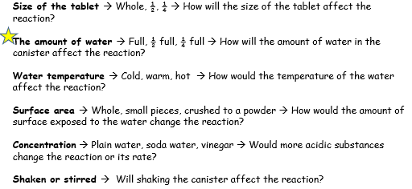
Challenge #3: Taking It Further
On Slide #4 we made predictions for several variables, but we have only tested one variable: the amount of water added to the canister.
Which variable will you test?
Work with a tablemate to design an experiment to test one of the other variables. List the steps in your experiment and explain how you will test just ONE variable (keeping all others the same.) Include the safety rules your team will follow and then have it approved by the teacher.
Use slide #8 to record your results and observations as well as a conclusion summarizing what you learned.
?

