Slide 1
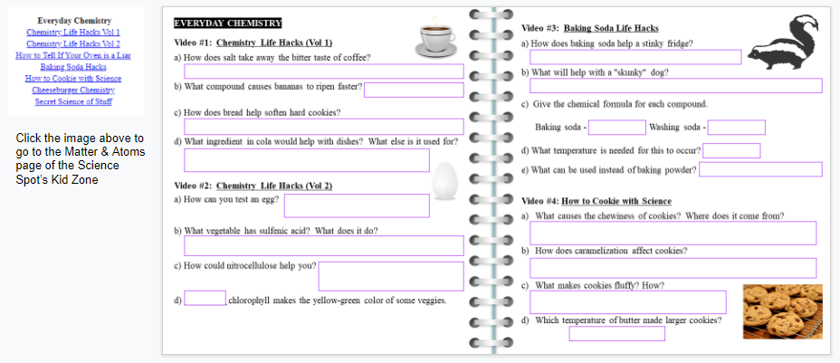
Everyday Chemistry – Life Hacks Answer Key
Student digital notebook available at https://docs.google.com/presentation/d/1ALtLDoZfpx_O9piK9qIXD9NezRW88dK1rFuYpsfFDi8/copy
Directions: Use the links on the Matter & Atoms page of Science Spot Kid Zone to complete each section.
Hyperlink has been added to the student assignment for quick access to the videos needed for the assignment.
T. Tomm Updated 2021 https://sciencespot.net/

Slide 2
Everyday Chemistry Video #1: Chemistry Life Hacks (Vol 1)
a) How does salt take away the bitter taste of coffee?
b) What compound causes bananas to ripen faster?
c) How does bread help soften hard cookies?
d) What ingredient in cola would help with dishes? What else is it used for?
Sodium ions block the bitter taste receptors on your tongue
Ethylene
Hygroscopic - Sugars in the cookie absorb moisture from the bread.
Phosphoric acid Getting rid of rust

Slide 3
Everyday Chemistry Video #2: Chemistry Life Hacks (Vol 2)
Good eggs sink, while bad eggs float due to hydrogen sulfide
How can you test an egg?
b) What vegetable has sulfenic acid? What does it do?
c) How could nitrocellulose help you?
d) _____chlorophyll makes the yellow-green color of some veggies.
Onions - they react causing your eyes to burn and water
Dries to make a thread stronger to help you thread a needle – found in nail polish
B

Slide 4
Everyday Chemistry Video #3: Baking Soda Life Hacks
How does baking soda help a stinky fridge?
b) What will help with a "skunky" dog?
Give the chemical formula for each compound.
d) What temperature is needed for this to occur?
e) What can be used instead of baking powder?
It's amphoteric - reacts with acids & bases
Hydrogen peroxide + baking soda + hand soap Oxidizes thiols so they don’t stink.
Baking soda - NaHCO₃ Washing soda - Na₂CO₃
400ºF
Baking soda & cream of tarter

Slide 5
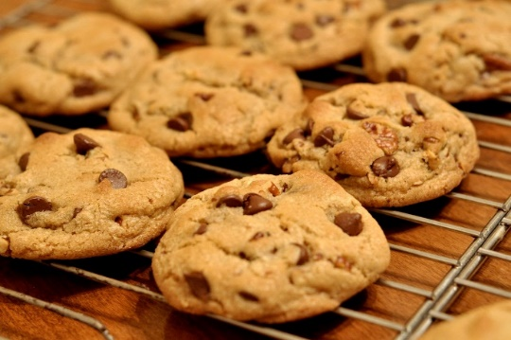
Everyday Chemistry Video #4: How to Cookie with Science
What causes the chewiness of cookies? Where does it come from?
How does carmelization affect cookies?
What makes cookies fluffy? How?
Which temperature of butter made larger cookies?
Gluten - Comes from flour + water
It gives the cookie butterscotch, rum, & nut flavors
Sodium bicarbonate (baking soda) - creates CO₂ gas bubbles
Melted butter

