Slide 1
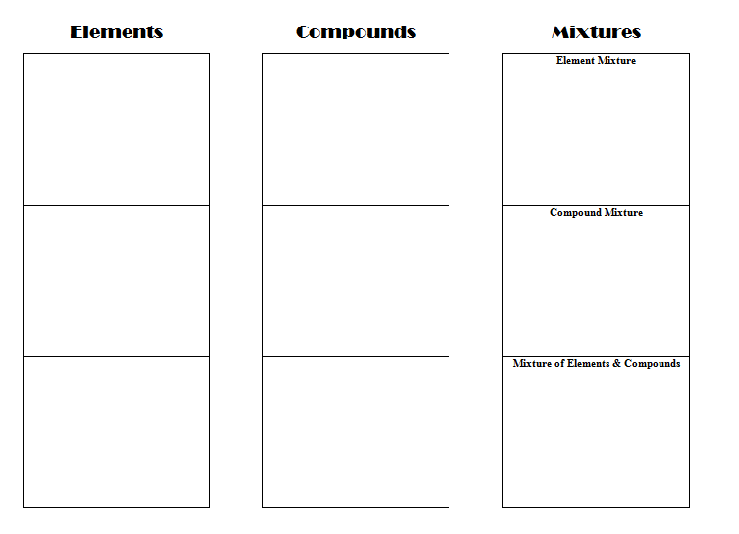

Building Blocks of Matter
Glue the worksheet on page __.
Get a bag of LEGOs from your teacher.
Sort the LEGOs into 4 piles based on their color.
Make sure the blocks are not connected together.
Project developed by T. Tomm 2017
http://sciencespot.net/

Slide 2
Elements vs. Compounds
LEGOs that are not snapped together are not chemically bonded to each other. These would be considered elements.
LEGOs snapped together represent a chemical bond forming one molecule of a compound.
One block = One atom of an element
Each color is a different ELEMENT.

Slide 3
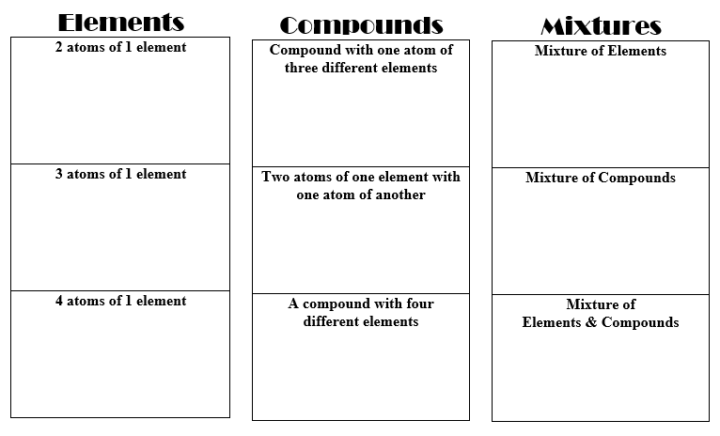
Elements – Challenge 1
Challenge 1: Make a model that represents two atoms of an element.
Draw blocks and shade them with colored pencils to make your model.
Label using the symbol = first letter of the color.
Add coefficients to show how many atoms of the element you have.
2B
COEFFICIENT
2NaCl

Slide 4
Elements – Challenge 2
Challenge 2: Make a model that represents three atoms of one element.
Draw blocks and shade them with colored pencils to make your model.
Write an expression to show this.
What coefficient will you need for three atoms of an element?
2B
3Y

Slide 5
Elements – Challenge 3
Challenge 3: Make a model that represents four atoms of an element.
Draw blocks and shade them with colored pencils to make your model.
What coefficient will you need for four atoms of an element?
B
3Y
4G

Slide 6
Compounds
Has 2 or more different elements bonded together.
LEGOs snapped together represent a chemical bond forming one compound.
As we learned, LEGOs that are not snapped together are not chemically bonded to each other. These would be considered elements.
Since the Lego blocks are representing compounds, they must be snapped together. SUBSCRIPTS are used to show how many of each atom are in a compound.
H₂O
SUBSCRIPT

Slide 7
Compound – Challenge 1
Challenge: Create a compound consisting of one atom of three different elements (i.e. use 3 different colored blocks.)
Make a model of the compound by drawing blocks and shading them with colored pencils.
Write the chemical formula using the first letter of the color as the symbols.
BYG
(any order)

Slide 8
Compound – Challenge 2
Challenge: Create a compound with 2 atoms of one element and one atom of two different atoms.
Make a model of the compound by drawing blocks and shading them with colored pencils.
Write the chemical formula using the first letter of the color as the symbols. Add subscripts to show how many atoms of that element are in the compound.
BYG
(any order)
B₂Y
(any order)
H₂O
SUBSCRIPT

Slide 9
Compound – Challenge 3
Challenge: Create a compound with at least four different elements.
Make a model of the compound by drawing blocks and shading them with colored pencils.
Write the chemical formula using the first letter of the color as the symbols.
Use subscripts to show how many of each atom is included in the compound.
BYG
(any order)
B₂Y
(any order)
Y₂R₂B
(any order)

Slide 10
Mixtures – Not Chemically Combined
Elements – Simplest pure substance made up of only one type of atom.
Compound – Two or more elements chemically combined.
Mixture – Two or more substances mixed together, but not chemically combined.
Notes: Since we are creating mixtures, we use ADDITION signs to show what is added together. SUBSCRIPTS are used to show how many of each atom are in a compound, while COEFFICIENTS are used to show that we have more than one element or compound.

Slide 11
Mixtures – Challenge 1
Challenge 1: Create a mixture of at least three different ELEMENTS.
Make a model of the mixture by drawing blocks and shading them with colored pencils.
Write the chemical expression using the first letter of the color as the symbols.
Remember to use coefficients if needed and addition signs to show what is added together.
2B + Y + R

Slide 12
Mixtures – Challenge 2
Challenge 2 - Create a mixture of at least 2 different COMPOUNDS.
Make a model of the mixture by drawing blocks and shading them with colored pencils.
Write the chemical expression using the chemical formulas using addition signs, subscripts, and coefficients as needed.
Remember to use coefficients and subscripts if needed along with addition signs to show what is added together.
2B + Y + R
2B + Y + R
B₂Y + G₂Y + B₂R
B₂Y + G₂Y + B₂R

Slide 13
Mixtures – Challenge 3
Challenge 3 - Create a mixture of ELEMENTS and COMPOUNDS.
Make a model of the mixture by drawing blocks and shading them with colored pencils.
Write the chemical expression using the chemical formulas using addition signs, subscripts, and coefficients as needed.
Remember to use coefficients and subscripts if needed along with addition signs to show what is added together.
2B + Y + R
2B + Y + R
B₂Y + G₂Y + B₂R
B₂Y + G₂Y + B₂R
B₂Y + G₂Y + B + R

Slide 14
Mixtures – Challenge 3
Challenge 3 - Create a mixture of ELEMENTS and COMPOUNDS.
Make a model of the mixture by drawing blocks and shading them with colored pencils.
Write the chemical expression using the chemical formulas using addition signs, subscripts, and coefficients as needed.
Notes: Since we are creating mixtures, we use ADDITION signs to show what is added together. SUBSCRIPTS are used to show how many of each atom are in a compound, while COEFFICIENTS are used to show that we have more than one element or compound.
2B + Y + R
B₂Y + G₂Y + B₂R
B₂Y + G₂Y + B + R

Slide 15
Review– Write an expression for each example.
2B + Y + R + 2G
B₂Y + 2G₂Y + B₂R
B₂Y + G₂Y + B + 2R

Slide 16
Final Challenge – Use all your Lego blocks to represent a chemical substance. Write the expression for it.
Use all your Lego blocks to represent a chemical substance – your choice of elements, compounds, or mixtures.
Write the expression for it.
Be prepared to share with the class.

