Slide 1
Hot Chocolate Science
Find the assignment on Google Classroom.
Lesson developed by T. Tomm - Updated 2025 https://sciencespot.net

Slide 2
Teacher Notes:
This lab was developed to explore states of matter as well as physical and chemical changes, which are concepts we’ve studied during our first unit in Chemistry unit. It will also be used during the second unit as we discuss classification of matter (elements, compounds, and mixtures), chemical bonding, and chemical reactions.
I borrowed the larger percolator from our school cafeteria. The school also provided cups and spoons. I purchased Swiss Miss mix with marshmallows, which were available with larger packets (33% more powder). Since we had completed the Boyle’s Law marshmallow lab the previous week, I used the leftover marshmallows so students were able to get a good “cream” on the top (if they waited long enough for them to melt).
Students had time to work with their table mates to complete the last slide. They had time the following week to share what they had learned.
NOTE: Viewing the presentation in edit mode will allow you to see any notes I’ve added in the margin area to the left and right of each slide.
Digital assignment for students available at https://docs.google.com/presentation/d/1X6pOA_9SLZ3yYn-lE7zpiyh7ucfdUFYJa95CTU9R1-U/edit?usp=sharing

Slide 3
Time to make some hot cocoa …
1st – Open the packet and dump the contents into the cup.
2nd – When it is your turn, take your cup to the side counter and add water to fill the cup ½ of the way up.
Follow the leader around the room to stay spread out!
3rd – Use your spoon to stir the cocoa to help it dissolve as you wait in line.
4th – Return to the side counter and add enough water to get to fill it almost up.
5th – Continue stirring until all of it is dissolved.
6th – Get 10 marshmallows to add to the cocoa.
7th – Let it cool down a little bit and then enjoy!

Slide 4
Hot Chocolate Science
Part A: Cocoa Science
What causes the powder to clump? Why?
How do you avoid lumps?
What is the difference between hydrophilic and hydrophobic? Give an example of each.
What protein in milk acts as an emulsifier in hot cocoa?
What does the term viscosity mean? How does it relate to hot chocolate?
Starch molecules attract water → Puff up → Mesh together to form a seal around dry powder.
Dissolve the powder in a smaller amount of water before adding more water.
Loves water
Starch ←
Hates water → Fats
Casein
Viscosity refers to a liquid’s ability to flow. Thicker hot chocolate has a higher viscosity than thinner ones.
NOTE: We had discussed viscosity during out density column experiment so this was a great tie in!

Slide 5
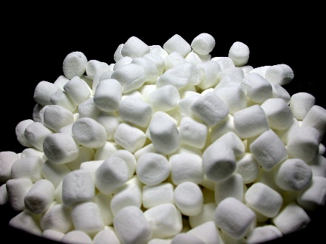
Part B: Marshmallow Science
Air
What is the key ingredient for “pillowy” puffy marshmallows?
What are the other ingredients in marshmallows?
3. Which ingredient gives it the elastic, squishy texture? What protein does it contain?
4. What do we call the ingredients that help to hold its shape?
NOTE: This section explains the science behind the marshmallows, which were used for the Boyle’s Law lab the previous week. It will also tie into our next lesson on elements, mixtures, and compounds.
Sugar, corn syrup, water, cornstarch, and gelatin
Gelatin →
Collagen
Emulsifiers
Part C: Hot Chocolate Effect
Air bubbles
1. What causes the Allassonic effect in a cup of hot chocolate?
2. Why does it happen?
More bubbles → Slower frequency (waves)→ Lower pitch
Less bubbles → Faster frequency (water) → Higher pitch

Slide 6
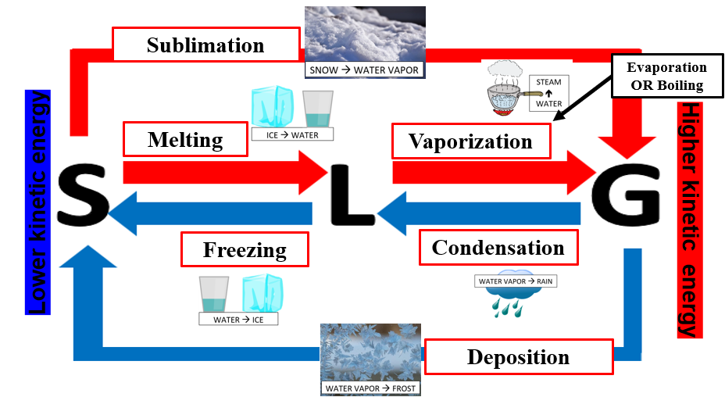
Part D: Quick Review
1. What happens to the kinetic energy as each substance changes: increase or decrease?
A. Steam rises from the surface
B. Sugar is melted to make marshmallows
C. Melted chocolate becomes solid chocolate
D. Hot cocoa cools to room temperature
E. Marshmallows melt in the hot water
F. Putting hot chocolate in the freezer
2. What type of change is occurring in each example: P = Physical or C = Chemical?
A. Hydrogen and oxygen combine to form water molecules
B. Water is heated up until it turns to steam
C. Mixing cocoa powder, sugar, and other ingredients to make the dry mix
D. Ripping open the powder packet
E. Powder dissolving in the water
F. Marshmallows melting in the solution
G. Stirring the hot chocolate
H. Drinking the hot chocolate
NOTE: This section reviews energy changes during phase changes, something my students get easily confused.
Image from States of Matter notes will be available on the Chemistry page of the Science Classroom at https://sciencespot.net.
OR
NOTE: This section reviews physical and chemical changes, which was the previous day’s lesson.
C
P
P
P
P
C
P
OR
P
P
NOTE: I usually have a few students who want to make their own marshmallows. This video is a great one to show them the steps.
C
Make your own marshmallows … https://www.youtube.com/watch/fPXJ1uobO_0

Slide 7
Part E: Questions
Brainstorm with your table group to develop 5 questions about this activity. Use online resources to help you answer the questions. Be prepared to share your results with the class.

Slide 8
Student Masters
The following slides were used to make PNG files for the digital assignment on Google Slides.
If you would like to edit the student assignment, make changes to the following slides. Choose the save the file as PNG and follow the prompts. The images can be added as backgrounds for the Google Slides in the assignment. I added textboxes and other interactive features the students would need to complete the activity.
The digital assignment is available at https://docs.google.com/presentation/d/1X6pOA_9SLZ3yYn-lE7zpiyh7ucfdUFYJa95CTU9R1-U/copy

Slide 9
Hot Chocolate Science
Part A: Cocoa Science
What causes the powder to clump? Why?
How do you avoid lumps?
What is the difference between hydrophilic and hydrophobic? Give an example of each.
What protein in milk acts as an emulsifier in hot cocoa?
What does the term viscosity mean? How does it relate to hot chocolate?

Slide 10
Part B: Marshmallow Science
What is the key ingredient for “pillowy” puffy marshmallows?
What are the other ingredients in marshmallows?
3. Which ingredient gives it the elastic, squishy texture? What protein does it contain?
4. What do we call the ingredients that helps to hold its shape?
Part C: Hot Chocolate Effect
What causes the Allassonic effect in a cup of hot chocolate?
Why does it happen?

Slide 11
Part C: Quick Review
1. What happens to the kinetic energy as each substance changes: increase or decrease?
A. Steam rises from the surface
B. Sugar is melted to make marshmallows
C. Melted chocolate becomes solid chocolate
D. Hot cocoa cools to room temperature
E. Marshmallows melt in the hot water
F. Putting hot chocolate in the freezer
2. What type of change is occurring in each example: P = Physical or C = Chemical?
A. Hydrogen and oxygen combine to form water molecules
B. Water is heated up until it turns to steam
C. Mixing cocoa powder, sugar, and other ingredients to make the dry mix
D. Ripping open the powder packet
E. Powder dissolving in the water
F. Marshmallows melting in the solution
G. Stirring the hot chocolate
H. Drinking the hot chocolate
OR
P
C
OR

Slide 12
Part D: Questions
Brainstorm with your table group to develop 5 questions about this activity. Use online resources to help you answer the questions. Be prepared to share your results with the class.

