Slide 1
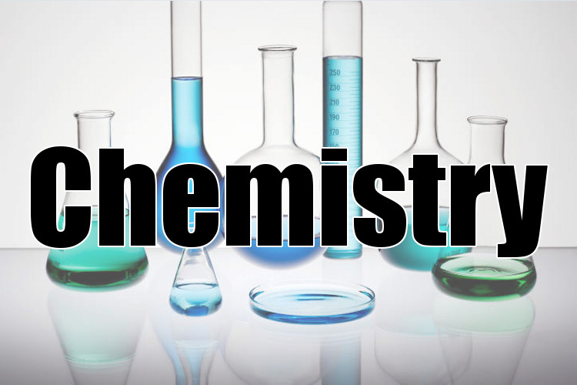
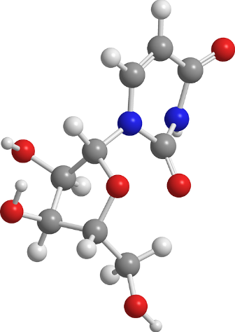
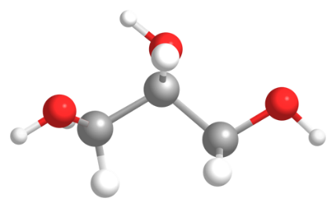
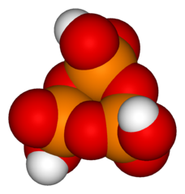
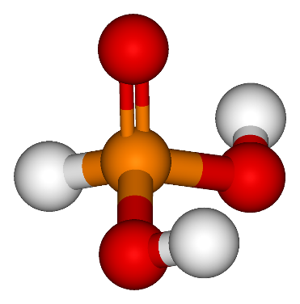
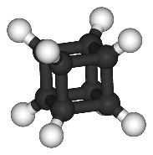
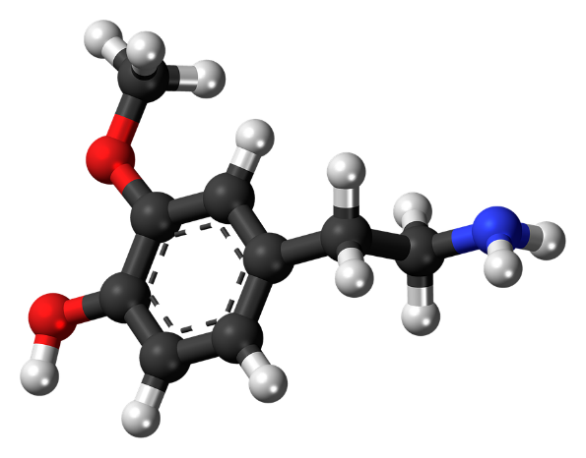
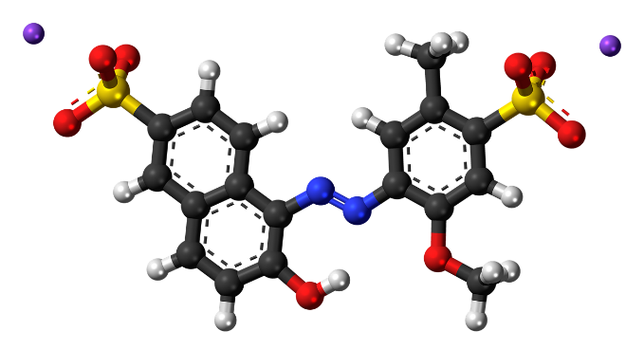
Digital student notebook available at https://docs.google.com/presentation/d/14BaL-B-W-06FpalMEY97sXHxTOrcYnqLz3kaXqkGMtU/copy
The textbook for this unit is available at CK12.org. I have provided links on the students slides (digital version) where needed.
Check in the margin areas on these slides for teacher notes and tips.
Hyperlinks are included on this slide to skip to specific sections in the notes.
Questions?
E-mail: ttomm@sciencespot.net
Introduction to
Lesson 1 – Matter
Lesson 2 – States of Matter
EDPuzzle: Changes in State
Lesson 3: Physical/Chemical
Everyday Chem Answer Key
Lesson 4: Classifying Matter
Activity 4A: Lego Chemistry
Activity 4B: Matter Classification
Unit Review
7th & 8th Grade Science Unit developed by Tracy Tomm Updated 2021 https://sciencespot.net

Slide 2
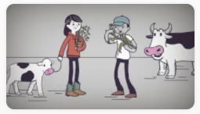
Day 1
We watch this video together in class to kick off our unit. We live in a rural community, so many of the students were familiar with the examples in the video.
Everything is Chemical
Discussion Questions:
What elements make up animals and plants?
How does it help us?
What are examples of chemistry in my life?

Slide 3
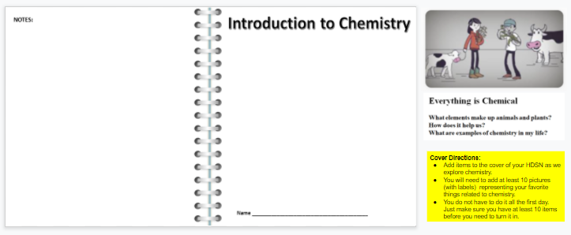
Day 1 (cont’d)
After watching the video on the previous slide, students have time to find examples of chemistry related to things they like – food, activities, etc.
Student Instruction Slide
NOTE: These slides are displayed on the classroom SmartBoard for all students to see. We review the instructions together so every knows what they need to do.
Cover Directions:
Add items to the cover of your HDSN as we explore chemistry.
You will need to add at least 10 pictures representing your favorite things related to chemistry.
Add textboxes to explain how each item is connected to chemistry.
You do not have to do it all the first day. Just make sure you have at least 10 items before you need to turn in your notebook.

Slide 4
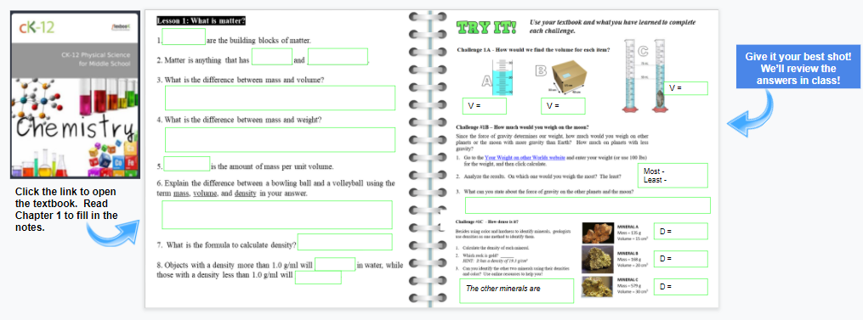
Your Assignment:
Read Chapter 1 in the textbook to complete SLIDE 2.
Day 2 (cont’d)
Spend 10-15 mins sharing a few of the cover items students have used and their connections to chemistry.
Assign Slide 2 for the next class period.

Slide 5
Class Notes
Review slides #6-9 in class. I allow students who are finished with their notes to make additions/corrections.
This lesson also includes the Density Challenge that is available as a separate assignment.
Introduction to
Class Notes
Lesson 1: Matter
Main Page

Slide 6
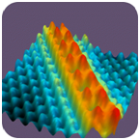
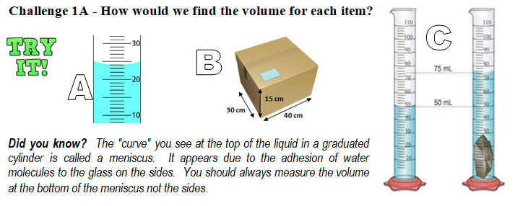
Lesson 1: What is matter?
ATOMS
__________ are the building blocks of matter.
Matter is anything that has __________ and ____________.
What is the difference between mass and volume?
MASS
VOLUME
MASS → Amount of matter in an object.
VOLUME → Amount of space it takes up.
75-50 = 25 ml
What is the “curve” called?
24 ml
30x40x15
18,000 cm³
MENISCUS

Slide 7

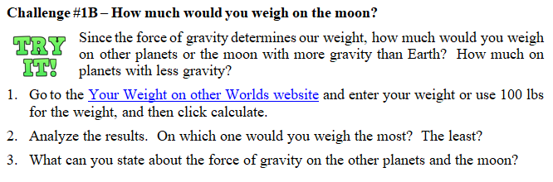
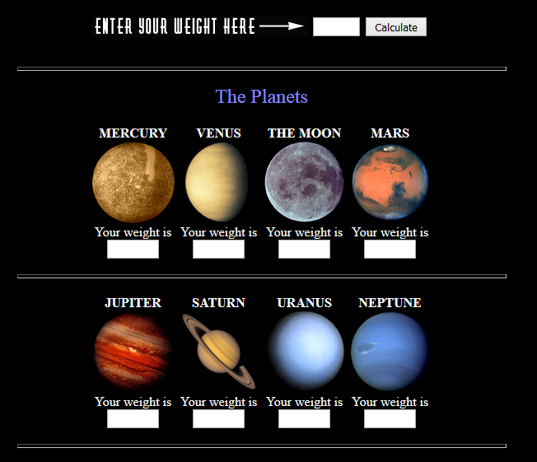
4. What is the difference between mass and weight?
Watch this
WEIGHT is the force of gravity acting on an object’s MASS.
Weight changes with changes in gravity, while mass only changes if matter is added to or removed from an object.
Click the image to go to the website
2. Most – Jupiter
Least – Moon (or Pluto if you consider it a planet)
3. The force of gravity on Jupiter is stronger making your weight more than on Earth, but the gravity on the moon is less making us weigh less.

Slide 8

DENSITY
5. ___________ is the amount of mass per unit volume.
6. Explain the difference between a bowling ball and a volleyball using the term mass, volume, and density in your answer.
7. What is the formula to calculate density?
8. Objects with a density more than 1.0 g/ml will __________ in water, while those with a density less than 1.0 g/ml will __________
The volume of both objects is similar, but the bowling ball has a higher mass.
The bowling ball would have a higher density than a volleyball as it would have more mass for every cm³.
*16 lb ball
M = 7260 g
V = 5447 cm³
M = 260 g
V = 4719 cm³
7260/5447
1.33 g/cm3
260/4719
.06 g/cm3
Density = Mass ÷ Volume
M
D =
V
Find the density of each ball.
SINK
FLOAT

Slide 9
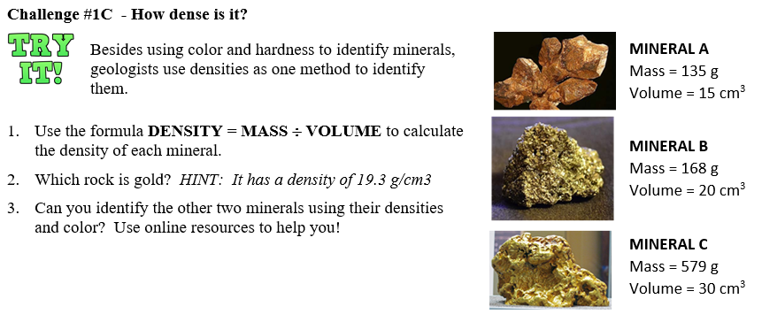
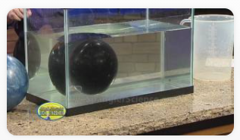
D =9 g/cm3
D =8.4 g/cm3
D =19.3 g/cm3
M
A = Copper
B = Pyrite (Fool’s Gold)
C = Gold
D =
V
Watch this …
Do all bowling balls sink?

Slide 10
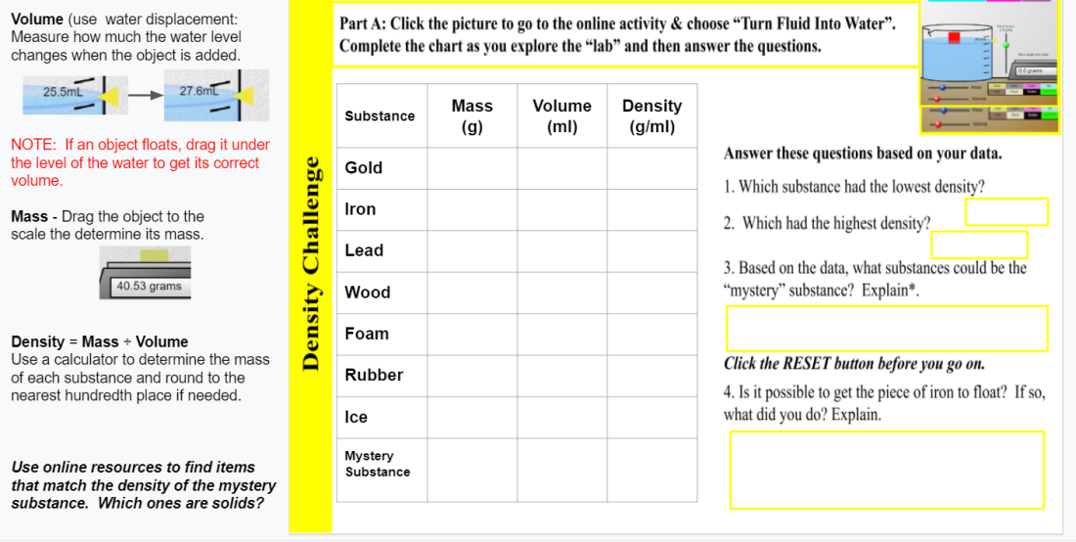
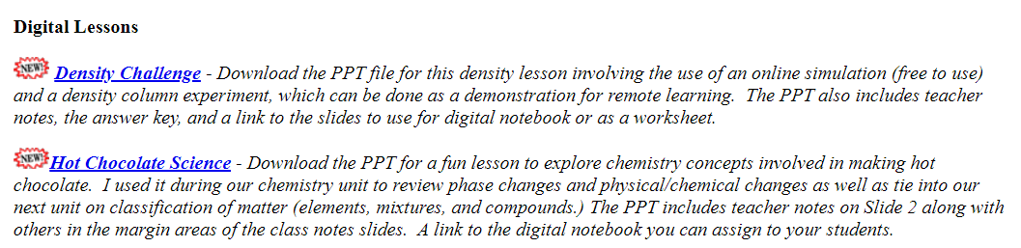
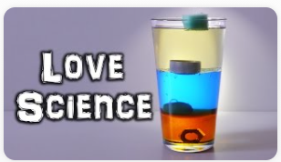
Density Challenge
Click the image below to open the assignment on Google Classroom.
Follow the directions to complete the tasks on each slide.
Click the image below to go to the Chemistry page of my website. Scroll down to find this lab along with a “sweet” Hot Chocolate Lab that relates to this unit.

Slide 11
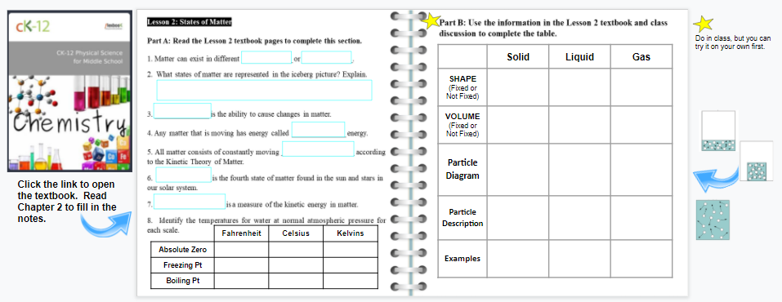
Student Instructions
Your Assignment:
Read Chapter 2 in the textbook to fill in the LEFT part of SLIDE 3.

Slide 12
Introduction to
Class Notes
Lesson 2: States of Matter
Main Page

Slide 13
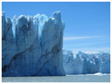
LESSON 2: STATES OF MATTER
Part A: Read Chapter 2 in the textbook to complete this section.
1. Matter can exist in different _____________ or _____________.
2. What states of matter are represented in the
iceberg picture? Explain.
3. ______________ is the ability to cause changes in matter.
4. Any matter that is moving has energy called ___________ energy.
5. All matter consists of constantly moving _______________ according to the Kinetic Theory of Matter.
6. ______________ is the fourth state of matter found in the sun and stars in our solar system.
STATES
PHASES
Water → Liquid
Glacier → Solid
Water Vapor in the air → Gas
ENERGY
KINETIC
PARTICLES
PLASMA
One more for #2 - Sunlight – Comes from the Sun → Plasma

Slide 14
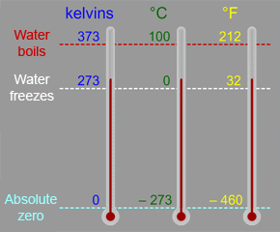

TEMPERATURE
7. __________________ is a measure of the kinetic energy in matter.
8. Identify the temperatures for water at normal atmospheric pressure for each scale.
 | Fahrenheit | Celsius | Kelvins
Absolute Zero | -460 | -273 | 0
Freezing Pt | 32 | 0 | 273
Boiling Pt | 212 | 100 | 373
Think About It – What does “Absolute Zero” mean?
https://docs.google.com/presentation/d/1Is8qgUe_TK9wF52kDyZoNI0VSPBcdRFPYbFqxdRB1mQ/edit?usp=sharing

Slide 15
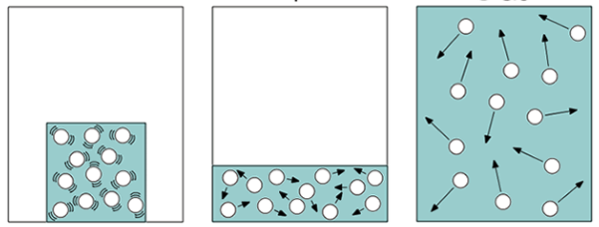
Part B: Complete the chart to describe the three main phases of matter.
 | SOLIDS | LIQUIDS | GASES
SHAPE | Fixed | Not fixed Takes shape of container | Not fixed Takes up available space
VOLUME | Fixed | Fixed | Not fixed Takes up available space
PARTICLE DIAGRAM
PARTICLE DESCRIPTION | Particles packed closely, vibrate in position | Particles can slide past one another allowing it to take the shape of its container | Particles spread further apart and moving faster
Examples | ?????? | ?????? | ??????
Notes:
Particle Diagrams from https://statesofmattertechnologyshowcase.weebly.com/particle-diagrams.html

Slide 16
Part B: Complete the chart to describe the three main phases of matter.
KE = Kinetic Energy | SOLIDS Lowest KE | LIQUIDS | GASES Highest KE
SHAPE | Fixed | Not fixed Takes shape of container | Not fixed Takes up available space
VOLUME | Fixed | Fixed | Not fixed Takes up available space
PARTICLE DIAGRAM
PARTICLE DESCRIPTION | Particles packed closely, vibrate in position | Particles can slide past one another allowing it to take the shape of its container | Particles spread further apart and moving faster
Examples | Ice, snow, rocks, bottles, gold | Water, soda, tea, lava//magma, density liquids | Steam, air, helium, water vapor, oxygen, methane
Notes:
Particle Diagrams from https://statesofmattertechnologyshowcase.weebly.com/particle-diagrams.html

Slide 17
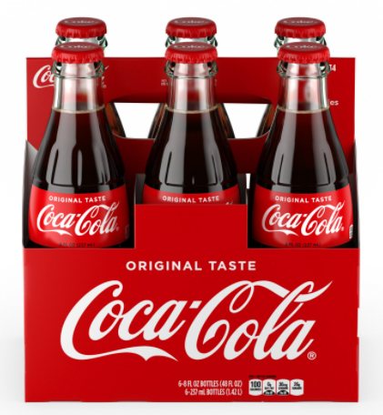
Source: https://flexbooks.ck12.org/cbook/ck-12-middle-school-physical-science-flexbook-2.0/section/2.16/primary/lesson/kinetic-theory-of-matter-ms-ps
Q: How could you use a bottle of cola to demonstrate these relationships between kinetic energy and state of matter?
Gas - Higher energy
No fixed shape
No fixed volume
Takes up available space
Liquid
Fixed volume
No fixed shape
Shape of its container
Solid – Lower energy
Fixed shape
Fixed volume
Opening the bottle allows the carbon dioxide gas to come out of the cola solution. The gas spreads into the surrounding air as it takes up available space as its shape and volume change.
Pouring the cola into a cup changes its “shape”, but it is still the same amount of cola. The particles slide over each other but not enough to pull apart completely. Volume stays the same, but its shape changes.
The glass bottle will remain the same size and shape if you do nothing to it. Its particles do not have enough energy to move apart or even to slide over each other. It keeps a specific shape and volume.

Slide 18
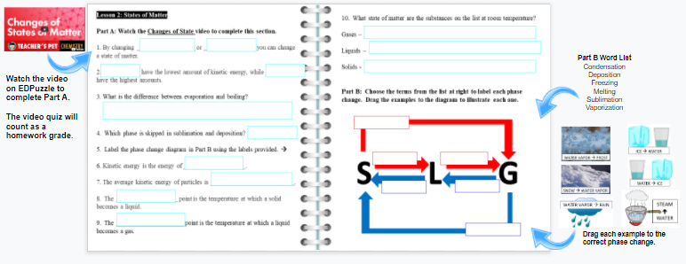
Your Assignment:
Complete SLIDE 4 as you watch the video on EDPuzzle.
Video Link: https://edpuzzle.com/media/5a14426686335640f0dd8423

Slide 19
Introduction to
Class Notes
EDPuzzle - Phase Changes
Main Page

Slide 20
Part A: Watch the Changes of State video to complete this section.
1. By changing _______________________ or ________________ you can change a state of matter.
2. ___________ have the lowest amount of kinetic energy, while _________ have the highest amounts.
3. What is the difference between evaporation and boiling?
4. Which phase is skipped in sublimation and deposition? ______________
5. Label the phase change diagram in Part B using the labels provided. (We will check after #9.)
6. Kinetic energy is the energy of ______________.
7. The average kinetic energy of particles is ____________________.
8. The ______________ point is the temperature at which a solid becomes a liquid.
9. The _______________ point is the temperature at which a liquid becomes a gas.
TEMPERATURE
PRESSURE
SOLIDS
GASES
Evaporation takes place only at the surface of a liquid, while boiling occurs throughout the liquid.
LIQUIDS
MOTION (or MOVEMENT)
TEMPERATURE
MELTING
BOILING

Slide 21
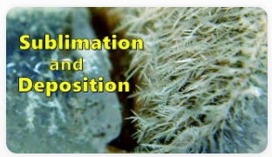
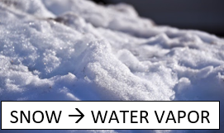
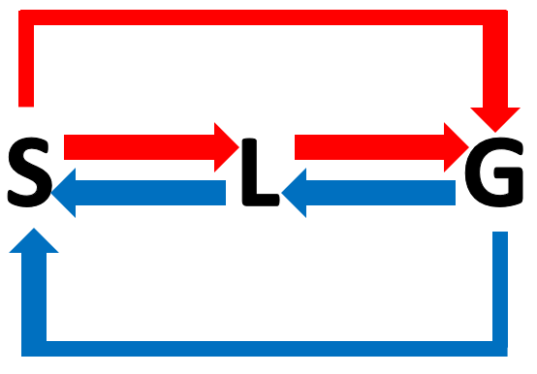
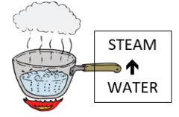
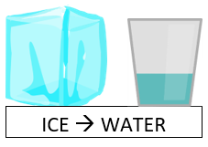
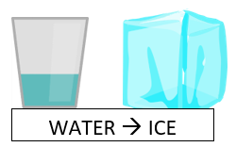
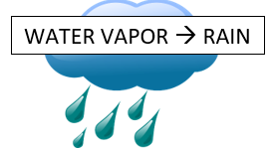
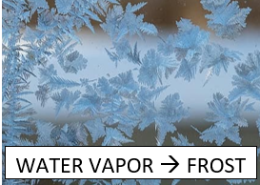

#5. Label the phase change diagram based on the textbook.
Sublimation
Evaporation OR Boiling
Melting
Vaporization
Higher kinetic energy
Lower kinetic energy
Freezing
Condensation
Deposition
Part B: Add the examples to finish the diagram.

Slide 22
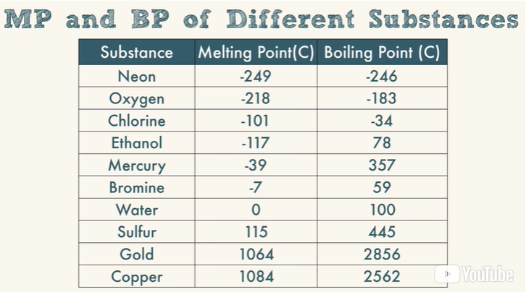
10. What state of matter are the substances on the list at room temperature?
Gases –
Liquids –
Solids -
Neon, Oxygen, Chlorine
Ethanol, Mercury, Bromine, Water
Sulfur, Gold, Copper
All of these are below 23º C, which would make them gases at room temp.
Room temp is between the melting and boiling points for these substances, which makes them liquids at room temp.
All of these are above 23º C, which would make them solids at room temp.
ROOM TEMPERATURE = 23º C

Slide 23
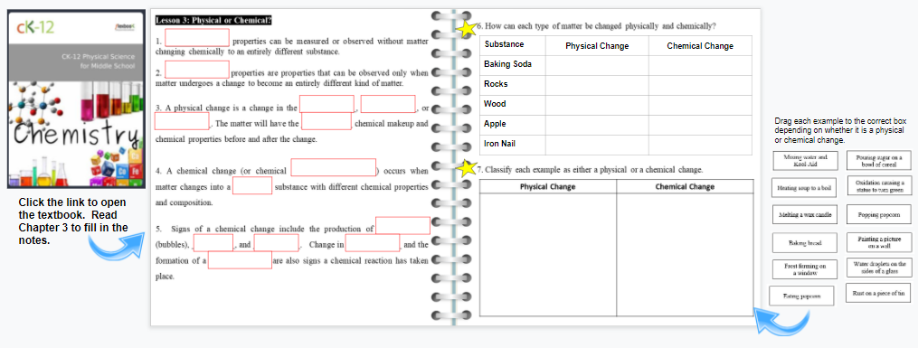
Your Assignment:
Read Chapter 3 in the textbook to fill in #1-5 on slide #5.
NOTE: 6 & 7 are starred = We will do those together in class!

Slide 24
Introduction to
Class Notes
Lesson 3: Physical or chemical?
Main Page

Slide 25
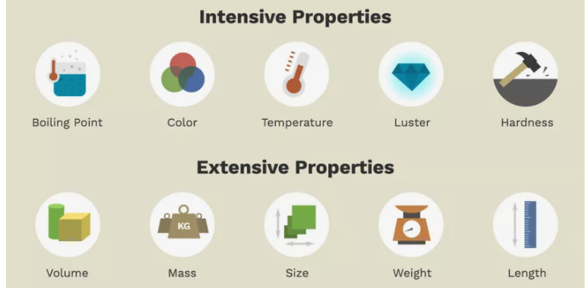
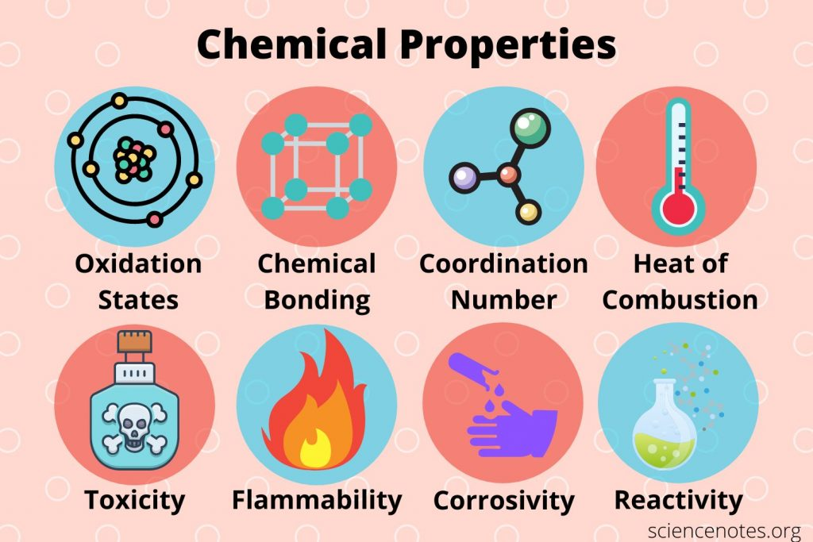
Lesson 3: Physical or Chemical?
1. _______________ properties can be measured or observed without matter changing chemically to an entirely different substance.
PHYSICAL
Intensive properties do NOT depend on the quantity, but extensive properties do.
Properties DESCRIBE
matter
CHEMICAL
2. _______________ properties are properties that can be observed only when matter undergoes a change to become an entirely different kind of matter.
Substance must be changed to know what happens chemically.

Slide 26
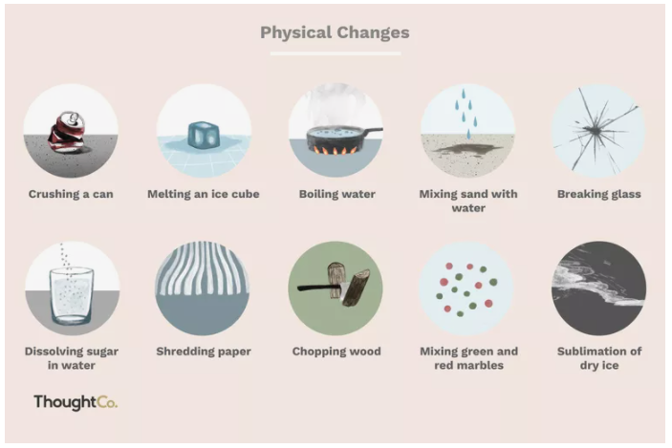
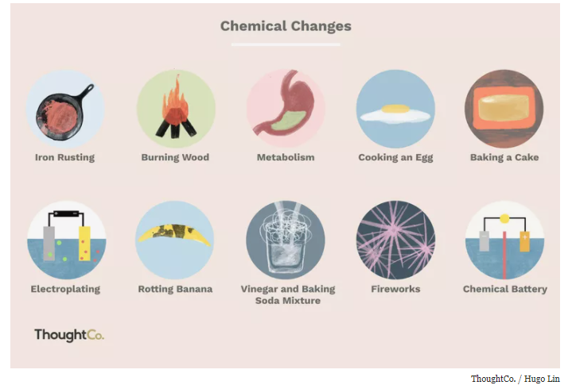
3. A physical change is a change in the _______, ________, or _______. The matter will have the _________ chemical makeup and chemical properties before and after the change.
SIZE
SHAPE
STATE
SAME
Water is still H₂O when it is ice, liquid, or steam.
4. A chemical change (or chemical ____________) occurs when matter changes into a _____ substance with different chemical properties and composition.
REACTION
NEW
Iron changes into FeO2 when it rusts – a new chemical substance.
PROPERTIES DESCRIBE, CHANGES HAPPEN

Slide 27
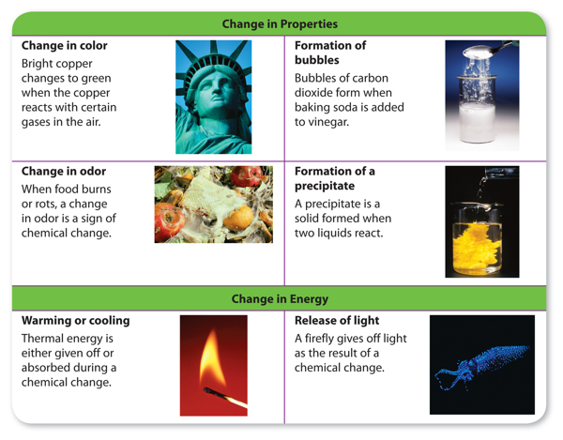
GASES
5. Signs of a chemical change include the production of ____________ (bubbles), __________, and ___________. Change in _____________ and the formation of a ______________ are also signs a chemical reaction has taken place.
SOUND
LIGHT
COLOR
PRECIPITATE
What signs of a chemical change have you seen or experienced?
Abe Lincoln statue turned green.
Neon bracelets glowing after breaking the glass inside
Gases produced during digestion given off as a burp
Ice pack activated to use after an injury
Light & heat given off as wood burns
Changing the color of your hair using a permanent hair dye
Notes:
(tl) Royalty-Free/CORBIS, (tr) Charles D. Winters / Photo Researchers, Inc., (cl) London Scientific Films/photolibrary.com, (cr) sciencephotos / Alamy, (bl) Brand X Pictures, (br) Dante Fenolio / Photo Researchers, Inc.

Slide 28
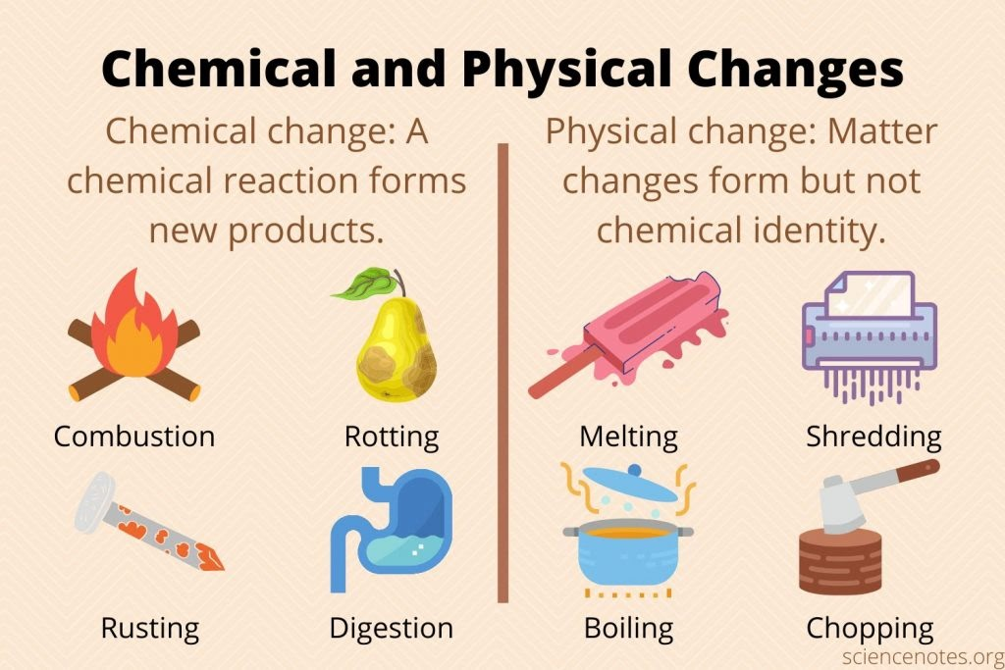

NEW SUBSTANCE CREATED
SAME SUBSTANCE BEFORE & AFTER

Slide 29
What type of changes did we see in yesterday’s video?
Physical → Change in size, shape, or state
Chemical → Change in chemical composition; new substance
P
Mixing flour, sugar, and eggs to make cookie dough
Butter melting
The water in the cookie changes to steam and then evaporates
Sodium bicarbonate reacts with acids in the dough to create CO₂ gas causing the cookie to “raise”
Maillard reactions occur as proteins and sugars break down
Caramelization occurs when sugar molecules are broken down
A cookie is broken into 2 pieces
A cookie is eaten
P
P
C
C
C
P
C

Slide 30
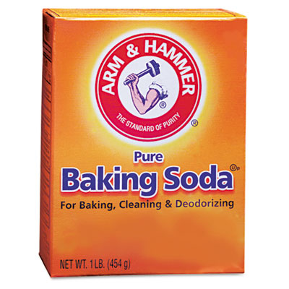

6. How can each type of matter be changed physically and chemically?
Sample answers …
Substance | Physical Change | Chemical Change
Baking Soda
Rocks
Wood
Apple
Iron Nail
Substance | Physical Change | Chemical Change
Baking Soda | Mix with water Pour or measure | Use it in cookies to make them rise up Mix with vinegar
Rocks | Smash, melt, or paint them Cement together to form a wall | Use HCl to test for carbonates (fizz) Acid Rain
Wood | Carve it, cut it, paint it | Burn it or let it rot (decompose)
Apple | Clean, rinse, cut into pieces, cover in caramel | Eat it Oxidation (turns brown) Rots or decomposes Plants making food with photosynthesis
Iron Nail | Bend it, hammer it into a board, paint it | Allow it to rust Place in a strong acid or rust remover

Slide 31
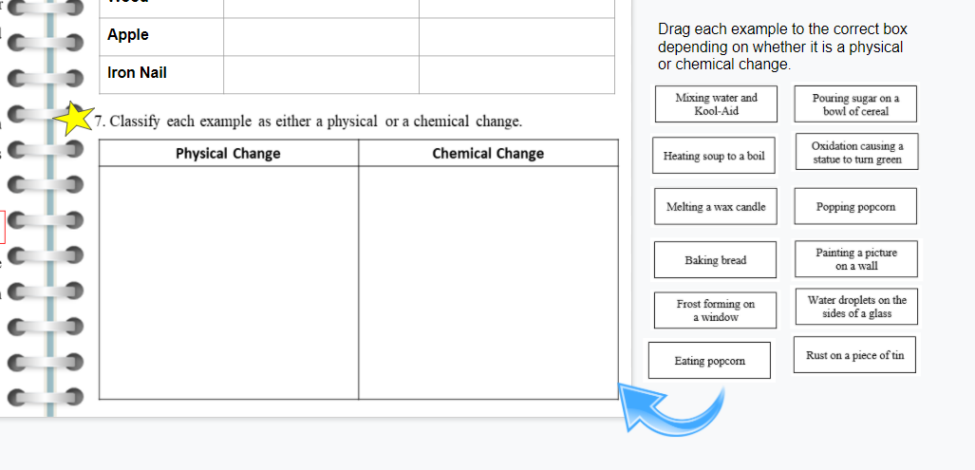
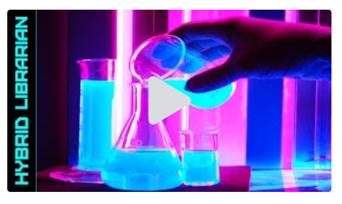
Your Assignments:
SLIDE 5 - #7 - Classify all of the
examples for #7 by placing
them into the correct columns.
You will be able to make corrections
when we review the answers in class.
EDPUZZLE
Watch The 10 Most AMAZING Chemical Reactions video.
Write down your three most favorite reactions on SLIDE 1 in the notes section!
It will count as a completion grade – not the quiz score itself!
Watch 100% of the video = 100% in ALMA
Video Link: https://edpuzzle.com/media/582e274cfd2b7d422c85a368

Slide 32
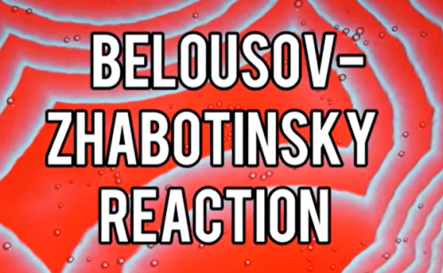
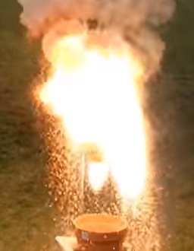
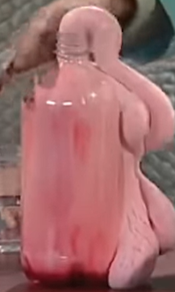
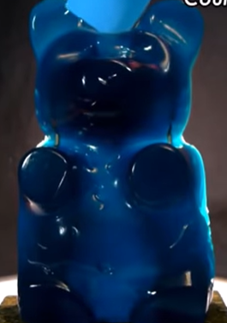
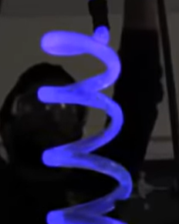






What was your favorite reaction?
Ferroin ions with Fe, Br, & O
Thermite
(Al + FeO₂)
KCl burns sugar
Elephant Toothpaste
Soap + H₂ O₂
Luminol Molecule
Fe, H₂ , & H₂ O₂
Golden Rain
Lead iodide (PbI₂)
Oscillating Clock (I)
Single Replacement
Fe in Cu, S, & O
Sulfuric acid (H₂SO₄ ) & Sugar
Pharaoh’s Snake

Slide 33












7. Classify each example as either a physical or a chemical change.
The answers are …
Physical Change | Chemical Change

Slide 34

Assignment:
Click the VIDEO ICON to access the videos you need to watch to complete each section.
List examples of physical and chemical changes you observe as you watch the videos.
Main Page

Slide 35


Everyday Chemistry
Video #1: Chemistry Life Hacks (Vol 1)
a) How does salt take away the bitter taste of coffee?
b) What compound causes bananas to ripen faster?
c) How does bread help soften hard cookies?
d) What ingredient in cola would help with dishes?
What else is it used for?
Sodium ions block those taste receptors on your tongue
Ethylene
The sugars help them absorb moisture from the bread.
Phosphoric acid
Getting rid of rust

Slide 36

Everyday Chemistry
Video #2: Chemistry Life Hacks (Vol 2)
Good eggs sink, while bad eggs float due to hydrogen sulfide
How can you test an egg?
b) What vegetable has sulfenic acid? What does it do?
c) What can nitrocellulose help you?
d) _____chlorophyll makes the yellow-green color of some veggies.
Onions - they react causing your eyes to burn and water
Found in nail polish - dries to make a thread stronger to help you thread a needle.
B

Slide 37

Everyday Chemistry
Video #3: Baking Soda Life Hacks
How does baking soda help a stinky fridge?
b) What will help with a "skunky" dog?
Give the chemical formula for each compound.
d) What temperature is needed for this to occur?
e) What can be used instead of baking powder?
It's amphoteric - reacts with acids & bases
Hydrogen peroxide + baking soda + hand soap
Oxidizes thiols so it doesn't stink.
Baking soda - NaHCO₃ Washing soda - Na₂CO₃
400ºF
Baking soda & cream of tarter

Slide 38

Everyday Chemistry
Video #4: How to Cookie with Science
What causes the chewiness of cookies? Where does it come from?
How does carmelization affect cookies?
What makes cookies fluffy? How?
Which temperature of butter made larger cookies?
5) What should you do if you are trying to do "good science"?
Gluten - Comes from flour + water
It gives the cookie butterscotch, rum, & nut flavors
Sodium bicarbonate (baking soda) - creates CO₂ gas bubbles
Melted butter
Repeat the experiment many times

Slide 39
Everyday Chemistry
Physical or chemical?
List five examples of each type of change you observed in the four videos for the lesson.
Physical Changes | Chemical Changes

Slide 40

Assignment:
Read Chapter 4 in the textbook to help you complete the notes for Lesson 4.

Slide 41
Introduction to
Class Notes
Lesson 4: Classifying Matter
Main Page

Slide 42
Chem Lesson 4 Notes
1. A _________ substance cannot be separated into any other substances.
2. ____________ are pure substances made up of atoms, which are represented by chemical ____________.
3. There is a total of ______ as of today with _____ existing in nature.
4. Give the chemical symbol for the most common element in each:
___ = Earth’s atmosphere ___ = Earth's crust ___ = Living things
5. Each element has a unique set of ________________, such as _______ being magnetic and _______ giving off a red glow when electricity flows through it.
PURE
ELEMENTS
SYMBOLS
118
92
N
O
C
PROPERTIES
IRON
Fe
Neon
Ne

Slide 43

6. Atoms are made of ______________ particles, which includes _____________, _____________, and ______________.
7. The ____________of an element is determined by the number of protons it has, such as every carbon atom having ____ protons.
8. Coal and sugar both contain the element carbon. Why are they so different from one another?
SUBATOMIC
PROTONS
NEUTRONS
ELECTRONS
IDENTITY
6
They have different percentages of carbon along with different elements.
Coal is 85% carbon, while sugar is only 42%.

Slide 44

9. Compounds are two or more elements combined ________________.
10. Chemical _____________ are used to represent compounds with _____________ to show the # of atoms of each element in a compound.
CHEMICALLY
FORMULAS
SUBSCRIPTS
ELEMENTS
Label the diagram in your HDSN.
SUBSCRIPT
atoms
COEFFICIENT
molecules
COMPOUND

Slide 45



11. Compounds are always in_________ proportions, but has ____________ properties from the elements that makes up each one.
12. Explain how water demonstrates that the properties of compounds are different from the elements that make them up.
13. Compounds may form structures called ______________,
such as sodium chloride. They may also exist as _____________,
such as carbon dioxide.
FIXED
DIFFERENT
How many atoms of C and O are in these compounds?
1 2
1 3
1 1
WATER IS A LIQUID THAT IS FORMED AS TWO GASES COMBINE CHEMICALLY.
CRYSTALS
MOLECULES

Slide 46
14. ______________ are substances mixed together, but not chemically combined. They have ______________ proportions with _______________ based on particle size
15.A __________________ mixture appears the same throughout, while you can see the parts in a ____________________ mixture does.
16. A ____________ occurs when a ___________ dissolves in a __________, such as salt water, air, & bronze (__________ of 2 metals).
17. A _____________ is made of medium-sized particles, such as Jell-O & ________.
18. A _______________ is a heterogeneous mixture with large particles, such as salad dressing and mud made from dirt suspended in water.
MIXTURES
DIFFERENT
PROPERTIES
HOMOGENEOUS
HETEROGENEOUS
SOLUTION
SOLUTE
SOLVENT
ALLOY
COLLOID
MILK
SUSPENSION

Slide 47


Things to do …
ALL SLIDES #1-7 SHOULD BE DONE!
This includes your cover – need 10 pictures along with a blurb that tells how it relates to Chemistry.
ATVs – Use fuels for power (combustion)
Cherry Pepsi – Solution made from syrup & CO₂ gas dissolved in water

Slide 48


Activity 4A: Lego Science: Building Blocks of Matter
Teacher Note: The video I used with my remote students is available at https://drive.google.com/file/d/1zJH2Kfak81EbF08PzffKL_ZI9hJXoNnm/view?usp=sharing.
Watch the video for an overview of how I present this lesson.
Extension: We connect this lesson with another lego activity in Unit 2 about compounds, conservation of matter, and balancing equations.
Check your baggie - You should have:
5 different colors
4 of each color
NOT CONNECTED together
Listen to the teacher’s directions to complete Activity 4A on Slide 10.
Please do NOT play with the Legos or doodle on your desk with the chalk –
you will have time later for a challenge!
Notes:
Lesson plan available at https://sciencespot.net/Media/Chem_LegoLesson.pdf

Slide 49
Elements – Simplest pure substance, found as atoms
Each COLOR is a different ELEMENT.
Each LEGO = 1 ATOM of that ELEMENT
Task 1: How would we represent 2 ATOMS of 1 ELEMENT?
The first letter of the color = Chemical symbol
R = Red Y = Yellow
B = Blue W = White
G = Green (or grey)
Use a COEFFICIENT in front of the symbol to show how many you have.
Notes: Since the legos are representing elements, they are not snapped together and we use coefficients to show how many of each we have.
2B

Slide 50
2B
Tasks 2 & 3 – Read the descriptions for each.
Try it on the table with the legos and use chalk to write the chemical formula.
Drag the colored boxes to the slide to show the correct answer after your answers have been checked.
3Y
4G

Slide 51
Compounds - 2 or more different elements bonded together.
If individual Legos are elements, how can we use them to represent compounds?
Task 1: Create a compound with 1 atom of 3 different elements.
Try it on the table by using the Legos to create compounds that match the descriptions. Use chalk to write the chemical formula on your table for the teacher to check.
Drag the “elements” you need to create the compounds on your worksheet/slide. Write the chemical formula for each in the textbox.
BYG
NOTE: LEGOs snapped together represent a chemical bond forming one compound. LEGOs that are not snapped together are not chemically bonded to each other. These would be considered mixtures.
Note: Subscripts are used to show how many of each atom are in a compound. If there is only 1 atom of that element, you do not need to write the 1.

Slide 52
Chromebook Tip – Use CTRL + Comma to make a subscript.
Task 2: Create a compound with 2 atoms of one element with 1 atom of another.
Try it on the table and then add to the slide after it is checked.
NOTE: LEGOs snapped together represent a chemical bond forming one compound. LEGOs that are not snapped together are not chemically bonded to each other. These would be considered mixtures.
BYG
Notes: Since the legos are representing compounds, they must be snapped together. Subscripts are used to show how many of each atom are in a compound.
B₂Y
Task 3: Create a compound with 4 different elements.
Try it on the table and then add to the slide after it is checked.
Y₂RB

Slide 53
Mixtures - Mixtures are not chemically combined
Task 1: Create a mixture of at least TWO different ELEMENTS.
Remember … not snapped = not bonded.
2B + Y + R
Notes: Since we are creating mixtures, we use addition signs to show what is added together. Subscripts are used to show how many of each atom are in a compound, while coefficients are used to show that we have more than one element or compound.

Slide 54
2B + Y + R
Task 2: Create a mixture of COMPOUNDS.
Try it on the table and then add to the slide after it is checked.
B₂Y + G₂Y + B₂R
Task 3: Create a mixture of ELEMENTS & COMPOUNDS.
Try it on the table and then add to the slide after it is checked.
B₂Y + G₂Y + B + R

Slide 55

Assignment:
Complete the Lego Review (right side) based on what you have learned from Activity 4A.

Slide 56



Lego Review – Complete this review based on what your learned from Part A.
A
What does this represent?
How many of each are there? Atoms = ____ Elements =______
How would we write this?
Mixture of elements
4
2
2G + 2Y
B
What does this represent?
How many of each are there?
Atoms = ____ Elements =_____ Compounds = _______
How would we write this?
Mixture of elements & compounds
4
2
2
3Y + R + 2YR + Y₂R
NOTE: For the Your Turn part, I give students time in class to create their mixtures using the Legos and write the expression on their slides.
They get to challenge another student in class to try to write their expression as they complete one based on the other student’s mixture. When done, they compare answers and discuss any differences.
C
What does this represent?
How many of each are there?
Atoms = ____ Elements =_____ Compounds = ______
How would we write this?
Mixture of elements & compounds
20
5
6
2G + 2Y + R₂ + W₄ + 2YG + 2B₂R
Your Turn: Create a mixture of ELEMENTS & COMPOUNDS using ALL the Lego pieces in one bag. Use the colored blocks to show your mixture below and then write an expression to represent it.

Slide 57

Assignment: Follow the directions to complete Activity 4B on Slide 9.
1st: Use the word bank to fill in the blanks.
2nd: Drag each substance to its correct classification.
3rd: Label the homogeneous mixtures using S for solution or C for colloid.

Slide 58























CLASSIFYING MATTER ANSWER KEY
Is it a pure substance?
NO
YES
Is the substance chemically combined?
It is a ____________.
MIXTURE
NO
YES
It is an _____________.
COMPOUND
ELEMENT
It is a ____________.
Does it look the same throughout?
Examples:
Examples:
NOTES:
Mud – Could be either depending on the size of the particles
Hot Chocolate – The powder dissolving in liquid is a solution, but when mixed with marshmallows it is a heterogeneous mixture.
Lemonade – It would be homogeneous if made using water and powder. A lemon shake-up would be heterogeneous since you can see the lemon slices and seeds.
NO
YES
It is a _________________ mixture.
HOMOGENEOUS
It is a __________________ mixture.
HETEROGENEOUS
THINK ABOUT IT:
Which mixtures are solutions?
Which ones are colloids?
Examples:
S
S
Examples:
S
C
C
S
C
C

Slide 59
Introduction to
Review Time
Main Page

Slide 60


Review assignment:
https://app.teachermade.com/s/Ic30HHESTqC9-qLJinoOqQ/
If you have an account, you are able to make a copy to edit for your own use. They offer free and paid versions.
Assignment:
Use your HDSN to help you complete the Unit 1 Review. Go to Google Classroom to get the link for your class period.
Upload a screenshot of your score before you turn in this assignment.
Done? Try the Match
game on Quizlet using the Chemistry Unit 1 Vocab set!

Slide 61


It’s time for a “Smillionaire” challenge!
What is a “smillionaire”?
This activity is similar to “Who Wants to Be A Millionaire”, but you are earning smileys instead of dollars.
How do you play?
Go to the link provided by the teacher. You have three hints you can use if you get stumped by a question. You may use your HDSN to help you, but Google is now allowed. You are also not allowed to ask classmates for answers, nor should you give answers to anyone.
Can I play it more than once?
Yes, you can play the game as many times as you want. The more you play, the better prepared you will be for your test. However, only “smillionaires” earned during class time can count for your total.
What should I do when I get a smillionaire?
Show the teacher your screen and then add your name with one tally mark to the board. If you get another smillionaire, add another tally mark. Prizes will be awarded – ask your teacher for details.
Smillionaire Link:
https://www.quia.com/rr/1438356.html
NOTE: You do not have to have a QUIA account to use this activity. However, if you want to edit it or track student use, you will need an account.
Questions?

Slide 62
SMILLIONAIRES

