Slide 1
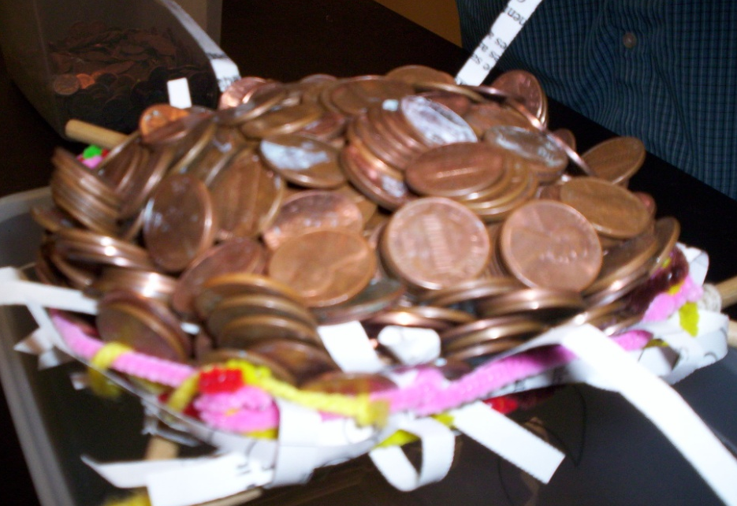
Build-A-Nest
Challenge
8th Grade Science
Technological Design Project
Illinois Learning Standard 11B
Created by Mrs. Tracy Trimpe
Havana Junior High School
http://sciencespot.net/

Slide 2
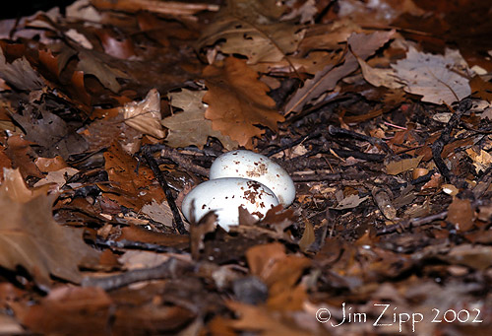
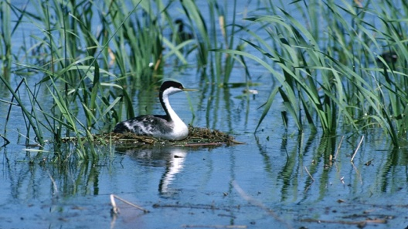
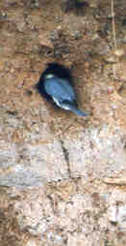
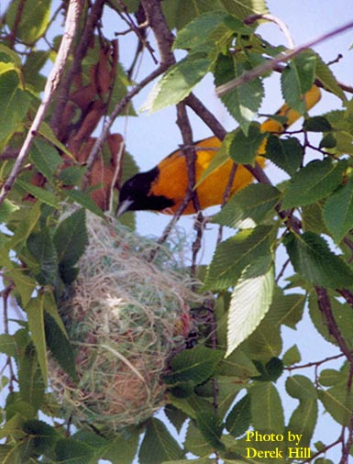
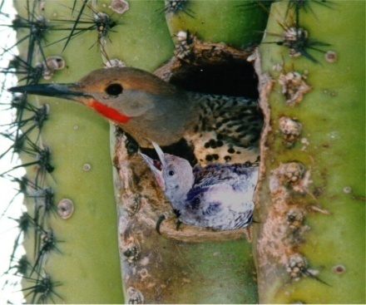
What do bird nests look like?
Scrape Nests
Simple depressions in the ground (sometimes with a few stones added) or in the leaf litter. Penguins, shorebirds, gulls, terns, nighthawks, vultures, and other species make this type of nest.
Platform nests
Relatively flat nests that may be located on the ground, in a tree, or on the tops of rooted vegetation or debris in shallow water (like the Western Grebe nest).
Burrow nests
This nest is effective at protecting eggs and young from predators & maintaining an appropriate microclimate for eggs & young. Some birds construct their own burrows, while others may use burrows constructed by other species.
Cavity nests
These nests are made in trees, cactus, or other plants. Some birds construct their own cavity nests and are referred to as primary cavity nesters. Species that use natural cavities or cavities constructed by other birds are called secondary cavity nesters.
Cupped nests
These nests are cup-shaped and may be constructed of various materials and in a variety of locations. They may be anchored on branches of a tree, suspended, or adhered to an object. Some may also be built on the ground.
What type of nest does a bald eagle use?
Source: http://www.biology.eku.edu/RITCHISO/birdnests.html

Slide 3
The Challenge … Which team can build the nest that will hold the most pennies?
Each team will receive one “Bird Buck” to buy nest-building materials from the Nest Store.
Your team will also receive a paper bag to hold all your materials and nest. All materials must remain in the room!
Teams are not allowed to borrow money from other teams or add their own money or materials. In addition, teams are not allowed to trade or share materials.
All sales are final! There will not be refunds for leftover materials or replacements for damaged materials.
Bonus points will be added to the final score equal to the amount of money that was not used. Teams will not receive any credit for leftover materials.
All nests must be designed to sit on the testing “branches” without additional support. The nest cannot be tied or anchored to the branches in any way.
Bird Buck
$1.00
May only be used at the Nest Store
The Nest Store
5 strips of paper = 1¢
2 toothpicks = 1¢
20 cm of yarn = 1¢
1 regular straw = 5 ¢
1 piece of pipe cleaner = 5 ¢
No refunds or replacements!

Slide 4
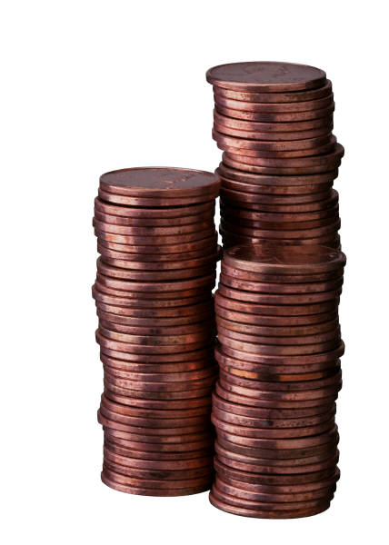
Testing Procedure ...
Teams will position the nest on the testing platform. After the teacher approves the nest, teams may begin adding pennies to the nest one at a time.
After the first penny has been added, no adjustments to the nest or its position on the branches will be allowed!
Testing ends when a penny falls through the nest or out of the top of the nest.
Teams will be allowed two accidental “drops” – third drop and you are done! Any penny that touches the nest and then drops into the bucket will not be considered an accidental drop.
Dumping pennies into the nest at the last minute is not allowed and will earn your team a zero score!
After testing, teams will use a scale to determine the total mass of the pennies held. The nest that holds the highest mass will be the winner. In case of a tie, the team with the lightest nest will be the winner.

Slide 5
Things to Consider ...
What materials will you use? How will you use them? Remember, you only have $1.00 to spend on materials!
How will you design your nest? What design elements will you use to help it hold a lot of pennies?
Brainstorm ways to use the materials you have available to make a strong nest. What could you use for braces or supports? What could be used as fillers for lining the nest?
What strategies will you use during testing to help the nest hold the most pennies? The way you place pennies in the nest may be a factor in how well your nest will do!

Slide 6
Time to make a plan ...
What is your grade?
Grades for this project will be based on completion of project pages, overall effort, teamwork, and final testing results.
Teams who complete all the required work, give 100% effort, and show good teamwork will not receive a grade less than an 80% B.

Slide 7
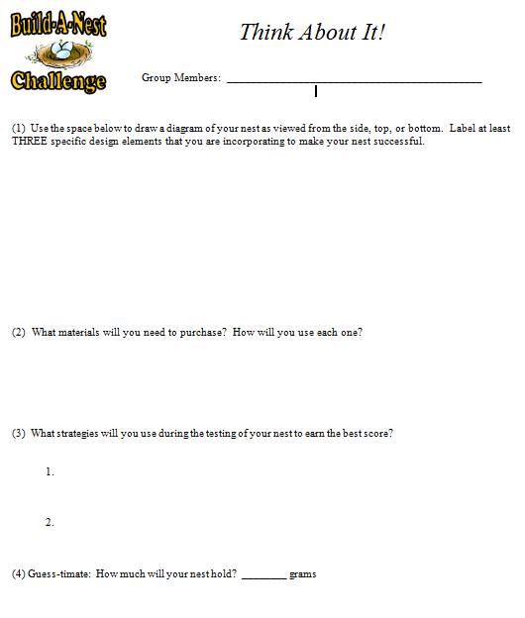
Your team must complete the Think About It page and
have it approved before you can start buying materials!
Design
Draw a sketch of your nest.
Label three design elements or the parts you are including that will make your nest successful.
Materials
What will you use?
How will you use them – structure, support, fillers?
Testing
What two things will you do during testing to make sure your nest holds the most pennies it can?
Estimate
How much mass will your nest hold?

Slide 8
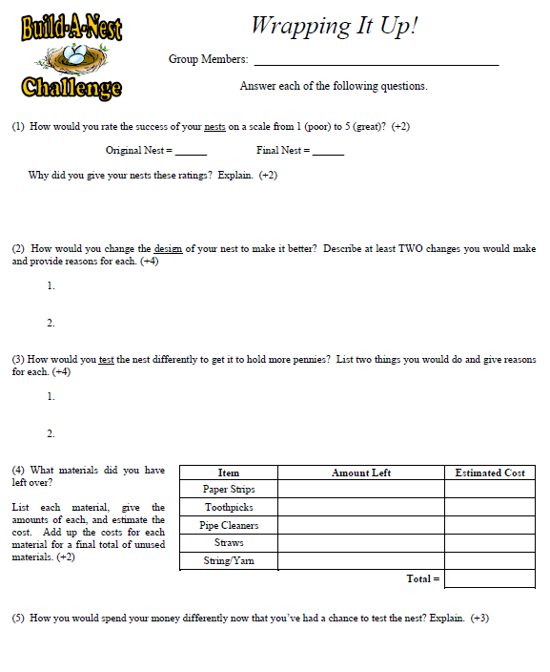
Evaluate how well your team’s nest performed.
Staple this page to the Think About It page and turn them in.
Success Rating - How did the nest do? Explain why you gave it the rating you did.
Improvements - Describe at least two changes you would make and give reasons for each.
Testing – Explain what your would you do differently if you had a chance to test the nest again
Materials – List the materials you had leftover and estimate the cost for each. Also include at least one thing you would do differently when spending your money.

