Slide 1
Eagle Survey 2011
Data Analysis

Slide 2
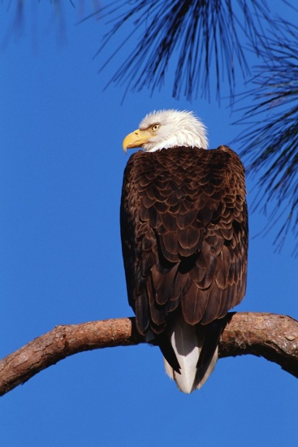
Survey 1: Population Count
Calculate the averages for adults, juveniles, and overall using the data from all the survey groups. Round averages to the nearest hundredth and then answer the questions.
How did your group’s averages from Survey 1 compare to the class averages? Explain.
What percentage of the bald eagles you observed in Survey 1 were adults?
Show your work!
Eagle | 1 | 2 | 3 | 4 | 5 | 6 | 7 | 8 | 9 | 10 | 11 | 12 | Total | Average
Adult
Juveniles
Total

Slide 3
Survey 2: Behaviors
Behavior | Adults | Juveniles | Total
Perching
Flying/Soaring
Preening
Hunting - Successful
Hunting - Not Successful
Pirating Food (Stealing)
Mating Behavior
Feeding Young
Nest Building
2. Which behaviors did you observe the most during Survey 2? Explain how your observations compare to those of your classmates.

Slide 4
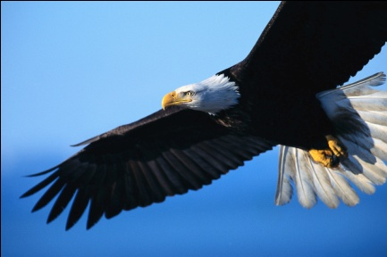
Other Questions to Answer
3. What are the chances an eagle would be successful in their hunt for food? Explain using your observations during Survey 2 and the class discussion about it.
4. Did the adults and juveniles interact in any way during either survey period? Explain.
What questions do you have about eagles? List at least two questions.
Turn in your worksheet when you done.

