Slide 1
The Atoms Family
Let’s visit Matterville …
Student digital notebook is available at https://docs.google.com/presentation/d/1t6rPiqEEyf3M0WUC6Gh27m3DQTeceBysV3ZylgeWHX0/edit?usp=sharing
Presentation created by T. Tomm Updated 2023 https://sciencespot.net/
Original Atoms Family lesson created by Kathleen Crawford, 1994

Slide 2
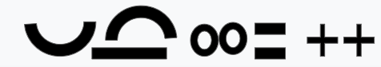
Atoms Family Story
In the center of Matterville, there is a place called the Nucleus Arcade, where two members of the Atoms Family like to hang out. Perky Patty Proton, like her sisters, is quite large with a huge smile and eyes that sparkle (+). Patty is always happy and has a very positive personality.
Nerdy Nelda Neutron is large like Patty, but she has a boring, flat mouth and eyes with zero expression (o). Her family is very apathetic and neutral about everything. Patty, Nelda, and their sisters spend all their time at the arcade.
Drag the symbols to create a face for each particle.
Student digital notebook is available at https://docs.google.com/presentation/d/1t6rPiqEEyf3M0WUC6Gh27m3DQTeceBysV3ZylgeWHX0/edit?usp=sharing
Name:
Patty Proton
Description:
Positive
Favorite Activity:
Hanging out at the Nucleus Arcade
Name:
Nelda Neutron
Description:
Neutral
Favorite Activity:
Hanging out at the Nucleus Arcade
O
O

Slide 3
Around the Nucleus Arcade, you will find a series of roadways that are used by another member of the Atoms Family, Enraged Elliott Electron. Elliott races madly around the Arcade on his bright red chrome-plated Harley-Davidson. He rides so fast that no one can be sure where he is at any time. Elliott is much smaller than Patty and Nelda and he is always angry because these bigger relatives will not let him in the Arcade. He has a frown on his face, eyes that are squinted with anger, and a very negative (-) attitude.
Name:
Elliott Electron
Description:
Negative
Favorite Activity:
Racing around the energy levels

Slide 4
The first Energy Street can only hold only two electron brothers. The second energy street, called the Energy Freeway, can hold 8 brothers. The third energy street, called the Energy Superhighway, can hold 18 of the brothers.
Nucleus Arcade
Center of the atom
Energy Street
Can hold 2 electrons
Energy Freeway
Can hold 8 electrons
Energy Superhighway
Can hold 18 electrons
Matterville

Slide 5


Challenge: Read the information below to answer these questions.
The morale of Matterville is stable as long as each negative electron brother is BALANCED out by one positive proton sister. The number of residents in Matterville depends on the proton and neutron families.
1. What would happen to the morale of Matterville if one Elliott Electron was kidnapped?
Lose 1 electron
More positive protons in the atom
Positive Ion

Slide 6
2. What would happen to the morale of Matterville if one Elliott Electron moved to Matterville?
Gain 1 electron =
More negative charges in the atom
Negative Ion

Slide 7
1st Verse:
They’re tiny and they’re teeny,
Much smaller than a beany,
They never can be seeny,
The Atoms Family.
Chorus
2nd Verse:
Together they make gases,
And liquids like molasses,
And all the solid masses,
The Atoms Family
Chorus
3rd Verse:
Neutrons can be found,
Where protons hang around;
Electrons they surround
The Atoms Family.
Chorus
Chorus:
They are so small.
(Snap, snap)
They’re round like a ball.
(Snap, snap)
They make up the air.
They’re everywhere.
Can’t see them at all.
(Snap, snap)

Slide 8
They’re tiny and they’re teeny,
Much smaller than a beany,
They never can be seeny,
The Atoms Family.

Slide 9
They are so small.
(Snap, snap)
They’re round like a ball.
(Snap, snap)
They make up the air.
They’re everywhere.
Can’t see them at all.
(Snap, snap)

Slide 10
Together they make gases,
And liquids like molasses,
And all the solid masses,
The Atoms Family

Slide 11
They are so small.
(Snap, snap)
They’re round like a ball.
(Snap, snap)
They make up the air.
They’re everywhere.
Can’t see them at all.
(Snap, snap)

Slide 12
Neutrons can be found,
Where protons hang around;
Electrons they surround
The Atoms Family.

Slide 13
They are so small.
(Snap, snap)
They’re round like a ball.
(Snap, snap)
They make up the air.
They’re everywhere.
Can’t see them at all.
(Snap, snap)

Slide 14
Ready to try it again?

Slide 15
1st Verse:
They’re tiny and they’re teeny,
Much smaller than a beany,
They never can be seeny,
The Atoms Family.
Chorus
2nd Verse:
Together they make gases,
And liquids like molasses,
And all the solid masses,
The Atoms Family
Chorus
3rd Verse:
Neutrons can be found,
Where protons hang around;
Electrons they surround
The Atoms Family.
Chorus
Chorus:
They are so small.
(Snap, snap)
They’re round like a ball.
(Snap, snap)
They make up the air.
They’re everywhere.
Can’t see them at all.
(Snap, snap)

Slide 16
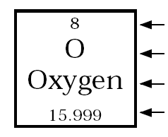
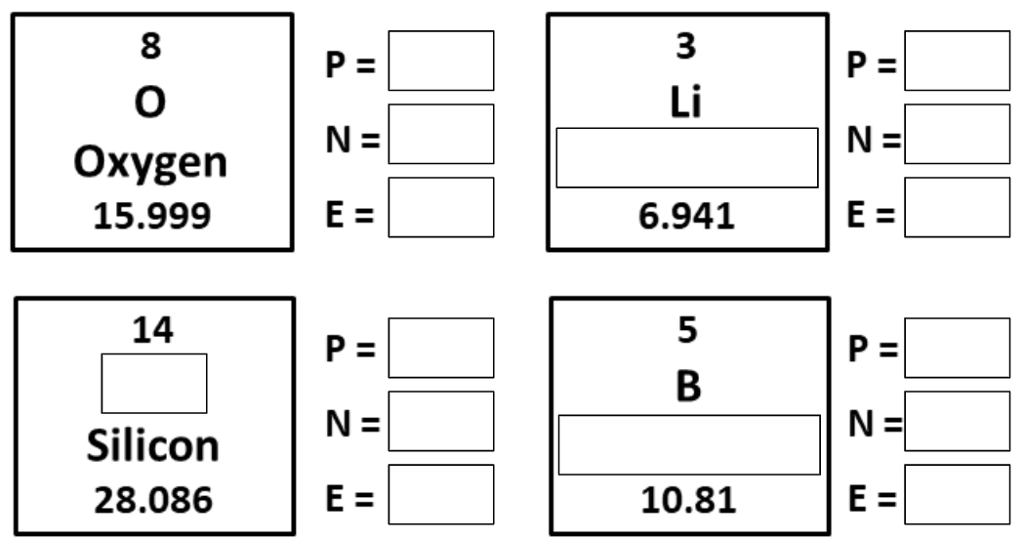
Atomic Math Challenge
1. Label the square from the periodic table.
Atomic Number
= Protons or Electrons
Chemical Symbol
Name
Atomic Mass
= Protons + Neutrons
2. Use this information to calculate the number of subatomic particles for each element. Click the image to the left of the slide to find a periodic table to identify the symbols and names.
8
Atomic Mass -
Atomic # = ???
8
←16 - 8 = ?
8

Slide 17
8
3
8
4
Lithium
8
3
3
5
Si
4
6
Boron
3
5

Slide 18
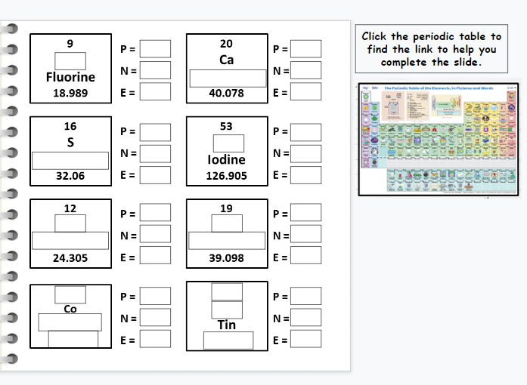

Assignment:
Finish the right side of the slide.
Click the table to find the link.

Slide 19
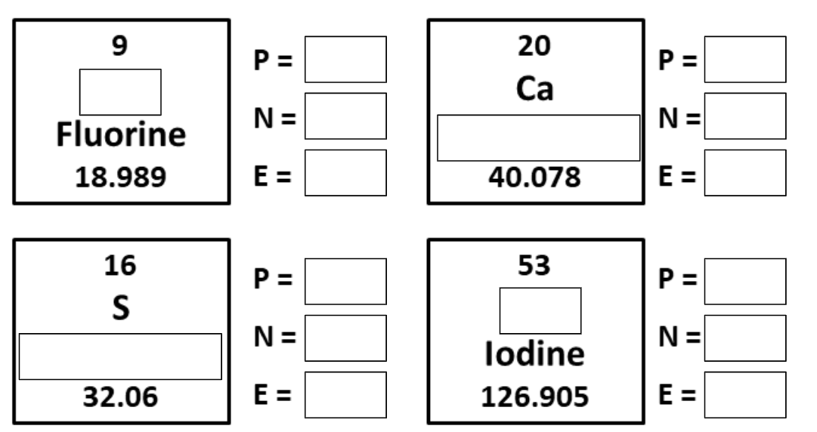

Slide 20
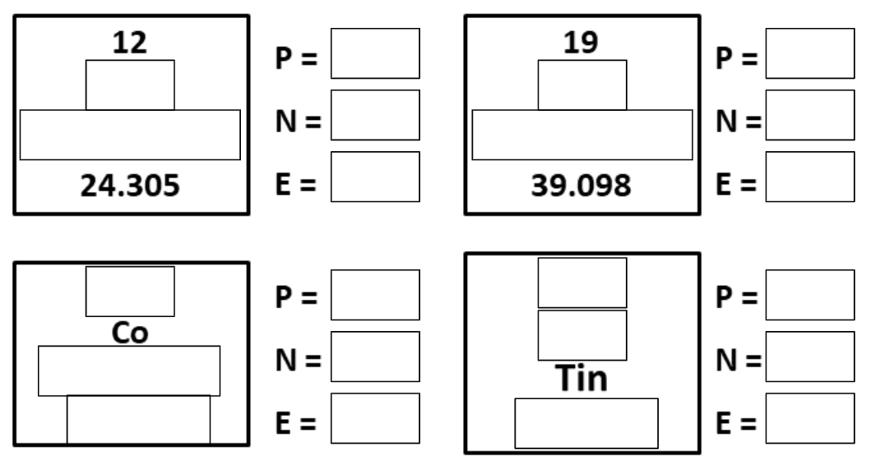

Slide 21
The Element Song

