Slide 1
Rocket Rally
Objective:
Create an air-powered rocket that will travel
the greatest distance.
Junk Box Wars @ http://sciencespot.net/

Slide 2
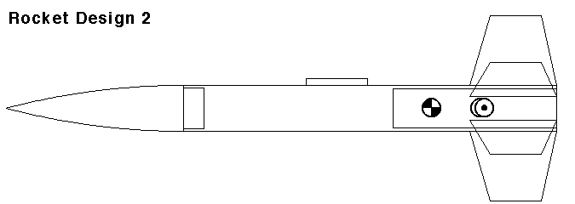
Think About It
How does each part of a paper rocket
affect its performance?
BODY
CONE
FINS
What modifications can we make to each section to get the best flying distance?

Slide 3
Competition Rules:
Your team will be provided with a junk box filled with materials that could be used to create your rocket or flying device. Each team will receive only one set of materials. Teams may use all or part of the materials in the junk box and are not allowed to share materials with other teams. All unused materials should be saved in case repairs are needed during competition.
Teams will be allowed time to build and test their device. Each team will be allowed three practice flights during the construction time. Competitors are allowed to bring diagrams to help during the building time. After the time is up, the device will be impounded and no changes will be allowed.
Machine Requirements:
Your rocket must be powered by the air pump and may not be aided by a helping hand or other energy source. You may not use your hands to guide it. The rocket must be able to sit unaided on the launching platform or device.

Slide 4
Testing Procedure:
Each team will be allowed 5 minutes to prepare their rocket for take-off. Each
team will be allowed three trials with 5 minutes allowed between trials for repairs and adjustments using materials left over from construction.
If the flying device does not leave the launching device for any reason, no
points will be awarded for that trial. The team with the best distance will be declared the winner. In the case of a tie, the teams involved will be allowed one additional trial. The team with the greatest distance on the tie breaker will be declared the winner.

Slide 5
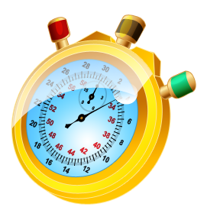
You will have 45 minutes to design, build, and test your rocket. After the time is up, all rockets will be impounded and the competition will begin.
Online Stopwatch
Questions?

