Slide 1
Magnificent
Marble Maze
Objective: Create a marble maze using the materials in a box of junk!
Junk Box Wars @ http://sciencespot.net/

Slide 2
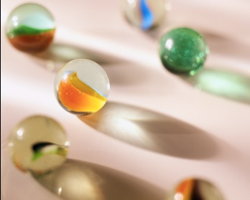
Think About It …
How can we build a marble maze or roller coaster using the materials in your junk box?
What items could be used to build these features?
Ramp
Hill
Loop
Spiral
(2 connected loops)
What features can we include to
help us get the longest run time?

Slide 3
Competition Rules:
Your team will be provided with a junk box filled with materials that could be used to create your maze. Each team will receive only one set of materials. Teams may use all or part of the materials in their junk box and are not allowed to share materials with other teams. All unused materials should be saved in case repairs are needed during competition.
Teams will be allowed time to build and test their mazes. Competitors are allowed to bring diagrams to help them build their maze. After the time is up, all mazes will be impounded and no changes will be allowed.
Machine Requirements:
Your maze must be created on one piece of poster board. Teams are allowed to use a wall or table leg to support their maze. The maze may not be attached to the supporting structure. The maze must incorporate at least 50 design points. Points will be awarded for different design elements such as ramps, hills, spirals, and loops.
The marble must enter the maze at point A located less than 5 cm from the top left corner of the poster board. The marble must exit the maze at point B located less than 5 cm from the bottom right corner of the poster board. The marble must stop at the end of the maze!

Slide 4
Testing Procedure:
Each team will be provided with a standard marble (between 12-17 mm in diameter) and allowed 5 minutes to prepare for the first trial. Teams will be allowed 10 minutes between trials to make repairs using the remaining materials in their junk box. No new construction or major design changes are allowed once competition begins.
The longest time out of the two trials will be considered for the final results. If the marble falls out of the maze, no points will be awarded for that trial. If the marble becomes stuck during the race, teams will be allowed to restart the marble with a “gentle” push. Each push will receive a 5 second penalty subtracted from their trial time. The timer will be stopped each time the marble stops!
Scoring:
The team with the longest trial time will be declared the winner. The maze with the most design points will be declared the winner in case of a tie.

Slide 5
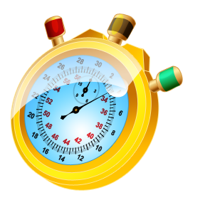
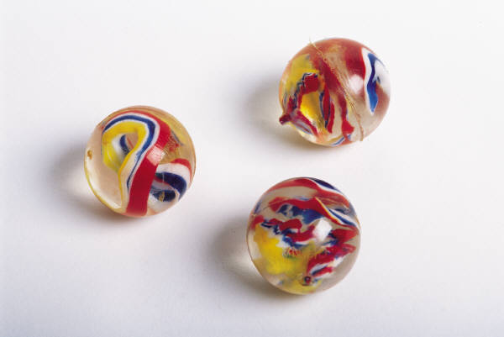
You will have 60 minutes to design, build, and test your device. After the time is up, all devices will be impounded and the competition will begin.
Online Stopwatch
Questions?

